Slide 1
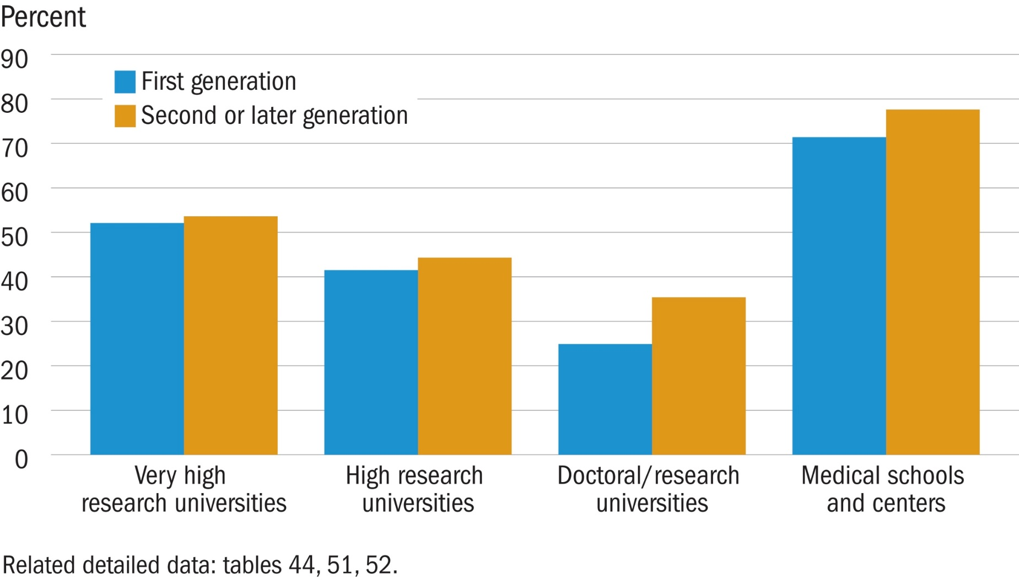
Postdoc rate among S&E doctorate recipients in the United States, by college generation and type of doctoral institution: 2010–14

