Slide 1
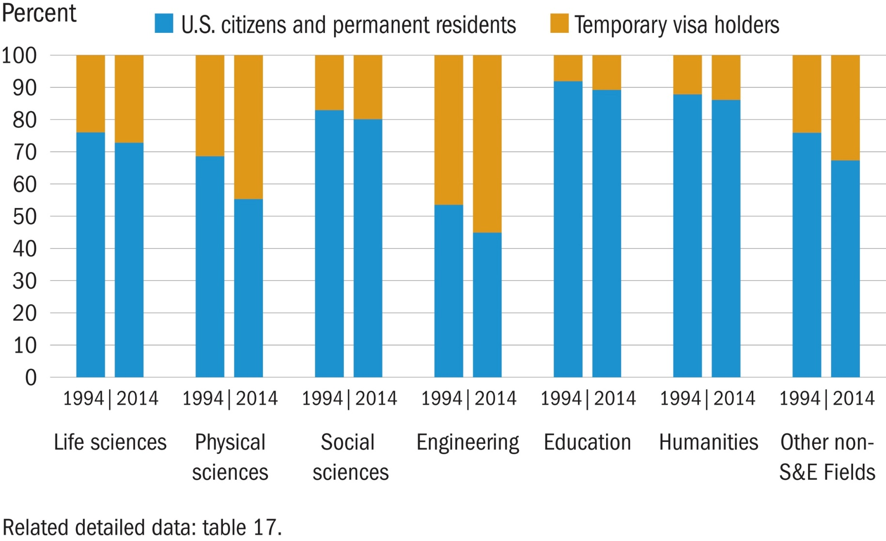
Doctorates awarded, by citizenship and field of study: 1994 and 2014

