Slide 1
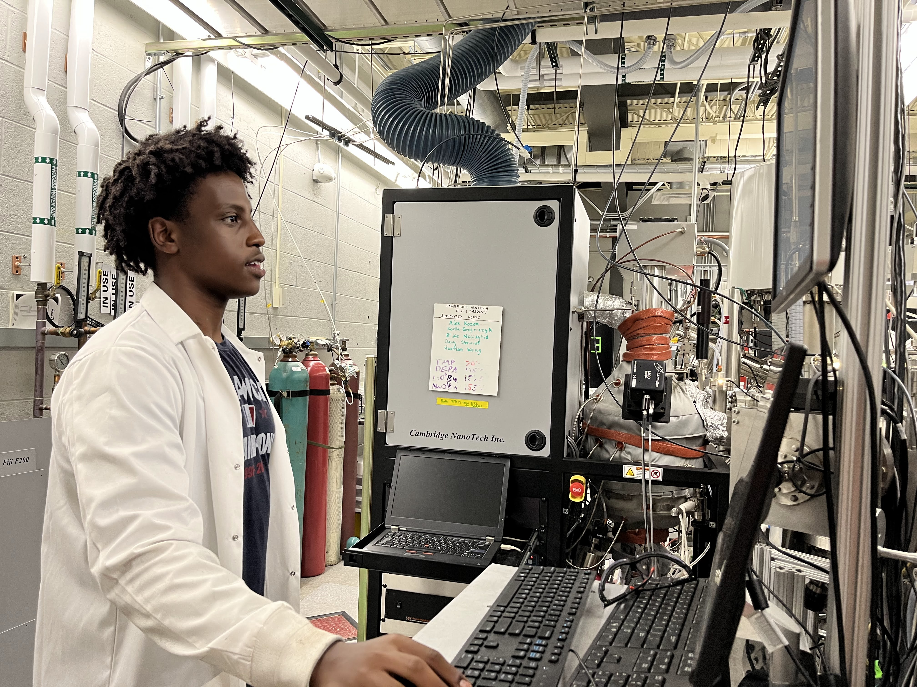
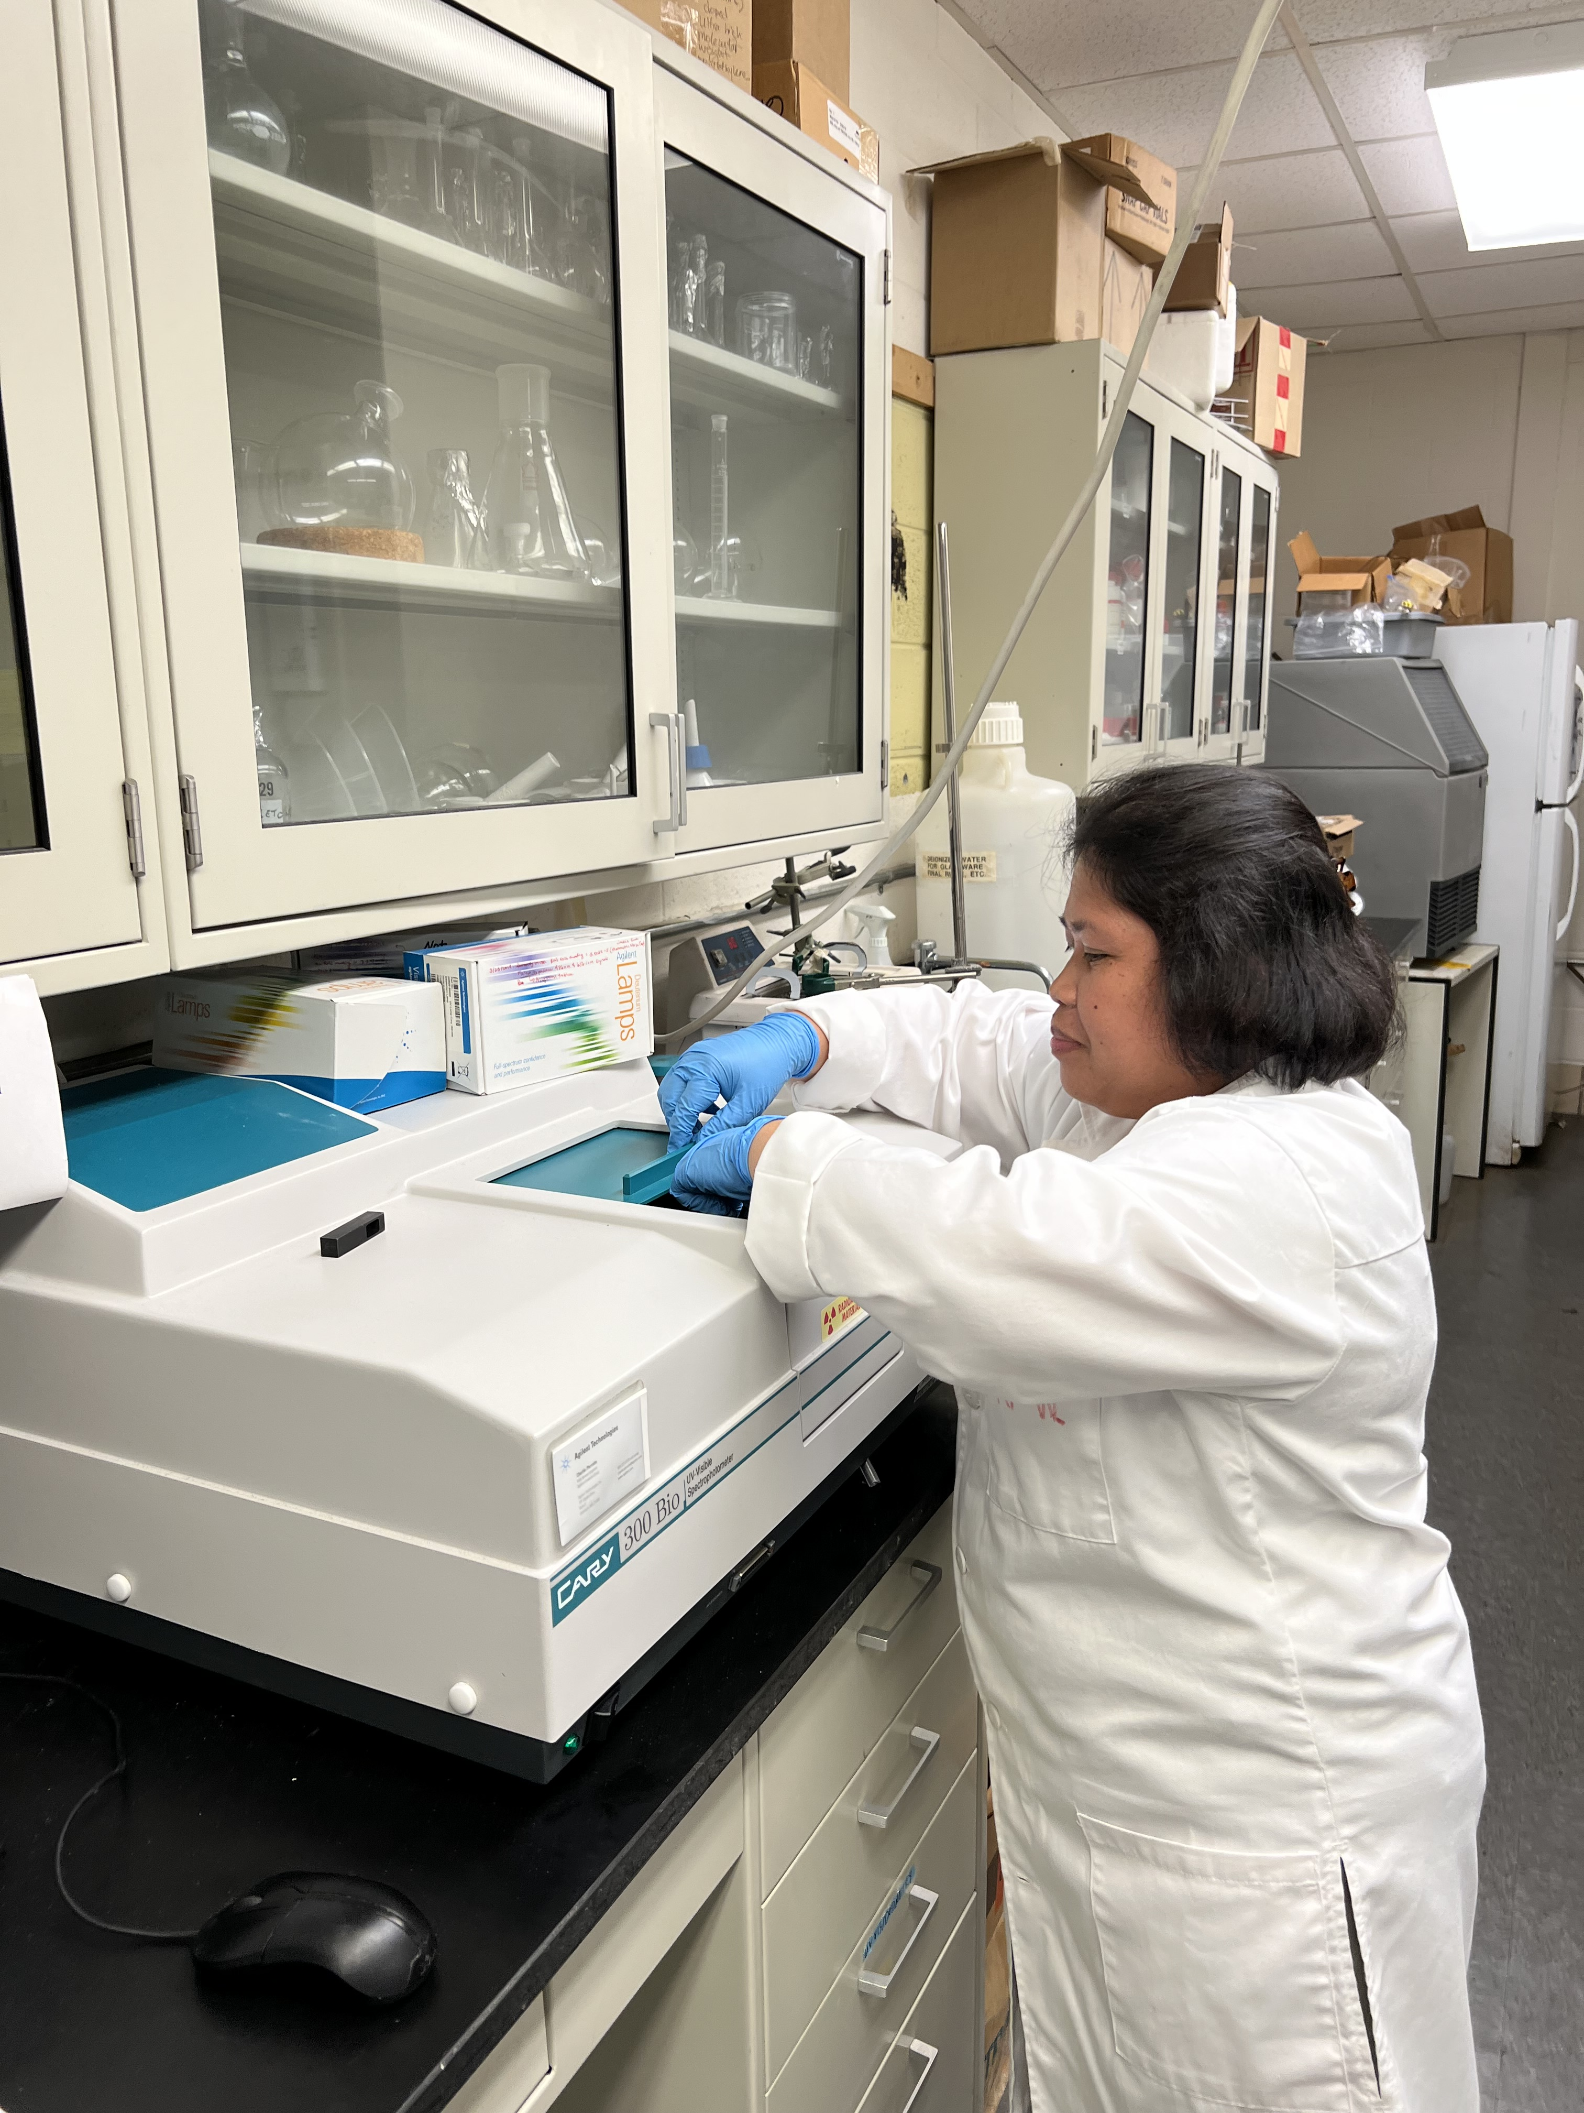
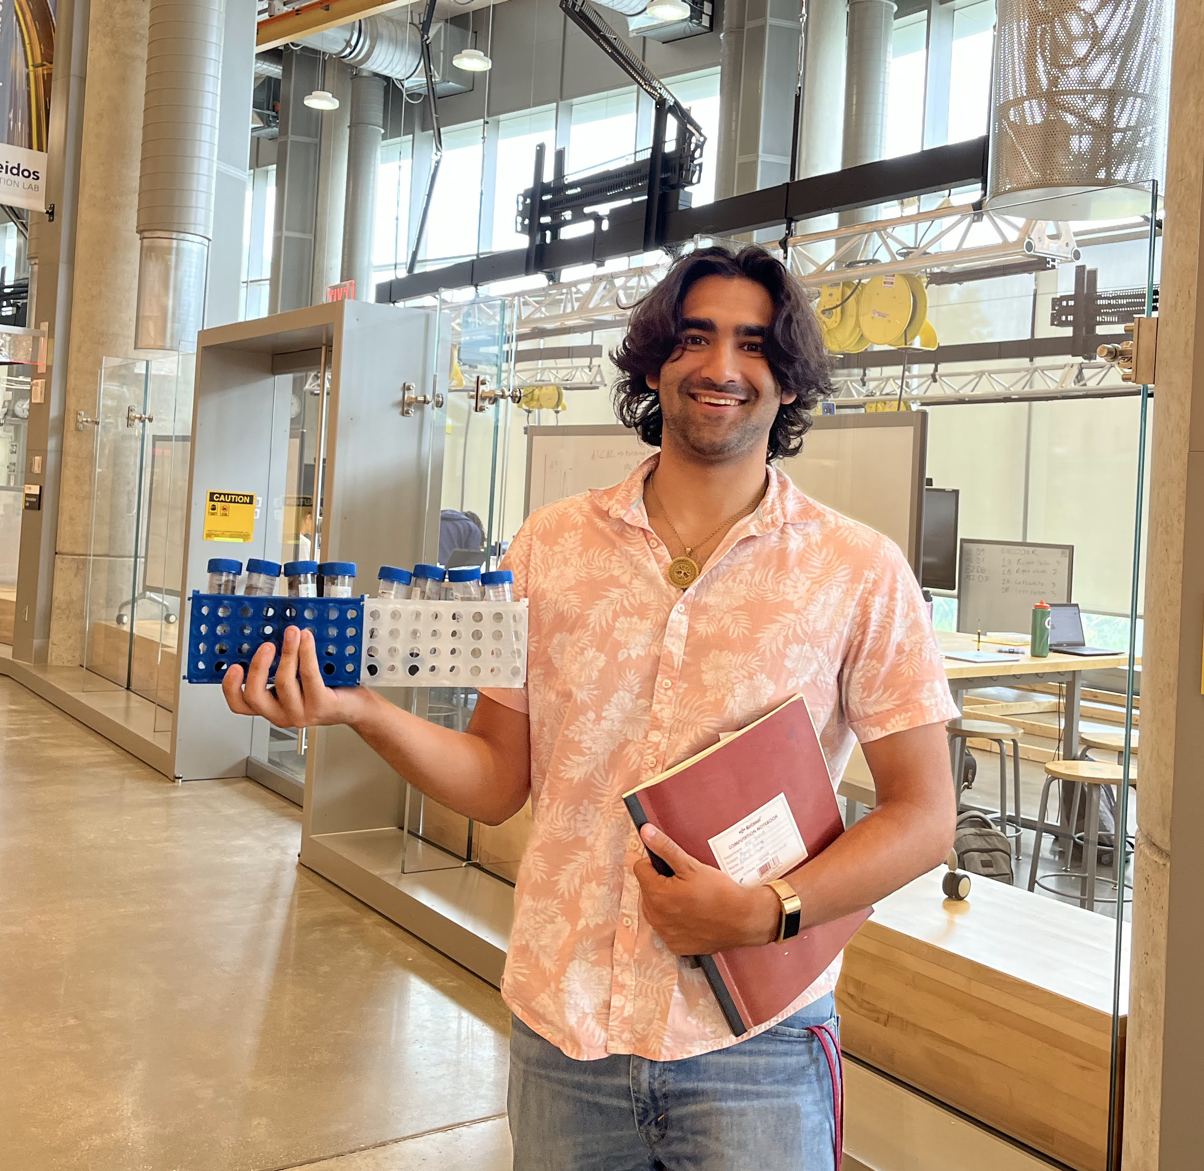
REU/RET Site: Summer Research Experiences in Renewable and Sustainable Energy Technology (ReSET)
2022 Intellectual Merit
DMR 2149982
Isabel K. Lloyd, University of Maryland, College Park
The Maryland Energy Innovation Institute hosted research projects for our joint Research Experiences for Undergraduates (REU) and Research Experiences for Teachers (RET) program.
REU:
All the students made progress on their projects that will inform their mentors’ future research.
All of the students learned future workforce training skills useful at the B.S. level or above
At least one student will be presenting their end of session poster at a conference this fall
Jason Maher found that Urban’s estimation^{1,2} of the theoretical stability of interfaces was helpful for pairs where both materials had known properties but not accurate enough to be useful when one material was brand new.
RET: Teachers experienced hands on learning in a research environment and learned how concepts in their subject areas play roles in energy research.
1
2
3
Selah Kemal (REU) validates new testing procedure to investigate battery failure mechanisms
Mildred Pates (RET) uses spectroscopy to evaluate sample quality
Askash Lujan explores new polymers for batteries
Notes:
Jason Maher worked with Yifei Mo on a computational investigation of the voltage developed when a new cathode material was paired with lithium oxide as a preliminary step in developing new solid state lithium ion batteries. In particular, while the average behavior estimated using Urban’s approach for phosphates and sulfates was reasonably accurate, there were a number of compounds that were outliers with percent error estimates greater than 40%.
Urban, Alexander, et al. “Computational Understanding of Li-Ion Batteries.” Npj Computational Materials, vol. 2, no. 1, 1, Mar. 2016, pp. 1–13. www.nature.com, https://doi.org/10.1038/npjcompumats.2016.2.
Nolan, Adelaide M., et al. “Solid-State Chemistries Stable with High-Energy Cathodes for Lithium-Ion Batteries.” ACS Energy Letters, vol. 4, no. 10, Oct. 2019, pp. 2444–51. DOI.org (Crossref), https://doi.org/10.1021/acsenergylett.9b01703.

Slide 2
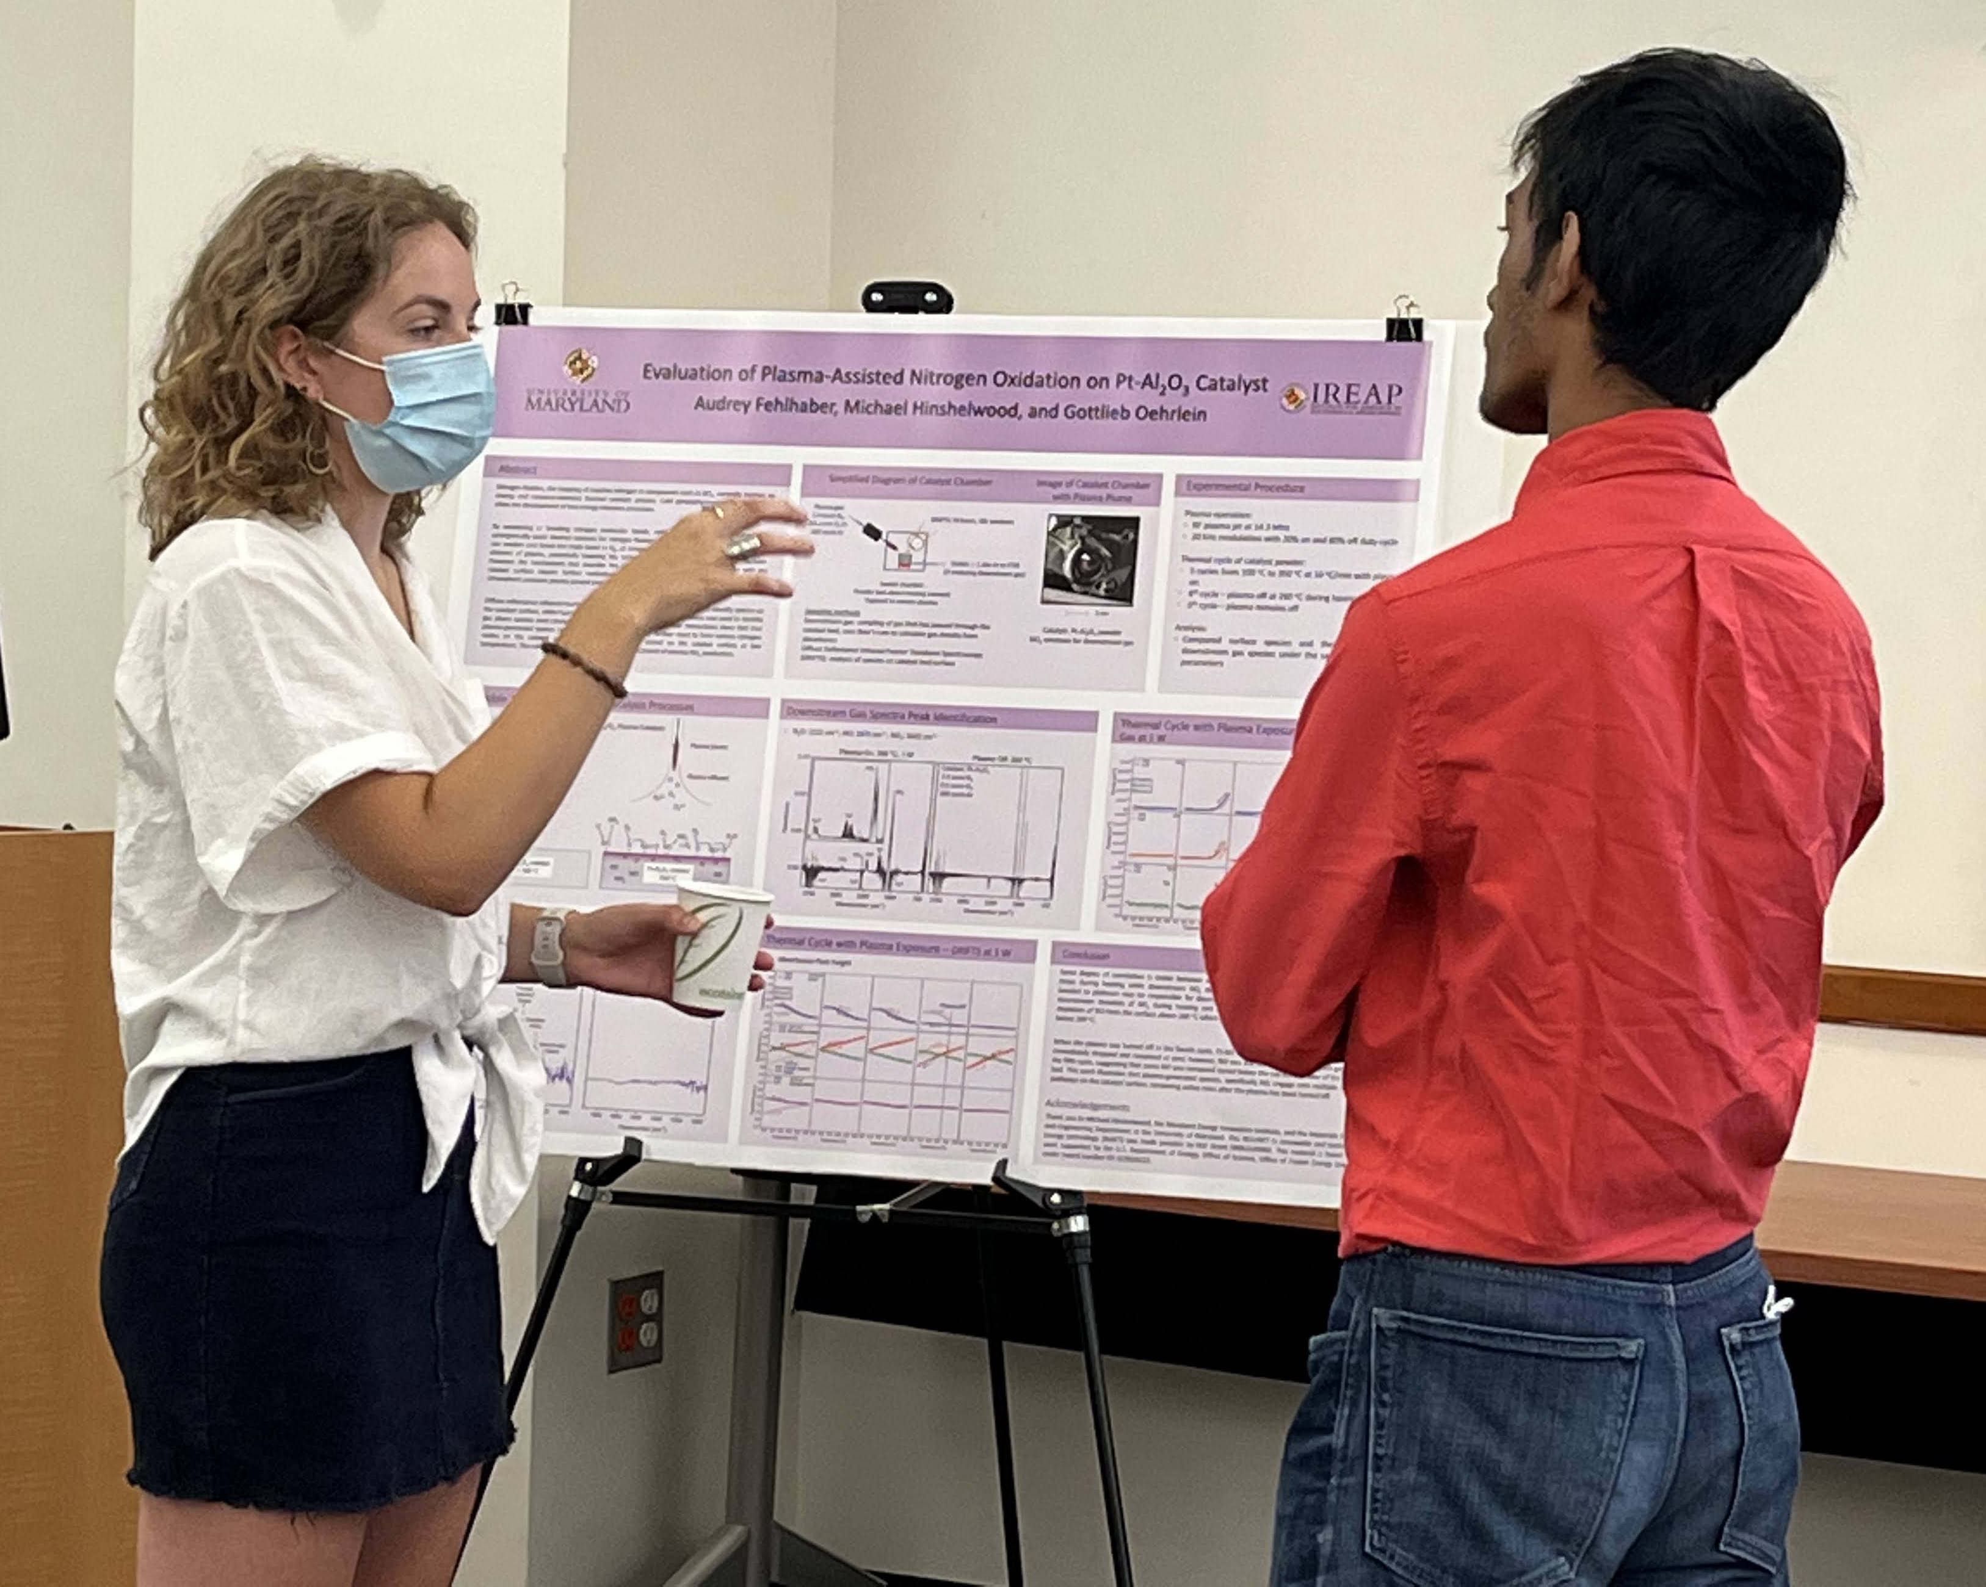
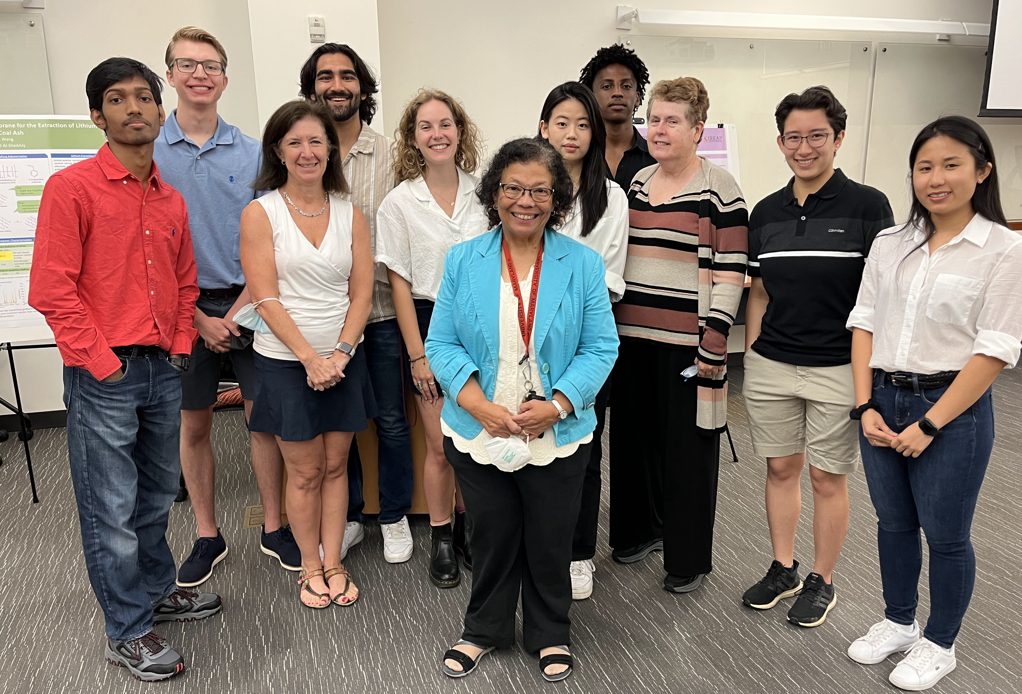
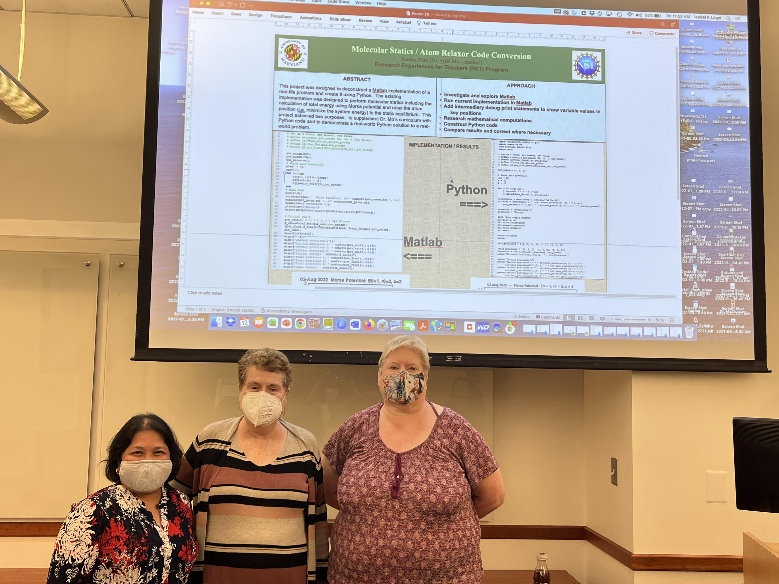
REU/RET Site: Summer Research Experiences in Renewable and Sustainable Energy Technology (ReSET)
2022 Broader Impacts
DMR 2149982
REU
2-year community college students successfully transferred to 4-year programs; several will continue to do research with their summer mentors
REU and RET
Cohorts participated in professional development activities each week ranging from joint seminars on careers pathways, poster presentations and ethics with the University of Maryland System LSAMP (Louise Stokes Alliance for Minority Participation) summer program to tours of a start-up company and nuclear reactor to elevator speech practice.
RET
High school students will learn about sustainable and renewable energy in a real- world context via:
New energy related curriculum units in the RET teachers’ classrooms
Visits the UMD to tour the Materials Science and Engineering Department and the Maryland Energy Innovation Institute
Isabel K. Lloyd, University of Maryland, College Park
Concluding poster session:
Audrey Fehlhaber (REU) explains her project to Rakin Alim (REU)
2022 REU Cohort: Rakin Alim, Mason Conaway, Akash Lujan, Audrey Fehlhaber, Crystal Pham, Saleh Kamel, Jason Maher with the PI Isabel Lloyd, Co-PI Luz Martinez-Miranda, and Executive Director, Cathy O’Brian Stephens
2022 RET Cohort: Mildred Pates and Sandi Platt with Isabel Lloyd

