Slide 1
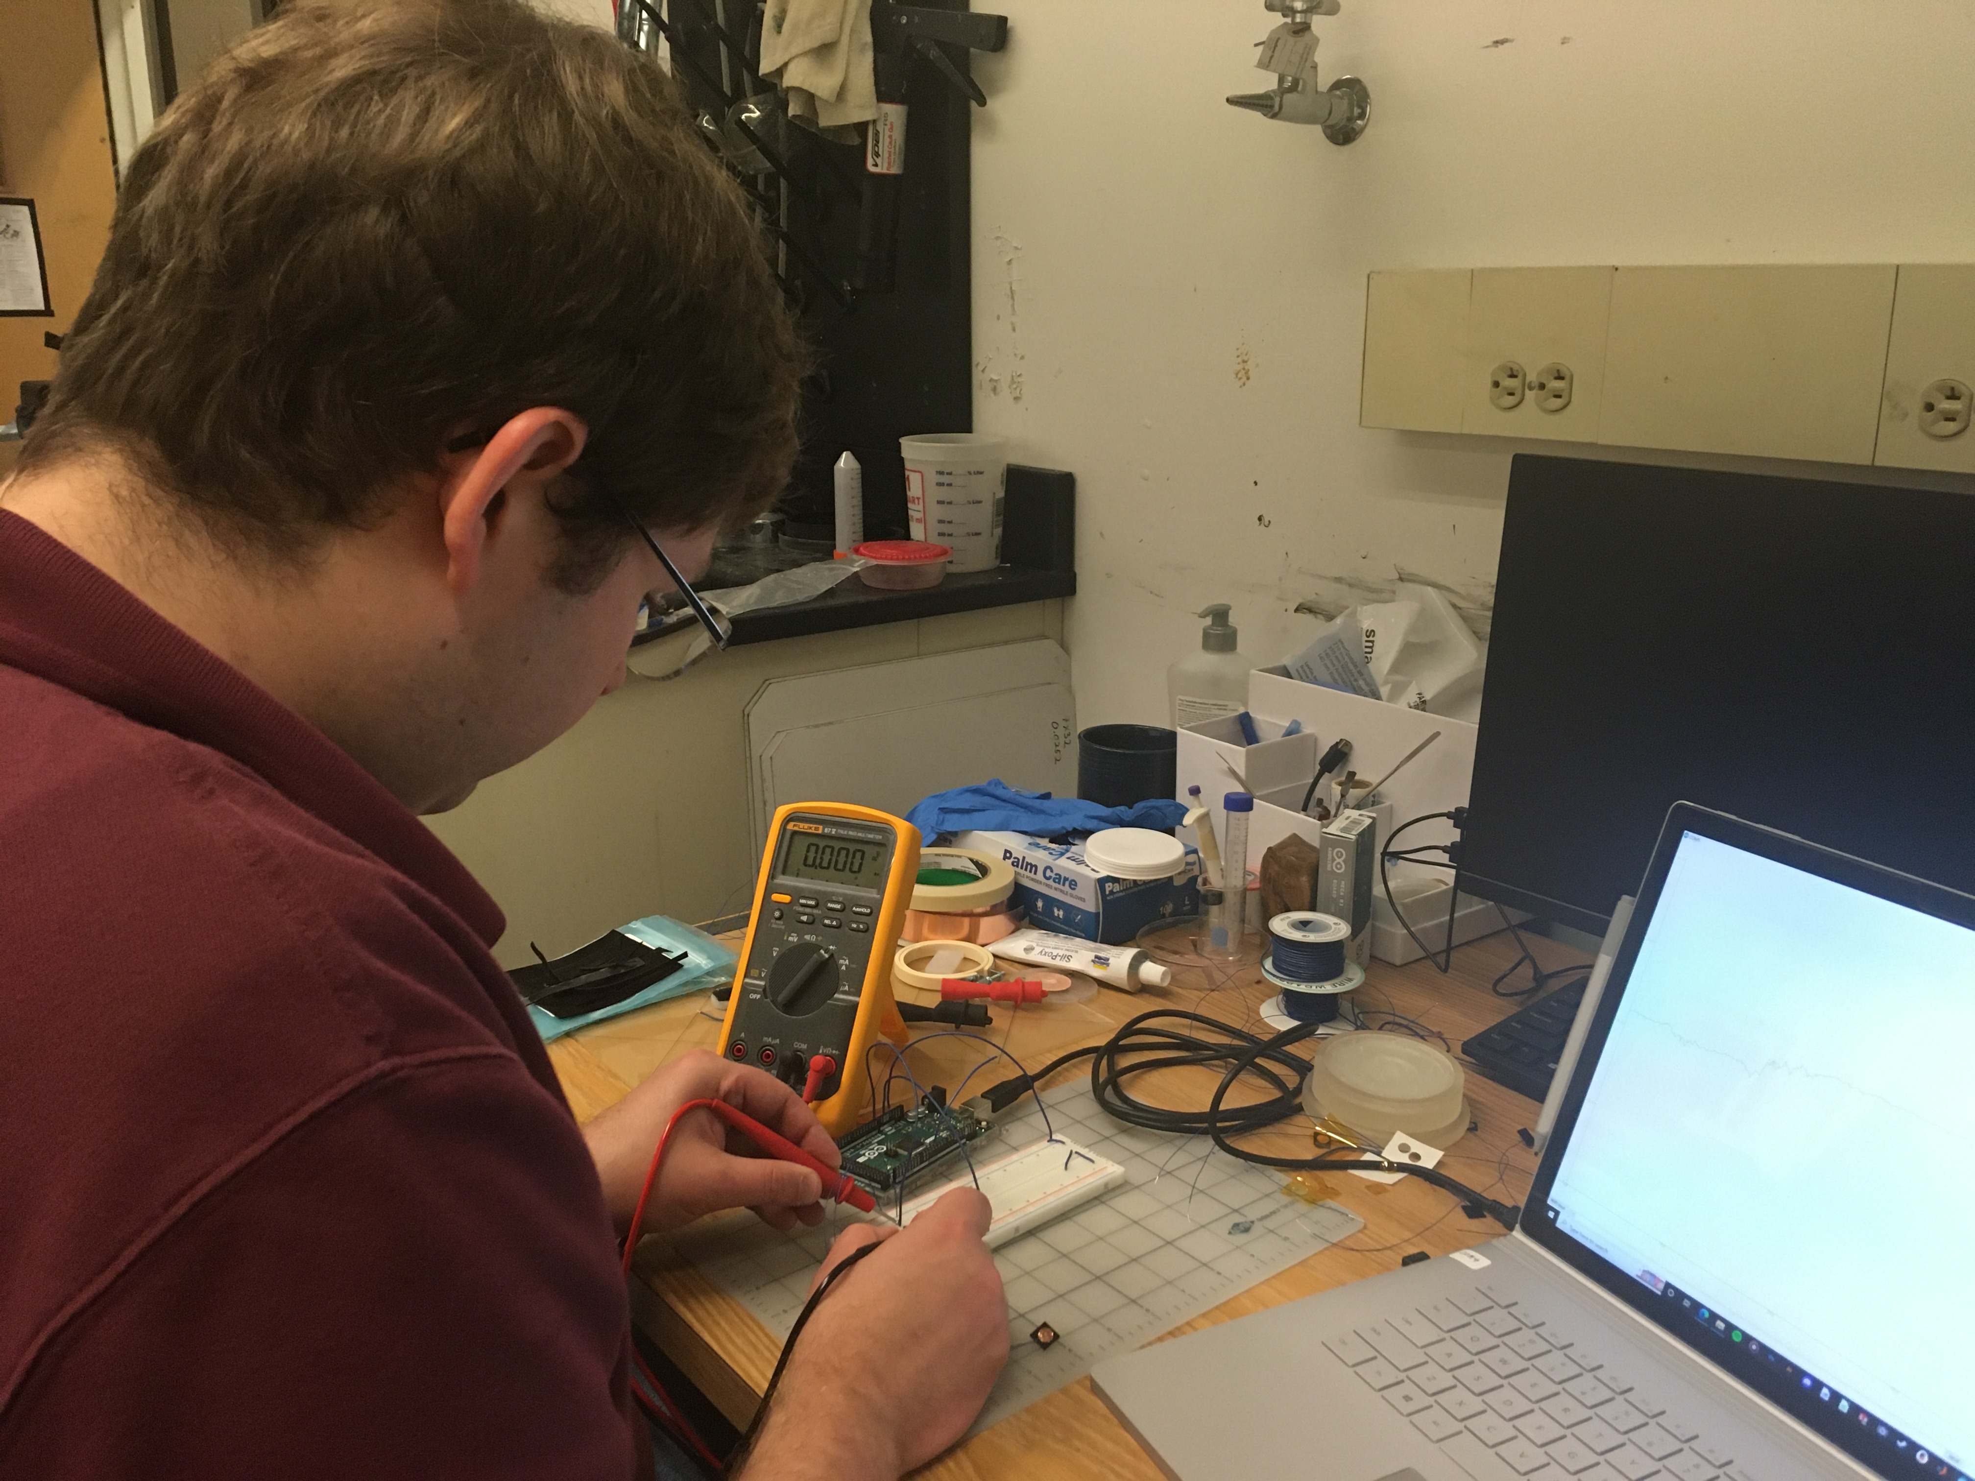
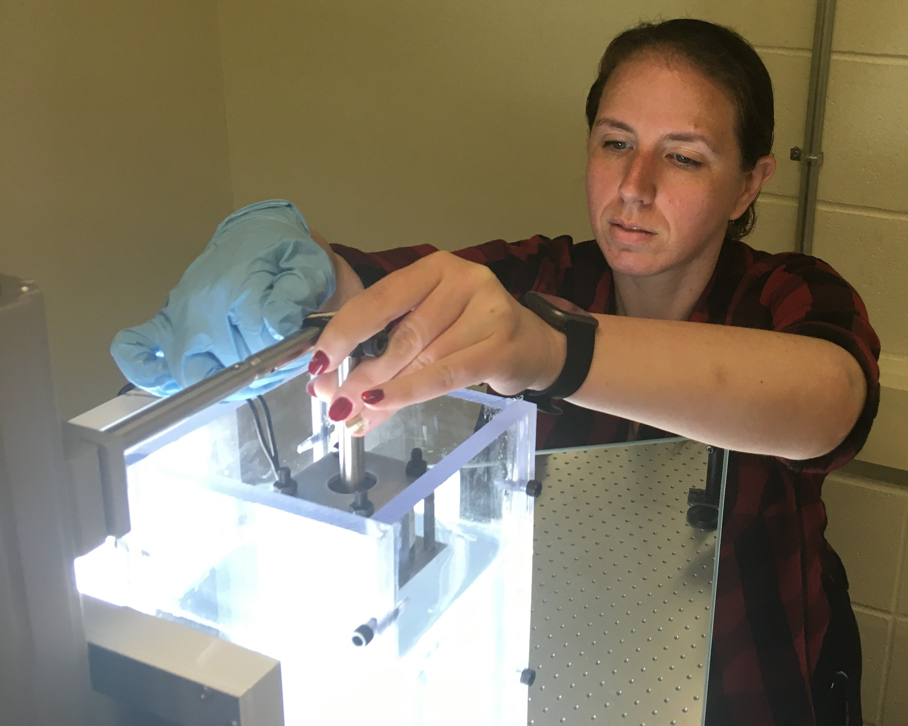
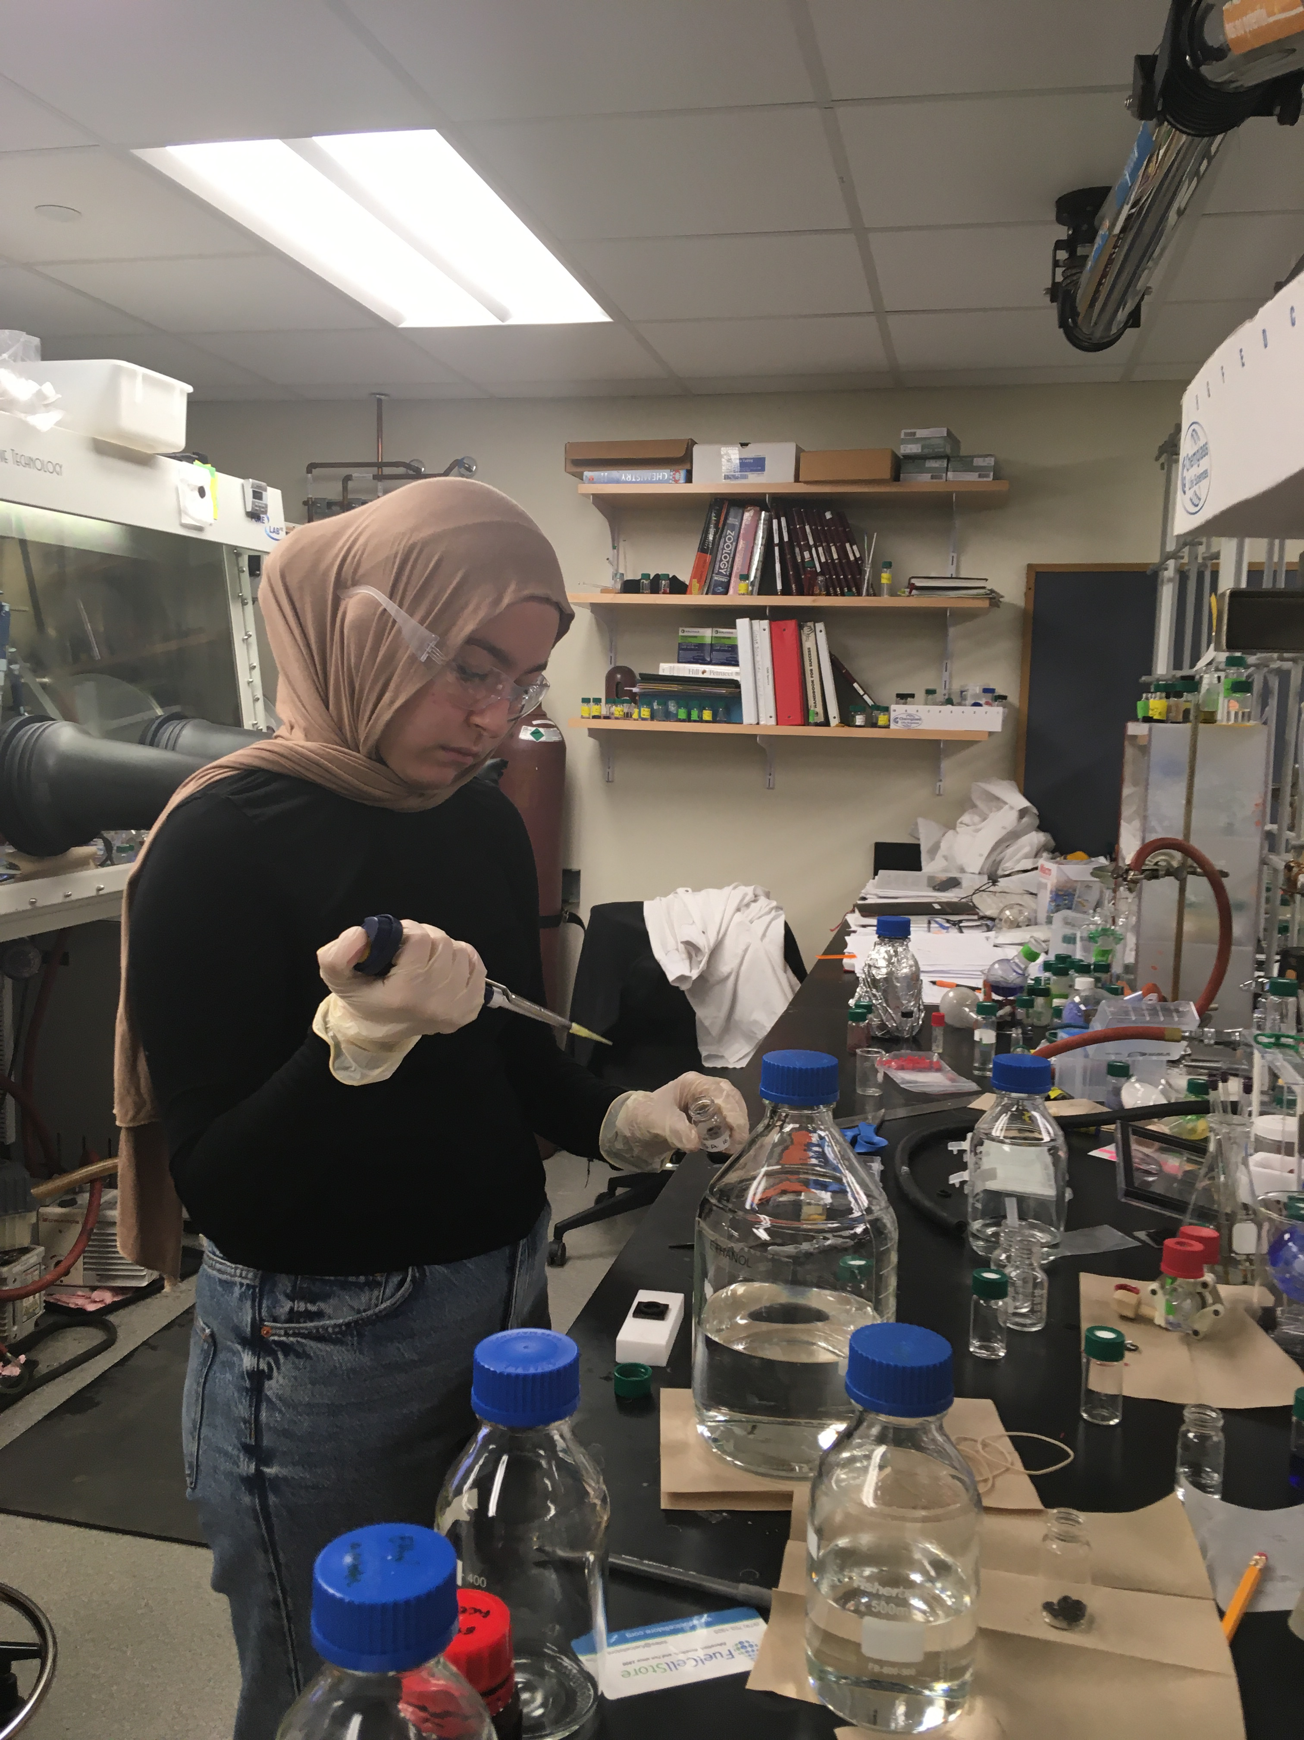
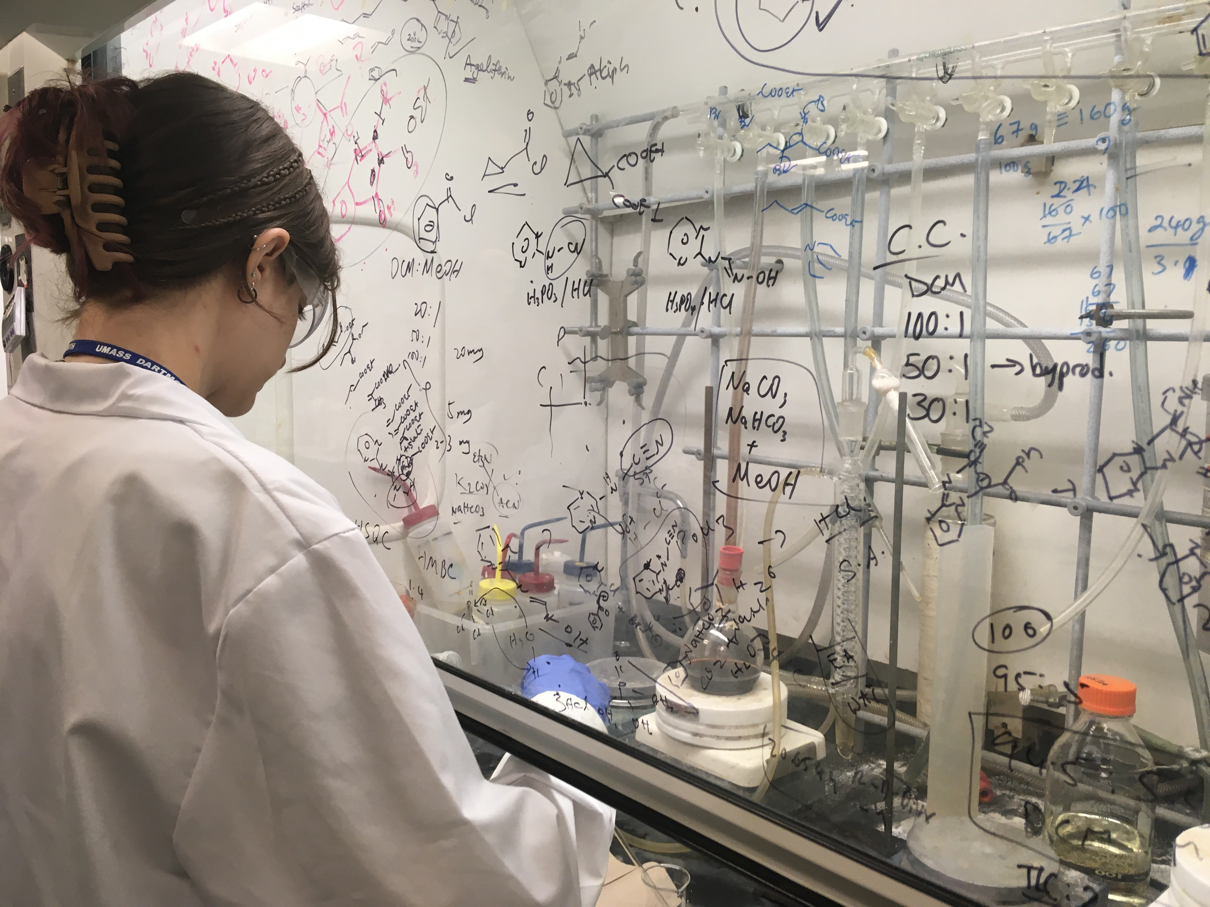
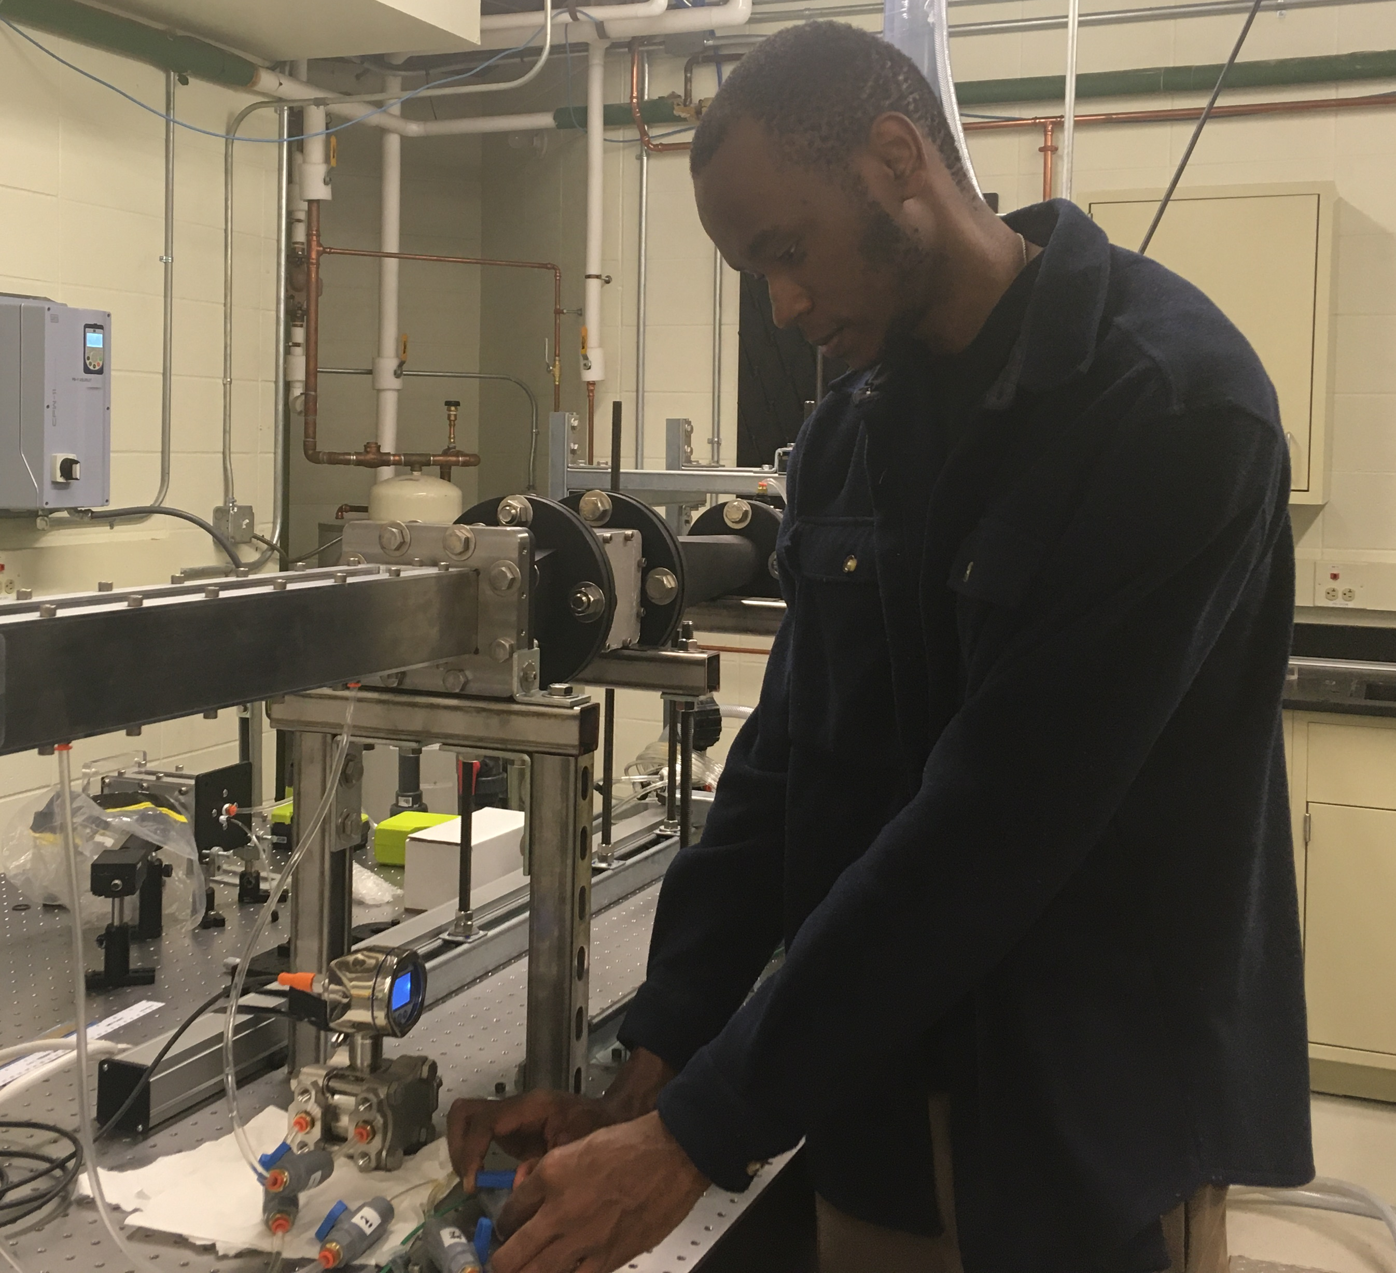
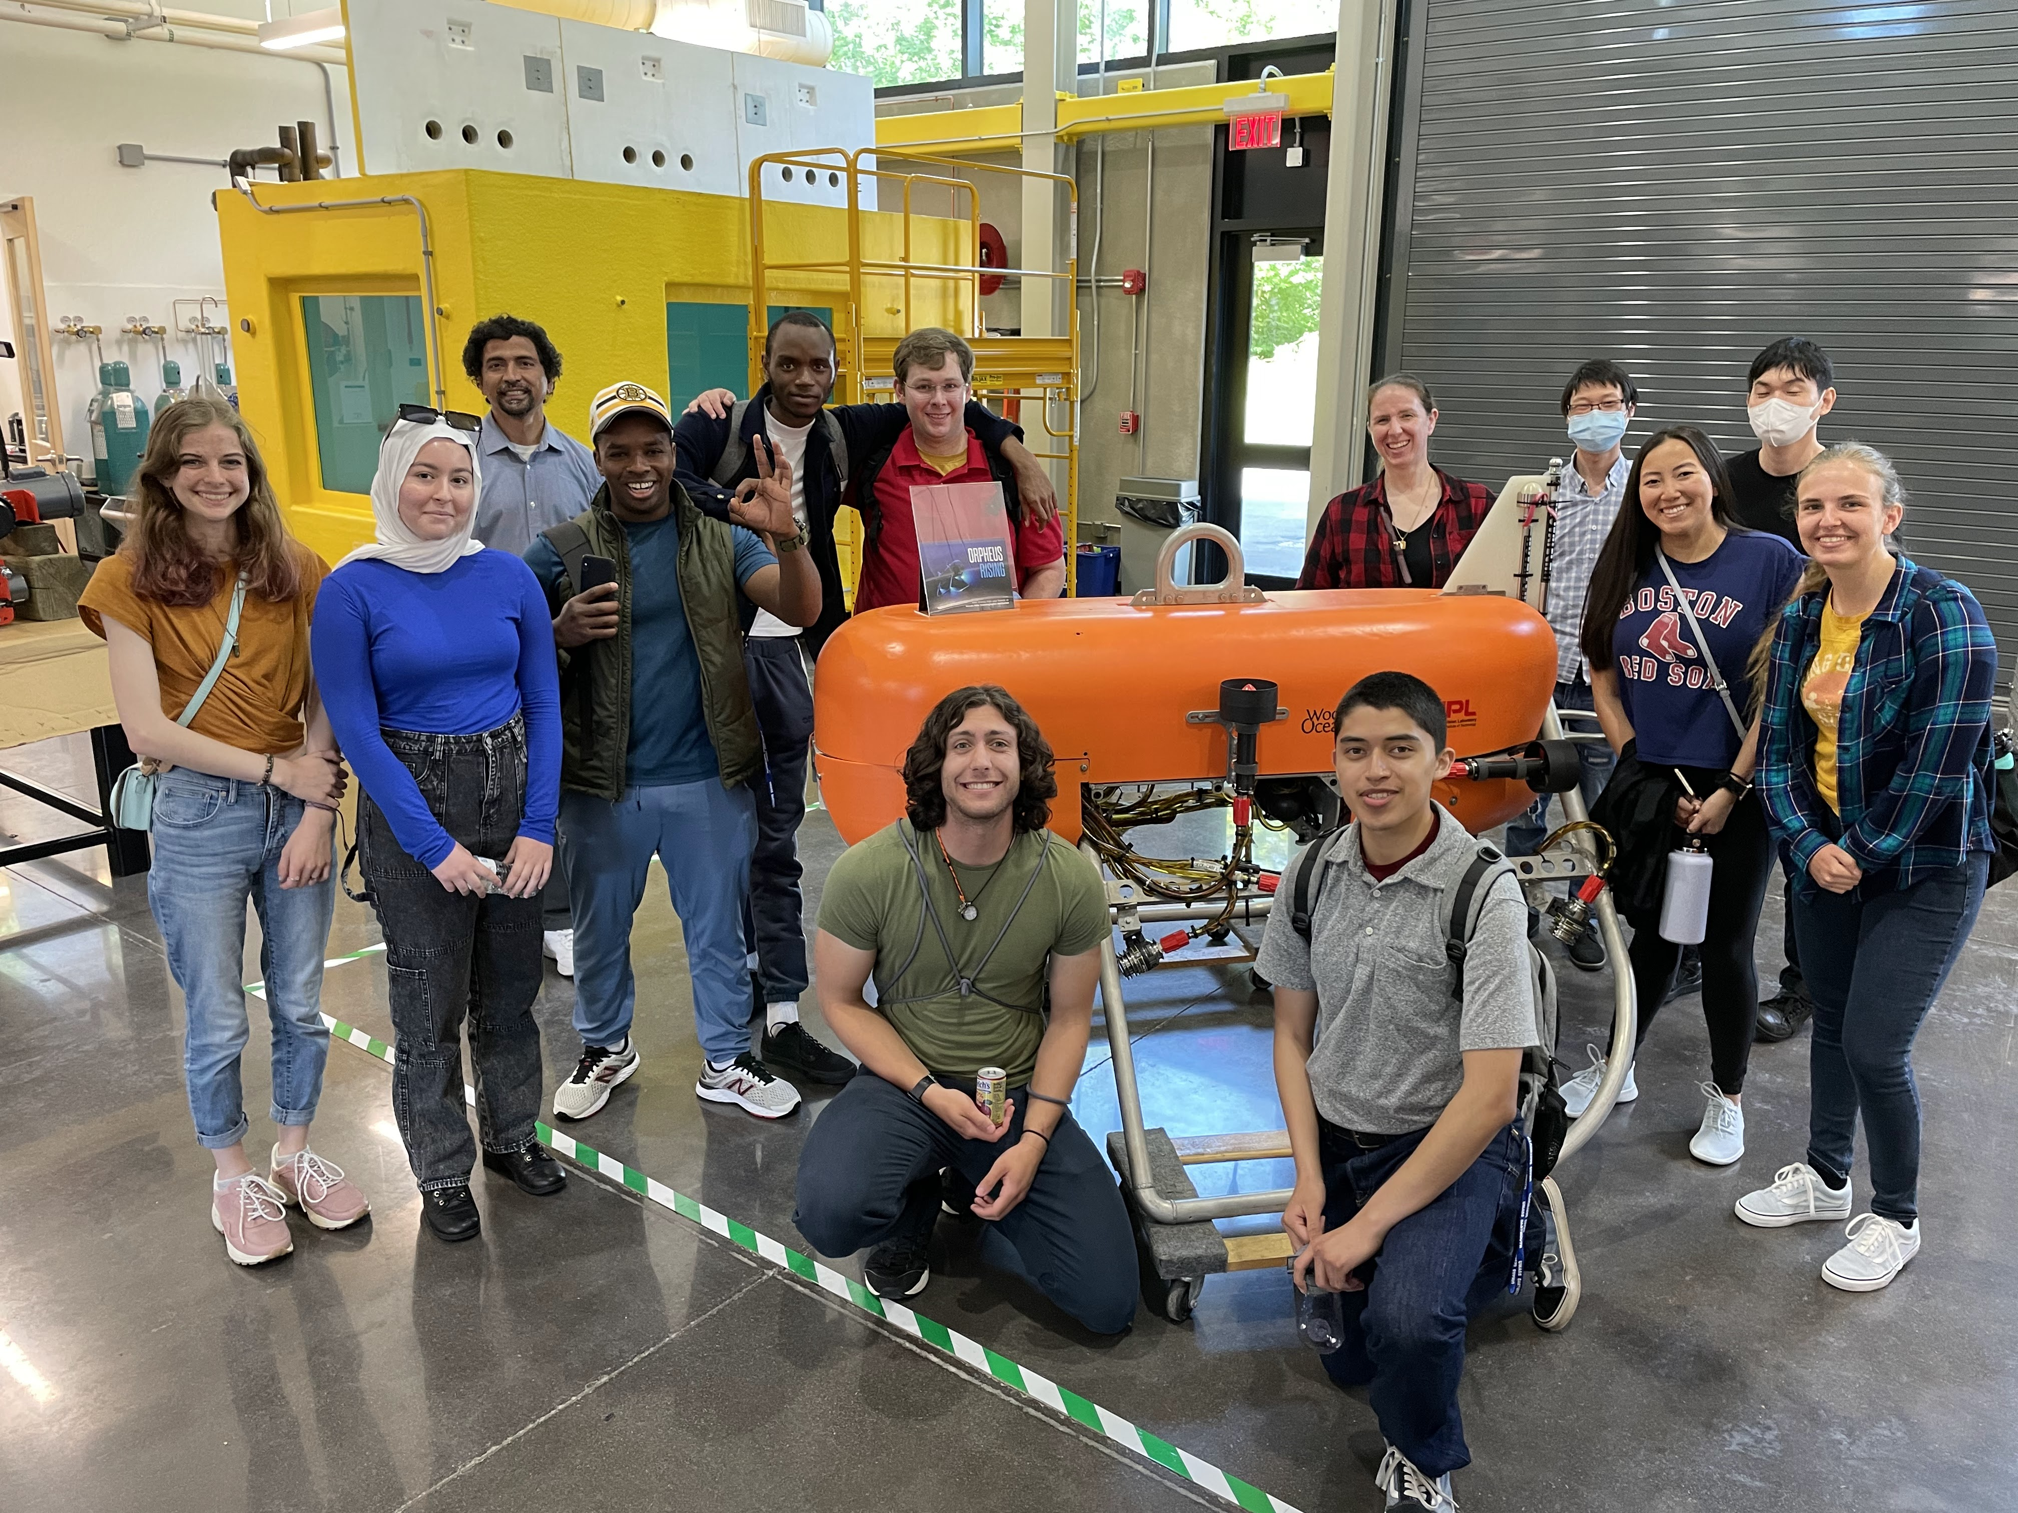
REU Site: Advanced Interdisciplinary Materials Research for Maritime Applications
2022 Intellectual Merit
DMR 2149893
Vijaya B. Chalivendra, University of Massachusetts Dartmouth
Conducted interdisciplinary advanced materials research for maritime applications
Trained a cohort of 10 community college students in various research topics: super hydrophobic surfaces, non-aqueous redox flow batteries, bioinspired photonic materials, surface adsorption of plasmonic nanoparticles on gold nanorods, tactile sensors for soft bodied underwater robots, antibiofouling coatings, plasmonic inks, and structural super capacitors
Enhanced skills of REU students through various workshops such as on research ethics, design of experiments, library databases, research communication skills, and scanning electron microscopy
Exposed REU students to various practical applications of advanced materials through field trips to Woods Hole Oceanography Institution (WHOI), Morgan Advanced Materials, AMETEK, and School of Marine Science and Technology of UMass Dartmouth.
(a)
(b)
(c)
(d)
(e)
(f)
Figures: (a)- (e) Pictures of some REU students
with their experiments, and (f) field trip to WHOI

Slide 2
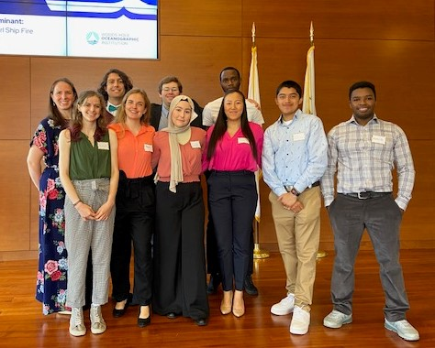
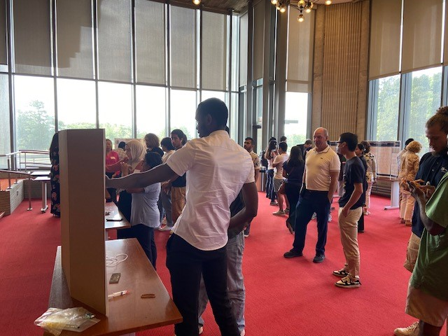
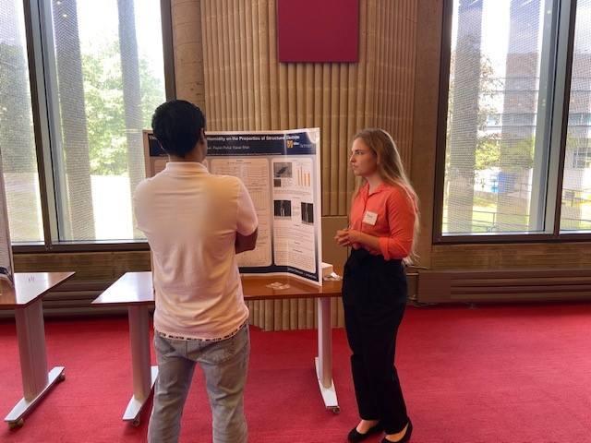
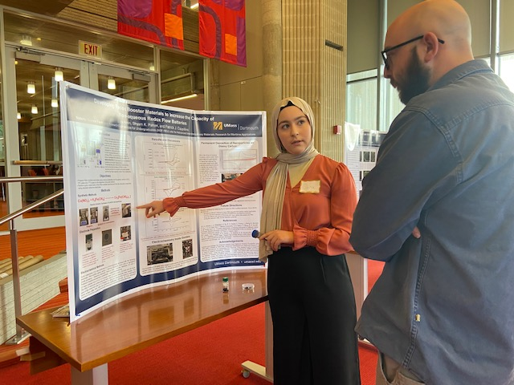
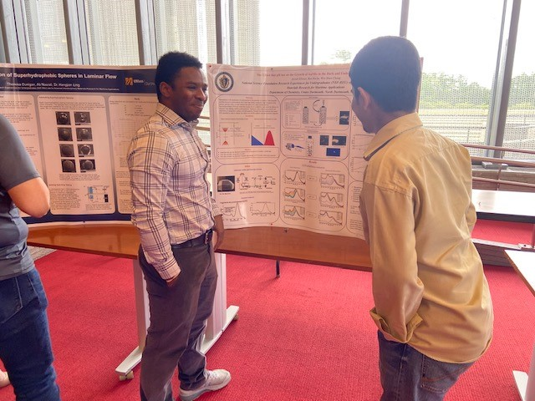
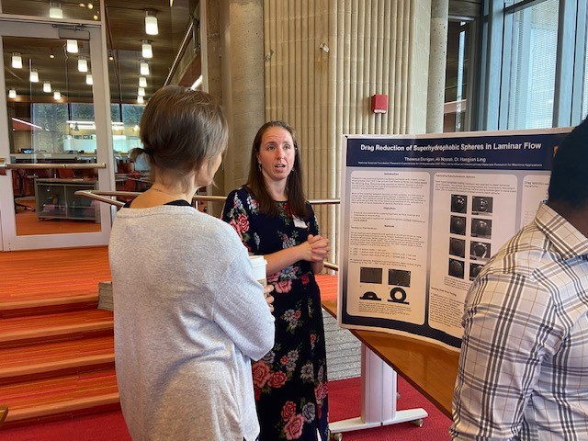
REU Site: Advanced Interdisciplinary Materials Research for Maritime Applications
2022 Broader Impacts
DMR 2149893
Recruited a cohort of 10 community college underrepresented students, out of which five are female students; two are African-American students; and one is Hispanic student.
Developed research presentation skills of REU students through weekly review meetings and exposed them to state-of-the-art materials research from graduate students’ presentations.
REU students established new connections with research community during weekly social gatherings of cookouts.
Participated in poster symposium and presented their research to UMass Dartmouth Community.
Vijaya B. Chalivendra, University of Massachusetts Dartmouth
(a)
(b)
(c)
(d)
(e)
(f)
Figure: (a) group Image of the REU students, (b)-(f) students are presenting
their research during the poster symposium at the end of REU-Site summer
program

