Slide 1
Discovery and Design with the FAST Principle: Following Local Models of Stability to Emergent Phenomena in Intermetallic Structures
2022 Intellectual Merit
DMR 2127349
Daniel C. Fredrickson, University of Wisconsin–Madison
Connecting the geometrical arrangements of atoms within a material to its properties is a fundamental goal in solid state and materials chemistry. For intermetallic phases—compounds formed from mixtures of metals—achieving this goal is particularly challenging due to the need for models relating composition to structure and function.
In this project, the chemical pressure quadrupole metric was developed as a means for investigating these relationships. When atoms are pressed from opposite sides by their neighbors, they tend to easily slide out into more spacious areas. This effect can give rise to easy atomic motion important for a variety of materials behavior. The CP quadrupole (QP) metric quantifies this character for the individual atoms within a structure from theoretical calculations. With this tool, surprising differences can be detected that are lost in a geometrical analysis of structures. For example, the local atomic arrangements in TiSi₂ and CrSi₂ are nearly indistinguishable, but the QP value is nearly twice as high for the former. This helps explain why the TiSi₂ type forms the basis for a broad superstructure family, but no analogues based on the CrSi₂ type have been observed.
The Chemical Pressure
Quadrupole (QP) Metric
TiSi₂
CrSi₂
QP = 0.49
QP = 0.23
Different behavior predicted for two very similar structures.
Notes:
Chemical pressure schemes are plotted for the atoms in the structures using the convention that black lobes correspond to negative pressures (atoms want to get closer to each other), while white lobes indicate positive pressures (atoms want to get farther away from each other). The size of a lobe along any direction is proportional to the magnitude of the sums of the pressure contributions along that direction.
Reference: Kendall Kamp, Daniel C. Fredrickson, A Tour of Soft Atomic Motions: Chemical Pressure Quadrupoles Across Transition Metal-Main Group 1:2 Structure Types, submitted to Chemistry of Materials.

Slide 2
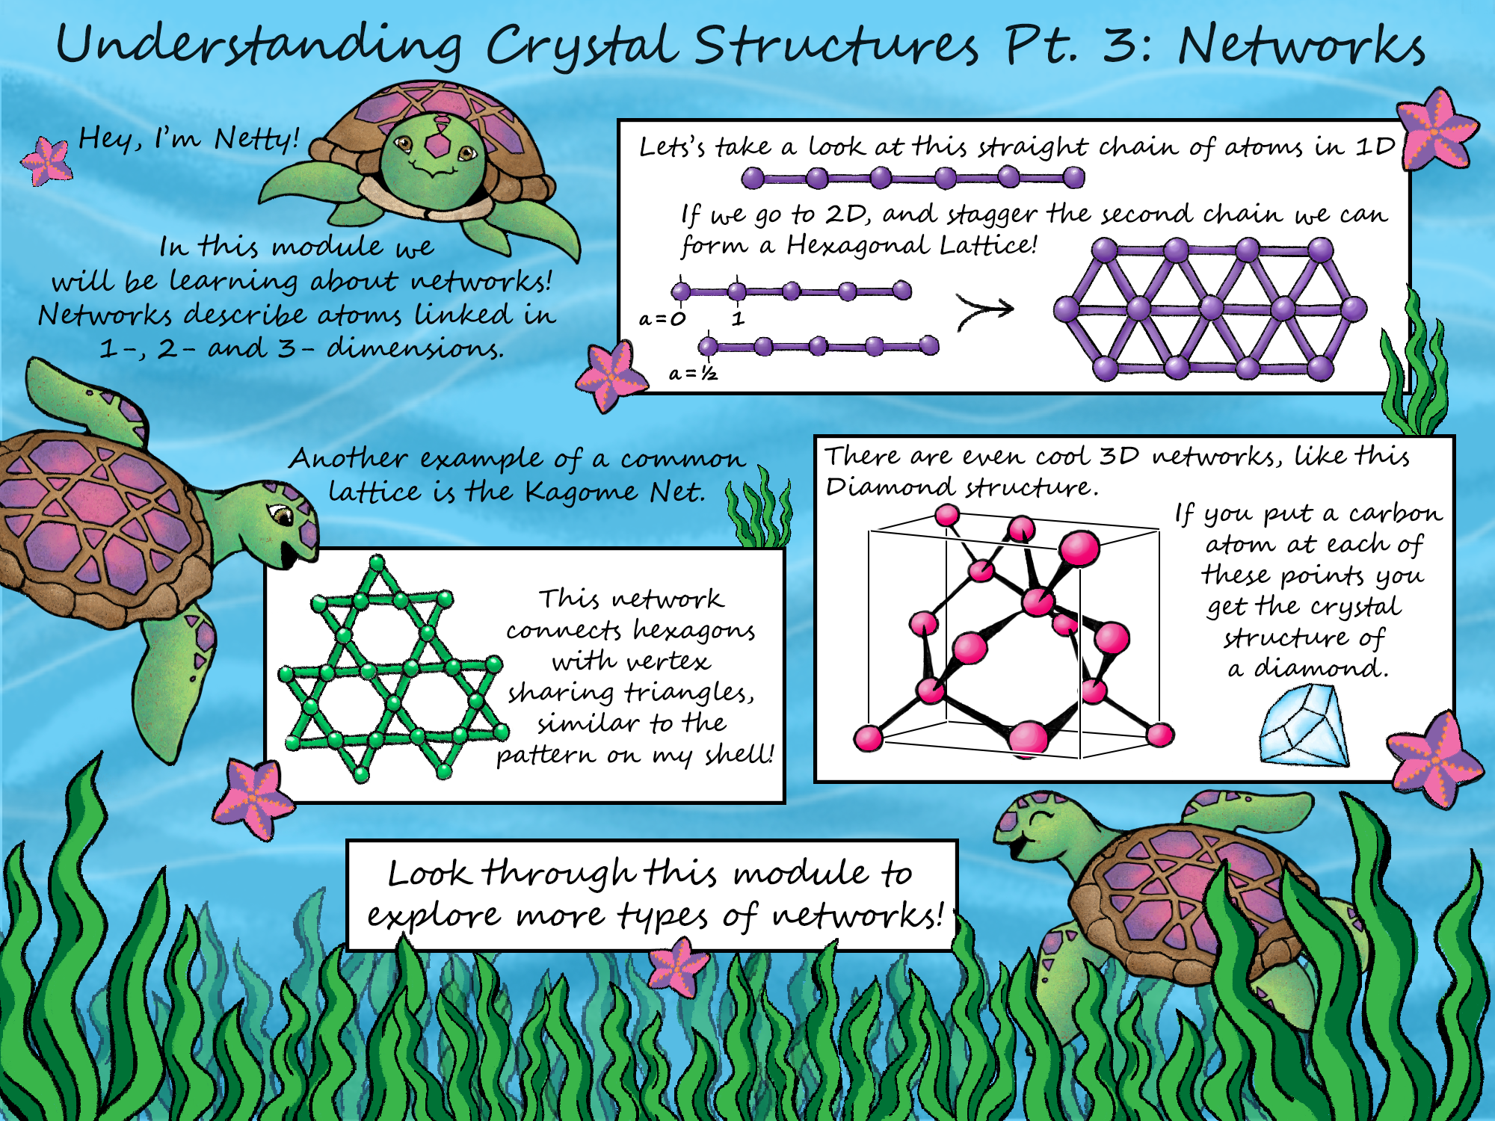
Discovery and Design with the FAST Principle: Following Local Models of Stability to Emergent Phenomena in Intermetallic Structures
2022 Broader Impacts
DMR 2127349
Daniel C. Fredrickson, University of Wisconsin–Madison
This project is continuing the development of the online textbook Interactive Solid State Chemistry as a freely available resource to students and educators. On this website, comics featuring characters such as Netty the Turtle, and Poly the Parrot introduce interactive tools that will lead students through concepts in solid state and materials chemistry.
This year the first unit, on understanding crystal structures, is being prepared for import into the LibreTexts platform. Over the course of a series of examples divided into four modules, students learn about how crystals are constructed at the levels of individual coordination polyhedra, the arrangements of these units into networks, and the combination of such networks into full crystal structures.
Image credit: Danica G. Gressel, an inorganic chemistry Ph.D. student in the Fredrickson Group.

