Slide 1
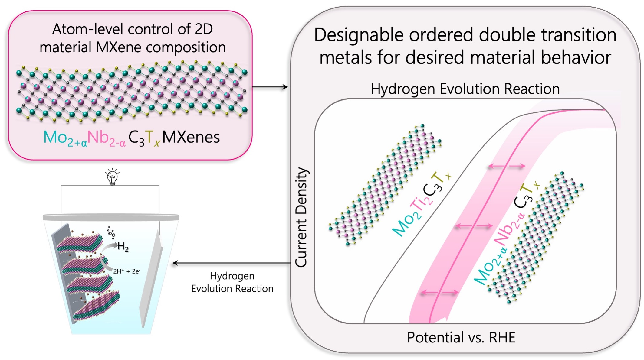
Theory-guided Design and Discovery of Rare-Earth Element 2D Transition Metal Carbides MXenes
2022 Intellectual Merit
DMR 2124478
Babak Anasori, Indiana University
Novel 2D Material Carbides
Design and synthesis of few-atom thick 2D carbides are essential for the advancement of future electronics and energy storage and generation.
We synthesized two novel 2D material MXenes: Mo₂Nb₂C₃T_{x} and W₂TiC₂T_{x}
Mo₂Nb₂C₃T_{x}: By the addition of Nb atoms within the metal layers of the electronic structure of Mo-containing MXenes is modified and led to the enhancement of its electrocatalytic performance as an earth-abundant and noble-metal free catalyst.
Mo_{2+α}Nb_{2-α}C₃T_{x}: high-precision control over the molybdenum content in the four-layers of metal further enhanced the electrocatalytic activity of MXenes.
W₂TiC₂T_{x}: A new layered material was used to synthesize a tungsten-containing 2D carbide for the first time. In this study, we identified weaker bonded atomic layers by computational methods and successfully removed those layers.
Notes:
This project aims to expand our design control and understanding of the family of ordered double-transition metal MXenes by the inclusion of the rare-earth (f-orbital) elements in MXenes.
In the first year of this project, we successfully designed new structures and expanded the family of ordered double-transition metal Mxenes by adding Mo_{2+α}Nb_{2-α}C₃T_{x} and W₂TiC₂T_{x.}
Mo_{2+α}Nb_{2-α}C₃T_{x}: A novel Mo-Nb MXene was designed and synthesized. We conducted a systematic study by changing the molar ratios of Mo:Nb to identify the effect of atomic intermixing in the M-layers of Mxenes. Our analyses indicate that Mo prefers the outer M layers and Nb prefers to occupy the inner M layers (see Mo_{2+α}Nb_{2-α}C₃T_{x} schematic).
Mo can occupy some of the inner M sites in the Nb planes. In other words, some intermixing of Mo atoms is allowed in the Nb inner M layers. However, the structure cannot be stable if Nb atoms intermix with Mo in the Mo layers (outer M layers).
Density functional theory calculations that were done by the collaborator PI (Prof. Strachan) confirmed higher stability of ordered structures: Mo in the outer M layers and Nb in the inner M layers.
The new Mo_{2+α}Nb_{2-α}C₃T_{x} composition show one of the lowest overpotential needed for hydrogen evolution reaction among 2D MXene carbides, getting closer to that of platinum.
We also synthesize a novel three-layer MXene with tungsten for the first time, W₂TiC₂T_{x,} from a non-MAX structure, opening more possibilities in the design of 2D structures.
W₂TiC₂T_{x} showed the lowest overpotential for hydrogen evolution reaction.
By modifying the electronic structure of these two Mxenes, we achieve electrocatalytic performances close to that of noble metals, a step toward earth-abundant catalysts.

Slide 2
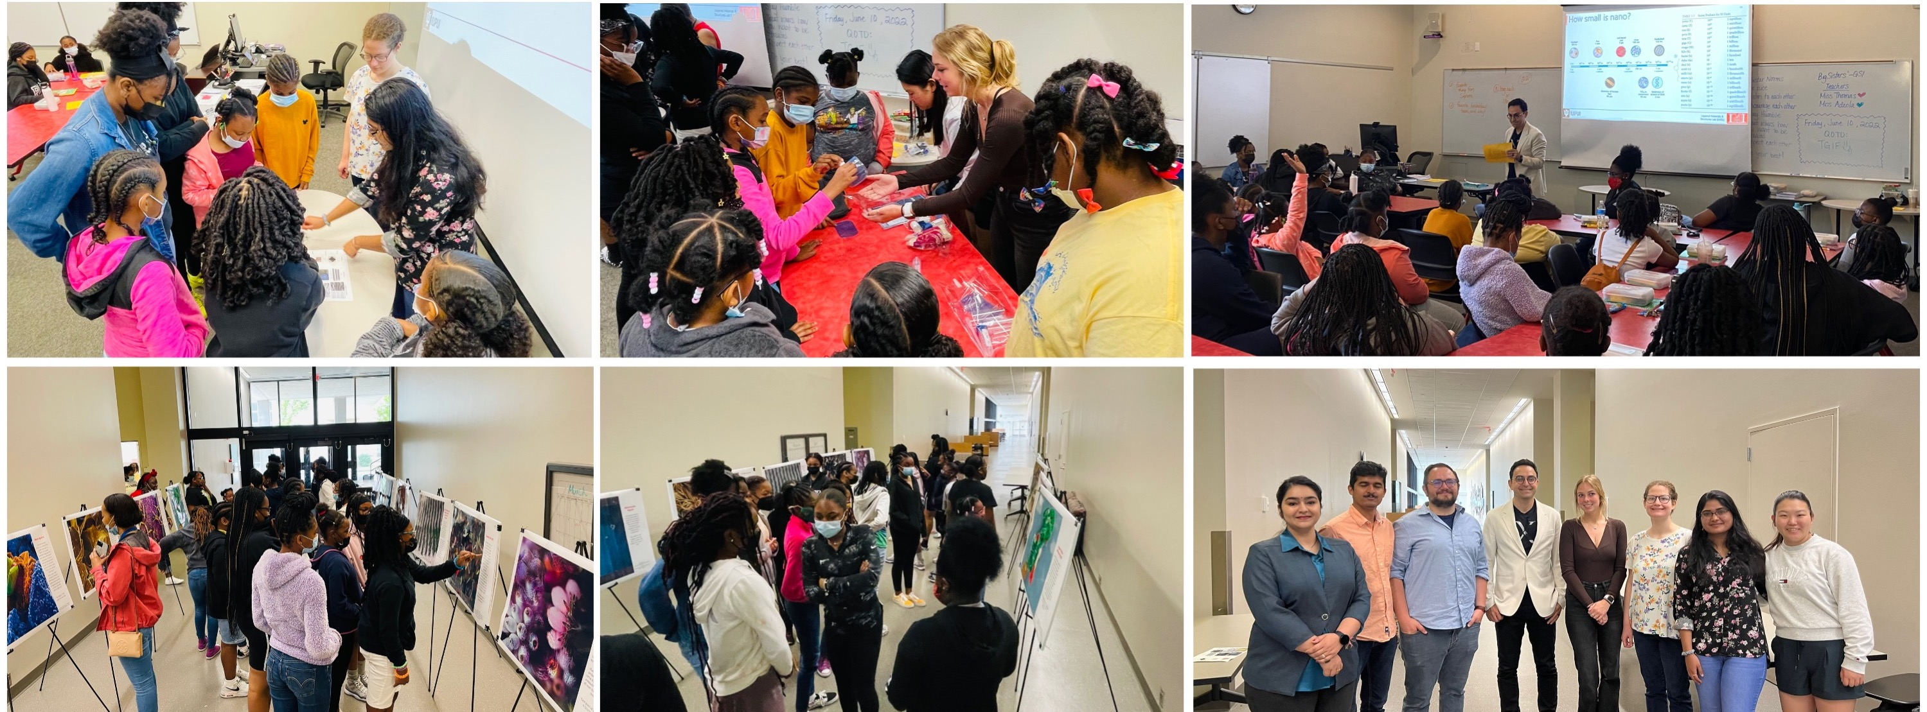
Theory-guided Design and Discovery of Rare-Earth Element 2D Transition Metal Carbides MXenes
2022 Broader Impacts
DMR 2124478
Babak Anasori, Indiana University
Training underrepresented STEM educators and researchers:
Three female undergraduate students worked on this project in the first year. All three have considered continuing to graduate school.
Two of the female students have started their graduate studies and stayed in the PI’s lab, a PhD student and an M.Sc. None of these students had considered graduate school prior to joining this research.
Combining art and nanoscience to encourage girls of color to consider STEM:
The first in-person NanoArtography gallery on campus.
The PI and seven of his students held the nanoart gallery and a half-day nanoscience workshop.
The workshop and NanoArtography gallery was for the Girl STEM Institute with hands-on nano-related demos for the 8-16 years old girls of color.
An undergraduate student presented her research and won the best poster award at an international conference in 2022.
An undergraduate student at her DOE summer internship at the Oak Ridge National Lab in 2022.
The first in-person NanoArtography gallery with a hands-on workshop for the Girl STEM Institute.
Notes:
Krista Pulley was an undergraduate student researcher with a dual degree in biology and mechanical engineering. She never thought about research in materials science. She presented her research at the Materials Research Society (MRS) in Spring 2022 and won the best poster award at the MXenes Symposium.
Krista Pulley received a one-year university fellowship to pursue her M.Sc. and she joined the PI’s lab.
Annabelle Harding was an undergraduate student who did not consider graduate school until the Fall of 2021. She started research in PI’s lab and worked on rare-earth-containing MXenes (this project). Annabelle applied for the DOE Science Undergraduate Laboratory Internship (SULI) in the Winter of 2022 and was selected to go to the Oak Ridge National Lab.
Annabelle Harding is now a PhD student in the PI’s lab and received the Purdue School of Engineering's one-year graduate fellowship. She is the only recipient from the Mechanical Engineering Department.
The PI’s lab organized a nanoart gallery.
NanoArtography is a science and art competition that was created by the PI in 2016.
The PI’s team created an art gallery for the 8-16 years old girls. We used the gallery to explain the concept of nano to them.
We had four hands-on stations that students could learn more about nano. The instructors for the hands-on experiments were the PI’s students (bottom right image).

