Slide 1
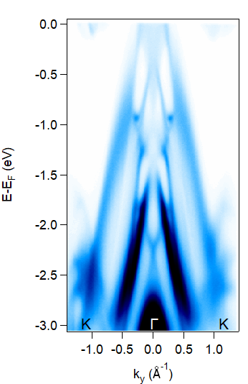
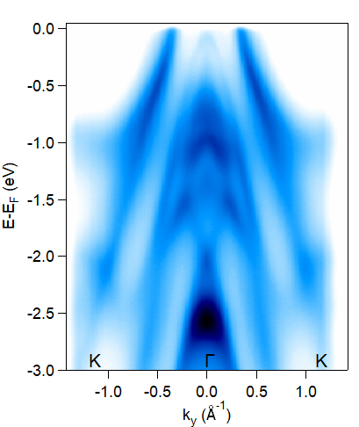
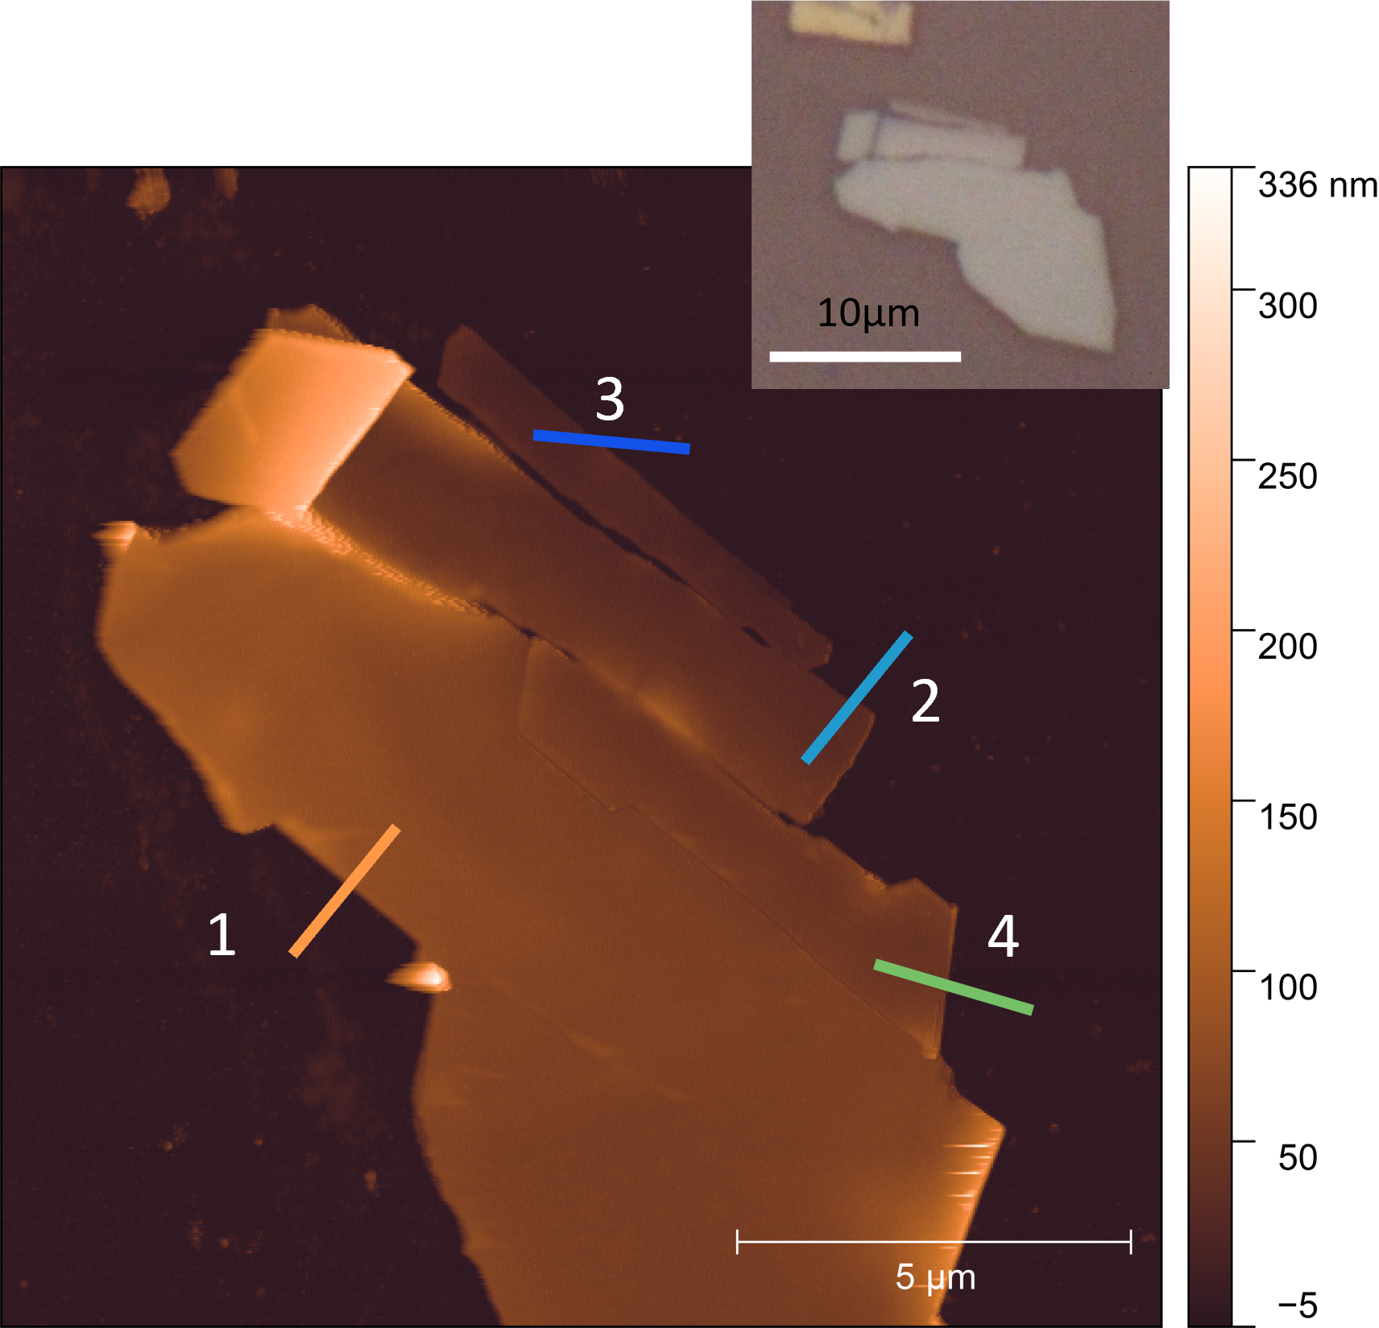
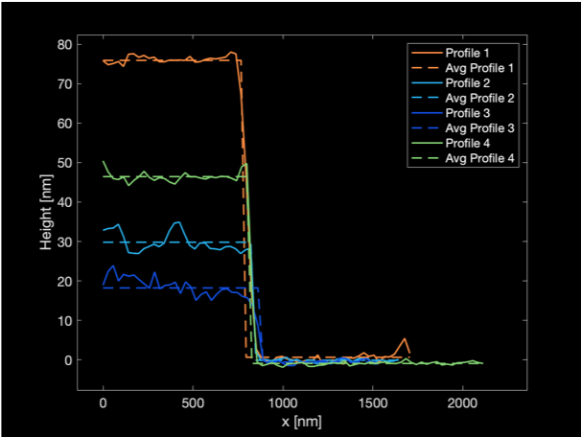
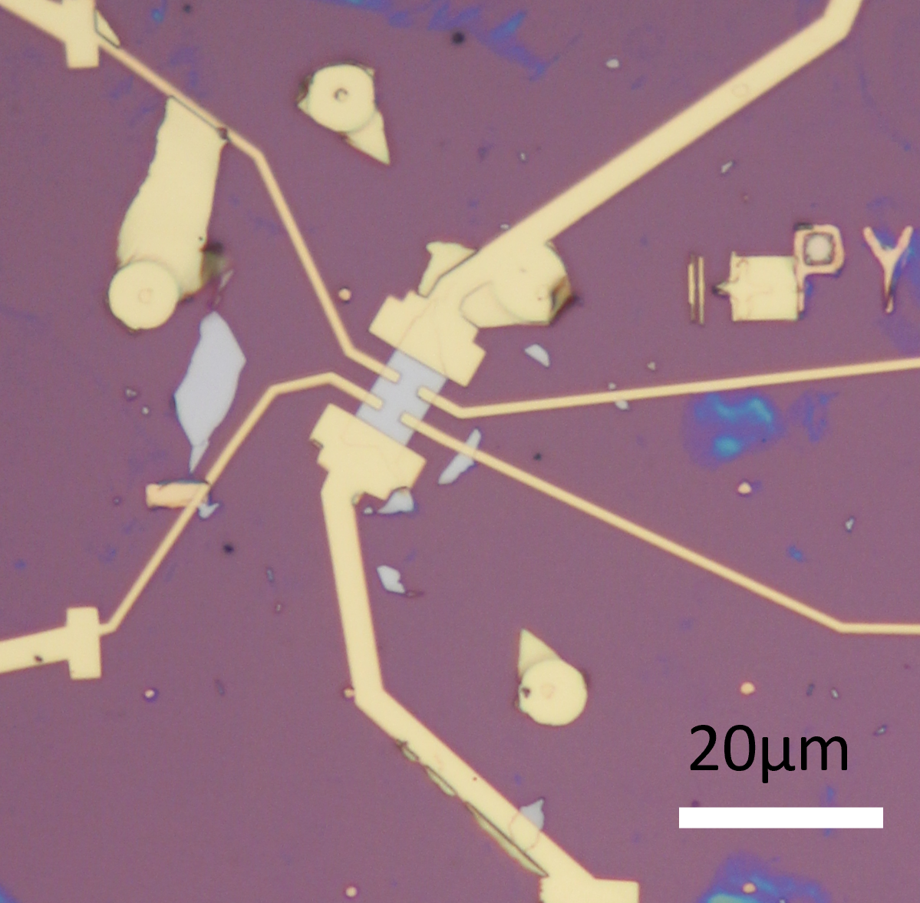
Study of a novel air-stable two-dimensional magnet
DMR 2122199
Michael R. Peterson, California State University-Long Beach Foundation
PREM research is focused on cooperative phenomena in solid state, organic/inorganic biomaterials with a strong interdisciplinary crossover between physics, biophysics, materials science, chemistry and mathematics. During the current reporting period, in one of our projects we studied a novel air-stable two-dimensional ferromagnet grown by the department of chemistry at Ohio State University.
Highlights:
Angle resolved photoemission spectroscopy ARPES characterization of the new family of air-stable van der Waals ferromagnetic materials Cr_{x}Pt_{1-x}Te₂, figure (a).
Preliminary analysis points towards the inheritance of some of the topologically protected states of the parent crystal PtTe₂ to the magnetic compounds Cr_{x}Pt_{1-x}Te₂, indicated with arrows in figure (a).
Surface science characterization of thin crystals of the Cr_{x}Pt_{1-x}Te₂ alloys and preliminary device fabrication for future electronic transport measurements at low temperatures.
(a) Band structure of the type-II Dirac semimetal PtTe2 and its Cr alloys Cr_{x}Pt_{1-x}Te₂ (b) Atomic force microscopy image of a thin crystal of Cr_{0.35}Pt_{0.65}Te₂ and profiles (c) showing crystals as thin as 20nm. (d) Preliminary electronic device
(a)
PtTe₂
Cr_{0.35}Pt_{0.65}Te₂
Cr_{0.45}Pt_{0.55}Te₂
(b)
(c)
(d)

Slide 2
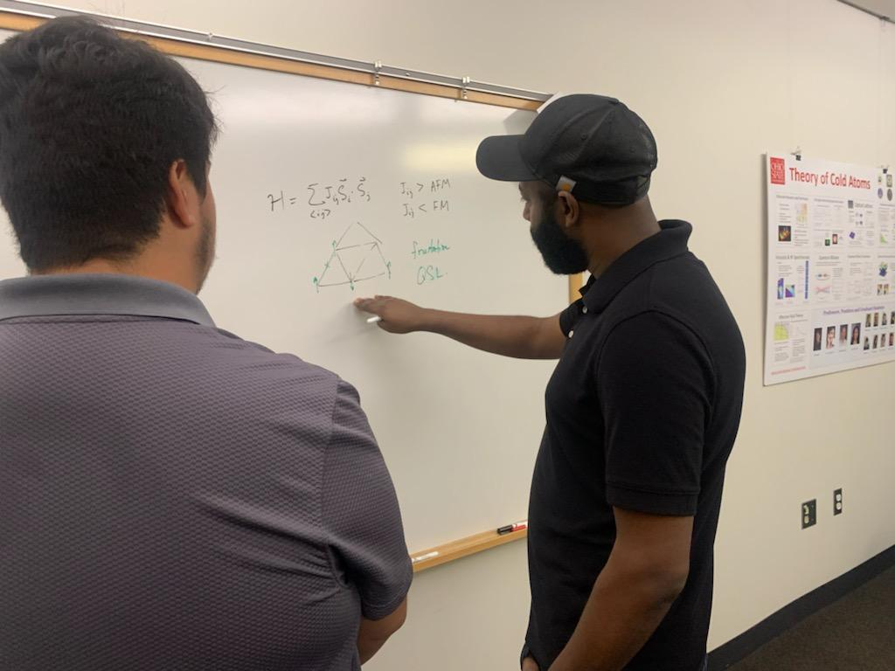
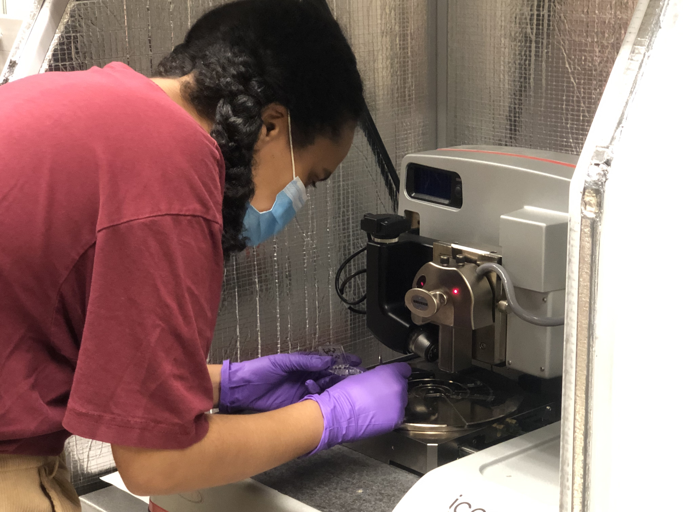
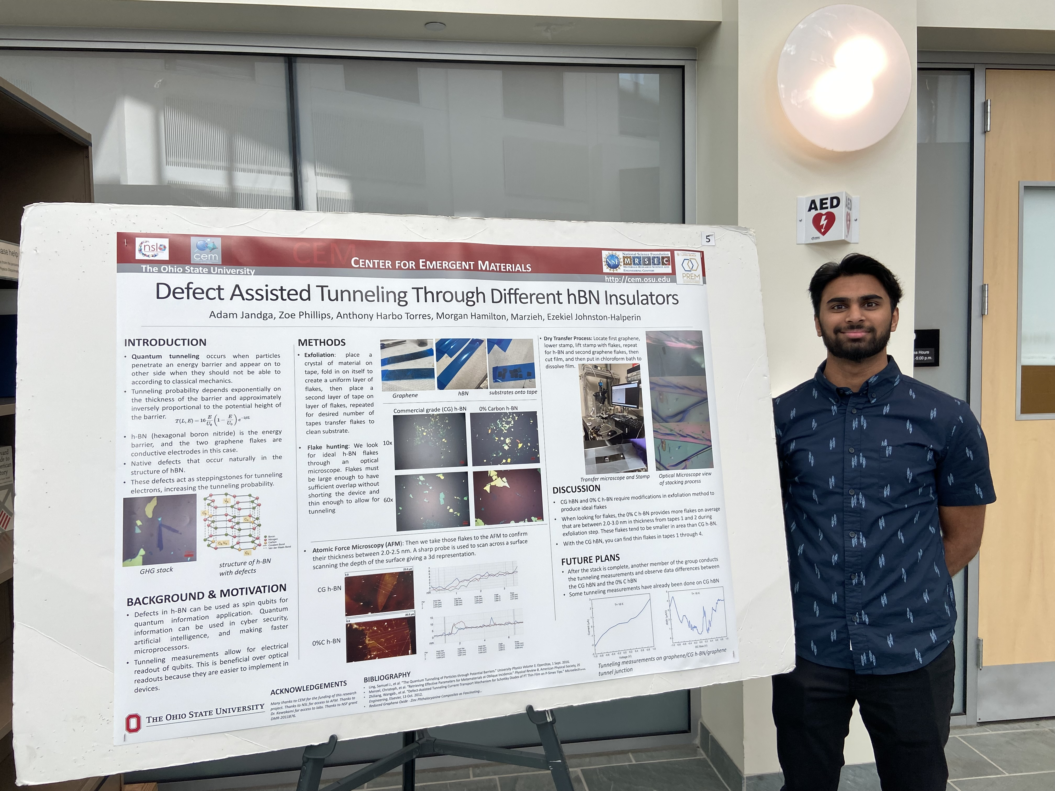
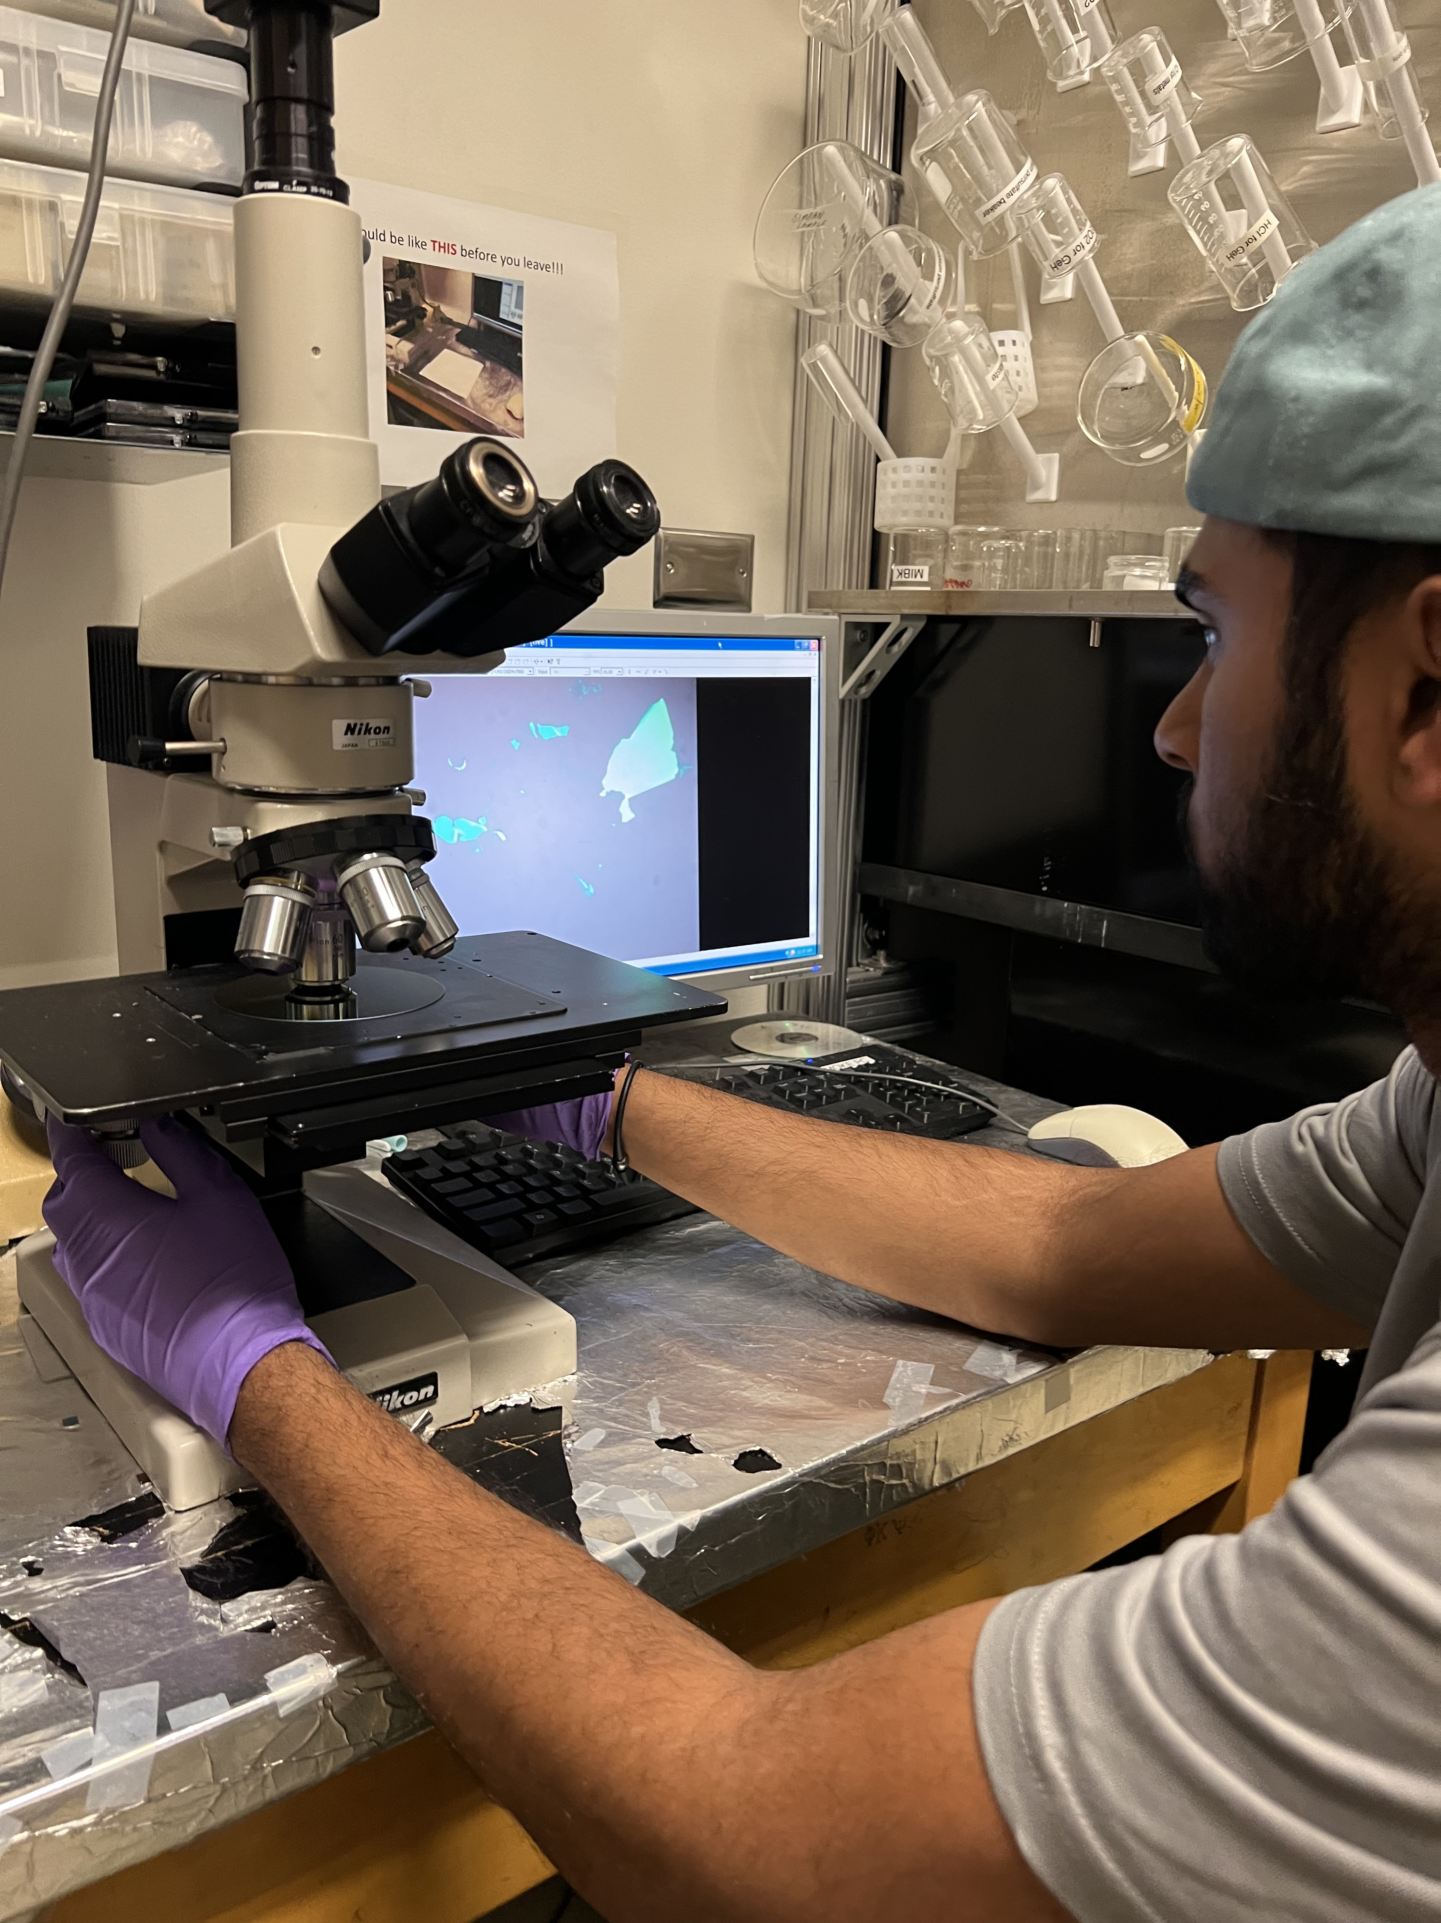
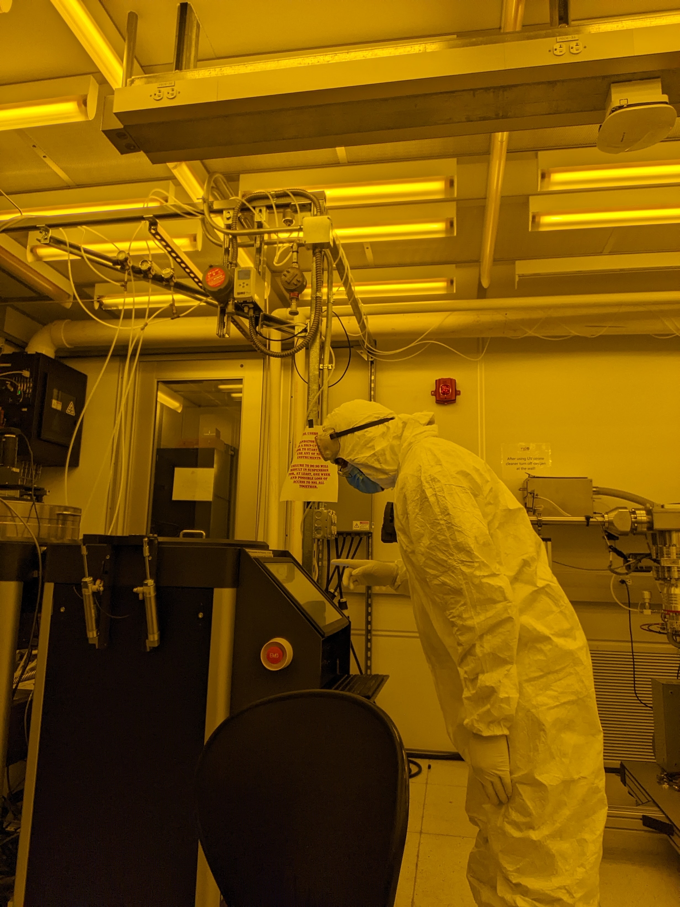
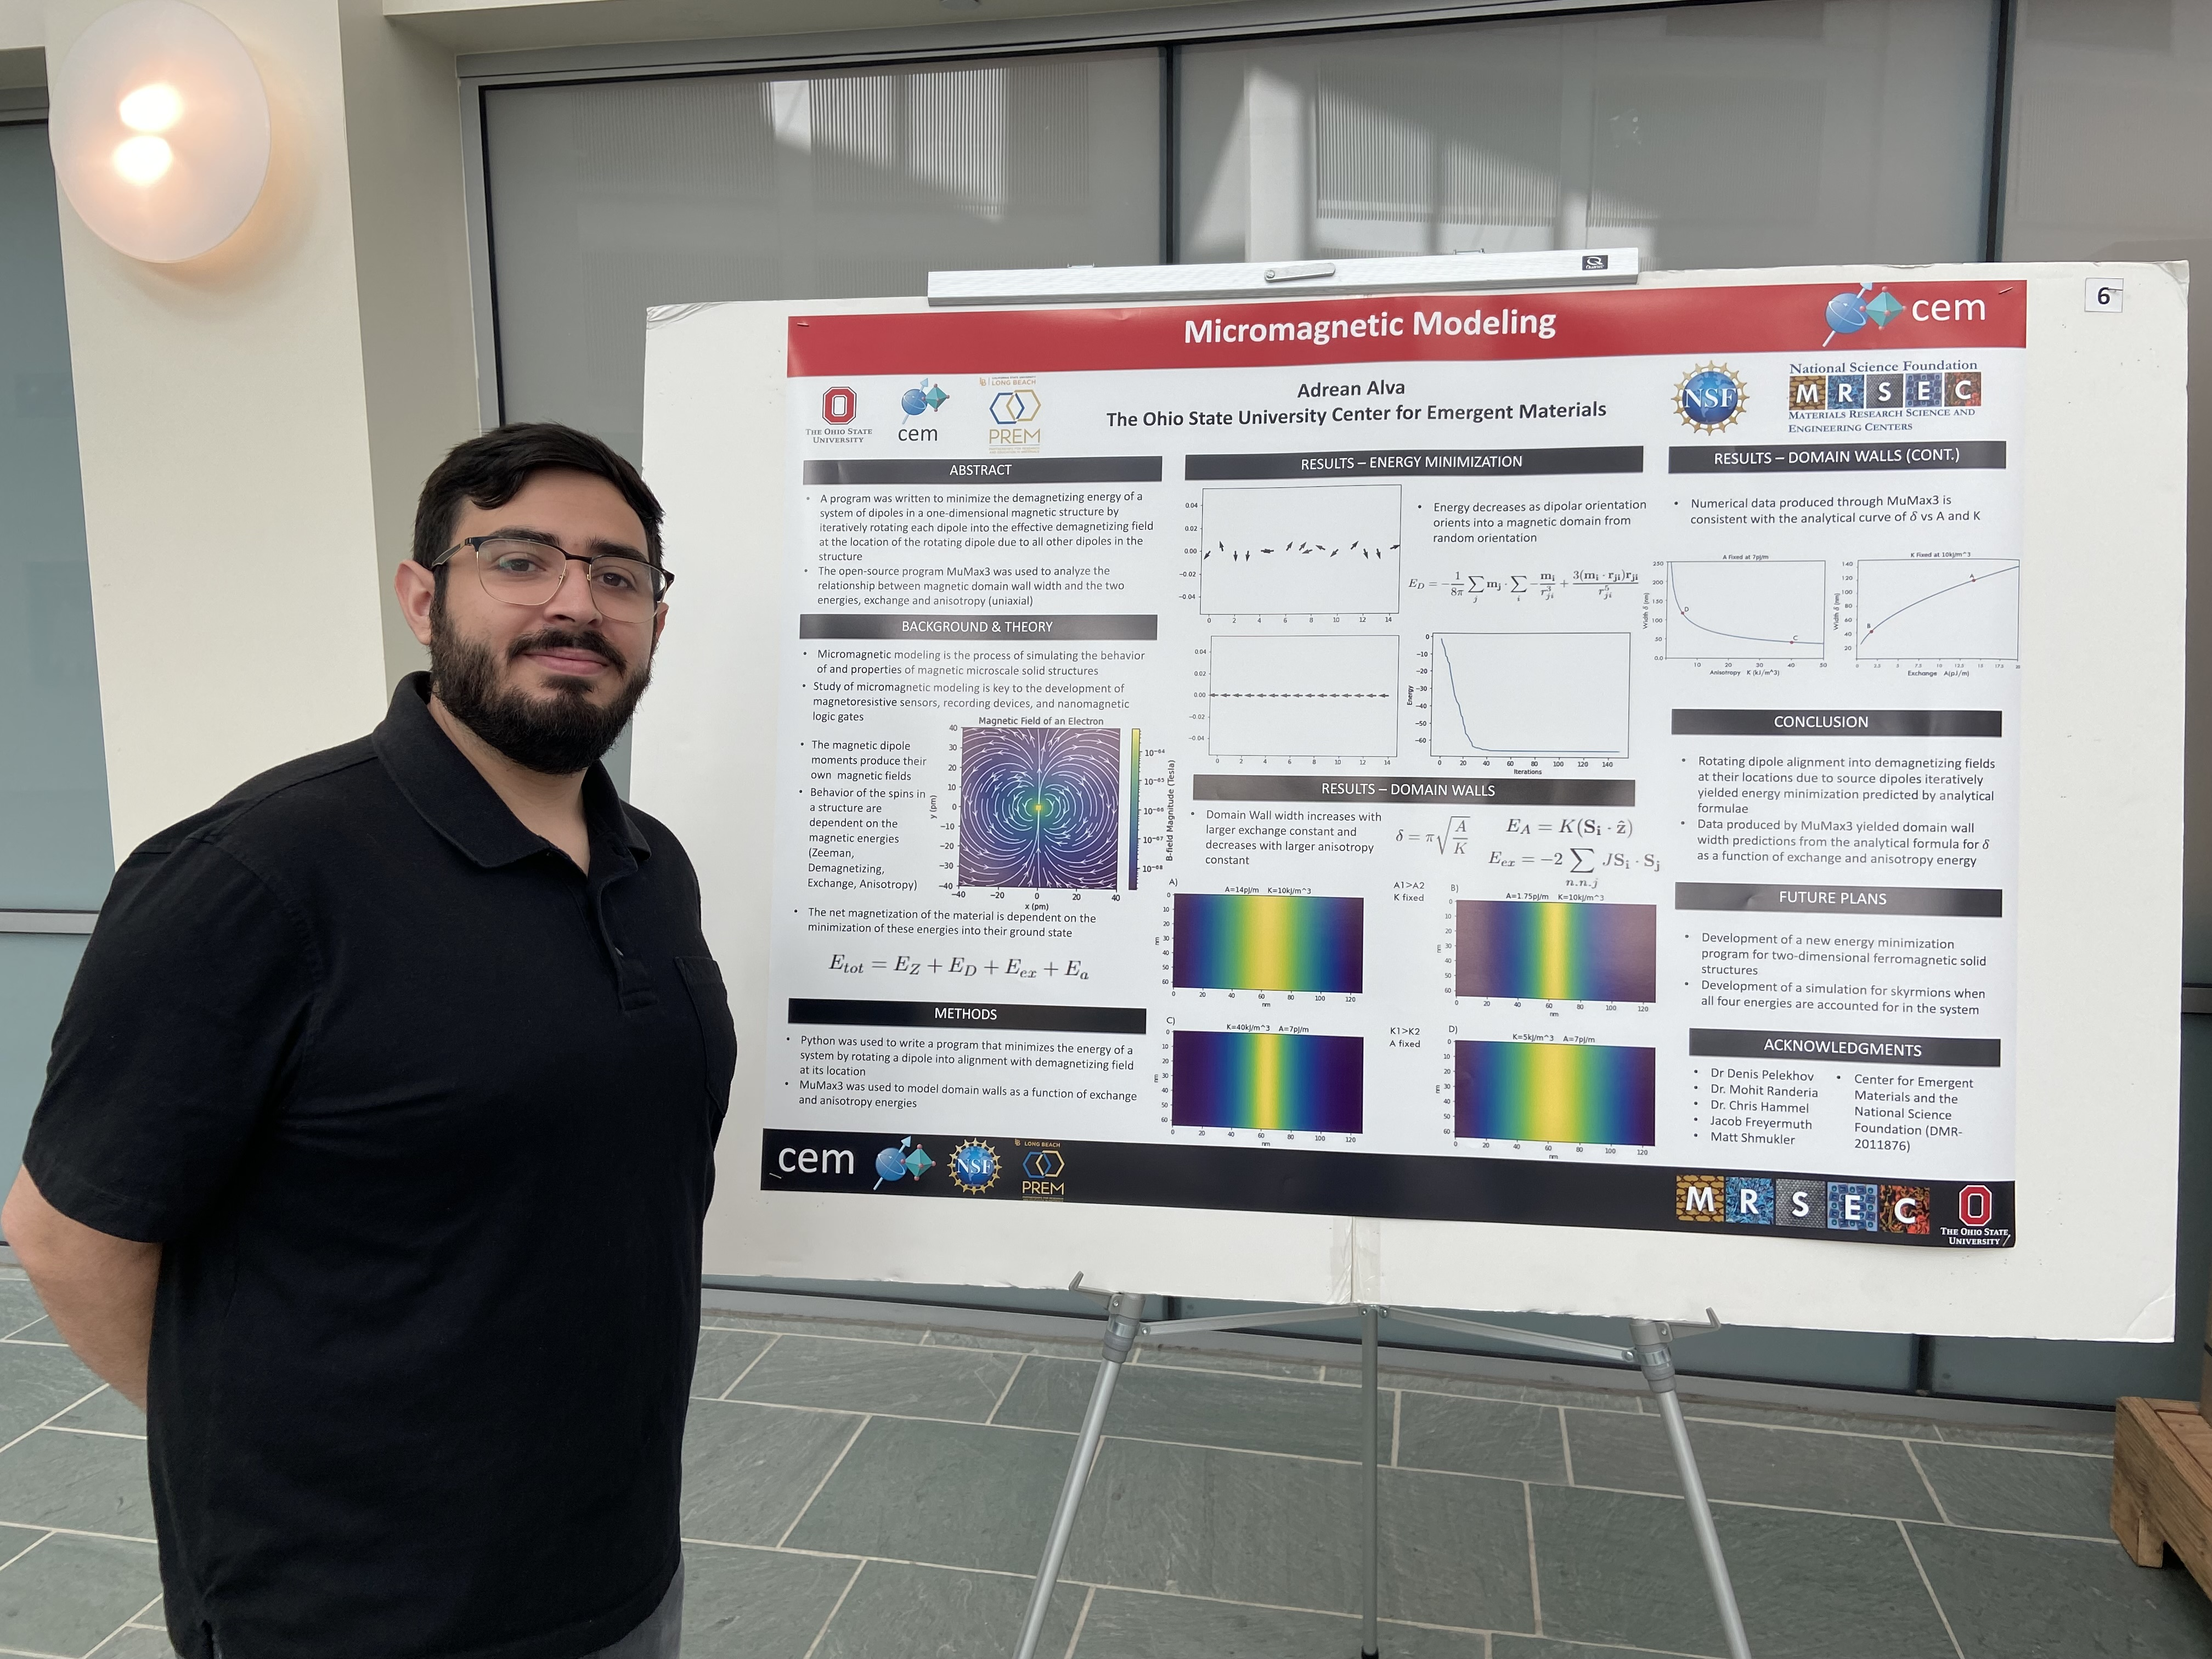
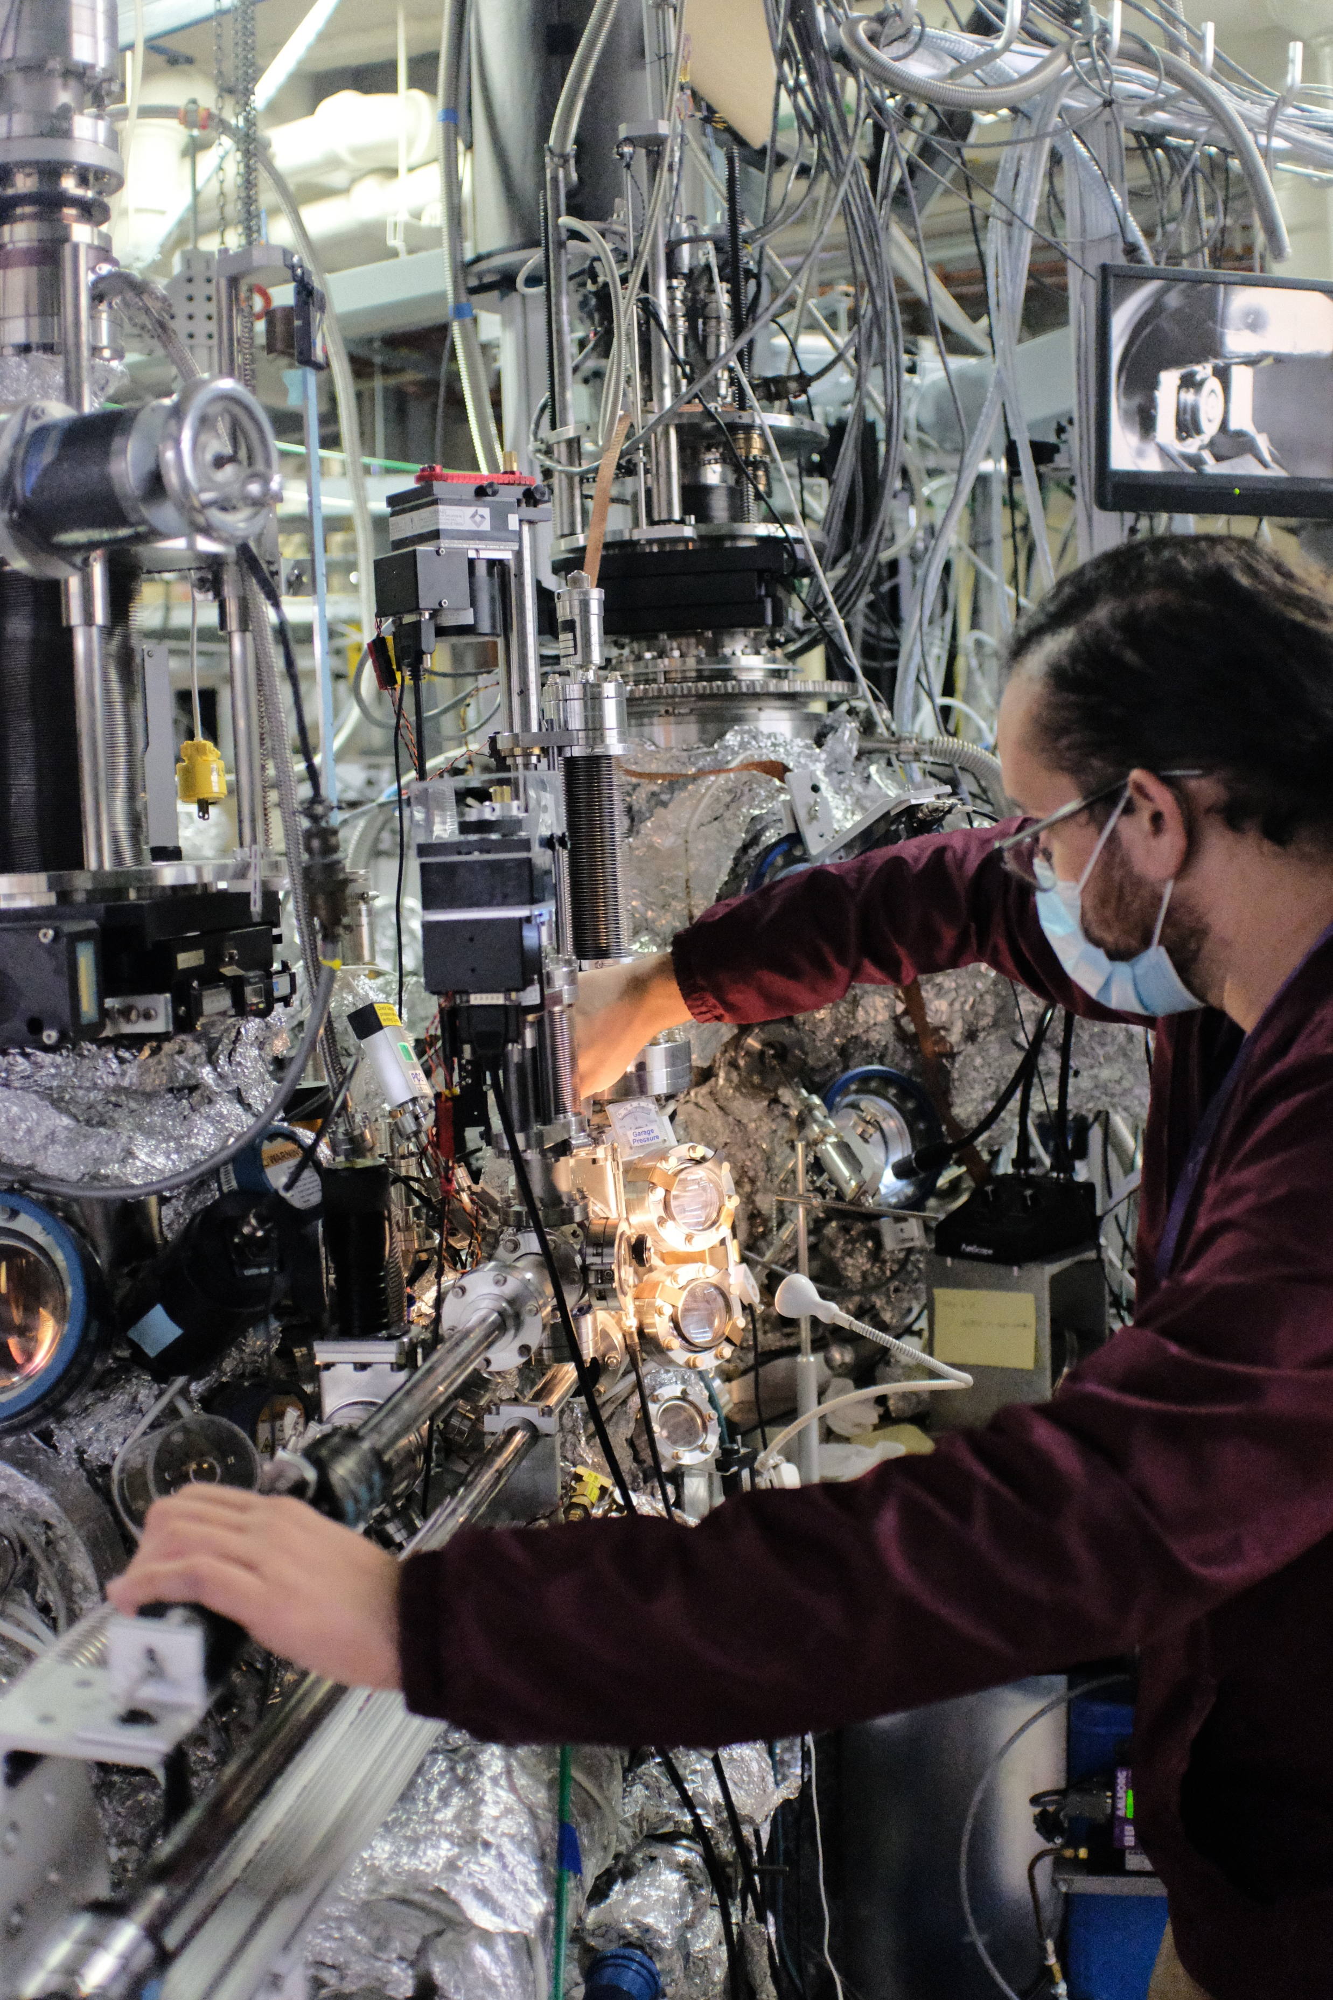
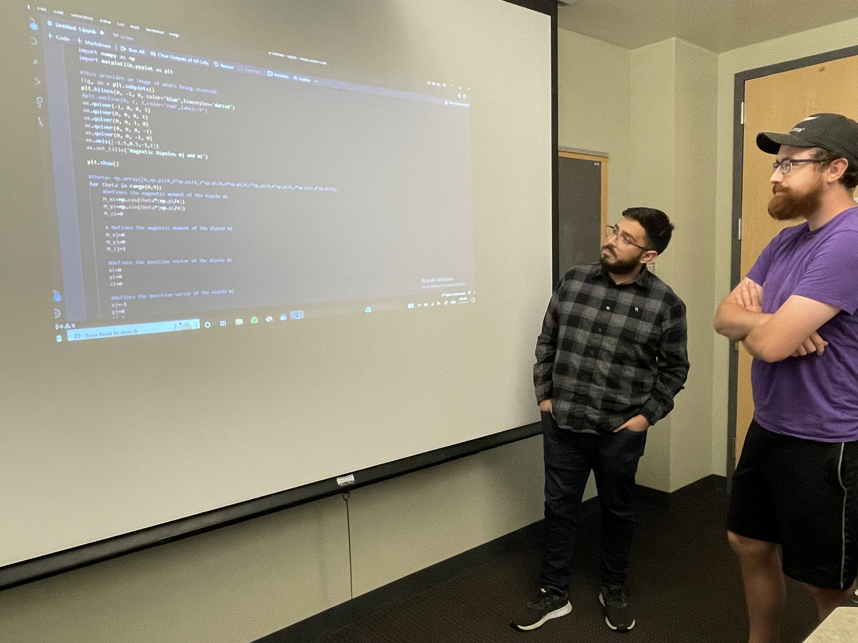
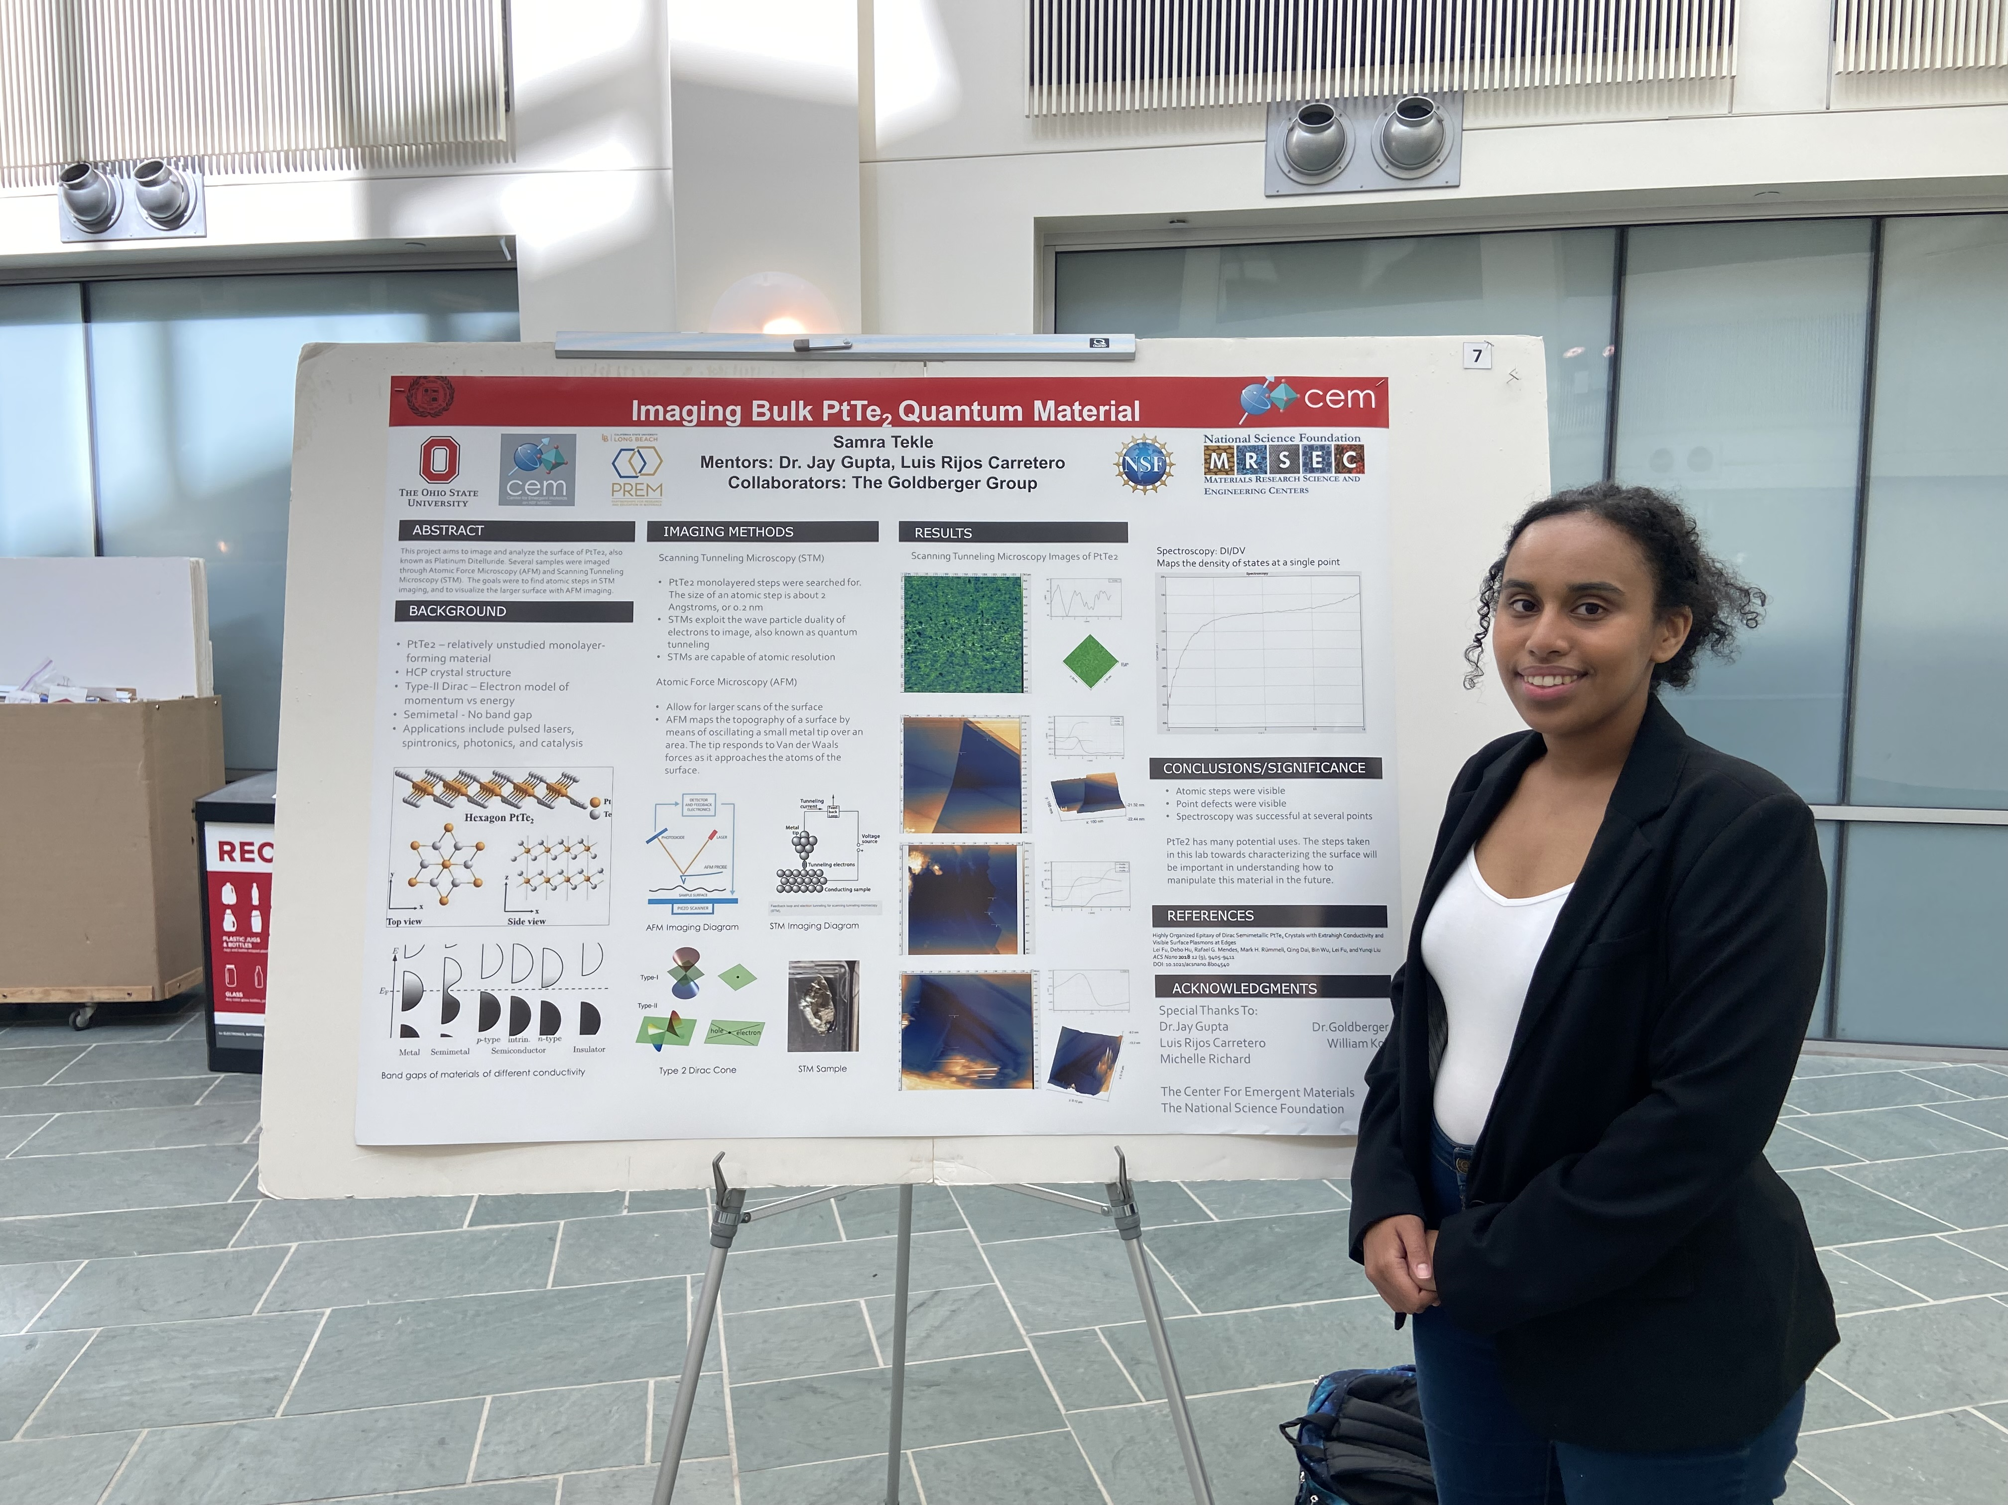
PREM: CSULB and OSU
Topologically driven phenomena in hard and soft condensed matter physics
DMR 2122199
Michael R. Peterson, California State University-Long Beach Foundation
In summer 2022, May 15 – July 23, three CSULB PREM UG students, Adam, Adrean, and Samra, attended the 10-week CEM REU program at OSU. Adam worked on defect assisted quantum tunneling using different types of hBN insulators in the Ezekiel Johnston-Halperin group. Adrean worked on computational modeling of magnetic thin films in Hammel’s group. Samra worked on imaging bulk PtTe₂ using STM in Gupta’s group.
In July 2022, CSULB PREM G students, Alejandro and co-PI Gu (CSULB) visited CEM and other PREM research labs at OSU. Alejandro used the FIB/SEM and RIE to modify nanosphere templates for his nanosphere lithography research on curved nanomagnetism at CSULB. Fanuel, CSULB PREM G student in Bill’s group also visited OSU in July 2022 to conduct and discuss his research.
In April 2022, Derek, in Ojeda-Aristizabal’s group, visited ALS to acquire ARPES data on the Cr_{x}Pt_{1-x}Te₂ materials fabricated in Goldberger’s group at OSU. Derek and Ivan attended the HEXT workshop at Cornell's CHESS synchrotron in May 2022.
(a)
(b)
(c)
(d)
(e)
(f)
(h)
(g)
(i)
(a) Fanuel discussing his research with Yohannes phD student at OSU, formal CSULB MS student. (b) Samra working on AFM in Jay Gupta’s group. (c) Adam working on optical microscope. (d) Adam presenting REU research at OSU. (e) Alejandro using Reactive Ion Etching machine at CEM OSU.(f) Derek at the ALS acquiring ARPES data on the Cr_{x}Pt_{1-x}Te₂ materials. (f) Adrean discussing his micromagnetic simulation with his OSU G student mentor, Jacob Freyermuth. (h) Adrean presenting REU research at OSU. (i) Samra presenting REU research at OSU.

