Slide 1
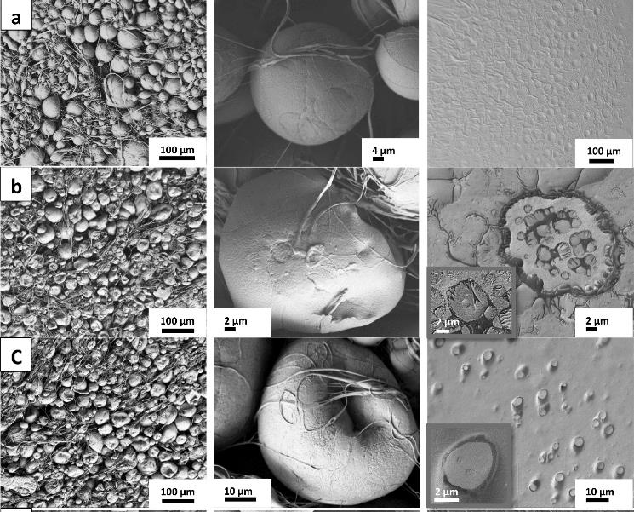
UTRGV-UMN PARTNERSHIP to Strengthen the PREM Pathway
DMR 2122178
Karen Lozano, The University of Texas Rio Grande Valley
The main focus of IRG 1 is to gain knowledge on ability to tailor and control the internal structure of nanofibers and its systems. The team uses emulsions, polymer blends, block copolymers and adjustments to the processing parameters within the forcespinning process to develop unique structures with promising potential applications in many areas such as drug delivery, wound care, batteries, sensors and many more.
This figure shows SEM micrographs of PLA-alginate emulsions at different alginate concentrations. The formation of beads during the spinning depends on the properties of the emulsion and associated forces acting on them. Beads with irregular shapes; shrunk, depressions and deflated appearance are seen and reproduced as needed.
PLA-Alginate composite Bead Features Dried Emulsion
bead-fiber structures
E Ibrahim, s ahmed, K Taylor, Sk Hasan-Abir, V Padilla, K Lozano, “Emulsion based centrifugally spun multifunctional poly(lactic acid)-alginate fiber, based membrane composites” In review
E Ibrahim, s ahmed, K Taylor, Sk Hasan-Abir, V Padilla, K Lozano, “Emulsion based centrifugally spun multifunctional poly(lactic acid)-alginate fiber based membrane composites” In review

Slide 2
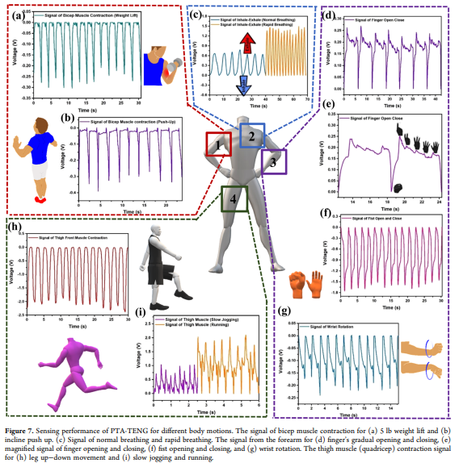
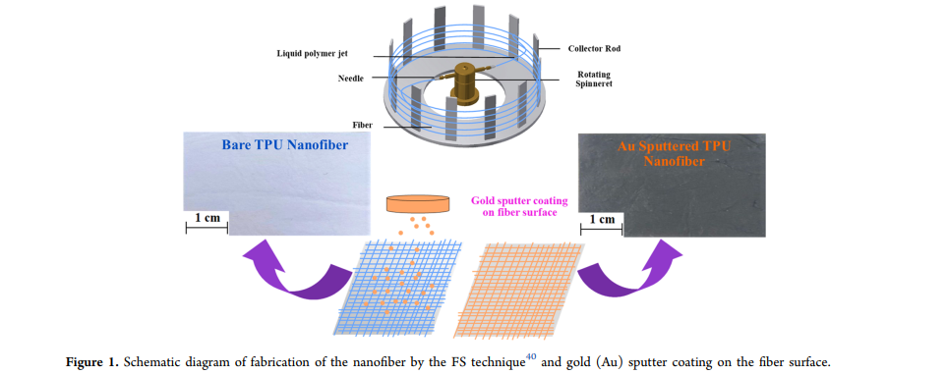
Sk SH Abir, MUl Sadaf, SK Saha, A Touhami, K Lozano, MJ Uddin, Nanofiber-Based Substrate for a Triboelectric Nanogenerator: High-Performance Flexible Energy Fiber Mats, ACS Applied Materials & Interfaces 2021, 13, 50, 60401-60412.
DMR 2122178
UTRGV-UMN PARTNERSHIP to Strengthen the PREM Pathway
Karen Lozano, The University of Texas Rio Grande Valley
Nanofiber-based triboelectric nanogenerator (TENG) with potential to be used as a cost-effective self-powered flexible body motion sensor.
The TENG was analyzed for sensory application by connecting to forearm, quadricep muscle, and chest, and it demonstrated capability for distinct human biomechanical motion-sensing application.
E Ibrahim, s ahmed, K Taylor, Sk Hasan-Abir, V Padilla, K Lozano, “Emulsion based centrifugally spun multifunctional poly(lactic acid)-alginate fiber based membrane composites” In review

Slide 3
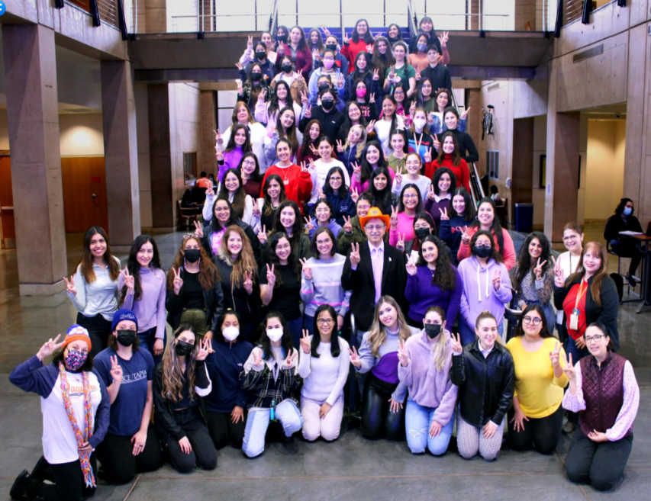
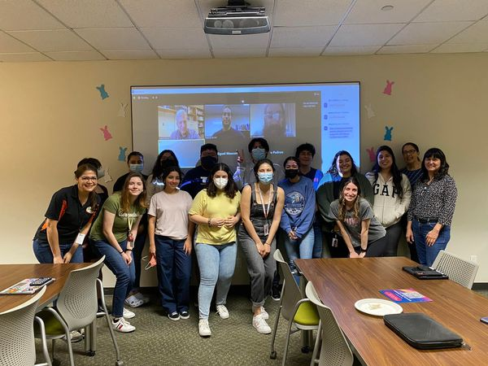
UTRGV-UMN PARTNERSHIP to Strengthen the PREM Pathway
DMR 2122178
Karen Lozano, The University of Texas Rio Grande Valley
The 2021-22 cycle was still slightly impacted by COVID 19 and a mixture of face to face and virtual activities were carried out. The PREM team remained highly active, numerous outreach activities were held for example presentations at Mother-daughter, visits to local schools, hosting k-12 on campus tours/activities and countless activities with our college students such as in the shown picture where PI Lozano, faculty advisor of SWE, presented to our female students on International Women’s day and the hybrid presentation given by UMN faculty.The PREM team also organized the 61th Regional Science and Engineering through a virtual platform. Winners are now about to travel to the Regeneron ISEF.
In this 1st year
56 students, 27 female (43 UG (41 URM) /13 MS (5 URM)) participated in research projects
12 peer reviewed journal articles were published, 11 with students/postdocs as coauthors.
14 students graduated (9 UG, 5 MS). 50% women and 71% URM
E Ibrahim, s ahmed, K Taylor, Sk Hasan-Abir, V Padilla, K Lozano, “Emulsion based centrifugally spun multifunctional poly(lactic acid)-alginate fiber based membrane composites” In review

