Slide 1
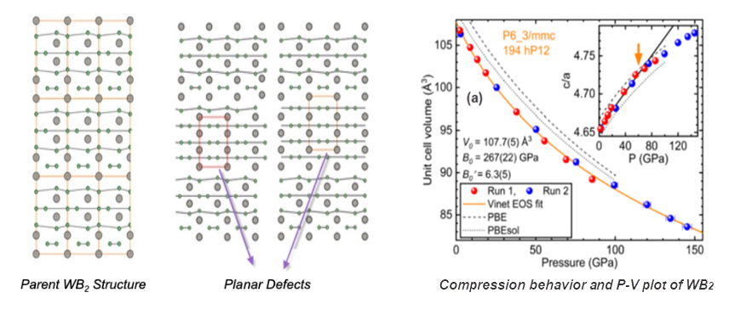
Ultrahard WB₂ Superconducts under Pressure
DMR 2119308
Russell J. Hemley, University of Illinois at Chicago
A unique combination of high-pressure structure and transport experiments, with crystal structure simulations has led to the discovery that ultrahard boride WB₂ becomes a superconductor under pressure.
Superconductivity emerges at 55 GPa, with a maximum T_{c} of 17 K at 91 GPa. No major structural change occurs; instead, mechanically induced stacking faults and twin boundaries appear in the parent structure as the material undergoes plastic deformation. This unprecedented creation of superconductivity through mechanically induced metastable defects unlocks new opportunities to look for other material systems in which metastable structures can be stabilized in the form of planar defects.
Such high-pressure synthesis provides a new route for designing ultrahard superconductors at ambient pressure through defect microstructures, that is, exhibiting novel properties as multifunctional materials with applications such as enhanced electrical transport in extreme environments.
J. Lim, A. C. Hire, Y. Quan, J. S. Kim, S. R. Xie, S. Sinha, R. S. Kumar, D. Popov, C. Park, R. J. Hemley, Y. K. Vohra, J. J. Hamlin, R. G. Hennig, P. J. Hirschfeld, and G. R. Stewart, Creating Superconductivity in WB₂ through Pressure-induced Metastable Planar Defects, Nature Communications 13, 7901 (2022) DOI: http://dx.doi.org/10.1038/s41467-022-35191-8
DMREF-2118718, 2119308
Notes:
Additional notes for DMREF staff would be very helpful here. This might include important technical details, further elaborations of the results, the abstract of the paper where these are published, explanations of acronyms and abbreviations, or whatever else you consider useful. Videos that can enhance understanding for a general audience are welcome.

