Slide 1
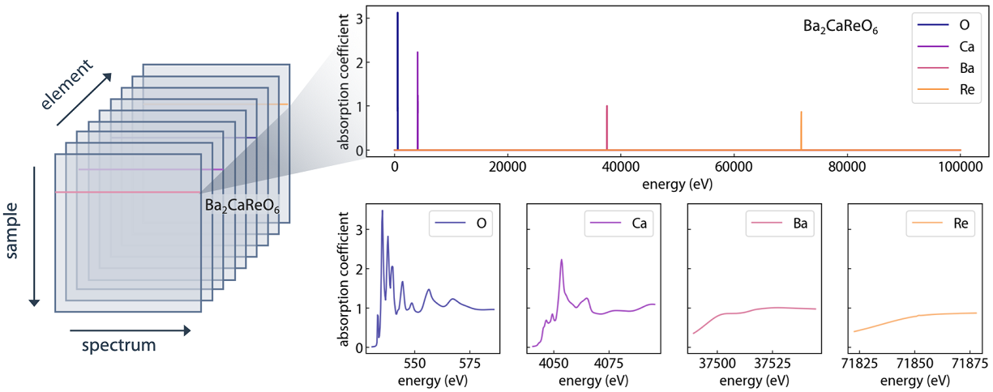
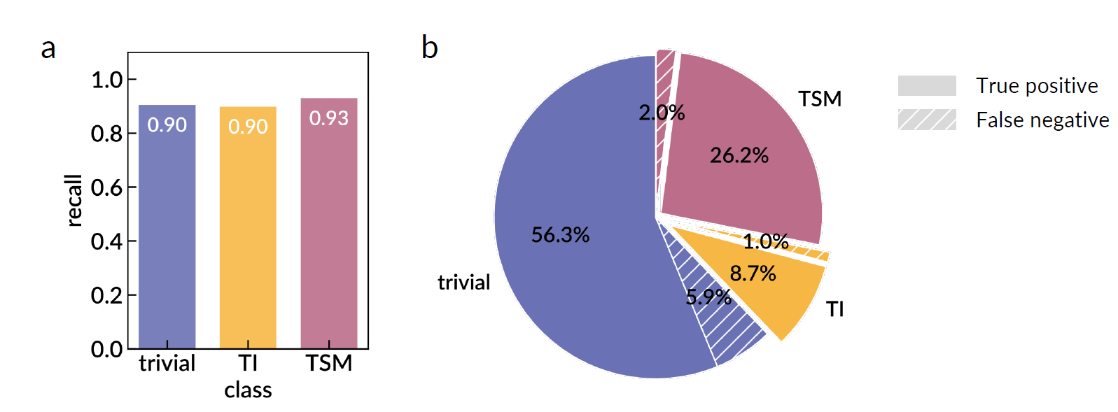
Machine-learning Spectral Indicators of Topology
DMR 2118523
Bolin Liao, University of California-Santa Barbara
Topological materials are promising for next-generation energy and information applications. However, the experimental determination of topology can be painstaking, with a few limitations such as limited sample types, high technical barriers, and limited sample environment.
In this work, by designing a machine learning architecture to analyze simple X-ray absorption spectra, materials’ topological class can be determined with over 90% accuracy. This enables the topological determination of new topological materials with much reduced technical barriers in broader types of material candidates, and facilitates study of other phenomena like topological phase transition and amorphous topological materials
N. Andrejevic, J. Andrejevic, B. A. Bernevig, N. Regnault, F. Han, G. Fabbris, T. Nguyen, N. C. Drucker, C. H. Rycroft, and M. Li, Machine-Learning Spectral Indicators of Topology, Advanced Materials 2204113 (2022) DOI: http://dx.doi.org/https://doi.org/10.1002/adma.202204113
The data structure (upper) and the main results (lower) of the model performance classifying topology from X-ray absorption spectroscopy.
DMREF-2118448
Notes:
The first step to study a topological material is to tell whether or not the material is topological. However, this step is nontrivial, often combining extensive calculations and sophisticated experiments. The work, led by Nina and her twin sister Jovana, combines X-ray absorption, a simple spectroscopy, with machine learning to form a spectral indicator to tell if a material is a topological insulator, a topological semimetal, or topologically trivial with 90%+ accuracy. It picks up missing materials from high-through topo quantum chemistry approach like Weyl semimetals, and passes experimental test. Using this model, we also made a list prediction of other new topological materials.
Paper link: https://onlinelibrary.wiley.com/doi/full/10.1002/adma.202204113

Slide 2
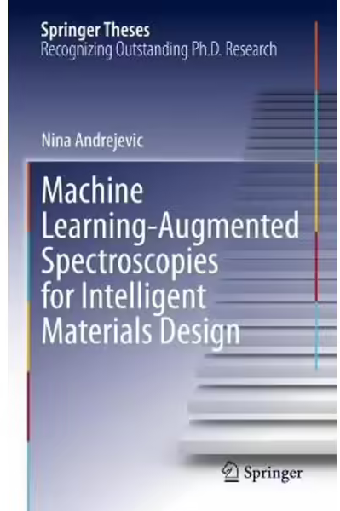
Graduate Training in
Machine Learning for Materials Design
DMR 2118523
Bolin Liao, University of California-Santa Barbara
The DMREF research work, led by Dr. Nina Andrejevic, a female material scientist in Mingda Li’s group, was a critical component in Nina’s Doctoral Thesis, titled “Machine Learning-Augmented Spectroscopies for Intelligent Materials Design”.
The thesis was subsequently selected and published by Springer as part of the Springer Theses series in 2022, in “Recognizing Outstanding PhD Research.”
Nina was also supported by NSF’s Graduate Research Fellowships Program (GRFP). Greatly indebted to NSF support, Nina is continuing her research through a competitive postdoctoral fellowship at Argonne National Laboratory.
The book cover of the published Thesis by Dr. Nina Andrejevic.
https://link.springer.com/book/10.1007/978-3-031-14808-8
DMREF-2118448
Notes:
MIT News highlight of the student: https://news.mit.edu/2022/fast-tracking-search-energy-efficient-materials-nina-andrejevic-0130
Argonne News highlight of the student: https://www.anl.gov/article/argonne-announces-2022-maria-goeppert-mayer-fellows-honoring-the-legacy-of-the-physics-nobel

Slide 3
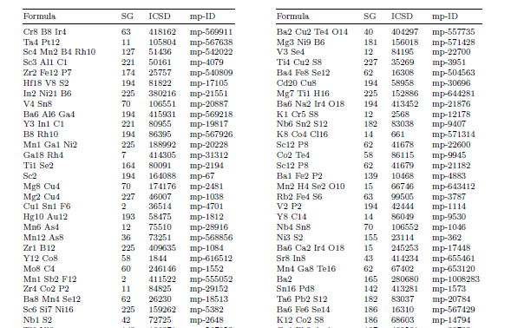
Data Driven Discovery of Topological Phononic Materials
DMR 2118523
Bolin Liao, University of California-Santa Barbara
This DMREF project has demonstrated an alternative avenue for the prediction of new topological materials from simple spectroscopic features, addressing the DMREF value of “significantly accelerate materials discovery and development”. In particular, the synergy of machine-learning modeling with the experimental validation addresses the DMREF concept to “work synergistically in a closed loop fashion.” The broadening of materials candidates further supports the DMREF mission to foster the “translation of materials research toward application”.
Partial list of newly predicted topological materials using their X-ray absorption spectra.
DMREF-2118448

