Slide 1
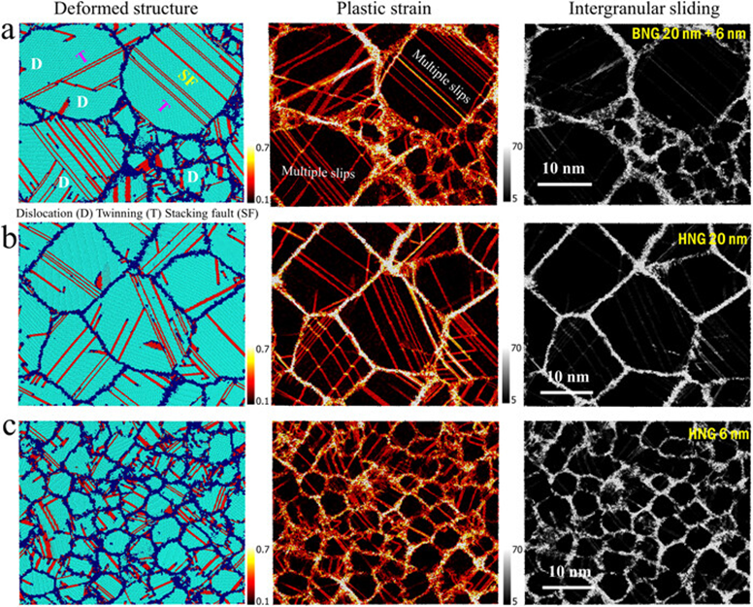
Strength softening mitigation in bimodal nanostructured metals
2022 Intellectual Merit
DMR 2105328
Penghui Cao, University of California-Irvine
We found strength softening of nanostructured metal can be tailored and mitigated by tuning structural heterogeneity and grain size uniformity
The enhanced intragranular slip, extra dislocation storage, and reduced grain boundary sliding are responsible for the strength softening mitigation (Figure)
The findings signifying the role of grain size non-uniformity on crystal plasticity shed light on a broad class of heterogeneous structured materials with improved strength and ductility
Wang H., Cao P. "Strength softening mitigation in bimodal structured metals" Journal of Applied Physics, 131, 045102 (2022). https://doi.org/10.1063/5.0075475

Slide 2
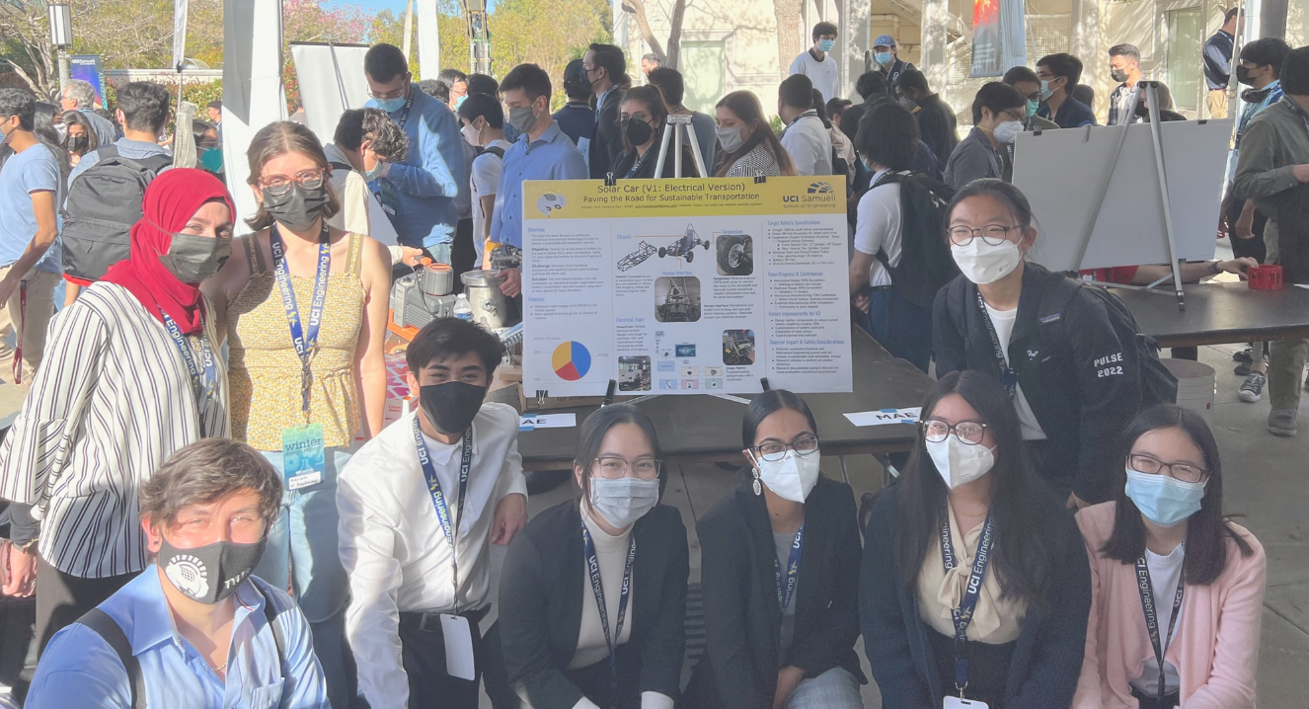
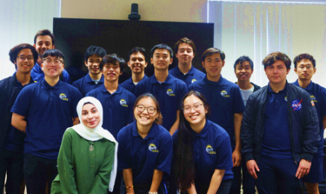
Strength softening mitigation in bimodal nanostructured metals
2022 Broader Impacts
DMR-2105328, MMN
Penghui Cao, University of California-Irvine
Leveraging this funding resource, I advise and support a senior project (Solar Car) team at UC Irvine, consisting of 25 undergraduate students. Female and URMs undergraduate students are constantly encouraged to act in a leading role on the team and sub-teams. The front row in the Figures highlights my team manager and sub-team leads.
Organized one symposium focusing on Heterostructured and Gradient Metals at MS Annual Meeting & Exhibition in Anaheim, California, USA (2022)
Organizing one symposium focusing on chemical ordering in metals and alloys in San Diego, California, USA (2023)

