Slide 1
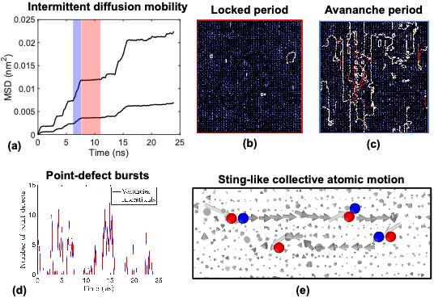
Thermodynamic and kinetics of interfaces in materials
2022 Intellectual Merit
DMR 2103431
Yuri Mishin, George Mason University
Point-defect avalanches mediate grain boundary diffusion
Goal: understand atomic mechanisms of accelerated atomic transport along grain boundaries (GBs) in metals.
Surprising result of atomistic simulations: strongly intermittent GB diffusion behavior and its system-size dependence unseen in previous work.
Avalanche-type generation of point defects causes spontaneous bursts of GB diffusivity mediated by highly cooperative atomic rearrangements.
The effect is explained by dynamic heterogeneity and dynamic facilitation in partially disordered systems.
The findings can significantly future computer modeling of GB diffusion and mass transport in nano-scale materials.
Notes:
The figure illustrates the intermittent diffusion in the Al Sigma=3 grain boundary (GB). (a) Example of atomic mean-square displacement as a function of time at the temperature 710 K (0.77 T_{m}). (b,c) Typical atomic displacement diagrams during the (b) locked and (c) avalanche time periods periods corresponding to the blue and red regions in (a). The arrows represent net displacements during time intervals of 1.2 ns and 3 ns and are colored by the displacement magnitude. Note the enhanced atomic mobility in the avalanche regime and only a few displaced atoms in the locked regime. (d) Peaks in the numbers of vacancies and interstitials correlate with the locked and avalanche time periods seen in (a). (e) Typical collective diffusion event involving Frenkel pairs. The arrows represent string-like atomic displacements during the time t = 80 ps colored in dark grey and light grey for displacements smaller and larger than the first-neighbor distance.

Slide 2
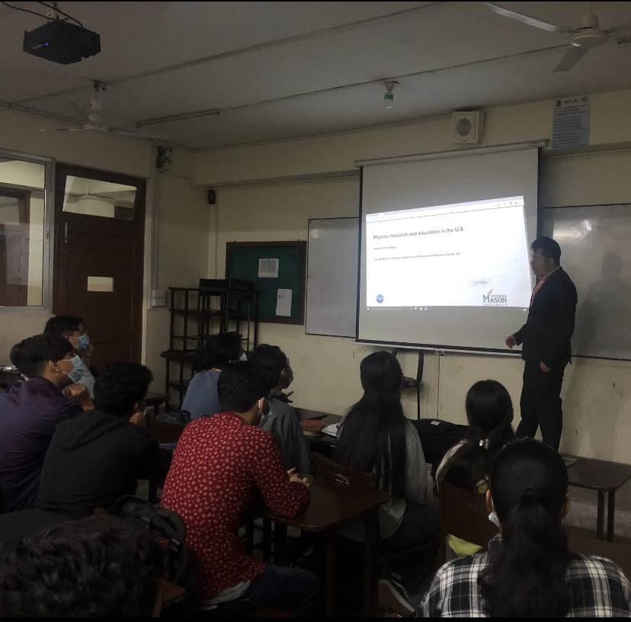
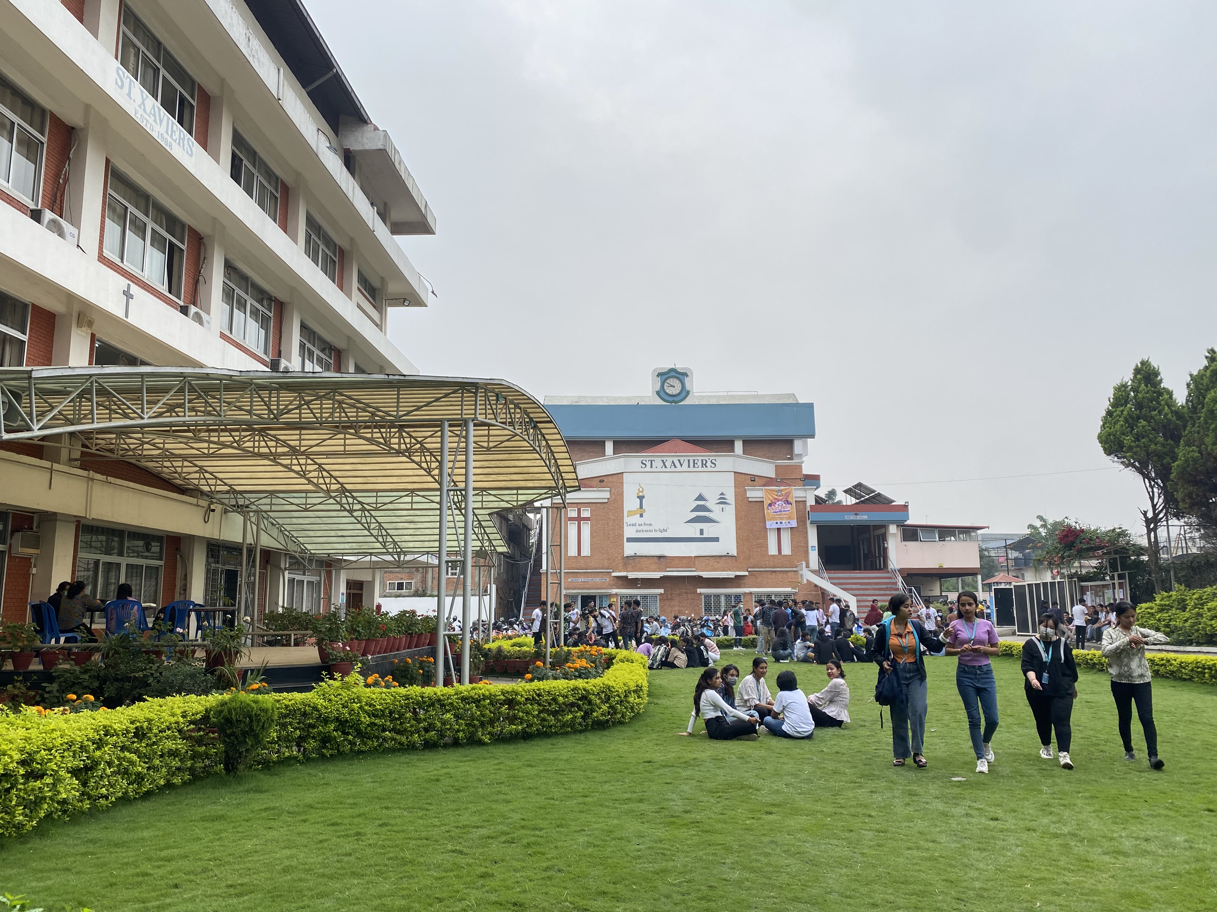
Thermodynamic and kinetics of interfaces in materials
2022 Broader Impacts
DMR-2103431, CMMT
Yuri Mishin, George Mason University
The graduate student and postdoc supported by this grant presented their research at the TMS-2022 conference. They also participated in several virtual seminars and workshops in computational materials science.
The PI is a co-organizer of The 10th International Conference on Multiscale Materials Modeling MMM-10 (Baltimore, MD, Oct. 2-7, 2022).
PhD student supported by this grant (Nishchal Thapa Magar) gave a series of presentations about his research and computational materials science in the USA to students in an undergraduate college in Nepal.
The PI and the postdoctoral researcher supported by this grant are guiding a research project of a local high-school student on grain boundary solute drag (Thomas Jefferson High School of Science and Technology, Alexandria, Virginia).
Conference co-organized by PI
Nishchal Thapa Magar (right) discusses his NSF sponsored research with students from St. Xavier’s undergraduate college in Nepal (left).

