Slide 1
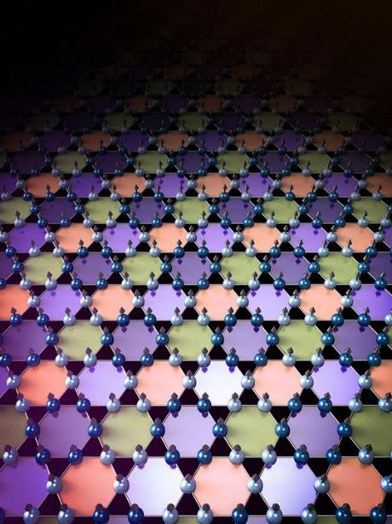
Interwoven: Charge and magnetism intertwine in kagome material
2022 Intellectual Merit
DMR 2100741
Pengcheng Dai, William Marsh Rice University
Discovery of charge and magnetism intertwining in kagome metal FeGe using a variety of techniques including neutron and X-ray scattering, angle-resolved photoemission spectroscopy, and transport measurement
Correlation, topology and magnetism come together to give rise to charge density wave
Serve as a unique example of charge density wave occurring at a much lower temperature than magnetism
Observe magnetism enhanced by charge density wave for the first time
X. K. Teng et al., Nature 609, 490 (2022).
J. X. Yin et al., Phys. Rev. Lett. 129, 166401 (2022).
Illustration courtesy of Jiaxin Yin, Ming Yi and Pengcheng Dai

Slide 2
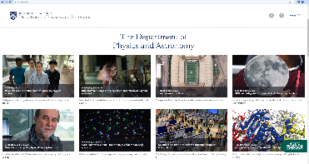
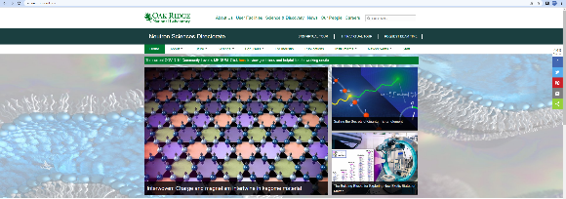
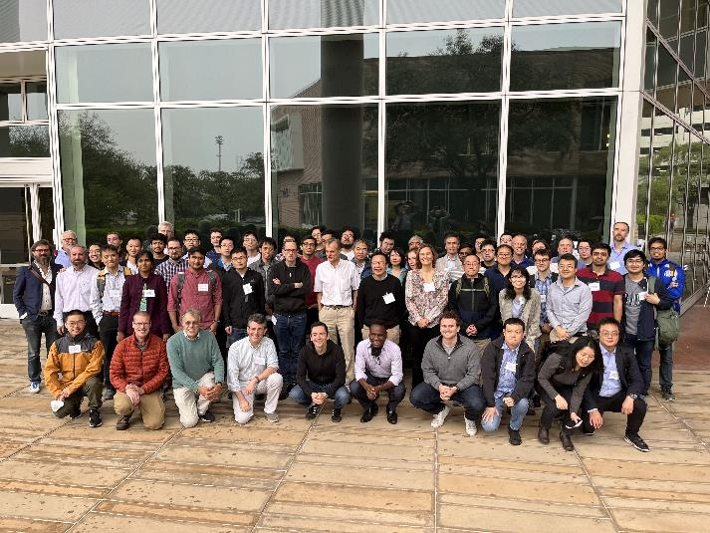
Interwoven: Charge and magnetism intertwine in kagome material
2022 Broader Impacts
DMR 2100741
Pengcheng Dai, William Marsh Rice University
The discovery of intertwining charge and magnetism has attracted media attention and covered as a front-page article at both Rice University and Oak Ridge National Lab (first and second figure on the first row).
The research was presented at Rice Center for Quantum Materials (RCQM) workshop (https://rcqm.rice.edu/events/120, the picture on the second row)
and the online version of APS March meeting, 2022
(https://meetings.aps.org/Meeting/MAR22/Session/S67.6)
The project is carried out with collaborations around the world. Sample growth and characterization was carried out by researchers at Rice University. Neutron scattering data was collected at Oak Ridge National Lab and Japan Proton Accelerator Research Complex. Angle-resolved photoemission spectroscopy was conducted at Advanced light source and National accelerator laboratory in collaboration with scientists in University of California, Berkeley. Transport measurement and Scanning Tunneling Microscopy, were performed at Washington University and Princeton University, respectively.

