Slide 1
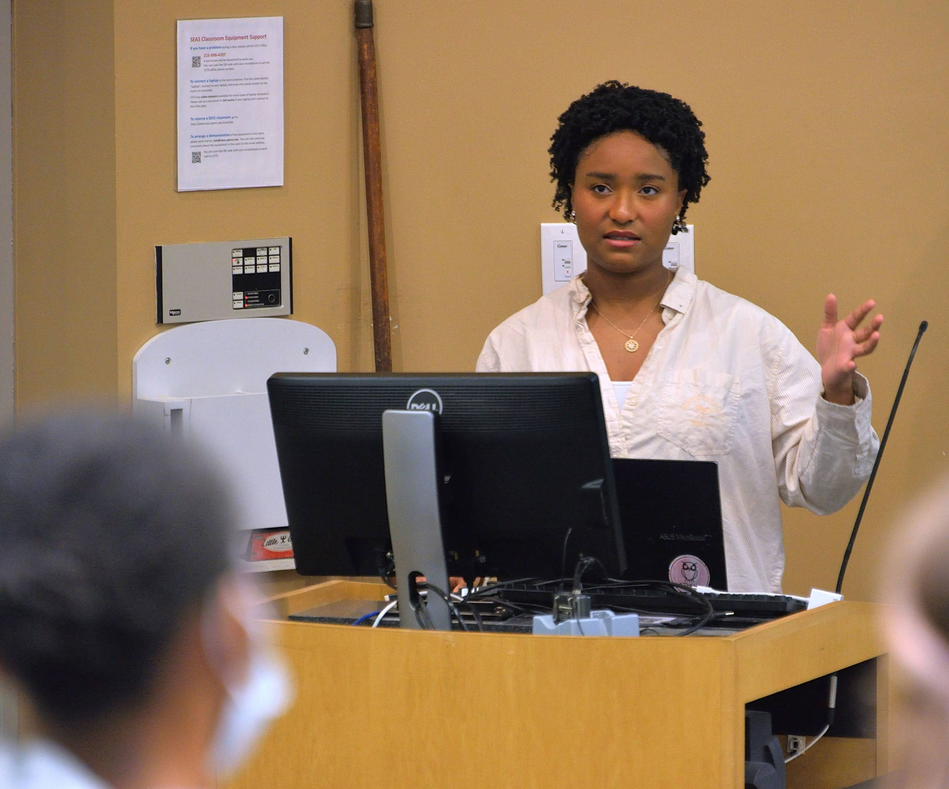
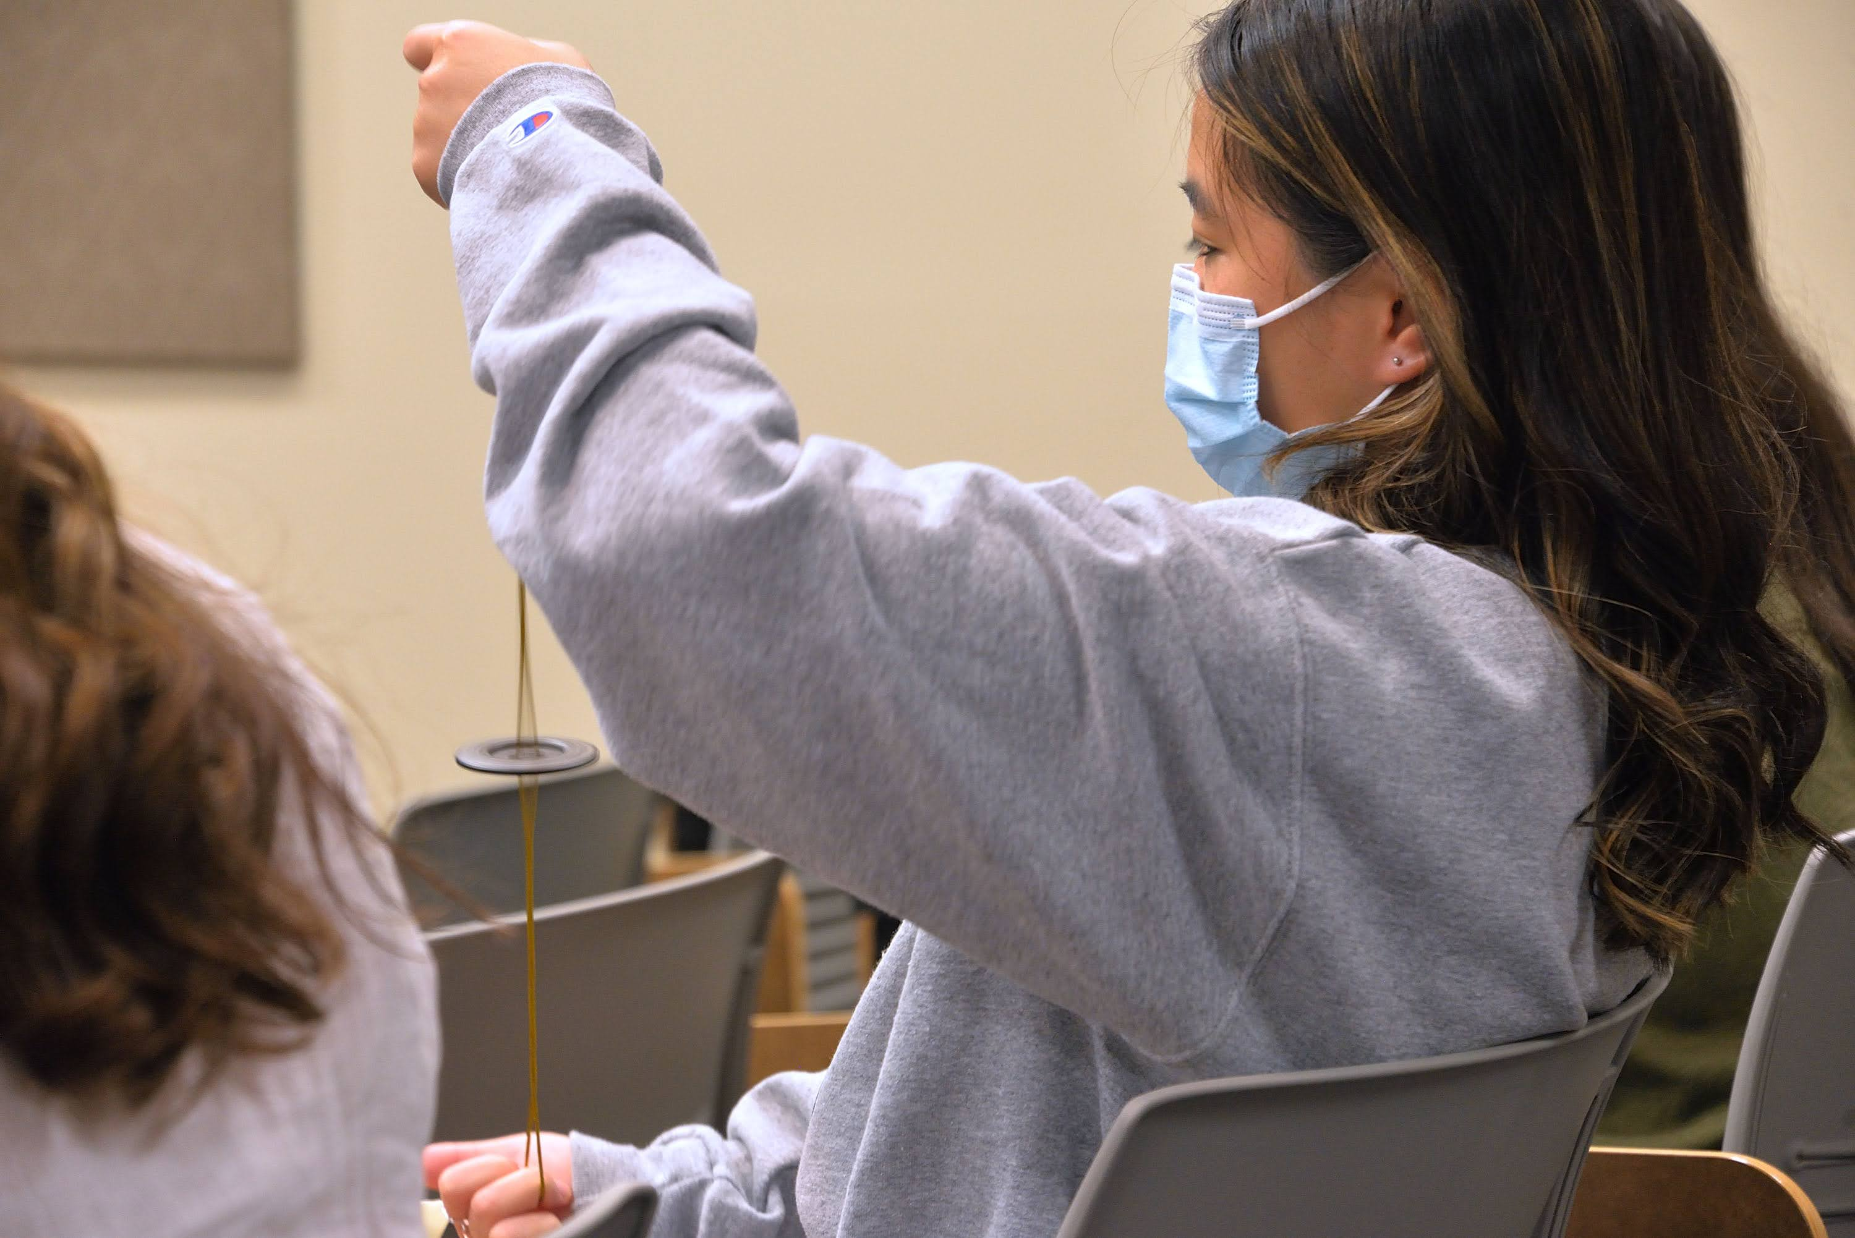
REU Site: Materials Research at the Laboratory for Research on the Structure of Matter (LRSM)
2022 Intellectual Merit
DMR 2050863
Eric A. Stach, University of Pennsylvania
Selected student participants of the Laboratory for Research on the Structure of Matter (LRSM) REU at the University of Pennsylvania (Penn) were grouped into pairs and integrated into active research groups of faculty affiliated with the LRSM, which has a tradition of excellence in materials research of all types. The REU program exposed students to the different areas of research that comprise the basic framework of a modern materials program. This summer, emphasis was placed on improving the students’ abilities to communicate their science to diverse audiences. One research pair (working with professors Paulo Arratia and Douglas Durian) implemented a clever way of demonstrating and simplifying the complex scientific concepts of their research project using a button and string that audience members could interact with.
Left: Courtney Jones, 2022 LRSM REU student, studying Mechanical Engineering at the University of Maryland Baltimore County, giving final presentation "Taut-Line Buzzers".
Right: REU student audience member using a hands-on demonstration implemented by the research pair.
Notes:
Please submit a separate Highlight for each DMR-funded project. Highlights should consist of two slides, one on Intellectual Merit and one on Broader Impacts. Please save only as .pptx or .ppt (not .pdf or .doc).
Report your most important finding this year.
Write it so it is comprehensible to non-experts.
Explain its impact and importance.
Consider bullet lists (if appropriate) rather than long, continuous text.
Since the text on the slide is brief and intended for non-experts, please add under Notes (below) a few more technical sentences on the accomplishment for use by DMR Program Directors. Feel free to include a reference.

Slide 2
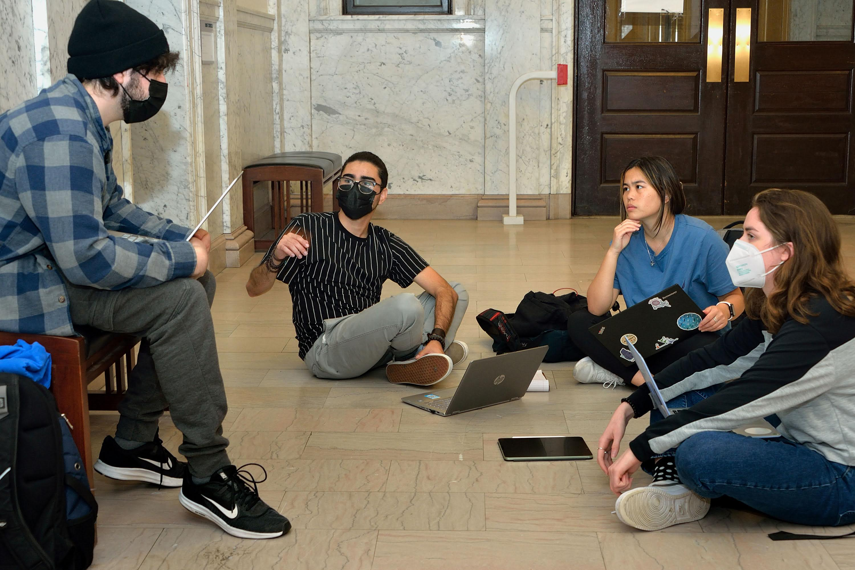
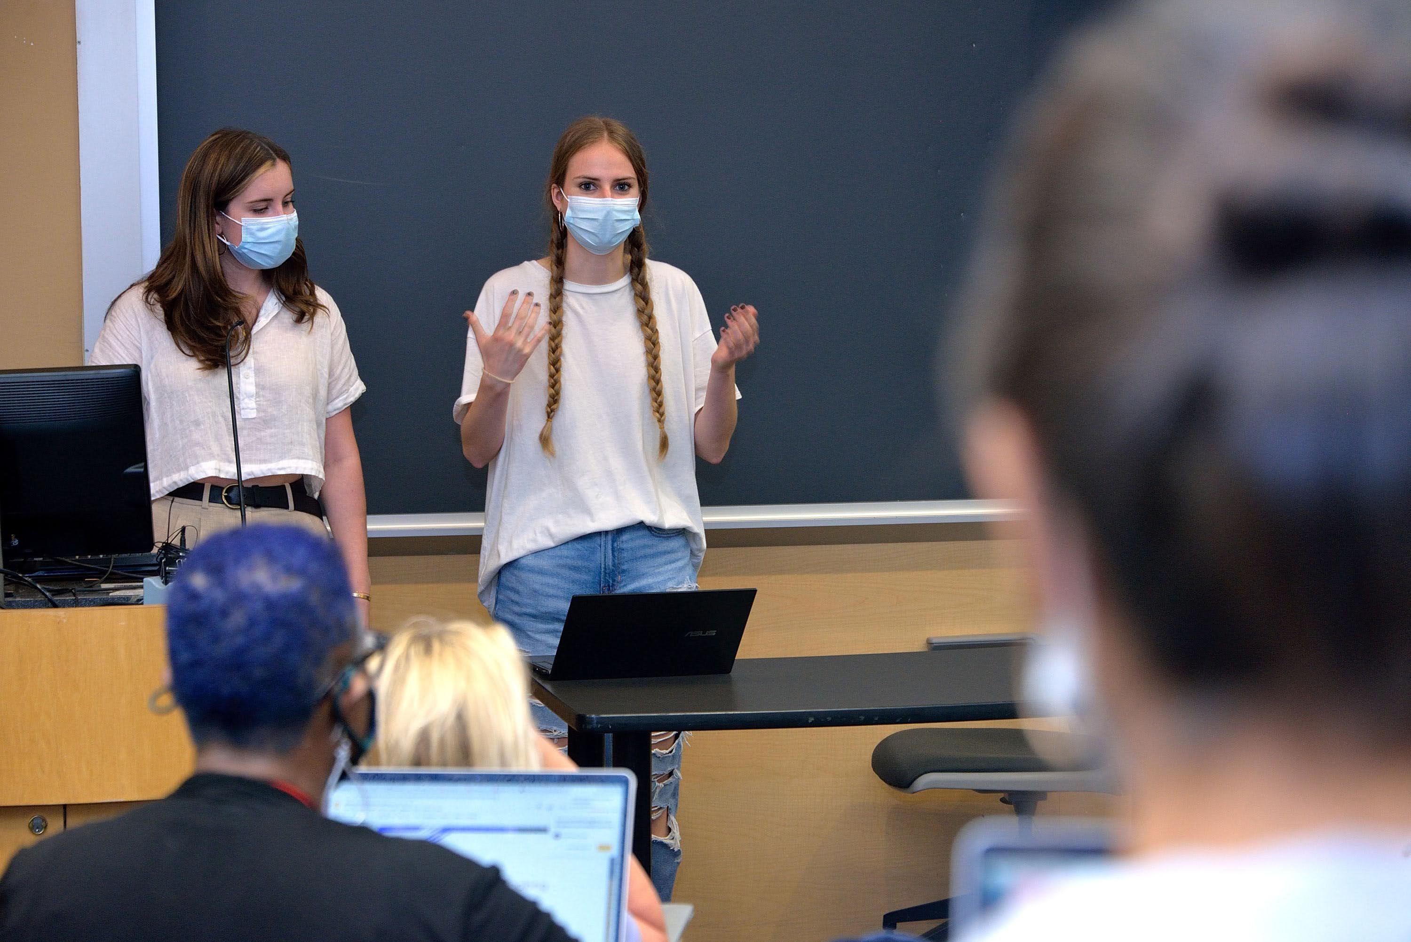
REU Site: Materials Research at the Laboratory for Research on the Structure of Matter (LRSM)
2022 Broader Impacts
DMR 2050863
Eric A. Stach, University of Pennsylvania
This summer, the Laboratory for Research on the Structure of Matter (LRSM) at the University of Pennsylvania (Penn) hosted 20 REU students for an in-person research program. Ten of these students were supported by the REU-Site grant. Of the 20 REU students, 90% came from under-represented groups in science, 35% were underrepresented minorities, 65% were women, and 5% (i.e. one student) with a disability. Four students came from various branches of the University of Puerto Rico, one from a Historically Black College, and one from a Minority Serving Institution. Finally, 15% of the students were the first college students in their families and 35% received Pell grants.
Weekly blocks of time were dedicated to building students’ ability to communicate their research not only to peers, but to younger audiences. This began with a Machine Learning workshop in which the students worked in small groups to learn how to simplify complex topics (like machine learning) so that younger audiences could also understand.
Left: A group of REU students brainstorming and preparing their presentation after the Machine Learning lesson.
Right: REU participants Caroline Harms (left) and Victoria Kyveryga (right) presenting after the Machine Learning lesson as part of the Science Communication Workshop.
Notes:
PLEASE REMEMBER TO SAVE YOUR FILE
AS FOLLOWS:
“Award number_(underscore) Last name.pptx”
(or .ppt),
e.g. 2067890_Smith.pptx

