Slide 1
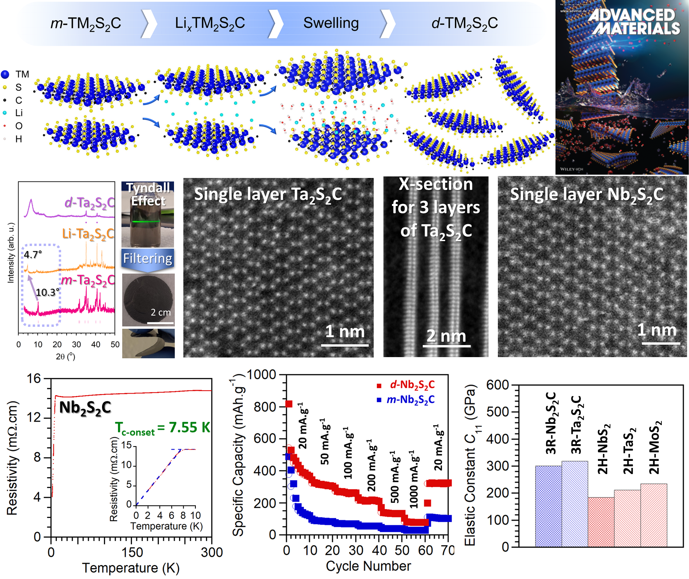
New Family of 2D Transition Metal Carbo-Chalcogenides
2022 Intellectual Merit
DMR 2048164
Michael Naguib, Tulane University
During the 1st year of the project a new family of two-dimensional (2D) transition metal carbo-chalcogenides (TMCC) was developed. First two examples for TMCCs are Nb₂S₂C and Ta₂S₂C were published in Advanced Materials and highlighted as a cover for the journal issue.^{(*)}
TMCC can be considered as a merge between 2D TM dichalcogenides (TMDCs) and 2D TM carbides (MXenes) as they have the electrochemically active surface of TMDCs and electrically conductive core of MXenes, reaching new paradigms.
Nb₂S₂C exhibit superconductivity
TMCCs were produced by inserting lithium ions between the layers electrochemically followed by simple agitation in water to separate the layers from each others.
The new 2D materials can store more than double the Li that can be stored by their 3D counterparts.
The new TMCC are 50% stronger than their TMDCs counterparts.
(*) A. Majed, et al. "Transition Metal Carbo‐Chalcogenide “TMCC”: A New Family of 2D Materials." Advanced Materials 2022, 34, 2200574.

Slide 2
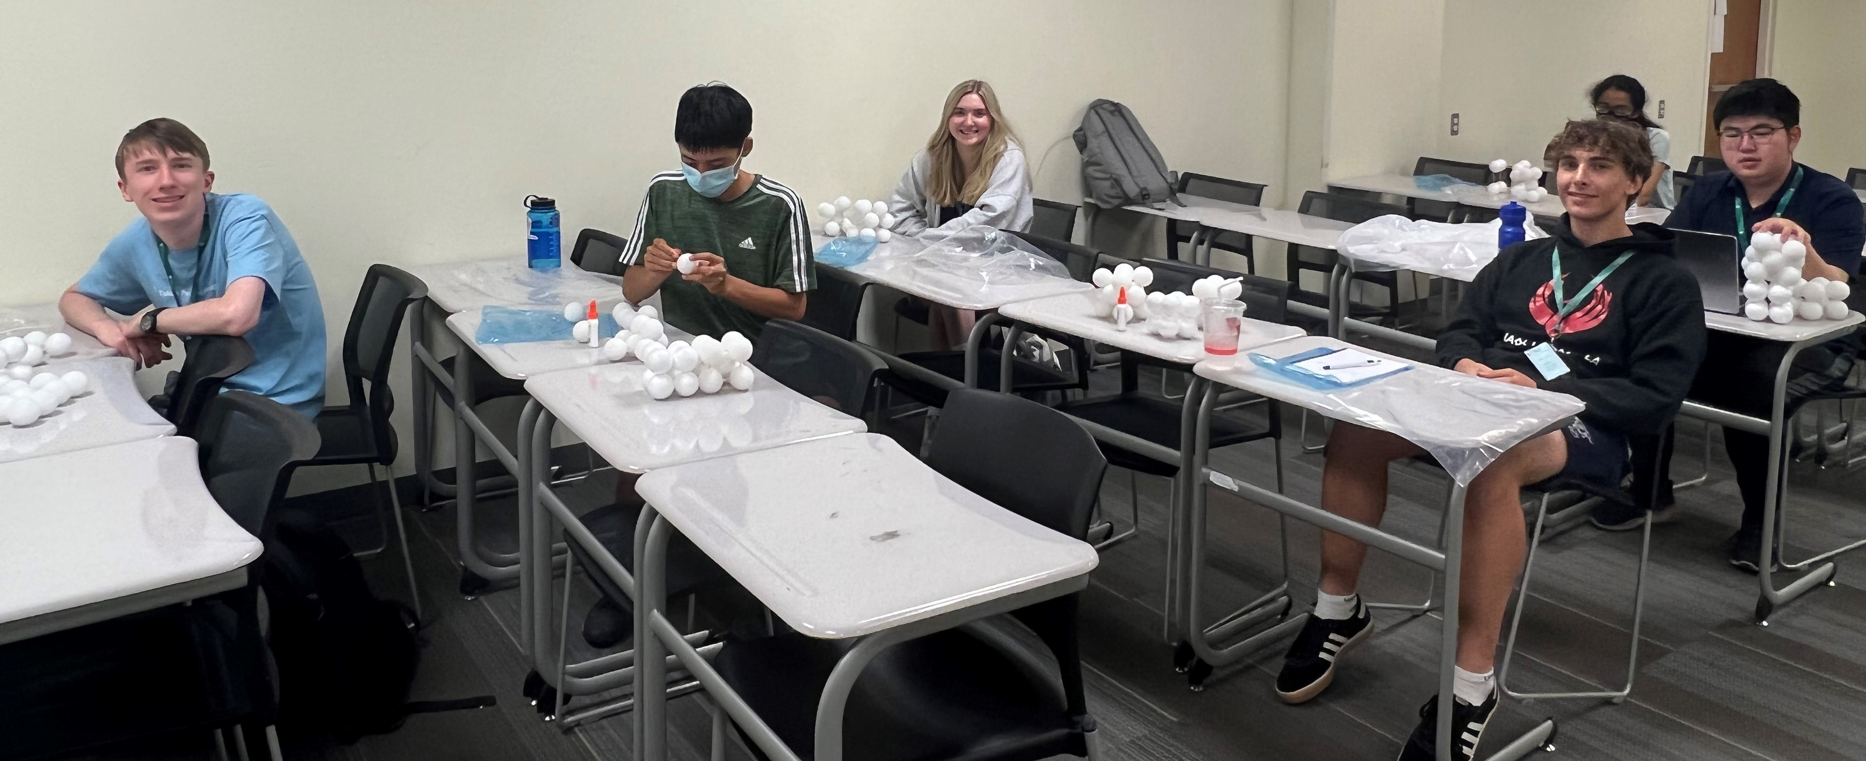
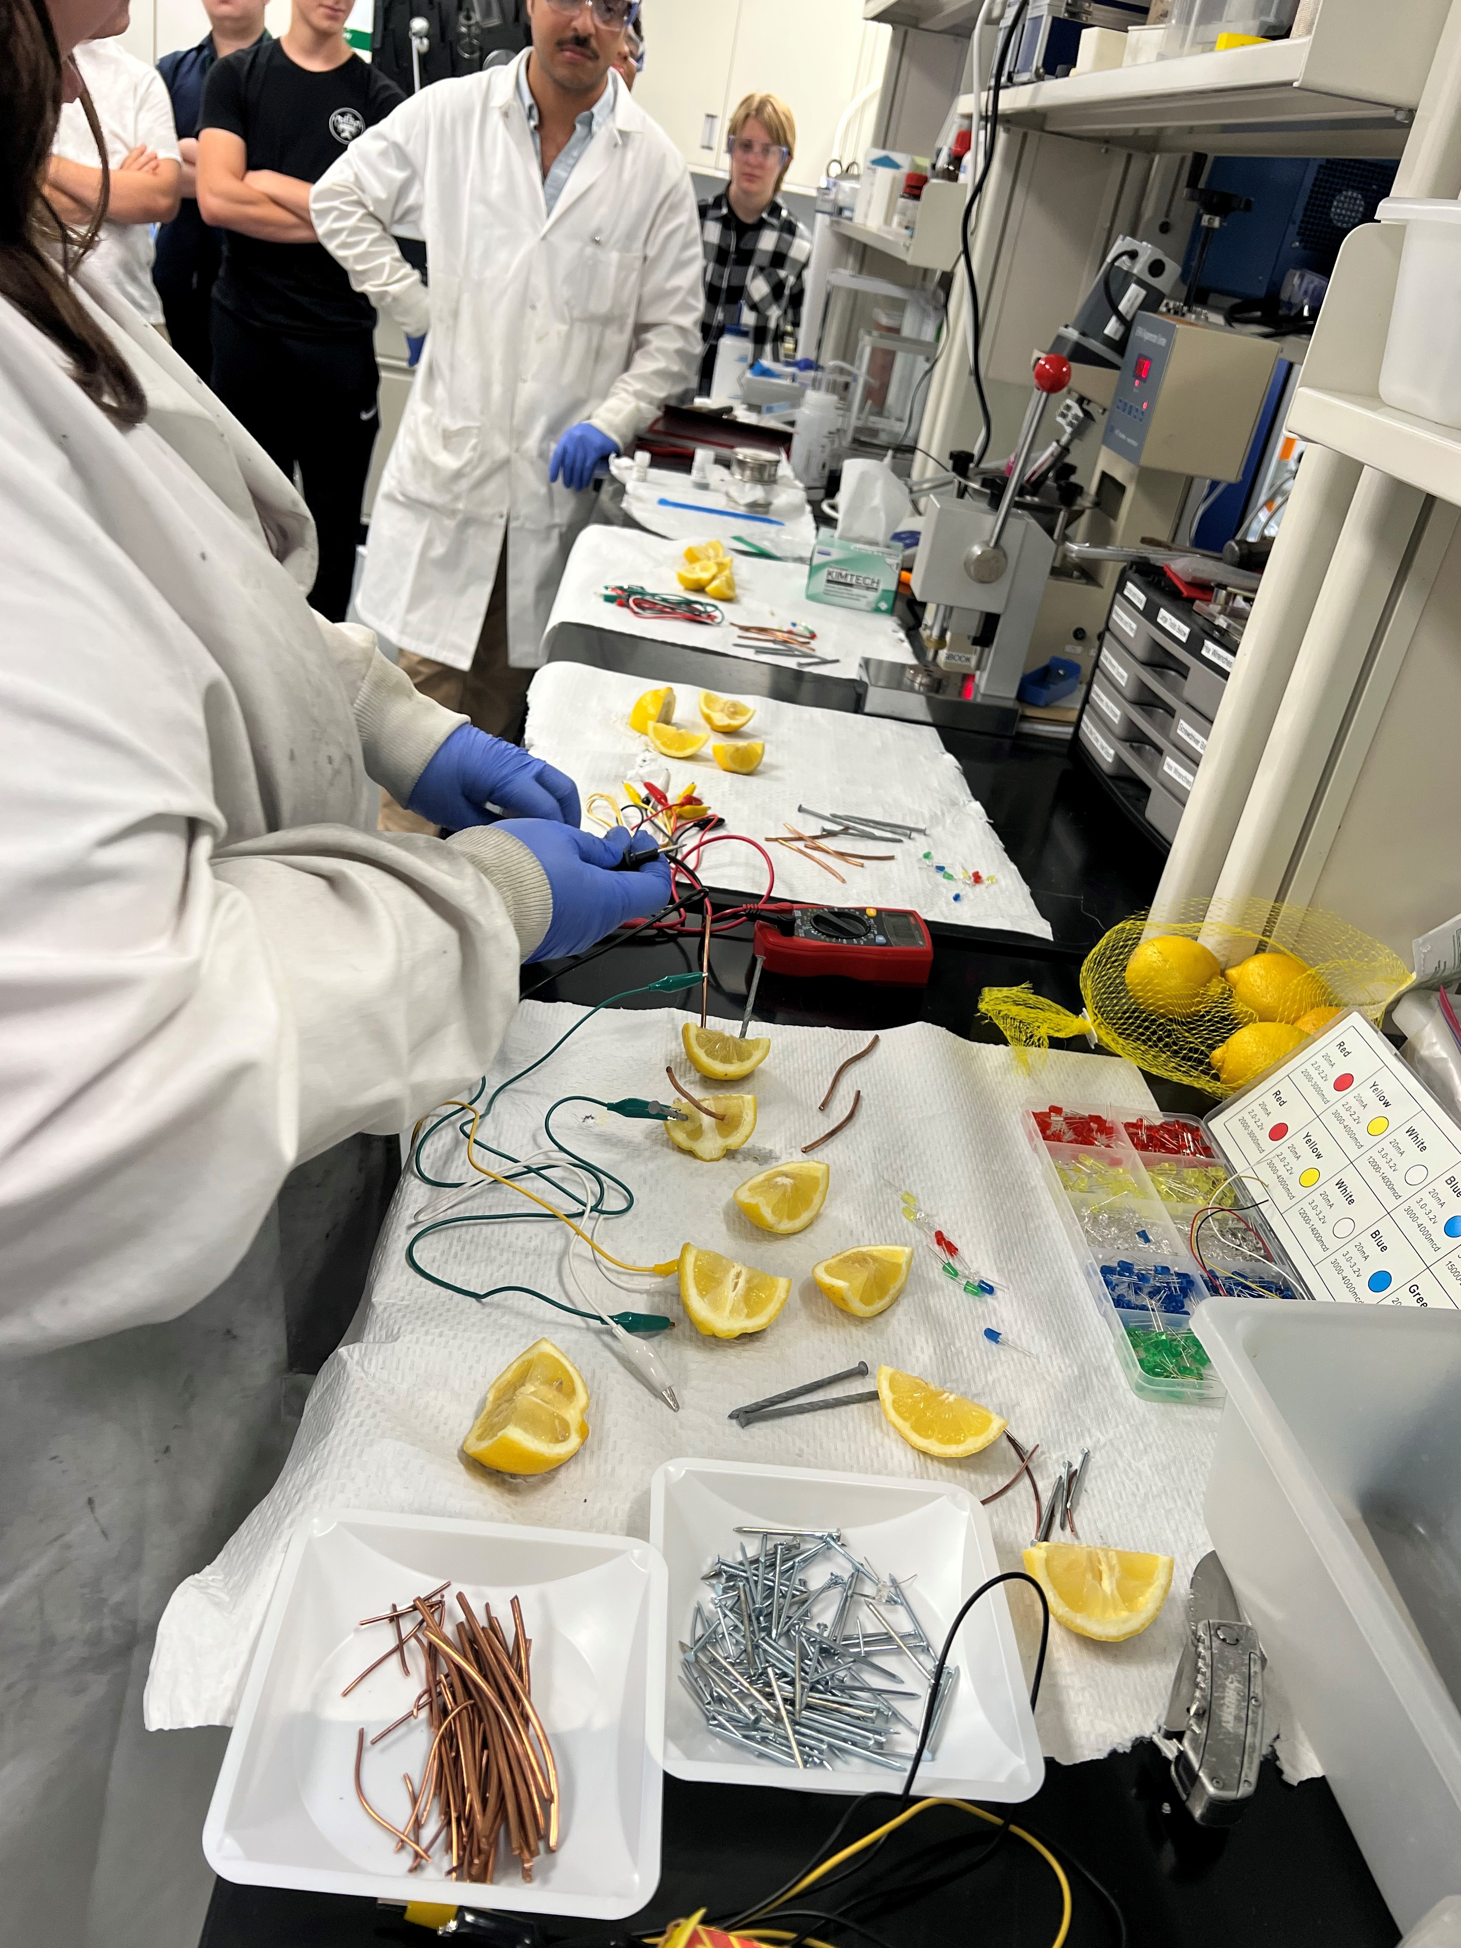
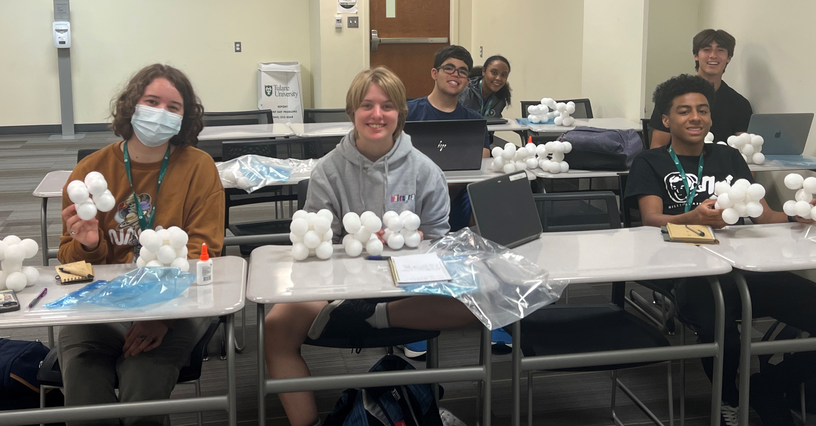
High School Students Getting their 1st Hands-on Materials Science Experience
2022 Broader Impacts
DMR 2048164
Michael Naguib, Tulane University
During Summer 2022, high school students from Louisiana got their first course about Materials Science and Engineering at Tulane University.
Students got introduction about materials structure, manufacturing, properties and applications.
Students carried out hand-on experiments to apply concept they learned in the lecture.
Demos like building your own crystal structure and building a lemon battery were received well by students.

