Slide 1
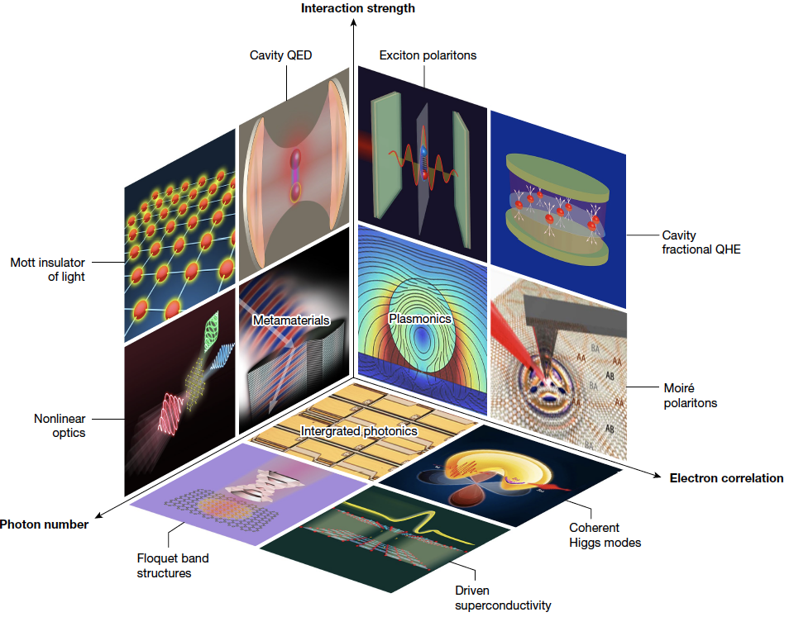
Strongly-Correlated Electron-Photon Systems
2022 Intellectual Merit
DMR 2037158
Victor M. Galitski, University of Maryland, College Park
In a series of recent papers, we have launched a new field of strongly correlated electron-photon coupled systems, which is based on the following new ideas and results:
Electronic materials strongly coupled to photons change their properties, which provides a new tool for material design.
In contrast to active irradiation/continuous driving, embedding materials in cavity QED platforms is a more practical approach.
The most significant impact of this research is expected to be felt in the field of superconductivity, where we showed that the transition temperature can be enhanced in hybrid systems.
Fundamentally new physics emerges when electron-photon hybrids are combined with strong correlations. E.g., in contrast to the conventional room-temperature exciton-polariton Bose-Einstein condensates (BECs), a zoo of strongly correlated BECs appear via coupling electronic collective modes to light.
The most recent result by the PI and collaborators is the realization that polaritons made of magnons in high-temperature superconductors can be created and used to manipulate ultra-high-temperature superconductivity.
The research outlined above is summarized in the Nature Perspective:
Bloch et al, Nature 606, 41-48 Jun-2022.
Interaction strength
Cavity QED
Exciton-polaritons
Cavity
quantum
Hall
Mott
insulator
of light
Moiré
excitons
Non-linear
QED
electron
correlations
Photon
number
Coherent Higgs
Floquet bands
Driven superconductivity
Map of strongly correlated electron-photon systems
Notes:
Dear Daryl, Serdar, and Sylvio:
Some additional details are that we have been working on trying to understand how to enhance Tc in superconductors by using TeraHertz cavity techniques. A particularly promising route is to take high-Tc cuprates and focus on the magnetic excitations (anti-ferromagnetic magnons), which are in the THz range. In this more technical paper with Eugene Demler: https://doi.org/10.1103/PhysRevResearch.4.013101 we showed how to actually achieve it experiment. Amir Yacoby’s group is interested in actually pursuing this route. The goal here is to manipulate Tc, which is high to begin with in the cuprates, by melting competing orders.
Another exciting direction is based on the simple realization that the cuprates – being layered compounds are natural cavities themselves. This provides a clue that perhaps this layered structure can be beneficial to superconductivity. Interestingly, there have been a variety of experiments where artificial metamaterial structures have been created out of Aluminum/Aluminum oxide layers grown one-be-one and the Tc of Aluminum almost doubled. We are working on understanding it and here is a recent preprint on that: https://arxiv.org/abs/2201.07731
In general, a combination of strong-correlation physics and metamaterial & cavity QED structures seems to be a promising new interdisciplinary field worthy of attention. Thank you for supporting our research,
Victor

Slide 2
Strongly-Correlated Electron-Photon Systems
2022 Broader Impacts
DMR 2037158
Victor M. Galitski, University of Maryland, College Park
The following activities contribute to broader impacts of this NSF-supported research & education project:
The PI continues development of the massive open online course “Exploring Quantum Physics,” which has attracted more than 100,000 learners from all over the world over the years. According to coursera.org, hosting it, there are more than 20,000 learners this semester alone.
The PI has also developed a new undergraduate course on introductory quantum mechanics (including some elements of quantum computing/quantum information). Apart from Maryland undergraduates, it attracted students from the historically-black Howard University in Washington, DC (through an existing Howard/UMD education consortium).
The PI has been supervising talented high-school students at Montgomery Blair high school’s magnet program including exposing them to quantum physics.
The PI currently supervises a group of students and postdocs, which includes two talented female scientists: Dr. Laura Shou and Dr. Yunxiang Liao.
Massive open online course on quantum physics

