Slide 1
Fundamental Understanding Enables Stable Battery Materials
2022 Intellectual Merit
DMR 2015650
Ricardo Castro, University of California-Davis
Nanomaterials can increase the charge-discharge rate of Li-ion batteries. However, the nanoscale effects bring instability to the structure, so that the improved charge-discharge rate does not last many cycles. Here, using fundamental aspects of thermodynamics, we demonstrate how atomistic simulations can help us design stable nanostructures for positive electrodes (cathodes). Providing new understanding on surface chemistry and composition, we are able to design for performance, while at the same time providing solid background for industrial level compositional design and understanding.
Notes: Using a theoretical framework covering interface energetics, we demonstrate how to select dopants that segregate to interfaces, innovatively using the physical-chemical principle of ‘surfactant’ on solid ceramics. This control of surface energies in oxides had only been demonstrated in model systems, but now it expands towards more application oriented materials.
La ions segregated into LiCoO₂ cathode structure. Dopant was selected based on atomistic simulation as a potential candidate for stabilization of nanoscale cathodes. Experiments demonstrate the predicted trend.
https://doi.org/10.1021/acs.chemmater.2c01246

Slide 2
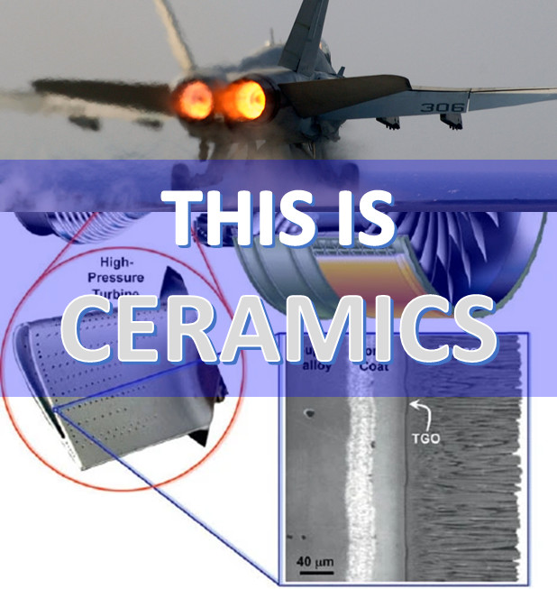
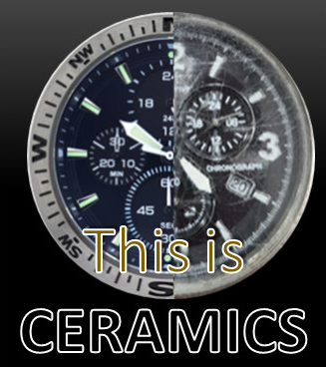
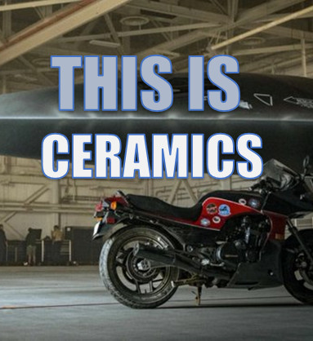
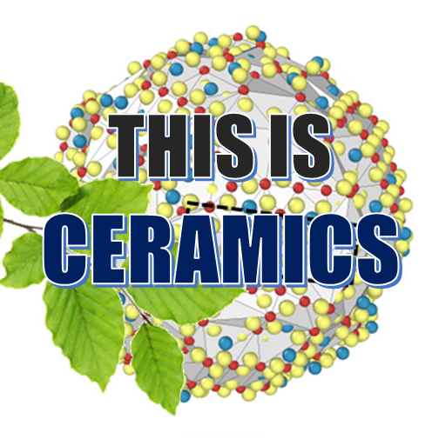
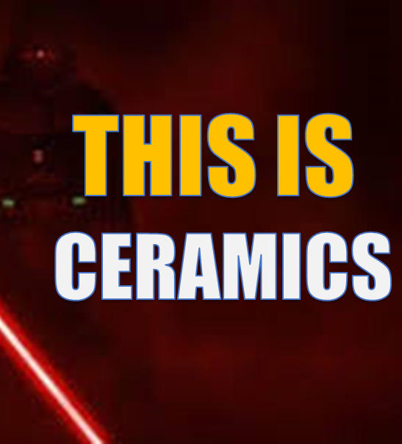
Ceramics Beyond Your Gramma’s Fine China
2022 Broader Impacts
DMR 2015650
Ricardo Castro, University of California-Davis
Educating our population about the impact of ceramics in the society requires the translation of complex engineering technologies into accessible language. In this project, we have started the series “THIS IS CERAMICS”, where we present topics where Ceramics is a key technological component, and why and how it makes a difference. This is (for now) a series of posts on LinkedIn as a pilot program to be extended to other social medias. The next step is to create Tik-Tok videos to reach a younger audience inspiring about high-tech materials.
We started the series with Top Gun: Maverick! The scene with DarkStar opened the conversation for UHTC, or Ultra High Temperature Ceramics. A key element to protect the aircraft against the temperatures and pressures adventured when one hits >10G! The posts had thousands of engagements, showing we are on the right track.
Other examples include watches, artificial photosynthesis, lightsabers, nuclear power, etc.
The image shows the headlines of the short stories. From the top and clockwise: Ceramics in nuclear energy, ceramics as thermal barrier coatings, transparent ceramics for watches, ceramics for light sabers (?), artificial photosynthesis enabled by ceramics, and ultra-high temperature ceramics for the Darkstar from TopGun.

