Slide 1
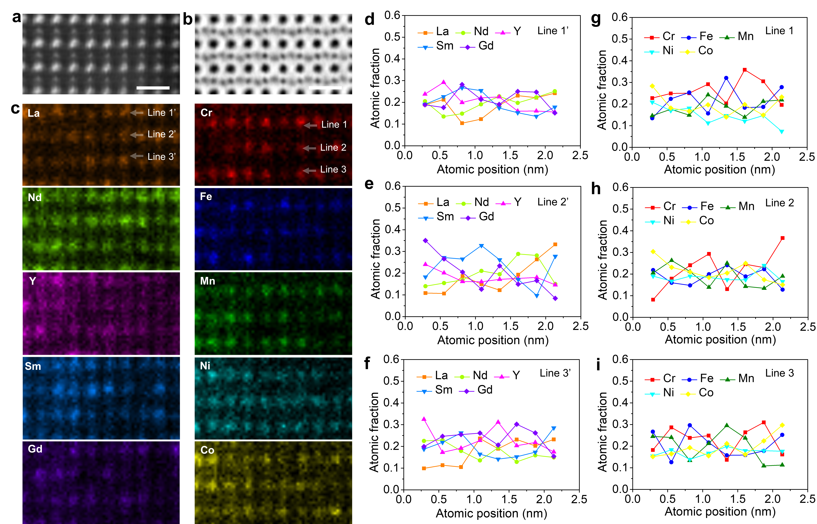
Direct observation of elemental fluctuation and oxygen octahedral distortion-dependent charge distribution in high entropy oxides
Intellectual Merit
DMR 2011967
Xiaoqing Pan, University of California-Irvine
• The goal of this research is to study the correlation between local elemental distribution, atomic structure, chemical bonding and magnetic properties in La(Cr_{0.2}Mn_{0.2}Fe_{0.2}Co_{0.2}Ni_{0.2})O₃, Gd(Cr_{0.2}Mn_{0.2}Fe_{0.2}Co_{0.2}Ni_{0.2})O₃ and (La_{0.2}Nd_{0.2}Sm_{0.2}Gd_{0.2}Y_{0.2})(Cr_{0.2}Mn_{0.2}Fe_{0.2}Co_{0.2}Ni_{0.2})O₃ perovskite-high entropy oxides (P-HEOs).
• In collaboration with the group from KIT, the UCI MRSEC team used aberration-corrected scanning transmission electron microscopy (STEM) and energy dispersive X-ray spectroscopy to reveal the atomic scale structure, compositional fluctuations and composition-dependent variation of oxygen octahedral distortion of P-HEOs. 4-dimensional STEM and electron energy loss spectroscopy reveal the elemental compositions and bonding covalency of the samples.
• The team experimentally shows the relationship between distinct magnetic phenomena observed in P-HEOs and their local atomistic features. The composition fluctuations are directly observed in the elemental mapping, which may be considered as a first step in understanding of unique properties of P-HEOs. The atomic-scale mapping of chemical distribution, lattice distortion and charge density maps as well as the correlation of these structural characteristics with their physical (magnetic) properties may open another perspective and fundamental basis for the rational design of HEOs with fascinating properties.
Atomic structure and compositional fluctuation of (5RE_{0.2})(5TM_{0.2})O₃. a HAADF-STEM and b ABF images of (La_{0.2}Nd_{0.2}Sm_{0.2}Gd_{0.2}Y_{0.2})(Cr_{0.2}Mn_{0.2}Fe_{0.2}Co_{0.2}Ni_{0.2})O₃ taken from [110] zone axis. Scale bar is 0.5 nm. c Atomic EDS mapping showing the disordered elemental distribution in the B site of the ABO₃ structure. Line profiles of the atomic fraction calculated from the relative intensity fraction, representing the distribution of individual d to f A-site and g to i B-site elements in a (001) plane projected along the [110] zone axis.
Su L, Huyan H, Sarkar A, Gao W, Yan X, Addiego C, Kruk R, Hahn H, Pan X. “Direct observation of elemental fluctuation and oxygen octahedral distortion-dependent charge distribution in high entropy oxides” Nature Communications, 13, 2358 (2022). https://doi.org/10.1038/s41467-022-30018-y

