Slide 1
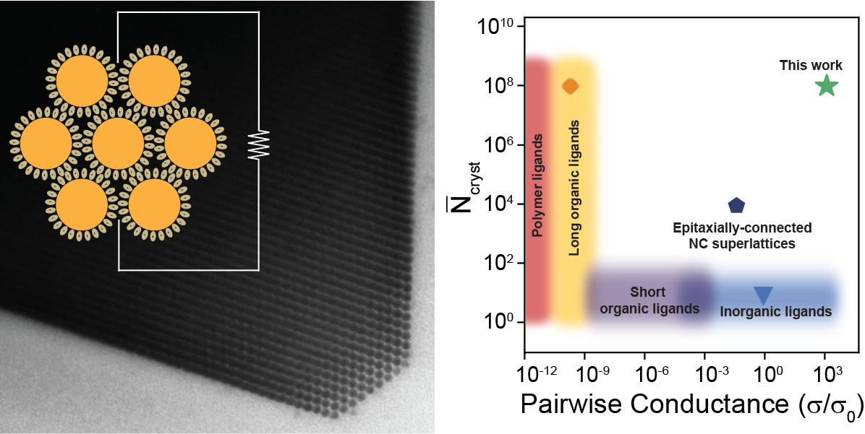
Self-assembly of nanocrystals into strongly electronically coupled all-inorganic supercrystals
DMR 2011854
Stuart J. Rowan, University of Chicago
Colloidal nanocrystals of metals, semiconductors, and magnets serve as functional building block materials, and the assembly of nanocrystals into higher order structures is critical to their performance in functional devices. We demonstrate the self-assembly of charged nanocrystals into strongly electronically coupled supercrystals, a feature previously not possible with traditional insulating organic surface ligands.
Preceding nucleation of large supercrystals, we identified a triple phase coexistence phase space where nanocrystal colloids separate into dilute and dense fluids, with solid supercrystals nucleating from the latter phase (bottom left). The existence of new colloidal fluid phases opens possibilities to dynamically manipulate charged nanocrystals and further control the structural and electronic properties of bottom-up assembled materials.
Science 2022, doi: 10.1126/science.abm6753.
Published online (3/24/2022)

