Slide 1
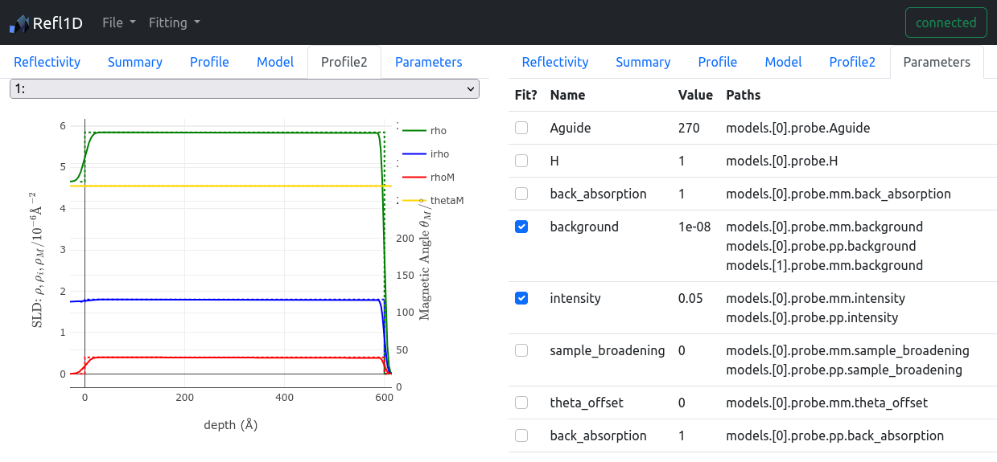
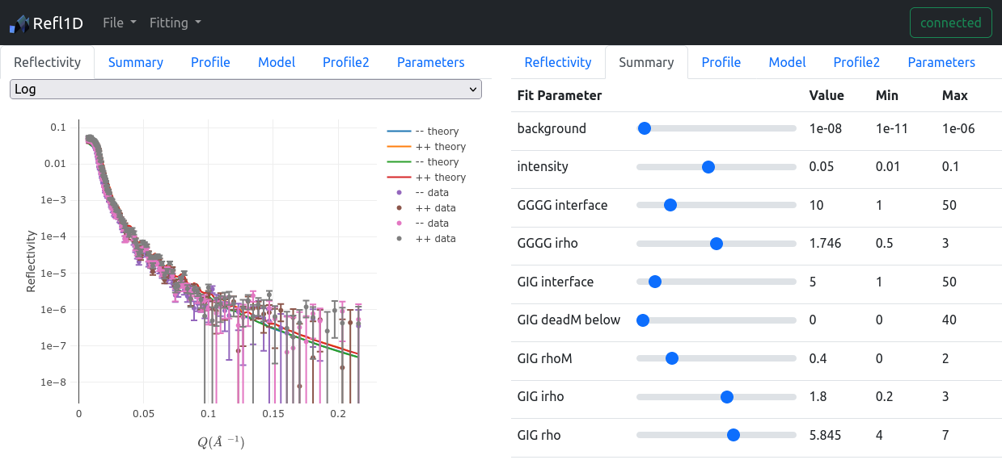
Web-based fitting interface: Refl1D
DMR 2010792
Dan Neumann, National Institute of Standards and Technology
Users need access to specialized fitting and modeling tools in order to analyze neutron scattering data acquired on the CHRNS instruments.
Existing analysis packages require installation and maintenance (updates) on users' computers. In many cases the analysis routines require heavy sustained computation. All of these create a barrier to entry for new users.
Providing a fitting service to users would mitigate this issue; a first step to creating this service is to enable remote (web-based) access to a 'live' fitting server for interactive fitting sessions, or static fit results for batch fits
We are developing a web interface to the Refl1D analysis software [1], which is used for analysis of data from the CHRNS CANDOR instrument.
An interactive mode with a websocket connection is available, as well as a 'snapshot' mode using a REST API.
The interface is detachable and re-attachable to the fitting session at any time, with a unique host/port, allowing the service to be tunneled through an authenticated external endpoint in the future.
[1] Refl1D was originally developed under NSF DMR-0520547.

