Slide 1
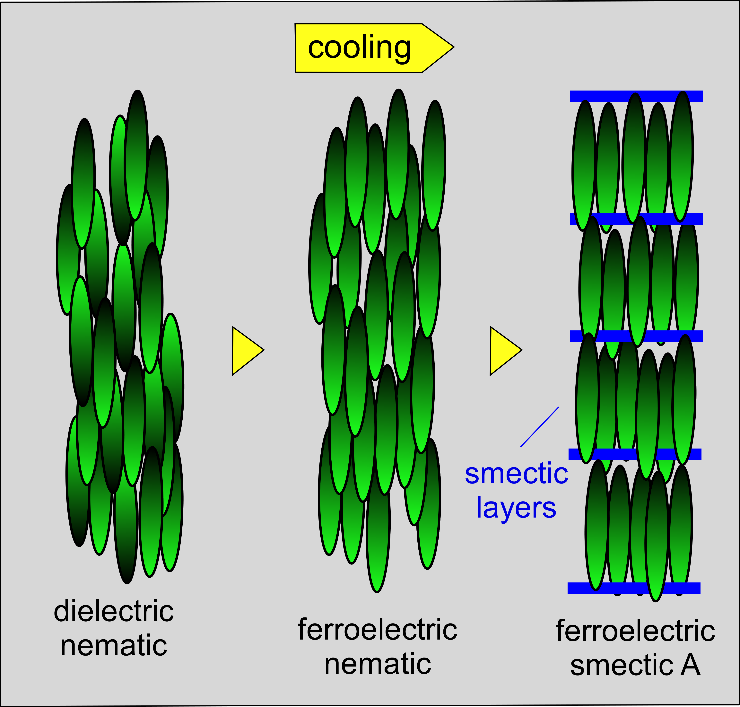
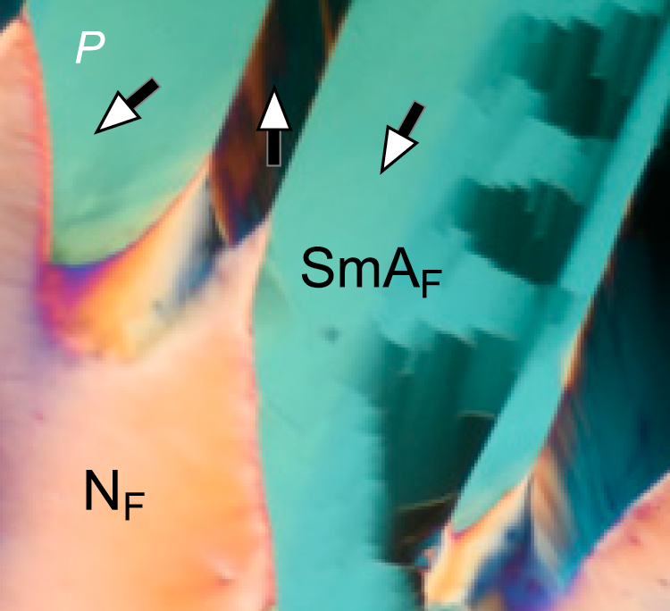
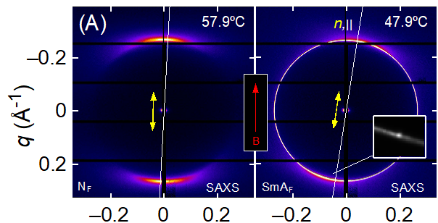
Observation of a uniaxial ferroelectric smectic A phase
2022 Intellectual Merit
DMR 2005170
The recent discovery of the ferroelectric nematic liquid crystal phase was both thrilling and unexpected, since it appeared in new molecules not much different in structure from many similar materials studied over the last 100 years. A fundamental question following this discovery was whether there could also be a ferroelectric smectic A, the counterpart to the ferroelectric nematic phase obtained when molecules spontaneously position to form planar, fluid layers normal to their molecular long axes.
We have now observed the smectic A_{F}, confirming it to be a phase of small dipolar, rod-shaped molecules which form two-dimensional fluid layers spaced by approximately the mean molecular length. The phase is uniaxial, with the molecular director, the local average long-axis orientation, normal to the layer planes, and ferroelectric, with a large spontaneous electric polarization parallel to the director.
"Observation of a uniaxial ferroelectric smectic A phase," X. Chen, V. Martinez, P. Nacke, E. Korblova, A. Manabe, M. Klasen-Memmer, G. Freychet, M. Zhernenkov, M. A. Glaser, L. Radzihovsky, J. E. Maclennan, D. M. Walba, M. Bremer, F. Giesselmann, and N. A. Clark, PNAS (2022). DOI: 10.1073/pnas.2210062119
Joseph E. Maclennan, University of Colorado Boulder
Figure: Structures of the conventional (non-polar) nematic and ferroelectric nematic phases, and of the ferroelectric smectic A, a new polar liquid crystal phase of the ferroelectric nematic realm. The layering is confirmed by the appearance of sharp X-ray scattering peaks along the molecular director and the ferroelectric nature of the phase by electrooptic measurements.
(B)
Notes:
"Observation of a uniaxial ferroelectric smectic A phase," X. Chen, V. Martinez, P. Nacke, E. Korblova, A. Manabe, M. Klasen-Memmer, G. Freychet, M. Zhernenkov, M. A. Glaser, L. Radzihovsky, J. E. Maclennan, D. M. Walba, M. Bremer, F. Giesselmann, and N. A. Clark, PNAS (2022). DOI: 10.1073/pnas.2210062119

Slide 2
Observation of a uniaxial ferroelectric smectic A phase
2022 Broader Impacts
DMR 2005170
Joseph E. Maclennan, University of Colorado Boulder
The ferroelectric nematic, chiral ferroelectric nematic, and antiferroelectric smectic Z_{A}, liquid crystal phases all discovered in the last two years, have each opened unanticipated doors to new soft matter science and potential for technology, and here the smectic A_{F} joins in this development.
These new ferroelectric materials suggest broad applications in the areas of nonlinear optics, telecommunications, and sensors that will be attractive for commercialization.
The project continues to provide opportunities for the education and professional development of both graduate and undergraduate students pursuing a variety of research from chemical synthesis to materials characterization and computer modeling.
These discoveries have been described in several publications and presented at major conferences,.
Graduate student Xi Chen prepares to deliver a remote presentation on ferroelectric liquid crystals at the 28th International Liquid Crystal Conference in Lisbon in July 2022.

