Slide 1
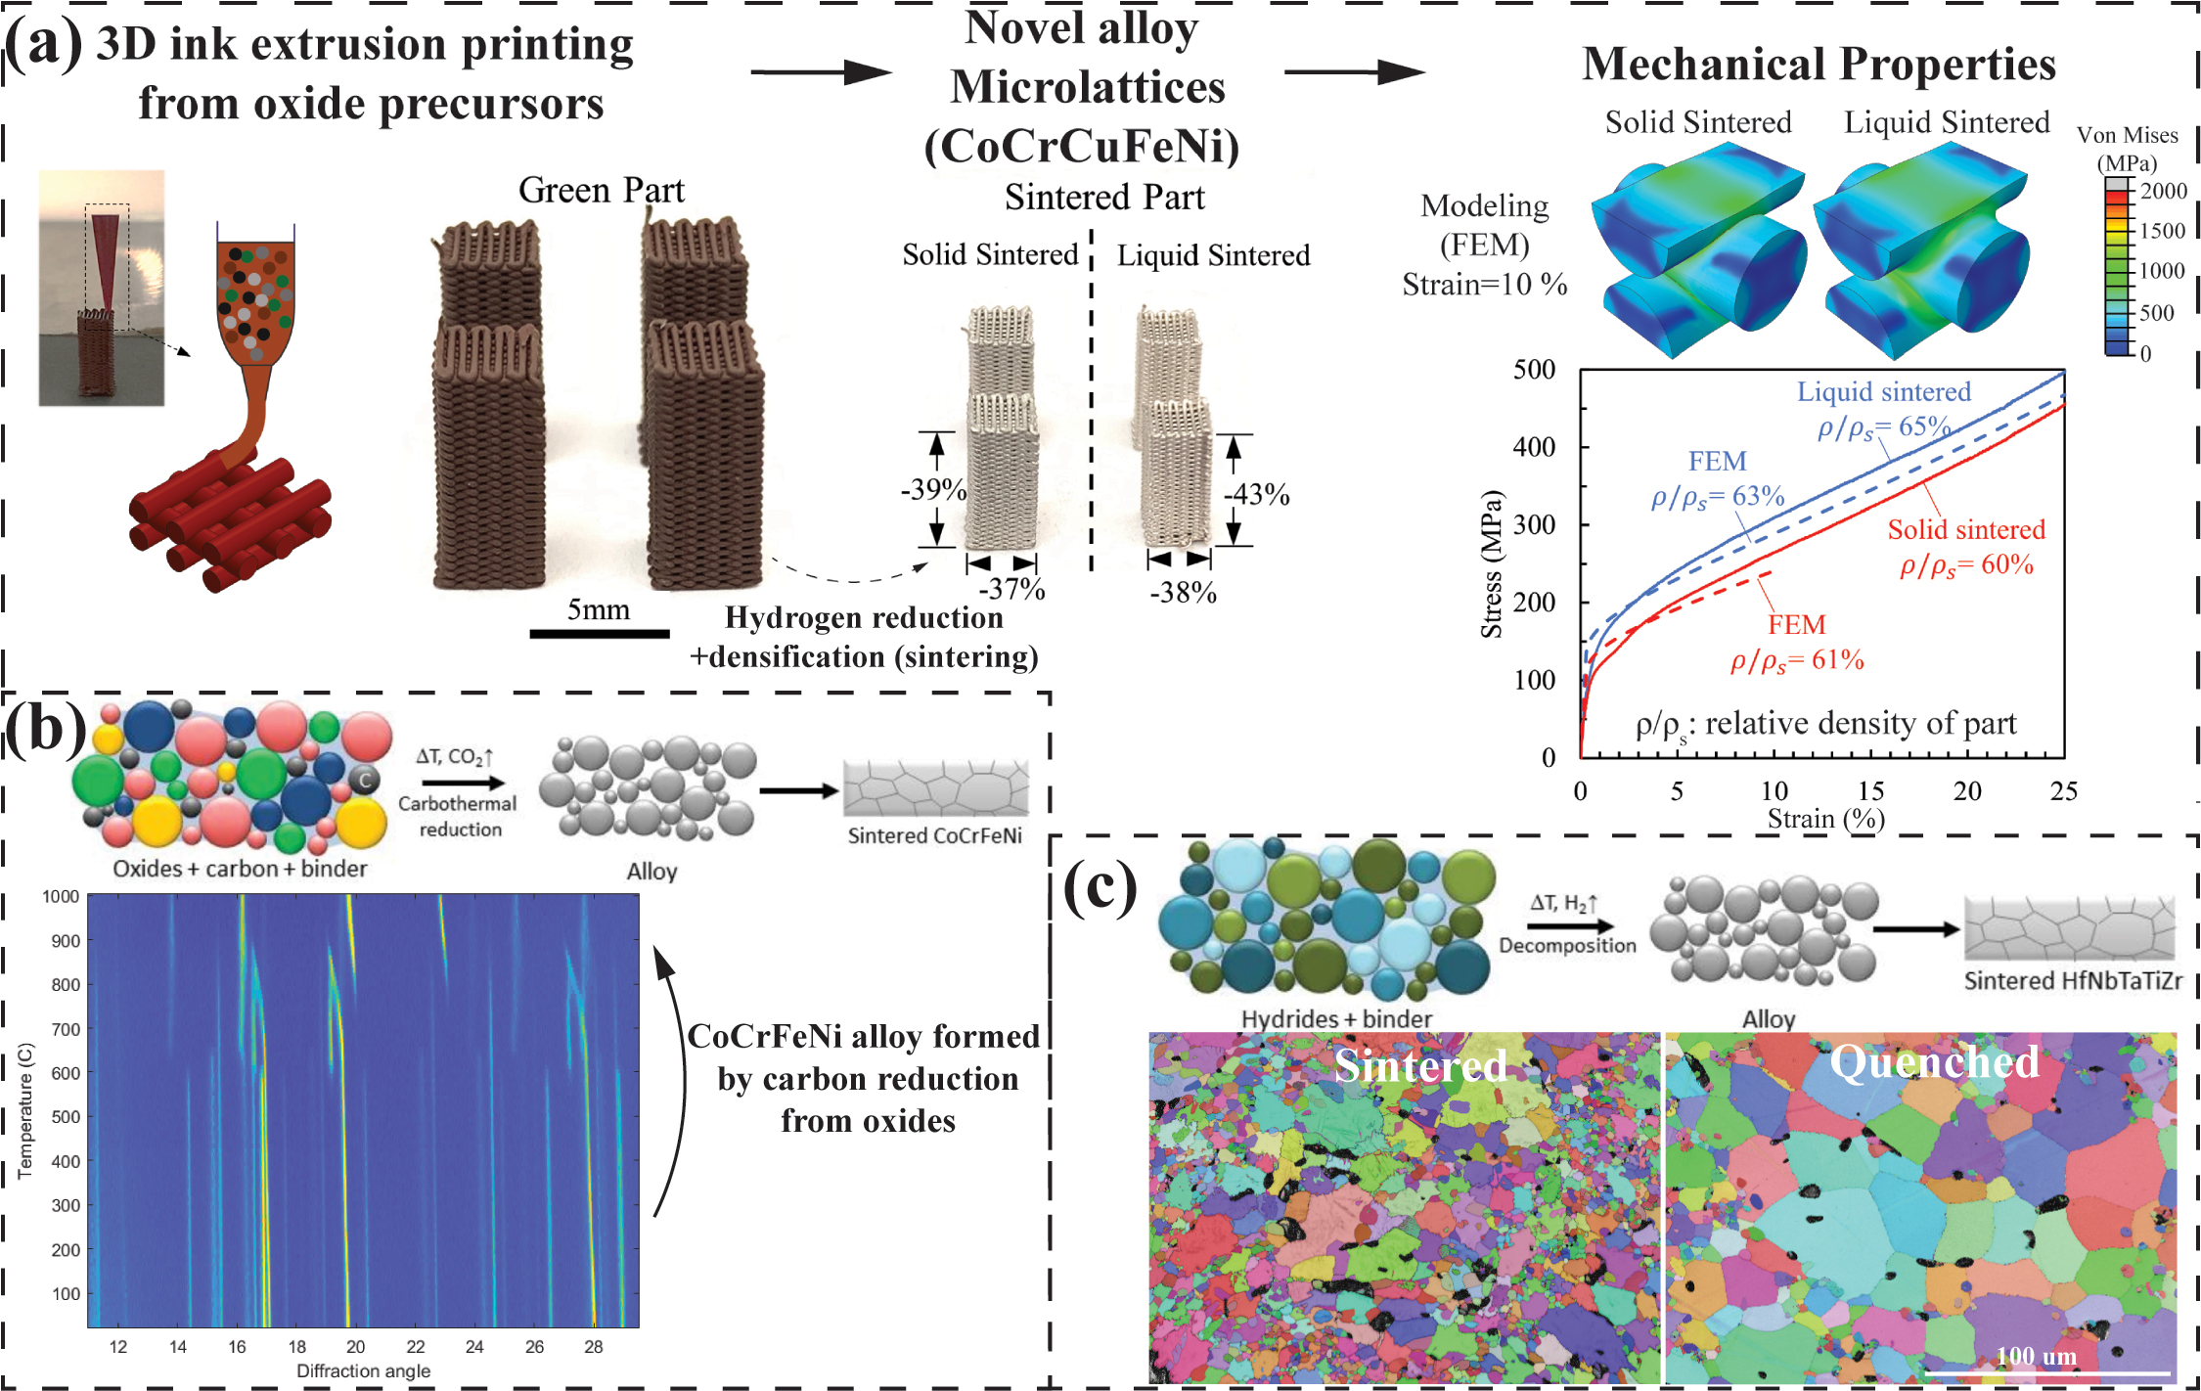
Ink-based additive manufacturing of high-entropy alloys from oxide and hydride powders
2022 Intellectual Merit
DMR 2004769
David C. Dunand, Northwestern University
(a) A dense and homogenous CoCrCuFeNi high-entropy alloy (HEA) is achieved via H₂ reduction of a blend of binary oxide powders followed by sintering.
3D-printed CoCrCuFeNi microlattices have better strength after liquid-phase sintering. D.C. Zhang, C. Kenel, D.C. Dunand. "Microstructure and mechanical properties of 3D ink-extruded CoCrCuFeNi microlattices." Acta Materialia 238 (2022):
(b) Reduction of a blend of binary oxide powders via carbon (rather than H₂) is demonstrated in 3D-printed micro-filaments of CoCrFeNi.
(c) A nearly-dense refractory HEA, HfNbTaTiZr, is achieved from a blend of hydride and elemental powders after 3D ink extrusion followed by vacuum sintering.
Notes:
(a) “Microlattices with orthogonal 0-90° architecture are 3D-extrusion printed from inks containing a blend of oxide powders (Co₃O₄, CuO, Fe₂O₃, and NiO) and metal powder (Cr). Equiatomic CoCrCuFeNi microlattices with ∼170 µm diameter struts are then synthesized by H₂-reduction of the oxides followed by sintering and interdiffusion of the resulting metals. These process steps are studied by in-situ synchrotron X-ray diffraction on single extruded microfilaments (lattice struts) with ∼250 µm diameter. After reduction and partial interdiffusion at 600 ˚C for 1 h under H₂, filaments consist of lightly-sintered metallic particles with some unreduced Cr₂O₃. A reduced, nearly fully densified (porosity: 1.6 ± 0.7%) alloy is obtained after solid-state homogenization at 1050 ˚C for 4 h under H₂, with a microstructure consisting of two face-centered-cubic phases, one Cu-poor and the other Cu-rich. When a 10 min excursion to 1150 ˚C is added to the 1050 ˚C homogenization, a Cu-rich melt forms which enhances densification (porosity: 0.3 ± 0.2%) and smooths both strut surfaces and sharp cusps at nodes in the microlattices. The liquid-sintered microlattices show higher compressive strength and ductility than the solid-sintered microlattices. These improvements are consistent with finite-element modeling results which show that smoothening of the sharp cusps at nodes by the solidified melt reduces stress concentrations. These CoCrCuFeNi microlattices can be integrated in more complex load-bearing applications, e.g., as cores of sandwich structures with an unusual combination of high specific stiffness, strength, and toughness. “
--(Zhang, Dingchang, Christoph Kenel, and David C. Dunand. "Microstructure and mechanical properties of 3D ink-extruded CoCrCuFeNi microlattices." Acta Materialia 238 (2022): 118187.)
This process can also potentially reduce CO₂ emissions (greenhouse gases) compared with conventional production of ferrous alloy because the reaction product of redox reaction is water. Using hydrogen eliminates CO₂ emission for reduction of metal oxide, which is needed for the steel industry of the future.
(b) Another novel alloy (CoCrFeNi) is produced from 3D printing from a blend of oxides and post carbon reduction. The mechanism and kinetics of carbon reduction are studied by in situ X-ray diffraction. This approach was studied to compare with hydrogen reduction process.
(c) A nearly dense refractory alloy (HfNbTaTiZr) is achieved from a blend of hydride and elemental powders by the 3D ink extrusion approach. A sing phase refractory high entropy alloy with some residue oxides was successfully obtained after sintering and quenching treatment. This kind of alloy has promising mechanical properties at high temperatures, which can be used in high-temperature load-bearing applications.

Slide 2
Ink-based additive manufacturing of high-entropy alloys from oxide and hydride powders
2022 Broader Impacts
DMR 2004769
Two graduate students (one female and one male) did research and got academic training during this period. One of the students will attend a national conference (MS&T’22) and present his research in an oral presentation.
A third graduate student (under-represented minority) is also doing metal ink-extrusion research on this project, with an NSF graduate fellowship covering his tuition and stipend.
A high school teacher from Lakes Community High School, Dr. Irina Stan, was embedded in our lab for 8 weeks in the summer of 2022 as part of MRSEC Research Experience for Teacher (RET) project, where she learned to ink-print various food items. She will bring back this research to her high school students and will demonstrate printing in her science class.
David C. Dunand, Northwestern University
An undergraduate student from the Computer Science department is developing a video game : 3D-THINK - based on tomography relevant to 3D printing - which will be available worldwide on an open platform when finalized in late 2022.
The 3D printing of mixed metal, oxide, or compound powders is universally applicable to a wide range of technically important metals. Our new method will translate to numerous alloy systems with wide applications in the automotive, aerospace, machinery, and biomedical industries. Using hydrogen eliminates CO₂ emission for reduction of metal oxide, which is needed for the steel industry of the future.
Ink extrusion printing of cookie paste by visiting high school teacher, Dr Irina Stan.
xxxx
Notes:
Three graduate students (including one female and one under-represented minority) are doing research on this project
A high school teacher (female) from Lakes Community High School learned 3D printing in the NU lab for 8 weeks in the summer 2022
An undergraduate student is developing a video game based on the science being developed in this project.

