Slide 1
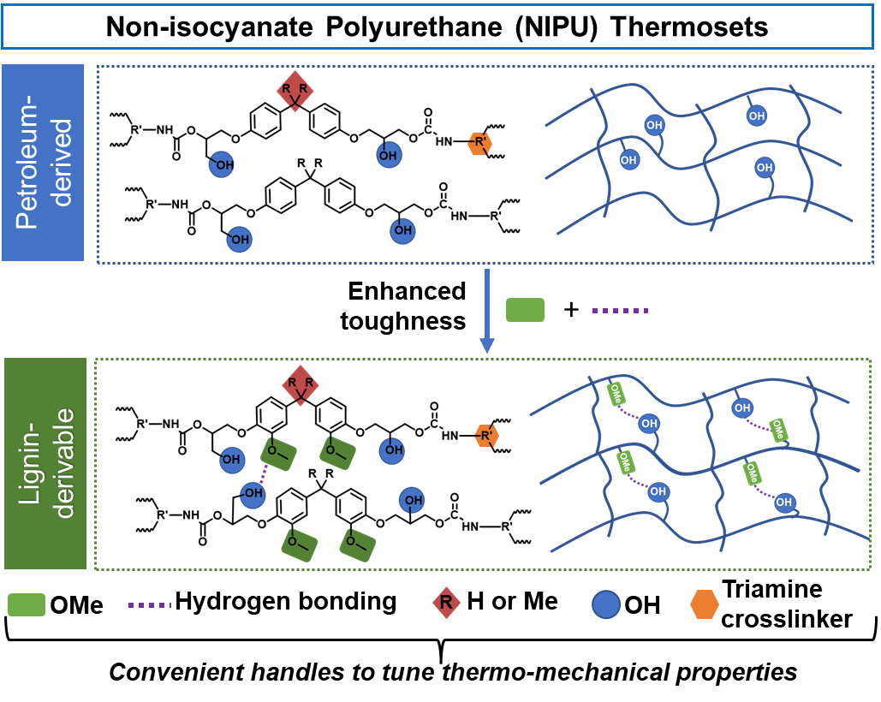
Lignin-derivable non-isocyanate polyurethane thermosets
2022 Intellectual Merit
DMR 2004682
LaShanda T. Korley, University of Delaware
The exploration of lignin-derivable bisguaiacols as an alternative for petroleum-derived bisphenol A/F (BPA/BPF) in thermosetting non-isocyanate polyurethane (NIPU) applications.
The lignin-derivable NIPU thermosets exhibited considerably higher toughness and elongation-at-break in comparison to conventional NIPU networks - without a reduction in elastic modulus, tensile strength, or thermal stability.
Structural differences in the lignin-derivable monomers, such as methoxy groups on the aromatic ring and bridging carbon substitutions, were leveraged as an efficient handle to tune the thermomechanical properties of NIPU networks.
The choice of triamine cross-linker provided NIPU thermosets that range from high-strength, brittle materials to tough, flexible networks.
Notes:
Manuscript in preparation:
Mhatre, S.; Mahajan, J. S.; Epps, T. H., III; Korley, L. T. J., RSC Materials Advances. (expected submission, 08/30/2022). “Lignin-derivable monomers as a platform for versatile non-isocyanate polyurethane thermosets.”
NIPU thermosets were synthesized by the reaction of bifunctional cyclic carbonates with trifunctional amines. First, bisguaiacols [bisguaiacol A (BGA) or bisguaiacol F (BGF)] were synthesized by dimerization of lignin-derivable phenols. Subsequently, the bisguaiacols were epoxidized and carbonated to provide the respective bifunctional cyclic carbonates (CCs) – BGA-CC/BGF-CC. The conventional cyclic carbonate controls were synthesized similarly from the carbonation of commercial bisphenol A diglycidyl ether and bisphenol F diglycidyl ether. The CCs differed from each other in the number of methoxy groups on the aromatic rings and the bridging carbon substitution. As a crosslinker, trifunctional amines- short-chain triamine, tris(2-aminoethyl) amine (TREN), and long-chain triamine, JEFFAMINE® T-403 (T403) were used. The lignin-derivable NIPU networks based on T403 had considerably higher toughness (~49-59 MJ/m³) and elongation at break (ε_{b} ~195-278%) in comparison to those of BPA/BPF-based controls (toughness ~26-35 MJ/m³, ε_{b} ~86-166%). The improved toughness of lignin-derivable NIPUs is hypothesized to be a synergistic effect of increased extensibility and enhanced inter-molecular hydrogen bonding caused by the methoxy groups on the aromatic ring. The tensile strength at yield for T403-based NIPUs ranged from 28 MPa to 45 MPa, whereas that of TREN-networks were in the range of ~65-88 MPa, with dimethyl substitution on bridging carbon increasing the yield strength. The elastic moduli of all the NIPU networks were between 1 GPa to 2 GPa, which is comparable to the moduli of conventional thermosetting PUs. The thermosets had glass transition temperatures (T_{g}’s) that ranged between 37 °C to 79 °C, wherein methoxy groups lowered the T_{g}’s while dimethyl substitution on bridging carbon increased the T_{g}’s.

Slide 2
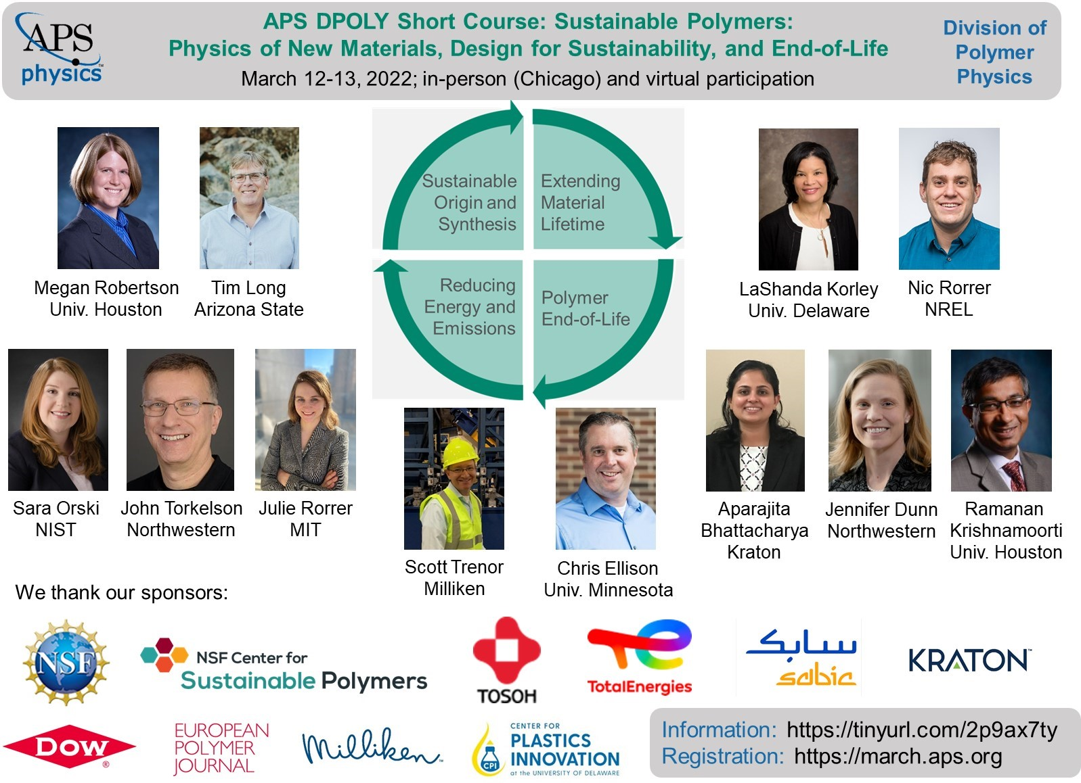
Building a sustainable materials platform for the community
2022 Broader Impacts
DMR-2004682, POL
Outreach this year focused on attracting young people to careers in science and engineering, providing research experiences for undergraduate students, highlighting the diversity of sustainable research and foundational aspects across the polymer community, and improving the technological literacy of the public. Undergraduate student, Eduardo Nombero-Bueno, gained scientific training and targeted mentoring in support of future graduate studies. Eduardo was named an American Chemical Society (ACS) Scholar in 2021. The PIs were co-organizers of several sustainability workshops, including the American Physical Society (APS) DPOLY 2022 Short Course focused on Sustainable Polymers.
LaShanda T. Korley, University of Delaware
Notes:
The DMR-supported research platform trains students to address key scientific and engineering challenges in biobased materials design, functional monomer generation, macromolecular synthesis, additive manufacturing/soft materials processing, and nanoscale materials characterization. It also creates an environment in which students will have the opportunity to unlock their creativity through cutting-edge sustainability research. Our broader impact activities including undergraduate training opportunities, workshop and short course development, K-12 introductory lessons on plastics, and focused mentoring and professional development activities for graduate students.

