Slide 1
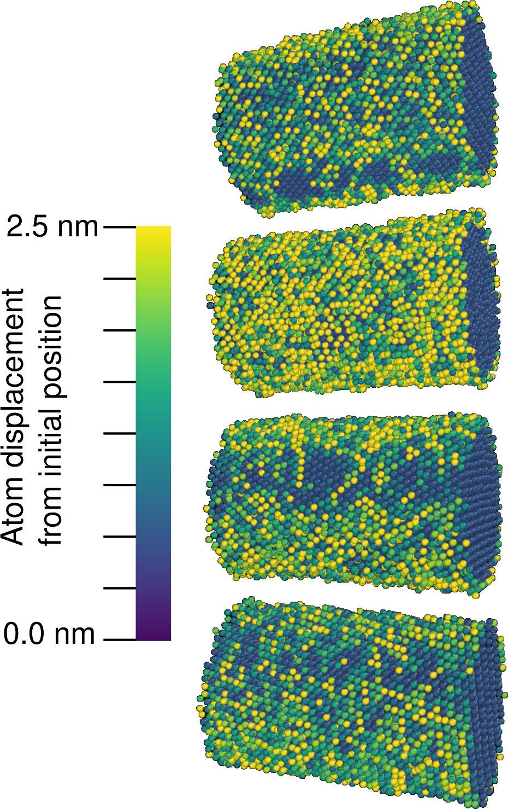
Pore Morphology Evolution Mechanisms in Nanoporous Metal Thin Films Under Thermal/Electrical/Mechanical Stress Fields
2022 Intellectual Merit
DMR 2003849
Erkin Seker, University of California-Davis
The experimental arm of the project observed that the grain morphology of sputter-deposited gold-silver thin films present a significant variation along the topography of the underlying substrate. Specifically, the gold-silver thin film morphology becomes denser on the edges of microfabricated silicon ridges while retaining a more traditional grain structure on the top surfaces of the ridges. For very narrow ridges, the less common denser grains constitute the entirety of the coating. This finding is significant because these variations in the precursor gold-silver alloy likely influence the resulting nanoporous gold (np-Au) film morphology, which dictates the performance of devices with micropatterned np-Au thin films.
The computational side of the project has developed a procedure to accurately measure surface diffusion rates using molecular dynamics simulations. This is significant because surface diffusion is implicated in a wide array of phenomena, including the catalytic reactions that occur in a catalytic converters, and precise knowledge of surface diffusion rates is an essential prerequisite to designing materials with better performance for such applications. The technique has been used to measure a previously-unrecognized dependence of the activation energy for surface diffusion on surface curvature.
Sputter-coated gold-silver thin films on micropatterned silicon ridges of varying widths reveal drastically different grain morphology on the surface and edge of the ridges.
Magnitudes of atomic displacements on the surface of gold nanowires of four crystallographic orientations at a uniform elevated temperature, simulated to measure the orientation-averaged surface diffusion coefficient.

Slide 2
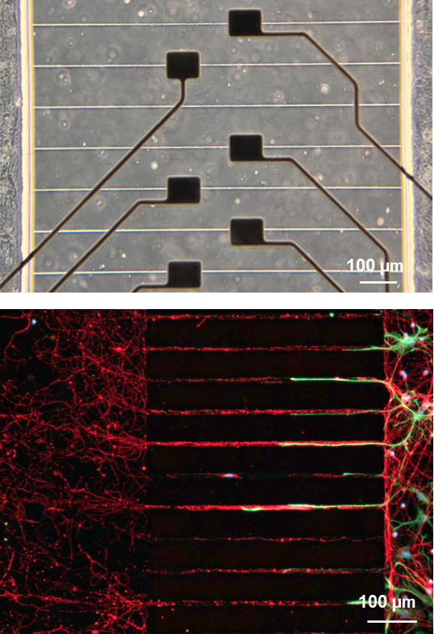
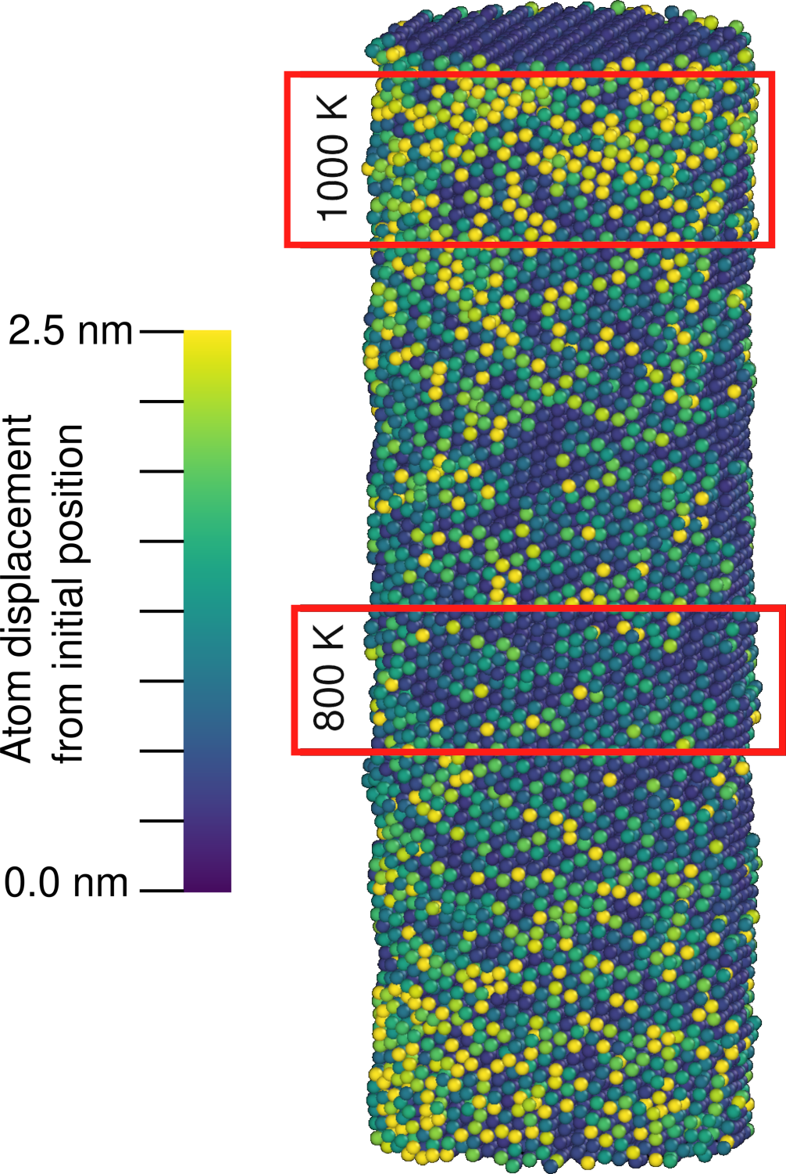
Pore Morphology Evolution Mechanisms in Nanoporous Metal Thin Films Under Thermal/Electrical/Mechanical Stress Fields
2022 Broader Impacts
DMR 2003849
Erkin Seker, University of California-Davis
Using the deposition and patterning techniques developed in this project, we micropatterned gold electrodes on glass substrates and used them to monitor electrical activity of neurons grown on these surfaces. Specifically, this study provided insight into how gold electrodes enclosed in microchannels enhance recording fidelity. The results highlight the broader impact of the ability to incorporate metals into devices for biomedical applications.
A first-generation female undergraduate student participating in the NSF California Alliance for Minority Participation (NSF CAMP) program received practical research experience with computational modeling by simulating the effect of thermomigration in NPG samples. This is a phenomenon whereby the transport of atoms from one region to another is driven by a temperature difference between the two regions. The student has since graduated and is employed as a structural analyst at Boeing.
Microfabricated gold surface electrodes encapsulated in microchannels enhance fidelity in recording neuronal signals cultured on the electrodes.
Magnitudes of atomic displacements on the surface of a gold nanowire in a temperature gradient, simulated to measure the effect of thermomigration on NPG samples.

