Slide 1
Probing the impact of surface chemistry on nanoparticle reactivity
2022 Intellectual Merit
DMR 2003613
Katherine Willets, Temple University
Project 1: Improving the Homogeneity of Silver Nanoparticle Electrochemical Reactivity Using Sacrificial Silver-Sulfide Shells
Shrinking silver to the nanoscale (<100 nm) results in desirable properties for energy storage, drug delivery, and catalysis.
Problem: Nanoparticle surfaces are affected by environmental contaminants (ex: think of how silver jewelry tarnishes) leading each particle to have slightly different surface chemistry leading to diminished performance and poor sample-to-sample reproducibility.
Goal: Create more uniform silver nanoparticle surface chemistry by using sacrificial shells to remove unwanted surface impurities. Here we explore silver-sulfide shells. (Top Figure)
Validation: After removal of the shell, more silver-like particles will show faster electrodissolution kinetics under an oxidizing potential (e.g., conversion of Ag → Ag⁺)
Results: There is an optimum sulfide concentration that leads to higher scattering intensity and faster oxidation kinetics after stripping of the sulfide shell, consistent with a more silver-like surface. We also find sulfide concentration-dependent behaviors that suggests different surface species are forming.
Project 2: Calcite-Assisted Localization and Kinetics (CLocK) Microscopy
Problem: Super-resolution imaging techniques allow us to monitor spatially-dependent changes in metal nanoparticles with nanometer precision; however, we cannot extract shape-dependent information (example: dark field scattering of single nanorods and nanospheres, Bottom figure, A ).
Solution: We developed a new, multi-parameter super-resolution imaging technique that can be integrated into any existing optical microscope by placing a rotating calcite crystal into its infinity space.
Results: The unique point spread function provided by CLocK microscopy (Bottom figure, B) affords immediate polarization and orientation information of nanoscale objects as confirmed with electron microscopy (Bottom figure, C) while allowing localization and kinetic information (such as electrochemical dissolution rates) to be maintained.

Slide 2
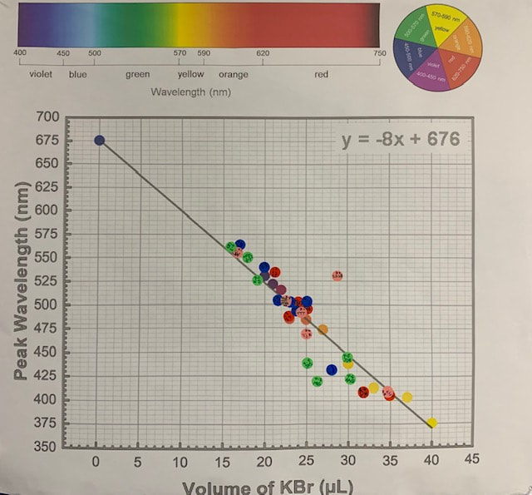
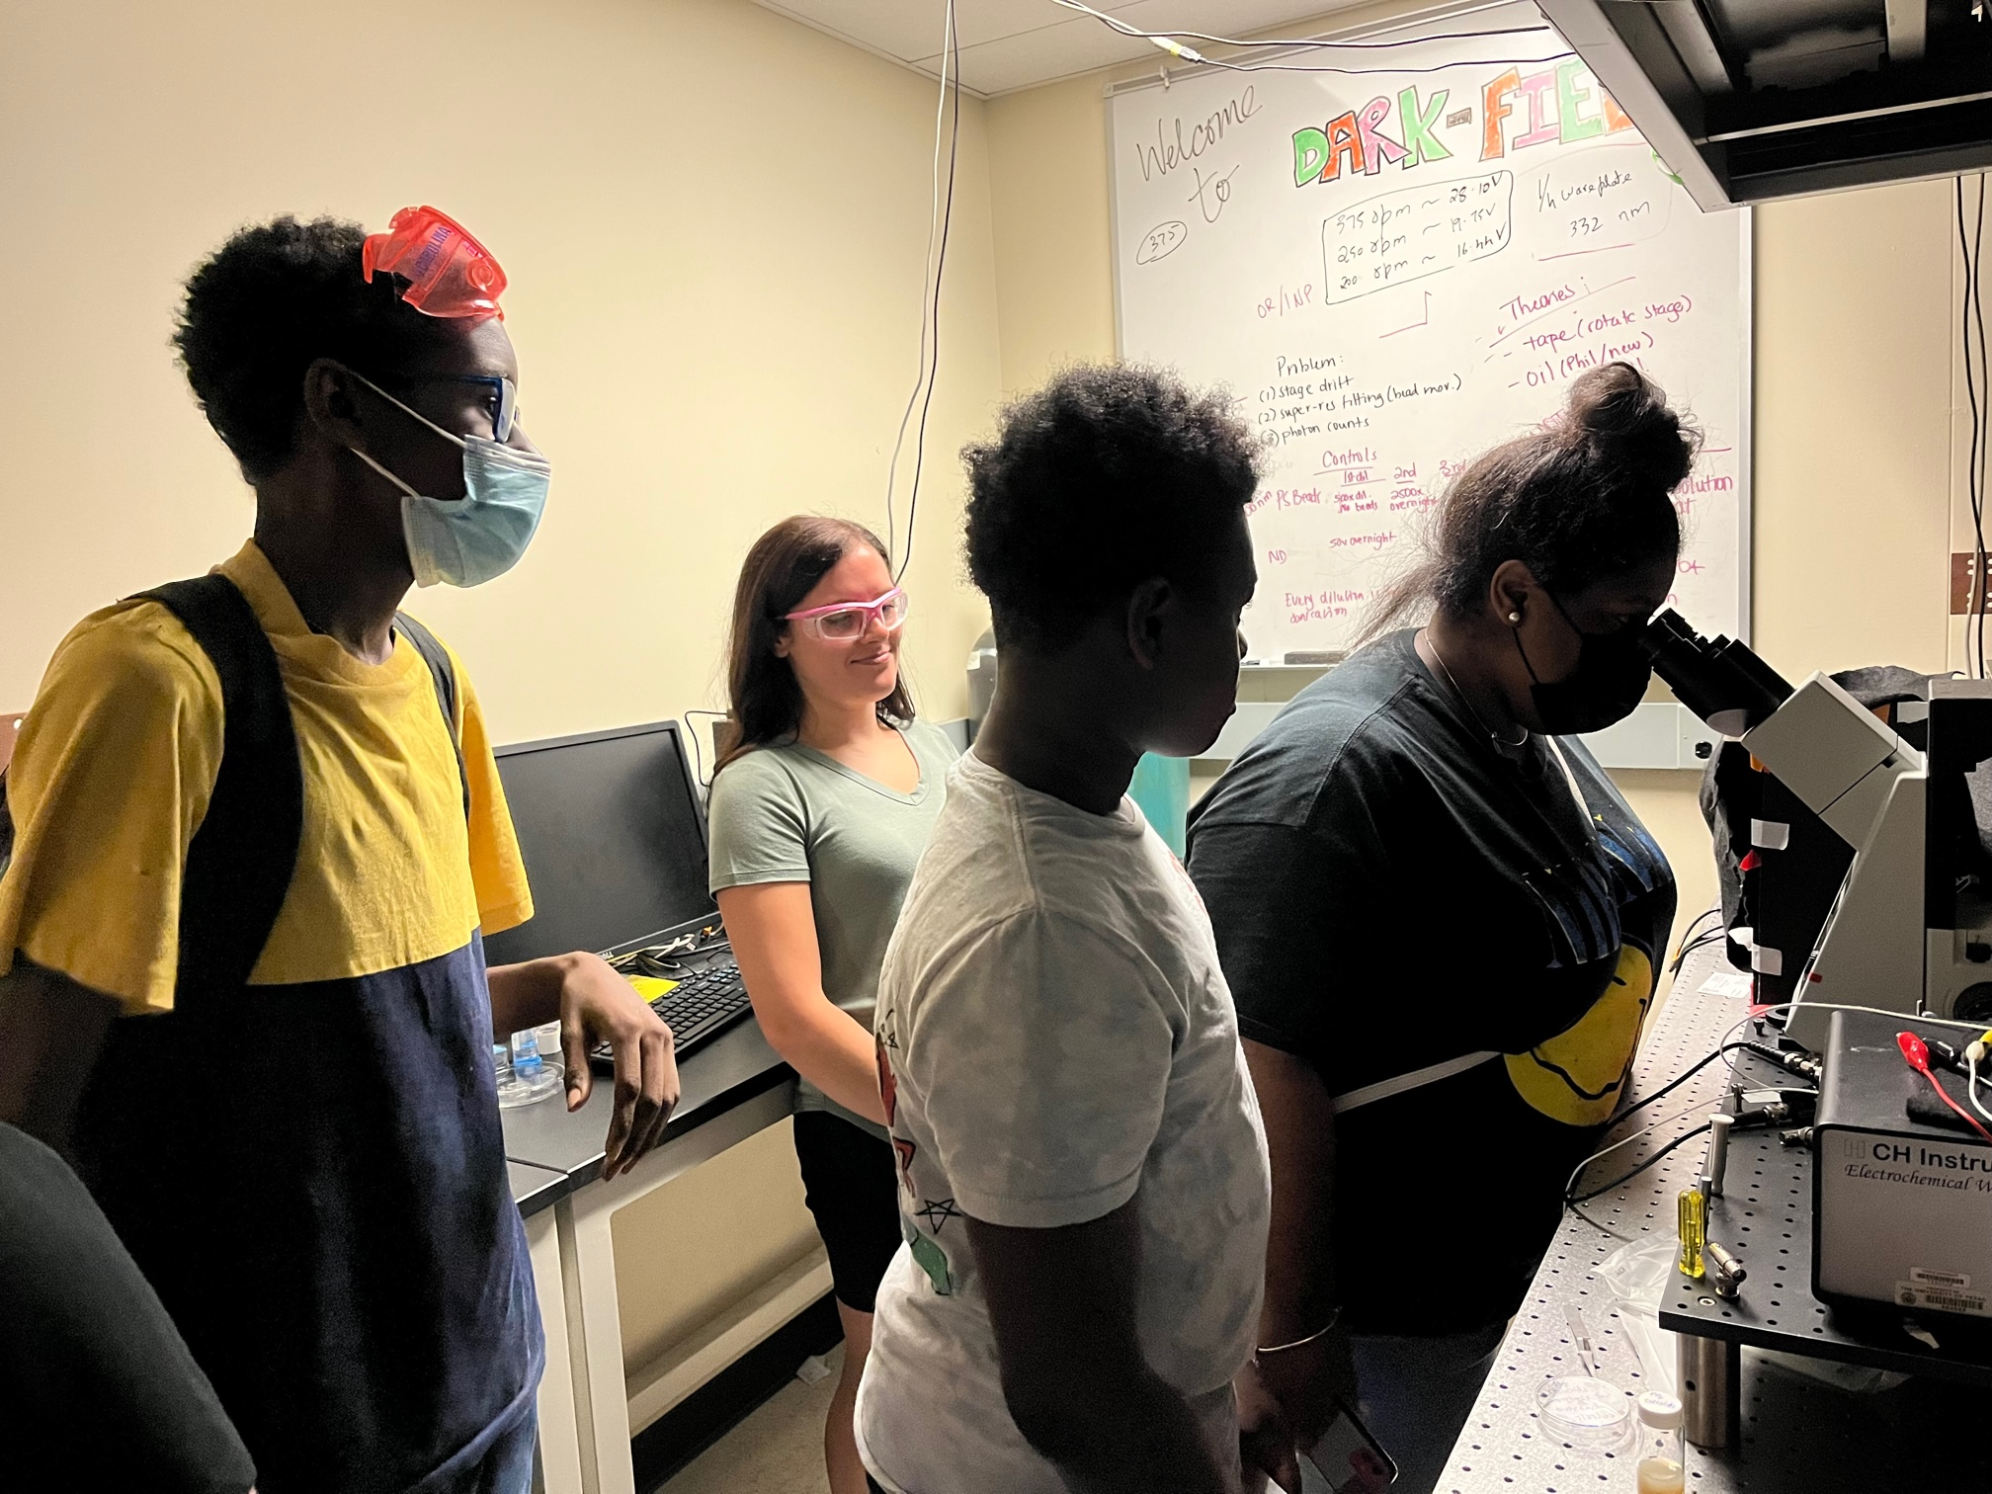
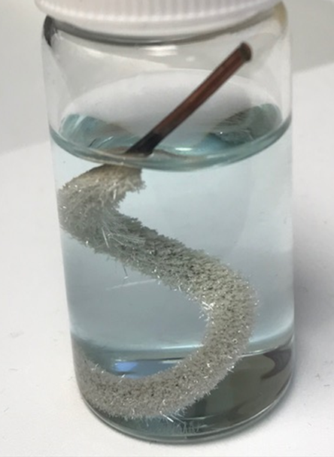
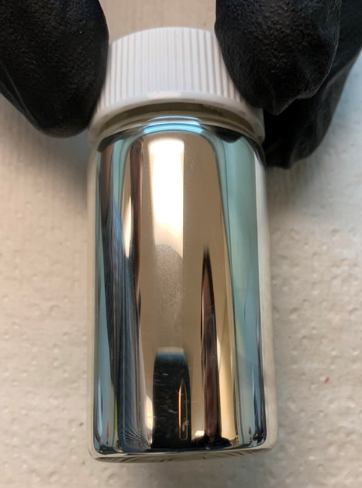
Willets Lab Community Outreach – Adventures in Silver
2022 Broader Impacts
DMR 2003613
Katherine Willets, Temple University
“Adventures in Silver,” our annual outreach activity at a local minority-serving high school in Philadelphia, was back in full force after several semesters of Covid-modified participation (May 2022)
Students synthesized silver nanoprisms with different size and thus color by varying the volume of added bromide (bottom right).
Students took spectra and generated a master plot of peak wavelength vs. bromide, top right.
We also did a few more demonstrations using electrochemistry to produce solid silver (Ag) from silver salt (Ag⁺), bottom left.
The lab also hosted 8 high school students from a local Philadelphia charter school for a day of fun experiments. Students toured a graduate research laboratory, synthesized nanoparticles, and got first-hand experience with an optical microscope and other high-end instruments, top left (July 2022).
Silver nanoprisms
“Fuzzy” Silver
Silver Mirror

