Slide 1
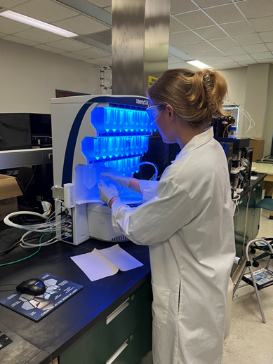
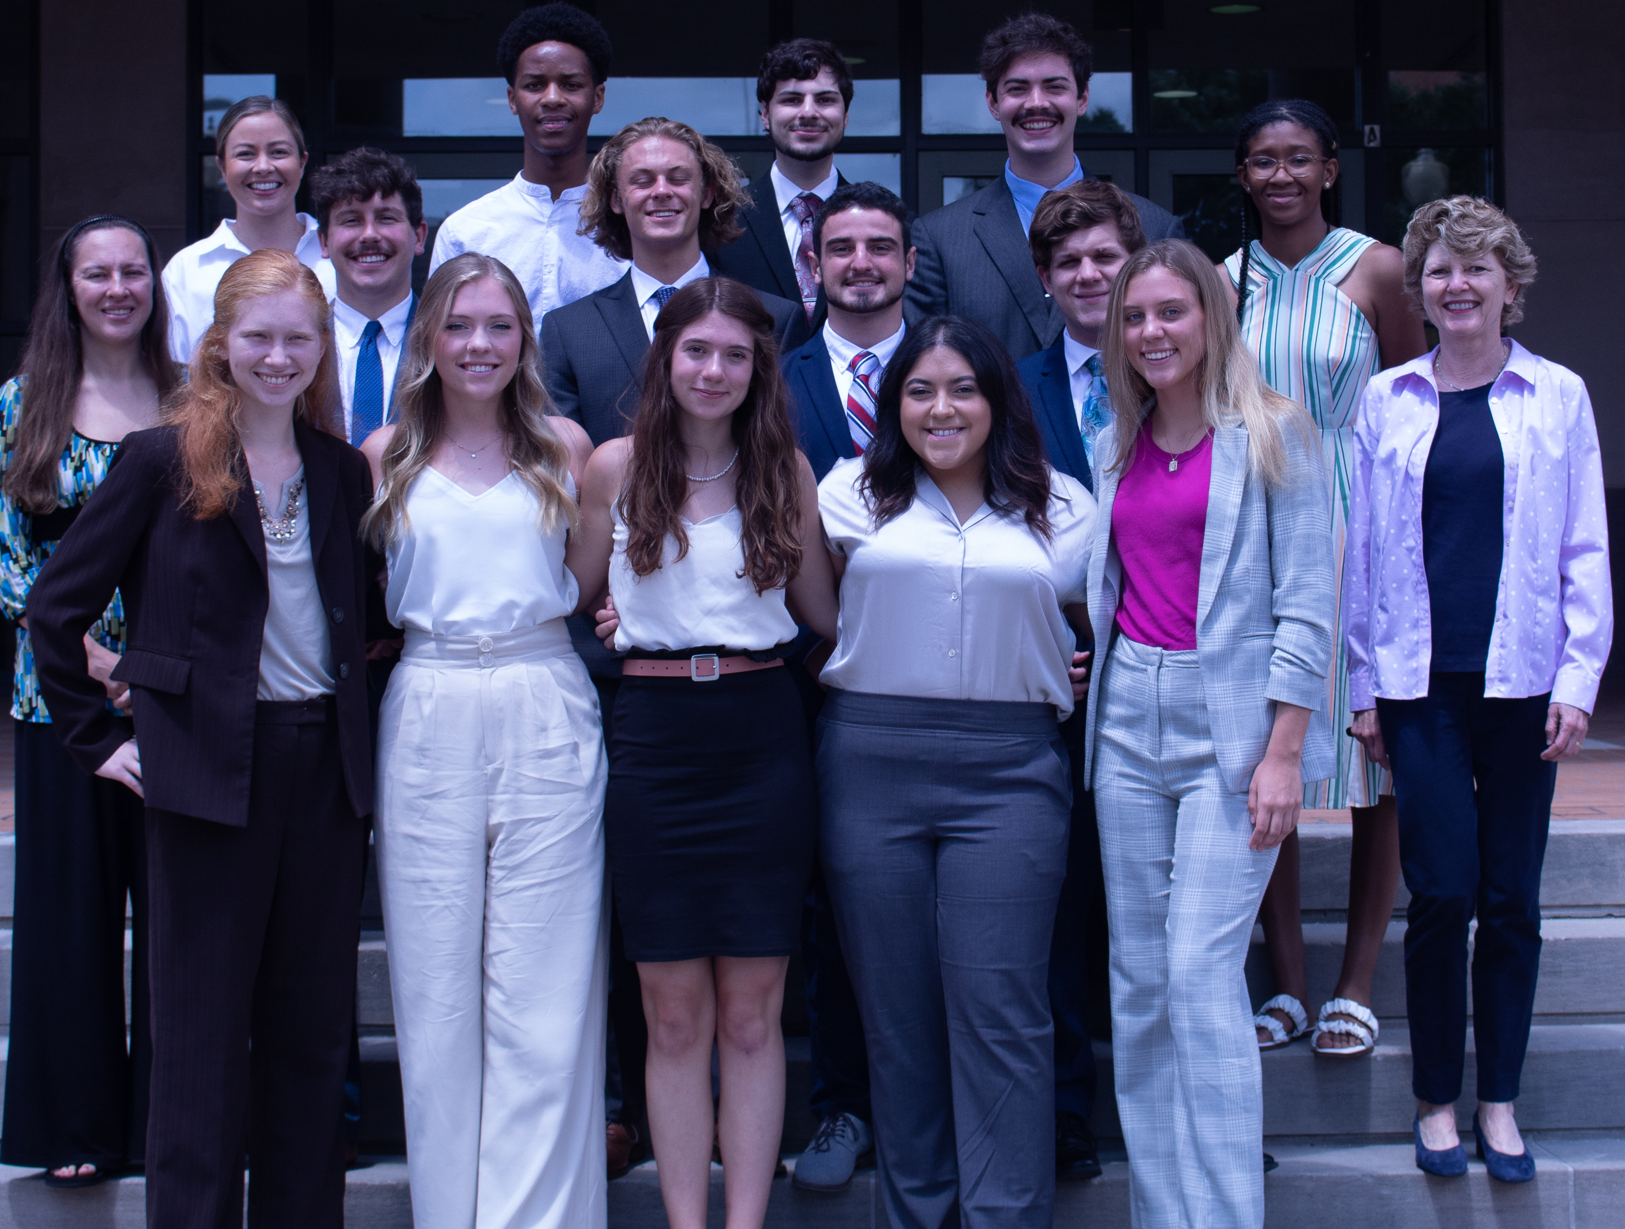
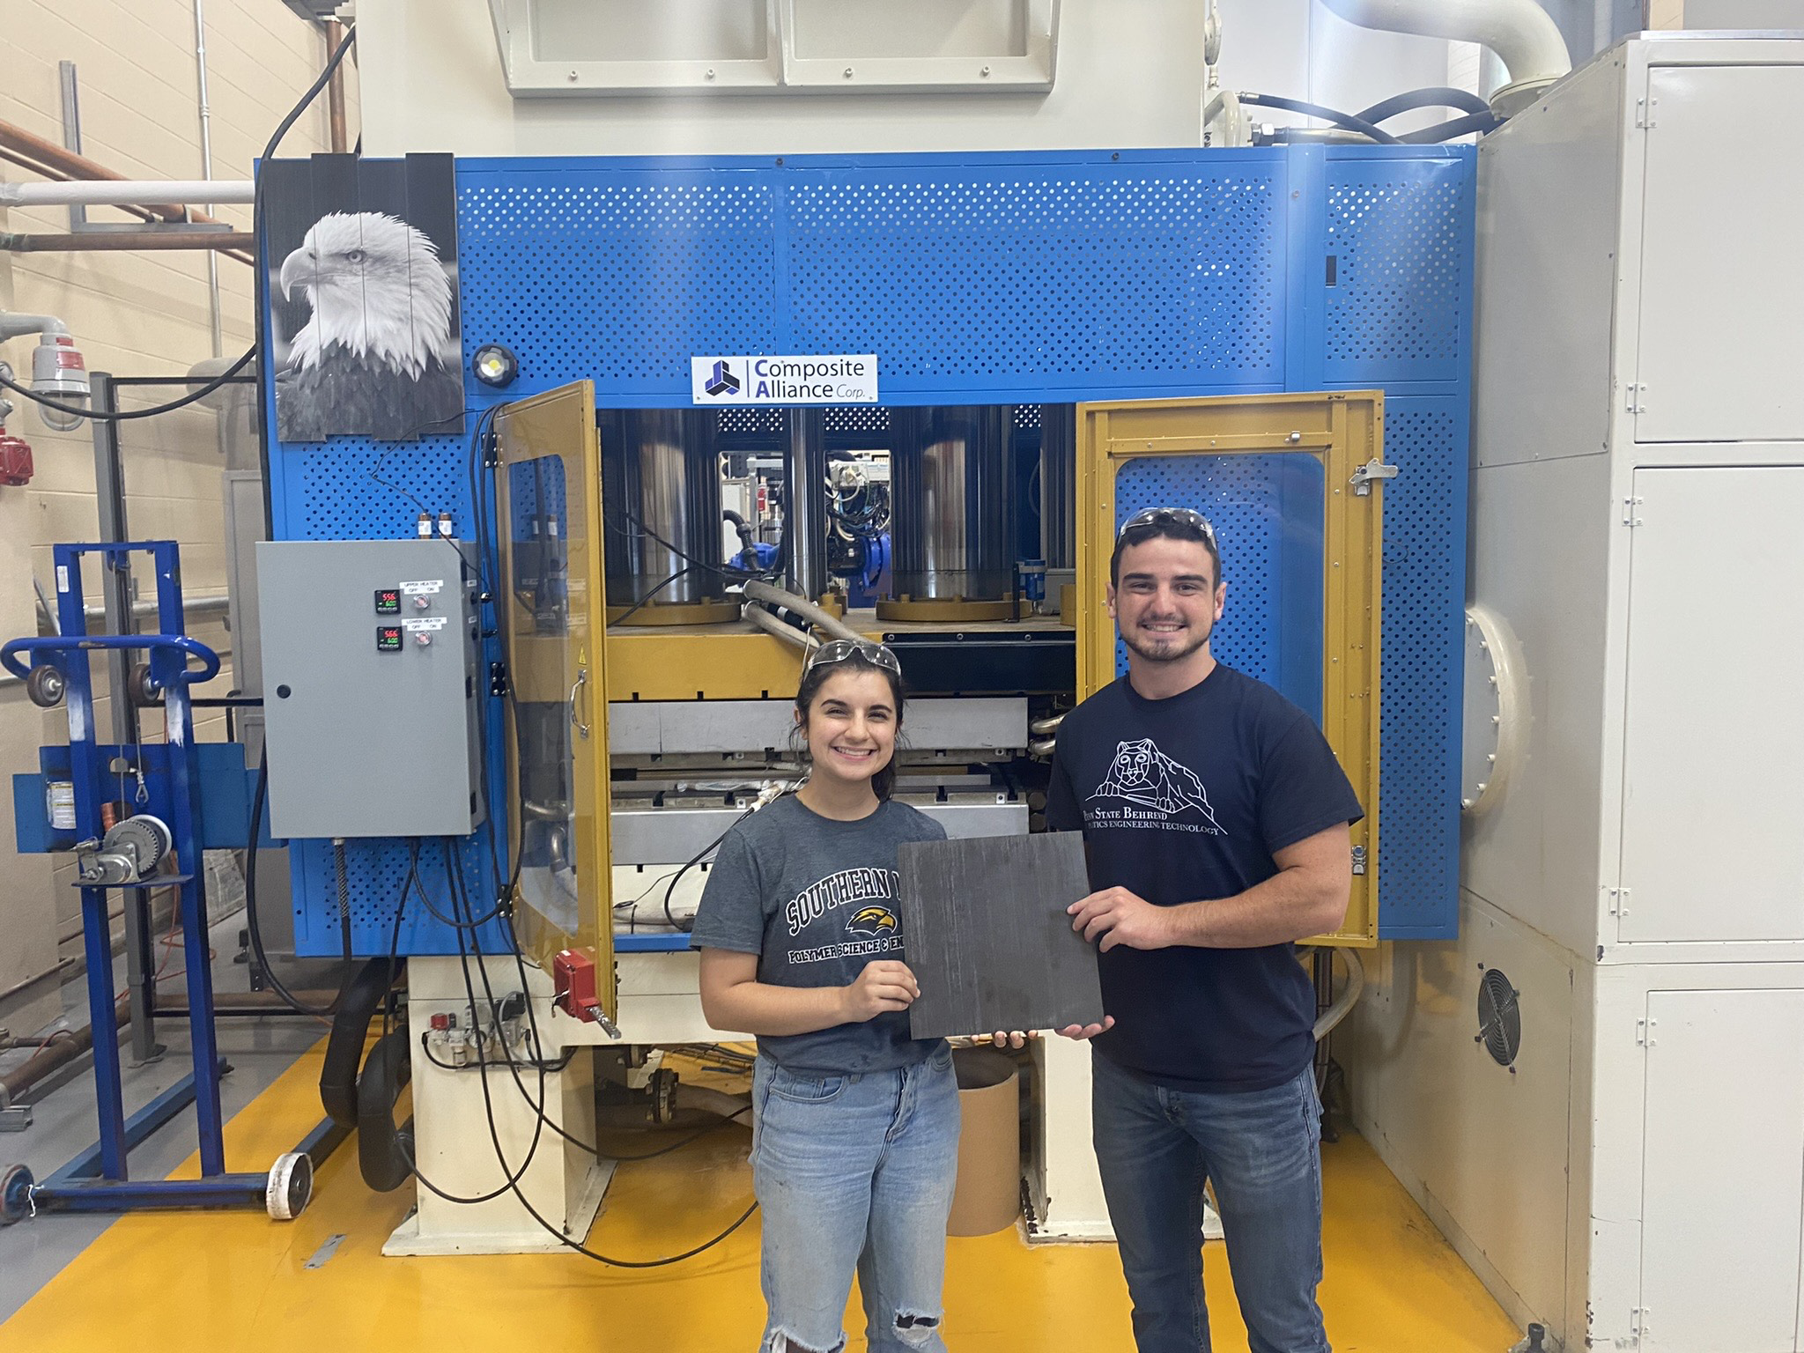
REU Site: Polymer Innovation for Sustainable Future
2022 Intellectual Merit
DMR 1950387
Sarah E. Morgan, University of Southern Mississippi
In 2022, thirteen students representing institutions throughout the United States (including two community college and six PUI students) participated in ten weeks of integrated research and education. Students are engaged in research to develop sustainable approaches to materials development to meet critical societal needs. Research areas included:
Polymers synthesized from renewable sources
Biodegradable materials
Reversible and repairable materials
Materials with enhanced properties and lifetimes
Reduced energy polymer processes
Materials to improve utilization of natural resources
Clockwise from top 2022 REU Cohort; REU participant Veronica Cunitz (Clemons lab) conducting research on the automated peptide synthesizer;
REU participant Joseph Previte (Wiggins lab) with his Graduate Student Mentor Lina Ghanbari holding a composite panel.
Notes:
Projects included:
Development of Orthogonal Post-Polymerization Modification Strategies: Au(I) Catalysis enabled Click Chemistry
Investigating Biofilm Formation on Polymer Substrates via Flow Cells
Peptide Decorated Polymer Block Polycations for the Targeted Delivery of mRNA in Cancer
Assessing Cellular Loading of Materials
Impacts of processing on crystallinity of conjugated polymers thin-films
Synthesis and characterization of galactose containing synthetic Janus glyco-dendrimersomes for utilizations in hydrophobic dye delivery.
Investigation of the effect of humidity on the hydrogen bond organization of hyperbranched polymers
Fabrication and characterization of polyolefin blends via reactive extrusion
Determination of the role of stereochemistry and regiochemistry for diketoenamine network architecture
Structure/Processing/Property Relationships of Polyphenylene Sulfide/Multi-Wall Carbon Nanotube Susceptor Films
Bio-Derived Benzoxazine Vitrimers Based on Dynamic Imine Exchange

Slide 2
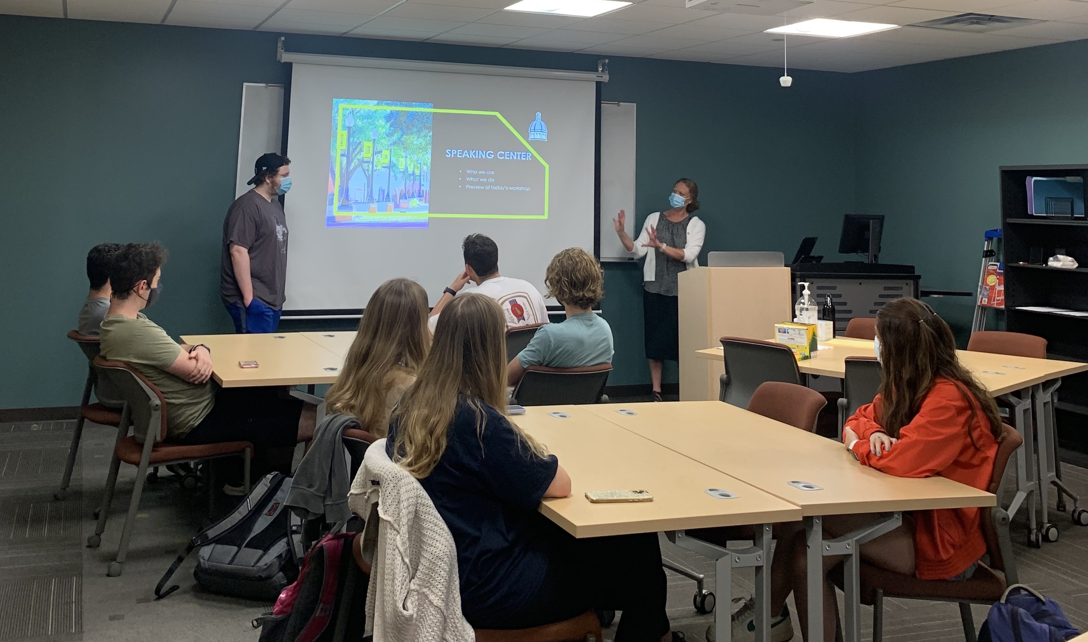
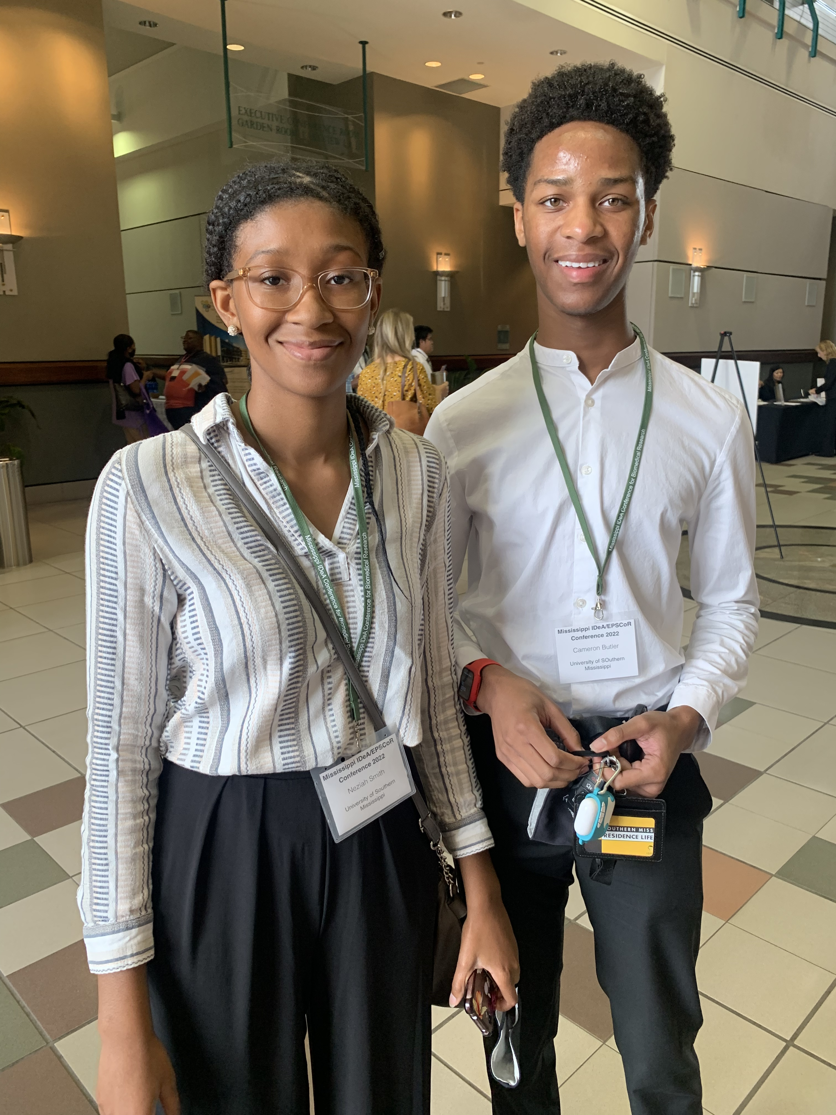
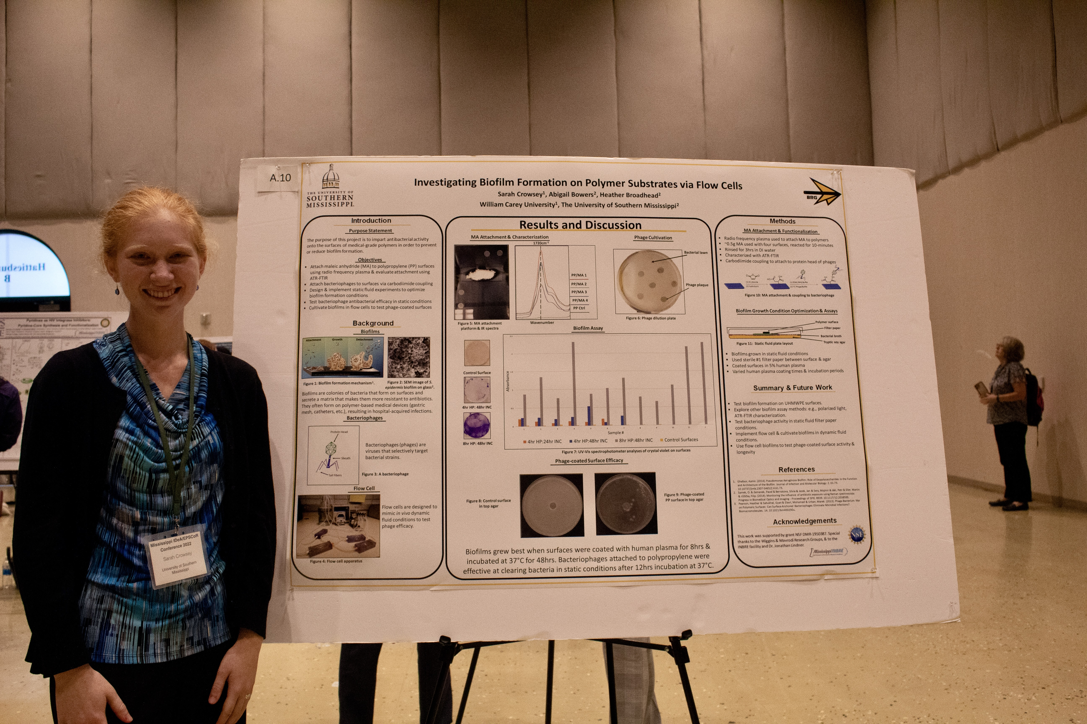
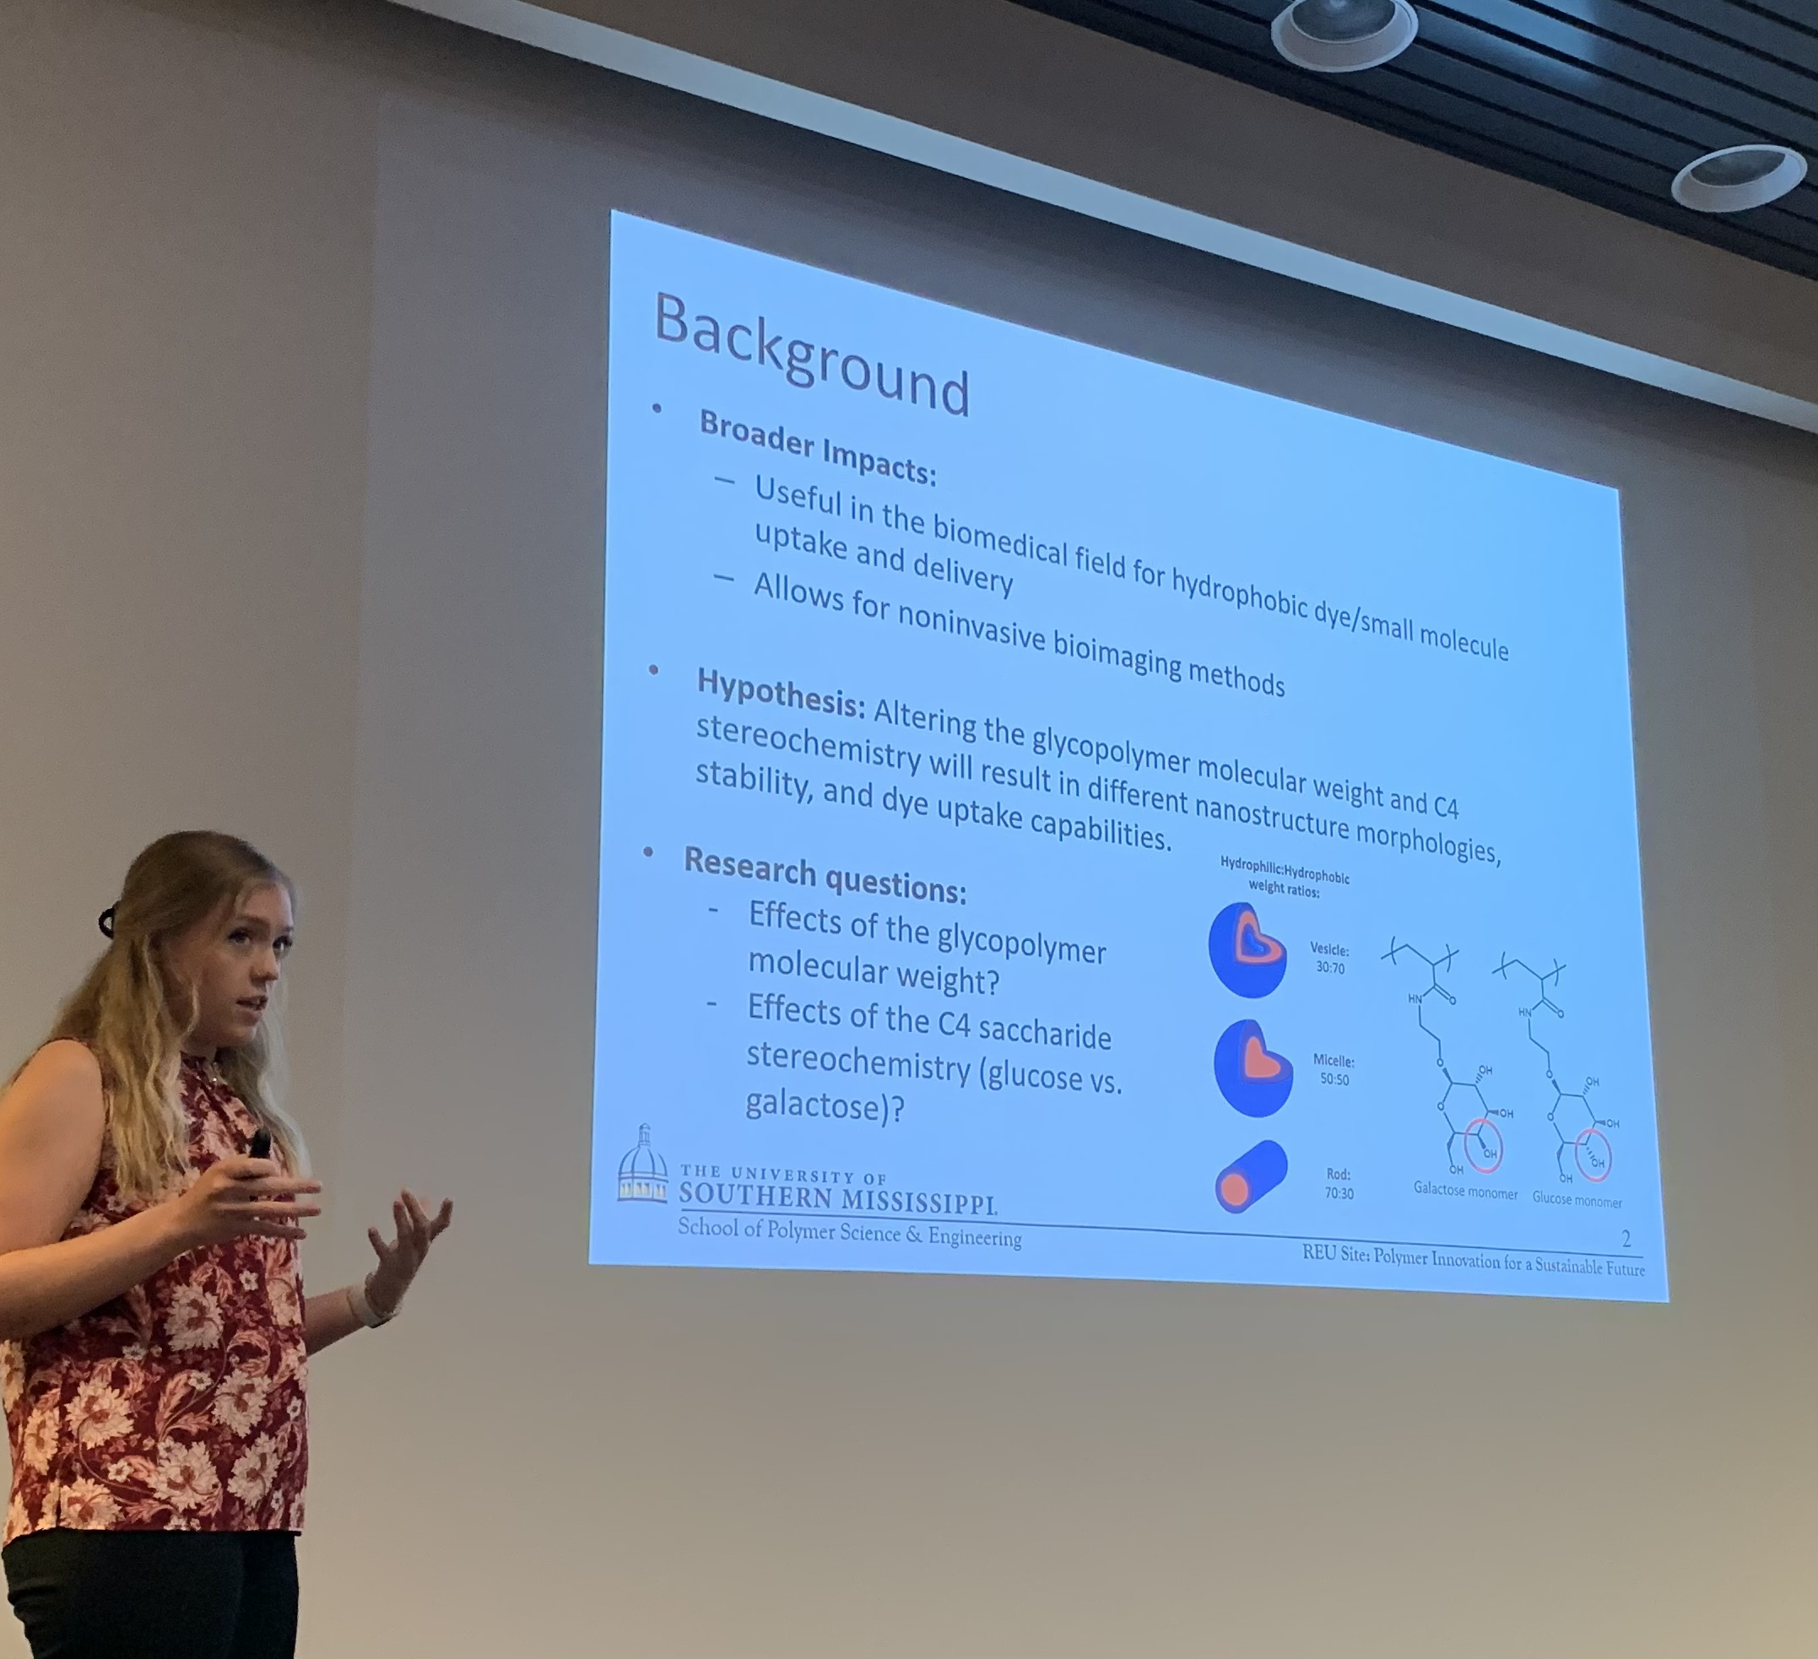
REU Site: Polymer Innovation for Sustainable Future
2022 Broader Impacts
DMR 1950387
Sarah E. Morgan, University of Southern Mississippi
REU students spend ten weeks conducting hands on research under the guidance of a graduate student mentor and a faculty advisor. They present their research orally three times during the summer and compete in a final poster presentation, this year being held at a joint conference of the MS NSF EPSCoR and NIH IDeA Networks. The competition winners received a travel award to present at the Spring ACS national meeting.
Throughout the summer, REU students participate in professional development including polymer science and engineering classes, communications and abstract writing workshops, teambuilding, and field trips to local industry and national labs.
From left to right: REU participants Neziah Smith & Cameron Butler (Qiang lab) at the MS IDeA & EPSCoR Conference; REU participants attending the Communications Workshop, REU participant Sarah Crowsey (Broadhead lab) presenting at the MS IDeA & EPSCoR Conference; REU participant Rachel Worden (Morgan lab) presenting her research.

