Slide 1
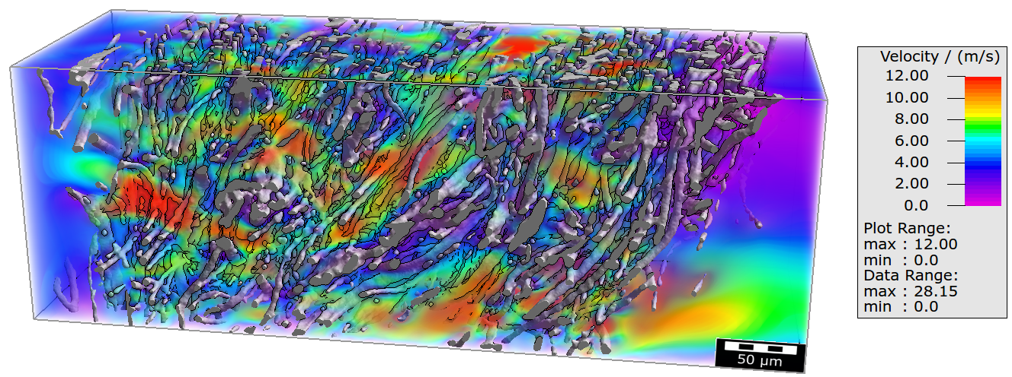
Multiscale Simulations of Fluid Flow in Microstructured Materials
2022 Intellectual Merit
DMR 1944942
Ulf D. Schiller, Clemson University
Structural and functional integrity of decontaminated N95 respirators
The widespread use of filtering facepiece respirators (FFRs) during the COVID-19 pandemic has not only led to supply shortages, but the disposal of single-use facemasks also threatens the environment with a new kind of plastic pollution. There are currently no standard test methods available for decontamination before their repeated use.
The Schiller Research Group combined experimental X-ray micro-tomography and numerical modeling to investigate the filtration performance of decontaminated N95 respirators (in collaboration with researchers from IIT Delhi, India, and the University of Szeged, Hungary).
The insights gained in this study provide scientific guidance on safe and effective decontamination of facemasks for healthcare workers and the general public.
S. Sharma, F. Wang, P. V. K. Rao, A. K. Agrawal, M. Jassal, I. Szenti, Á. Kukovecz, A. Rawal, and U. D. Schiller. Unfolding the Effects of Decontamination Treatments on the Structural and Functional Integrity of N95 Respirators via Numerical Simulations. Scientific Reports 12, 4191 (2022).
S. Sharma, F. Wang, S. Kumar, R. R. Nawal, P. Kumar, S. Yadav, I. Szenti, A. Kukovecz, U. D. Schiller, and A. Rawal. Structural and Functional Integrity of Decontaminated N95 Respirators: Experimental Results. Journal of Industrial Textiles, First published online April 10, 2022.
Computer simulations elucidate the effect of decontamination treatments on airflow and particle filtration in N95 facemasks. Numerical results suggests that non-solution-based treatments (UV light, heat treatment) are preferable compared with solution- based treatments (soap, hydrogen peroxide).
Notes:
We have combined state-of-the-art X-ray microtomography analysis and numerical modeling to investigate the filtration performance of decontaminated N95 respirators. Using the GeoDict software for image processing, the local structural heterogeneity of the meltblown nonwoven filtration layers has been unraveled. The X-ray images further served as input geometries for numerical simulations of the filtration efficiency of decontaminated meltblown layers. The computer simulations provide insights into the particle trajectories and penetration depths for meltblown layers that have undergone different decontamination treatments (soap, hydrogen peroxide, UV light, autoclave heat treatment). This information is practically impossible to obtain by experimental measurements and provides insights into the filtration mechanisms in fibrous media. Notably, in our simulations we have used realistic face velocities for human speaking conditions. To the best of our knowledge, this is the first attempt to analyze the key filtration mechanisms of decontaminated N95 respirators based on the integration of experiments and numerical simulations.

Slide 2
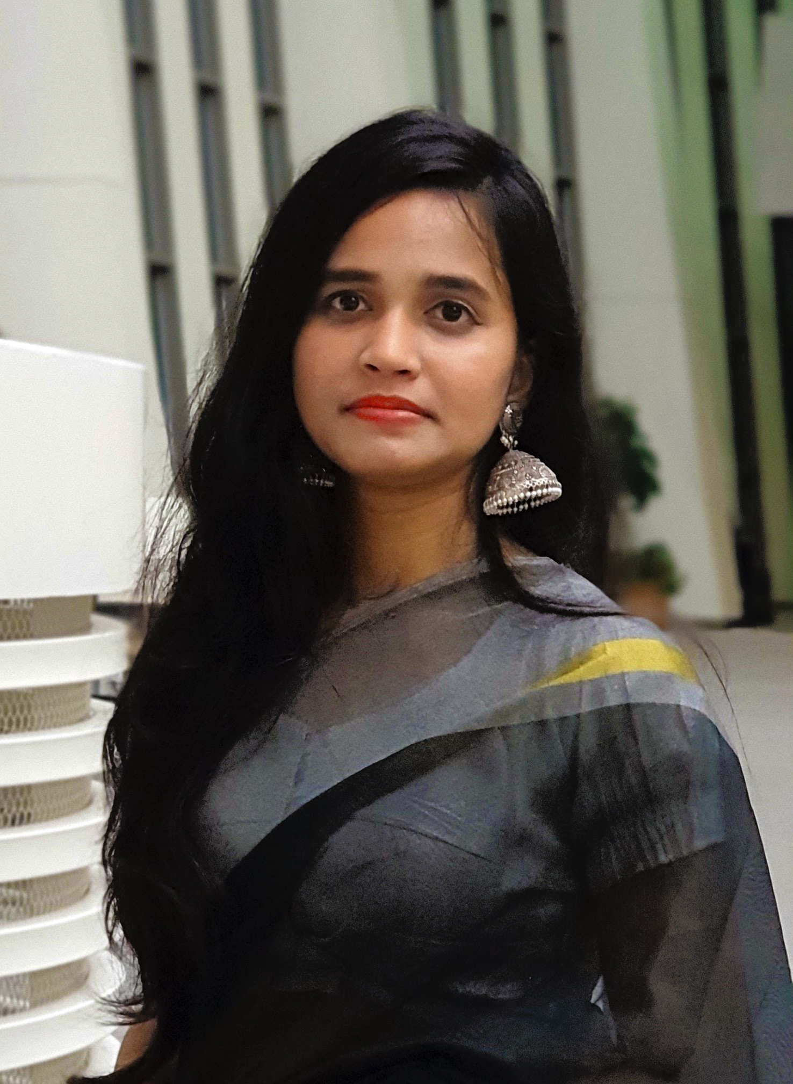
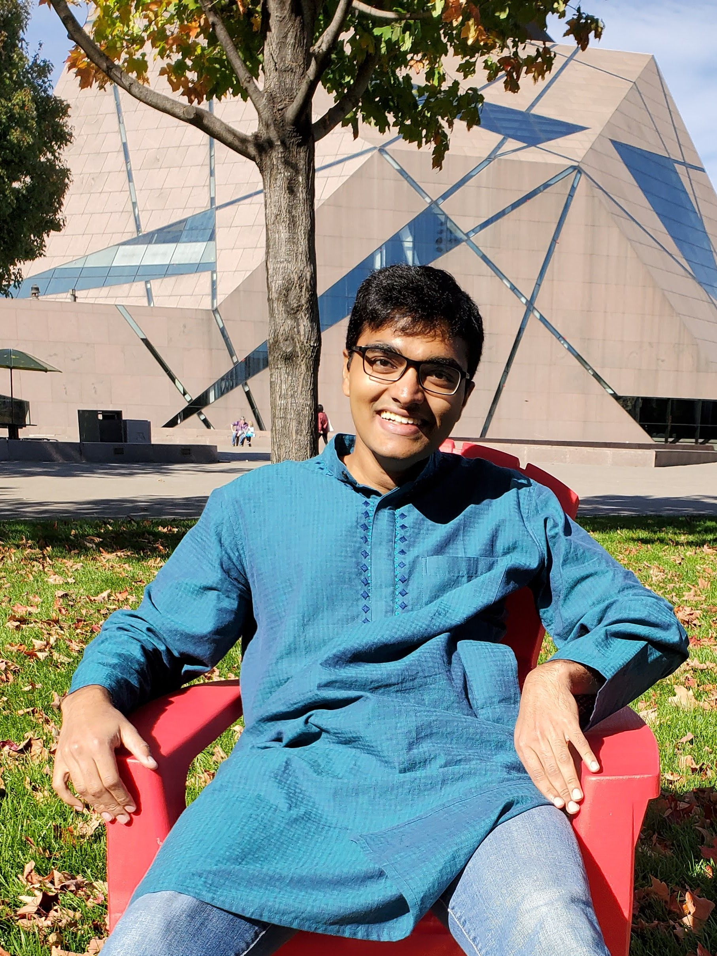
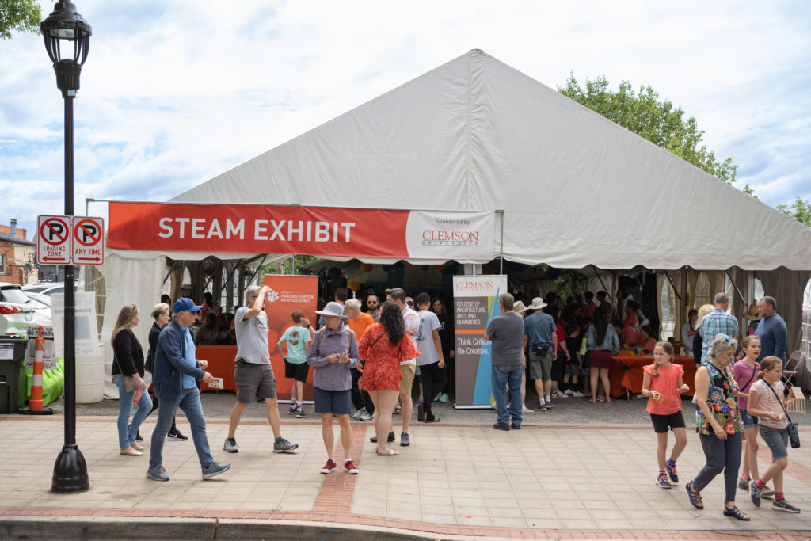
Education and Outreach on Computational Materials Science
2022 Broader Impacts
DMR 1944942
Ulf D. Schiller, Clemson University
The Schiller Research Group contributed to the Clemson STEAM exhibit at the Artisphere Festival in Greenville. The STEAM Exhibit provides a chance for the public to learn about the intersection of science, technology, engineering, arts and math and interact directly with Clemson faculty and students.
PI Schiller contributed to the release of the Data Carpentry Image Processing Curriculum. The Carpentries is a nonprofit organization that teaches software engineering and data science skills to researchers worldwide. The Image Processing Curriculum will be introduced to the global community at CarpentryCon 2022.
PI Schiller co-organized the Multiscale Modelling and Simulation Thematic Track as part of the International Conference on Computational Science (ICCS) 2022.
The Clemson STEAM Exhibit at Artisphere Festival in Greenville, SC showcases the intersection of Science, Technology, Engineering, Art, and Math. The exhibit features interactive displays, demonstrations, and engaging activities.

