Slide 1
Long-Range Energy Transfer Mediated by Lattice Resonances
2022 Intellectual Merit
DMR 1941680
Alejandro Manjavacas, University of New Mexico
Periodic arrays of nanoparticle support collective modes, known as lattice resonances, which occur at wavelengths that are commensurate with the periodicity of the array. These modes give rise to strong and spectrally narrow optical responses.
Here, we exploit the collective nature of lattice resonances to achieve long-range energy transfer between dipole emitters placed in the vicinity of the array.
Specifically, we analyze the spectral and spatial characteristics of the electromagnetic field produced by the array at a point r due to the presence of a dipole emitter placed at another position r_{μ} .
We show that, when the array supports a lattice resonance, the electromagnetic field away from the emitter is significantly enhanced compared to that of the emitter in vacuum. Moreover, we show that the enhanced field decays more slowly with distance.
Reference:
L. Zundel, A. Cuartero-González, S. Sanders, A. I. Fernández-Domínguez, and A. Manjavacas. ACS Photonics. 9, 2 (2022)
Electric field amplitude at position r produced by a periodic array of spherical silver nanoparticles that are 200 nm in diameter when excited by a dipole emitter located at a position r_{μ} , as depicted by the upper schematics (black dots). For comparison, we show the field of the emitter in vacuum using gray dots. The field of the array decays more slowly with distance than that of the dipole in vacuum, as indicated by the colored lines.

Slide 2
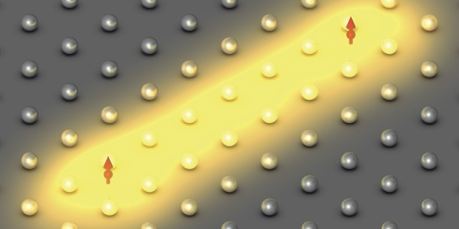
Long-Range Energy Transfer Mediated by Lattice Resonances
2022 Broader Impacts
DMR 1941680
Alejandro Manjavacas, University of New Mexico
Our work contributes to the fundamental understanding of the lattice resonances supported by periodic arrays of nanoparticles. While there has been much study into their response to illumination by a plane wave, there has been very little investigation of their excitation by localized sources.
Therefore, our results are expected to have significant impact on applications, such as sensing and quantum information processing, which involve the interaction between quantum emitters and periodic arrays of nanostructures.
Because the electromagnetic field produced by a periodic array extends farther than that of a localized source in vacuum, our results can also be used to achieve long-distance nanoscale energy transfer.
Lattice resonances can be used to facilitate long-range energy transfer between quantum emitters, enabling new applications in sensing and quantum information processing.
Two graduate students Lauren Zundel (left) and Stephen Sanders (right) have participated in this research project.

