Slide 1
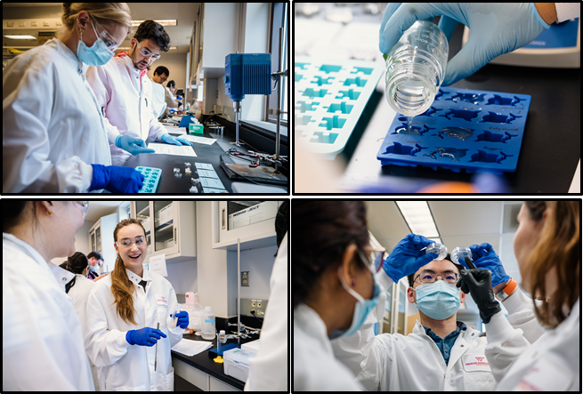
GlycoMIP Hosts 2nd Annual Summer School at VT
GlycoMIP at Virginia Tech & Univ. of Georgia, DMR-1933525
Education and Outreach: 2022 Summer School @ VT
GlycoMIP held its 2nd Summer School at the VT-GlycoMIP facility with an engaging, in-person agenda featuring hands-on analyses, demonstrations, panel discussions and lectures from leading experts. A diverse audience of 22 academic and industry scientists from across the US participated in the program, which contributed unique perspectives and varied interests in glycomaterial science. Modeled after GlycoMIP user facility capabilities, program content ranged from glycomaterial basics and applications, synthesis and automated glycan assembly, characterization of structure and properties, to computational methods and modeling. An interactive rheology competition comprised 6 stations and allowed small teams to prepare and test glycomaterials flow properties, gelation, and film-casting. The events was video-recorded and featured in the VT daily online newsletter, Virginia Tech X Daily.
Course evaluation feedback was highly positive, summarized well by one participant, “GlycoMIP Summer School was a profoundly enriching experience and positively engaging environment that deepened my appreciation for glycomaterials” (S. Negedu, LSU). The event attracted 11 students from 5 MSIs with 7 travel awards provided to broaden event participation and diversity. Summer School supports GlycoMIP’s goals of educating the next generation of glycomaterial scientists and engaging users and prospective users in services available through the GlycoMIP user facilities.
Maren Roman, Virginia Tech, Robert J. Woods, University of Georgia
GlycoMIP 2022 Summer School @ VT: June 13-17, 2022
22 Total Participants
9 Universities
2 Companies
18 Academic Researchers
4 Industry Scientists
Automated Glycan Assembly demonstration
Topics Covered
Glycomaterial Synthesis
Mass Spec., NMR, & Rheometry
Chiroptical Spectroscopy
Carbohydrate Interactions
Computational Methods & Modeling
Small teams prepared and evaluated glycomaterial rheological properties during an interactive competition
Notes:
What Has Been Achieved: GlycoMIP’s second annual summer school was held in the VT GlycoMIP facility June 13-17, 2022. A diverse group of 22 academic and industry scientists from 11 different universities and companies participated in the program. The in-person format allowed for instrument and technique demonstrations as well as hands-on exercises to accompany the lectures and panel discussions central to glycomaterial synthesis, characterization, and modeling. GlycoMIP 2022 Summer School @ VT supports the MIP’s goals of broadening participation and diversity in glycomaterials research and training the next generation of glycomaterial scientists.
Importance of the Achievement: Glycomaterials research is a challenging discipline to enter mostly due to a lack of educational programs and resources. GlycoMIP is dedicated to broadening participation in this field and the in-person Summer School provides a foundation for students and scientists to begin designing glycomaterials and analyzing them towards desired outcomes. The professional networks established during this one-week program are anticipated to foster continued interest and collaboration in glycomaterials science and retain researchers in the field.
Unique Feature(s) of the MIP that Enabled this Achievement: GlycoMIP has a large and renown group of faculty investigators, many of which are on the VT campus. The in-person format allowed participants to speak directly and personally with these experts, providing a unique resource towards their own interests and projects. These experts were crucial to the developing of an exceptional and comprehensive introduction to glycomaterials research. Also, the VT GlycoMIP facility is equipped with the majority of instrumentation critical to GlycoMIP’s synthesis and characterization areas and has adequate lab space to accommodate the 21 participants.

