Slide 1
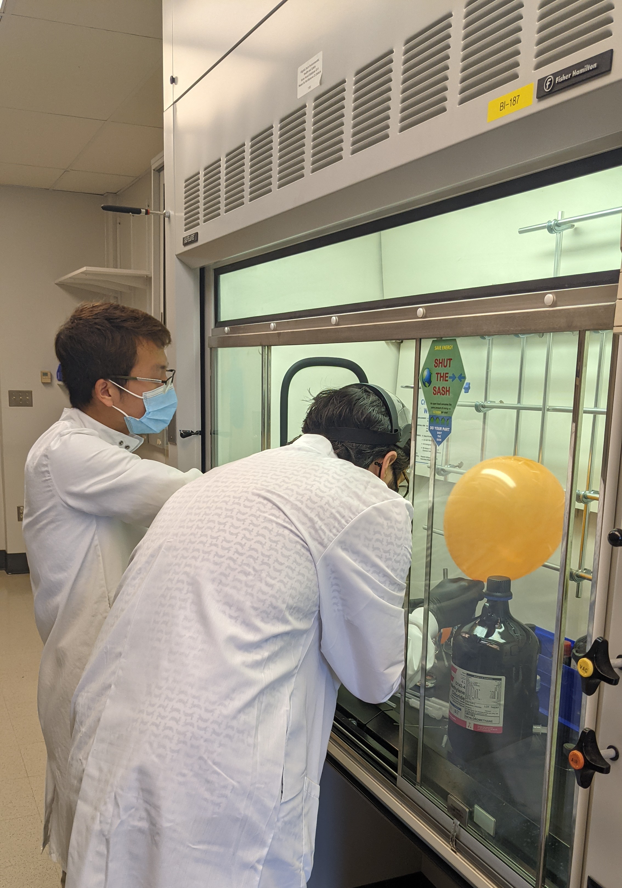
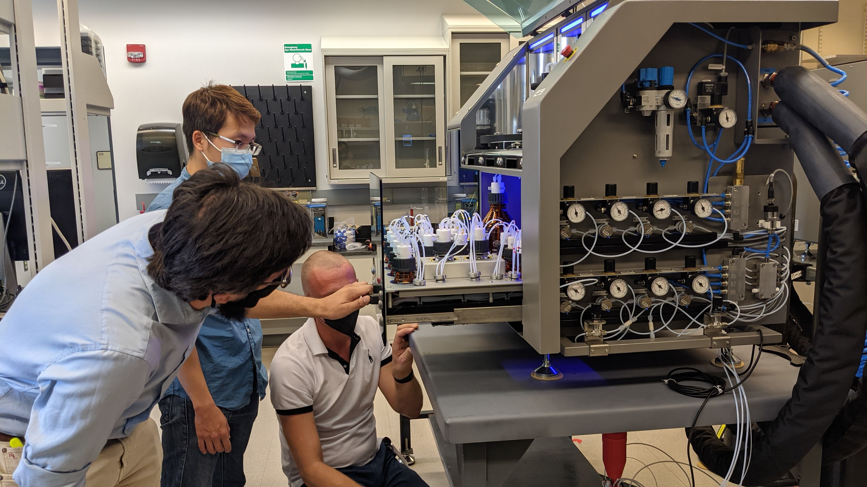
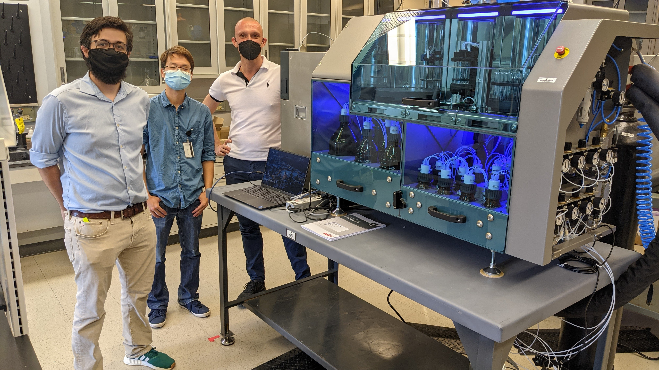
GlycoMIP User Facility installs first two Glyconeers ® in U.S.
GlycoMIP at Virginia Tech & Univ. of Georgia, DMR-1933525
User Program : Glyconeers Installation - 2021
Maren Roman, Virginia Tech, Robert J. Woods, University of Georgia
Meet Gottfried and Ingeborg, the newest instrumental members of the GlycoMIP user facility. Gottfried and Ingeborg are fully automated oligosaccharide synthesizers (Glyconeers®) from GlycoUniverse. These instruments are numbers 11 and 12 in the world and are the first of their kind in the United States.
An ongoing challenge for the field of glycoscience and glycomaterials is the limited access to structurally-defined glycans, as well as the tremendous synthetic effort and cost associated with designer glycan synthesis. Just as the DNA/RNA and peptide automated synthesizers have revolutionized research in their respective fields, the Glyconeers® are anticipated to significantly accelerate and reduce costs of complex glycan production, while also providing access to previously unattainable glycan structures.
These instruments deliver glycan building blocks to a temperature-controlled reaction vessel, where they can attach to a solid-support resin via a photo-cleavable handle. Selective deprotection of the building block allows for iterative glycosylation reactions with defined linkages until the desired glycan structure is generated.
The Glyconeers® are complemented by a suite of preparative and analytical instruments housed in the MIP’s synthesis facility that release resin-bound glycans, deprotect, purify, and characterize them.
Top left: Prepare building blocks for use on the Glyconeer®.
Top right: Inspect the solvent levels in the Glyconeer®.
Bottom left: A Glyconeers® after installation.
Notes:
What Has Been Achieved: The first two commercially available automated glycan synthesizers in the United States were installed in the GlycoMIP user facility at Virginia Tech in late September 2021. The instruments, named Gottfried and Ingeborg, are the 11th and 12th instruments produced by GlycoUniverse. Mario Salwiczek and Kim Le Mai Hoang, respectively the CEO and chief chemist of GlycoUniverse, traveled from Germany to install the instruments and provide training over the course of a week. The Glyconeers® use technology analogous to solid-phase peptide chemistry to systematically build sugars on a resin, producing a defined oligosaccharide.
Importance of the Achievement: The Glyconeers® enable us to rapidly generate complex glycans by precisely controlling the temperature, addition rates of reagents, and allow for solid-support purification after each reaction step. These instruments manufacture glycans at a rate of approximately 40 minutes per step and can produce a well-defined tetrasaccharide in as little as 8 hours. These are the only two instruments in the United States, providing GlycoMIP and the broader scientific community access to complex sugars.
Unique Feature(s) of the MIP that Enabled this Achievement: The GlycoMIP user facility at Virginia Tech comprises 11 different instruments allowing us to produce and fully characterize glycomaterials in-house. The Glyconeers® allow GlycoMIP to generate glycan arrays, prepare discrete glycomaterials for modeling and database generation, as well as labeled carbohydrates for glycobiological applications.

