Slide 1
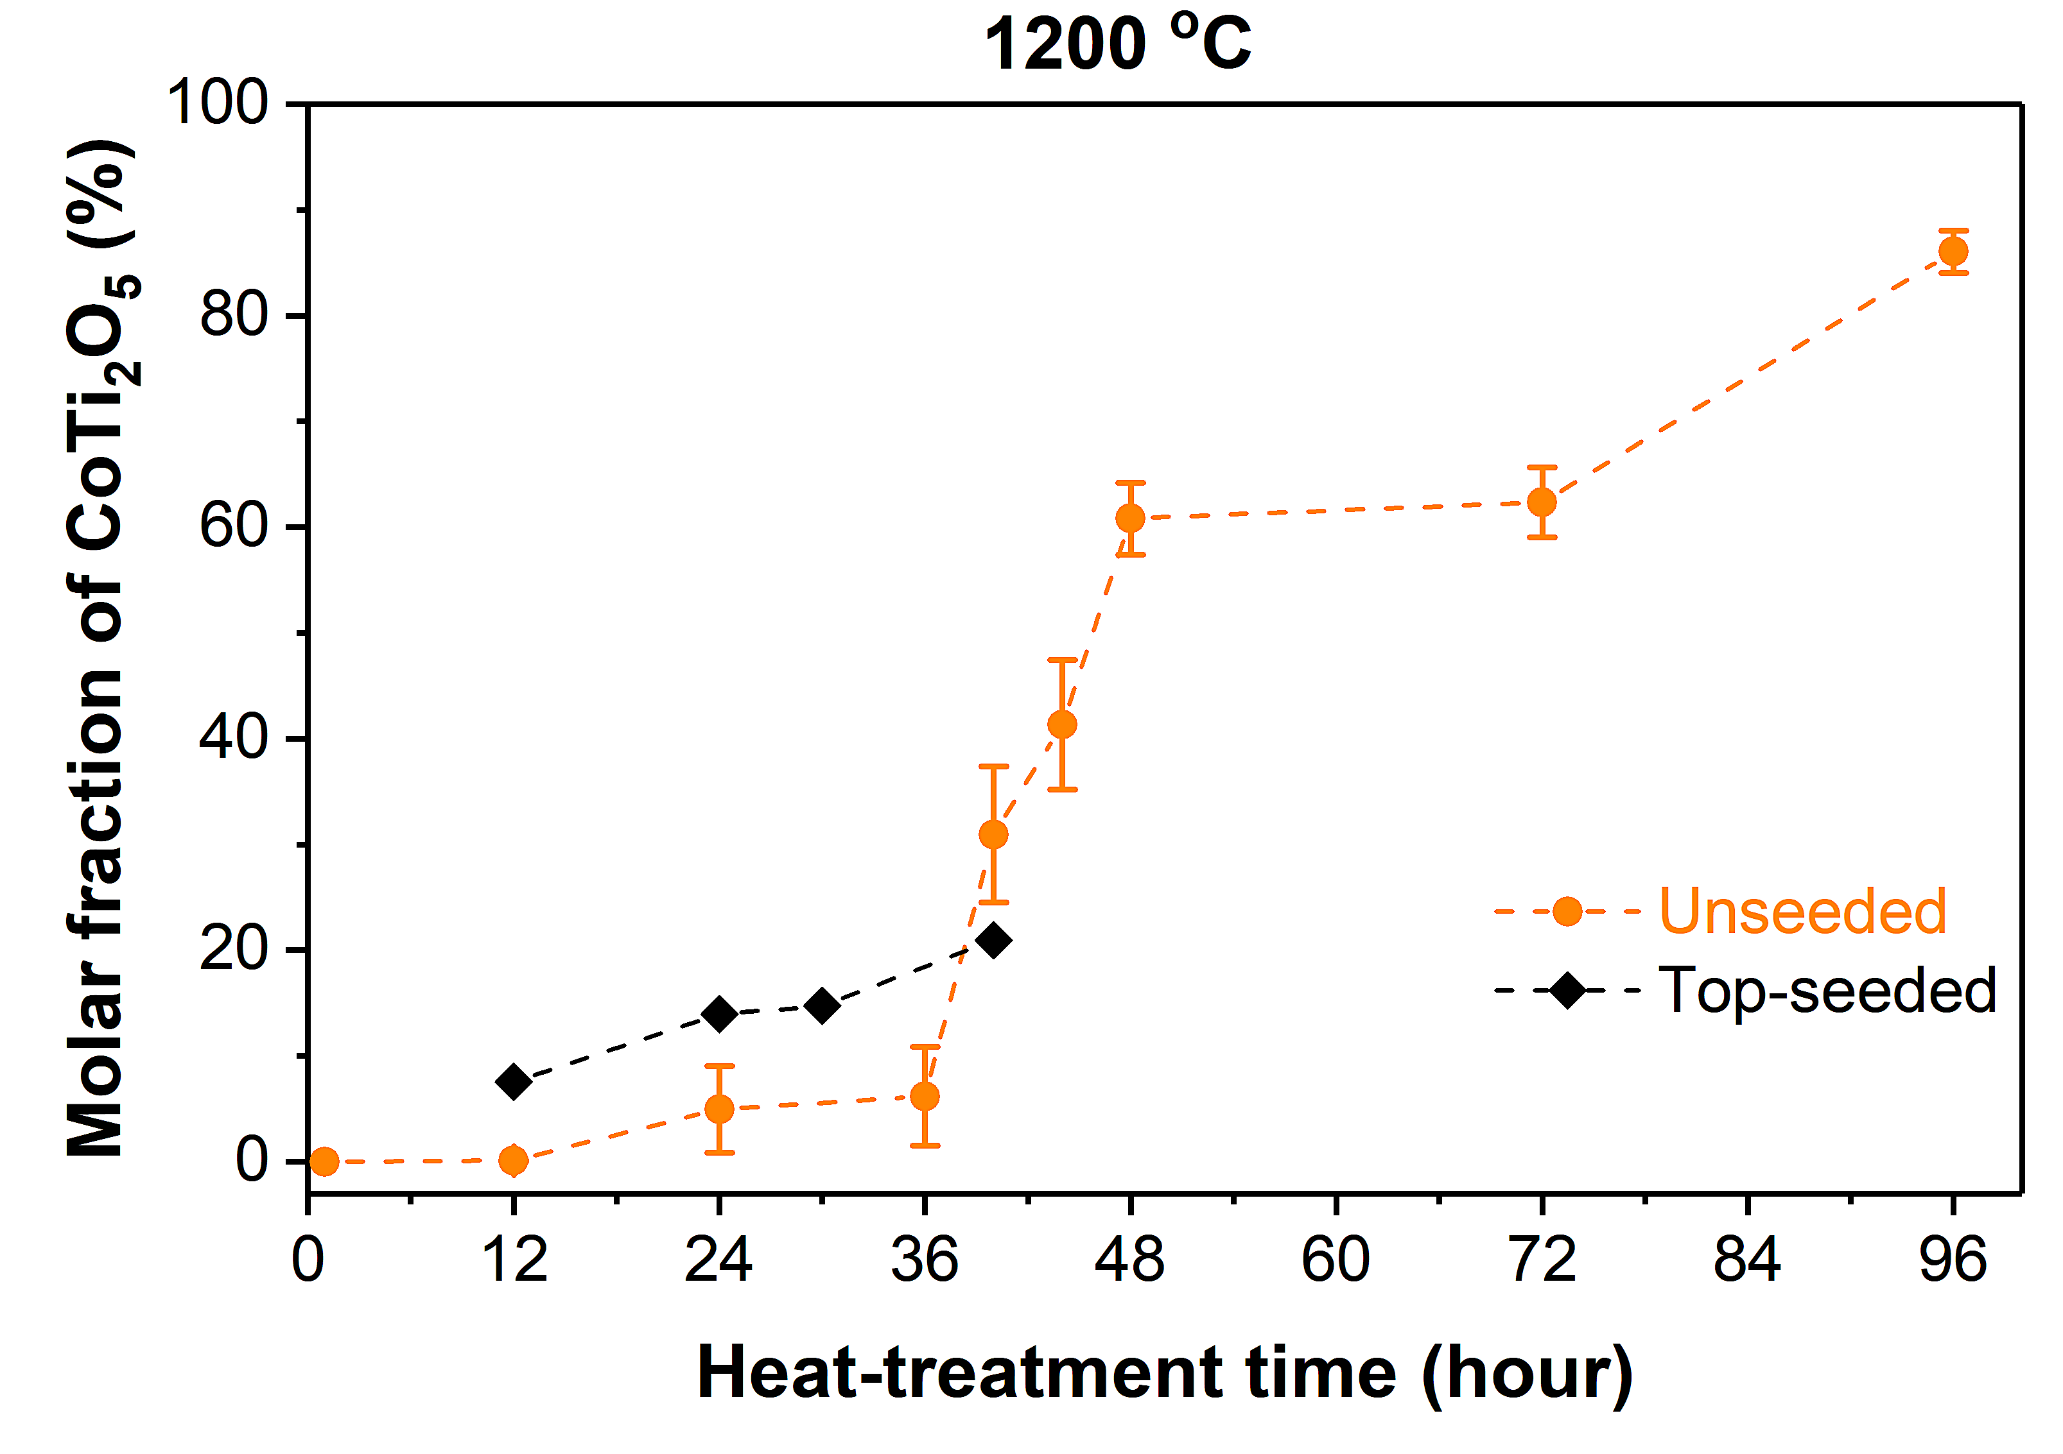
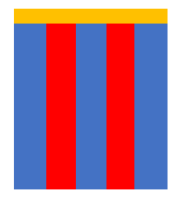
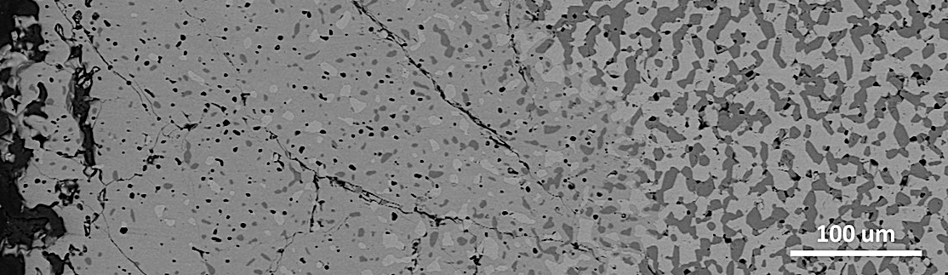
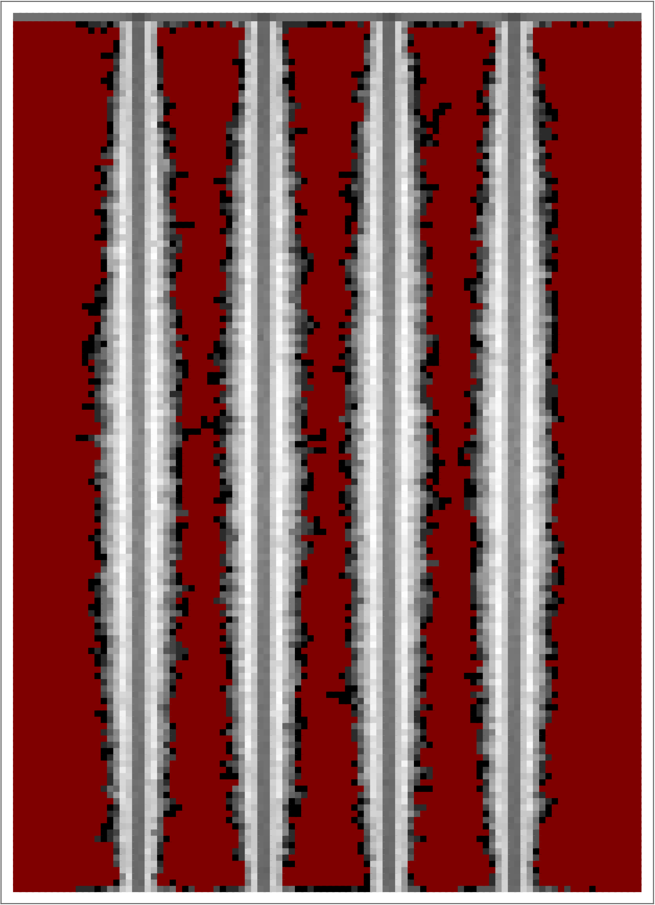
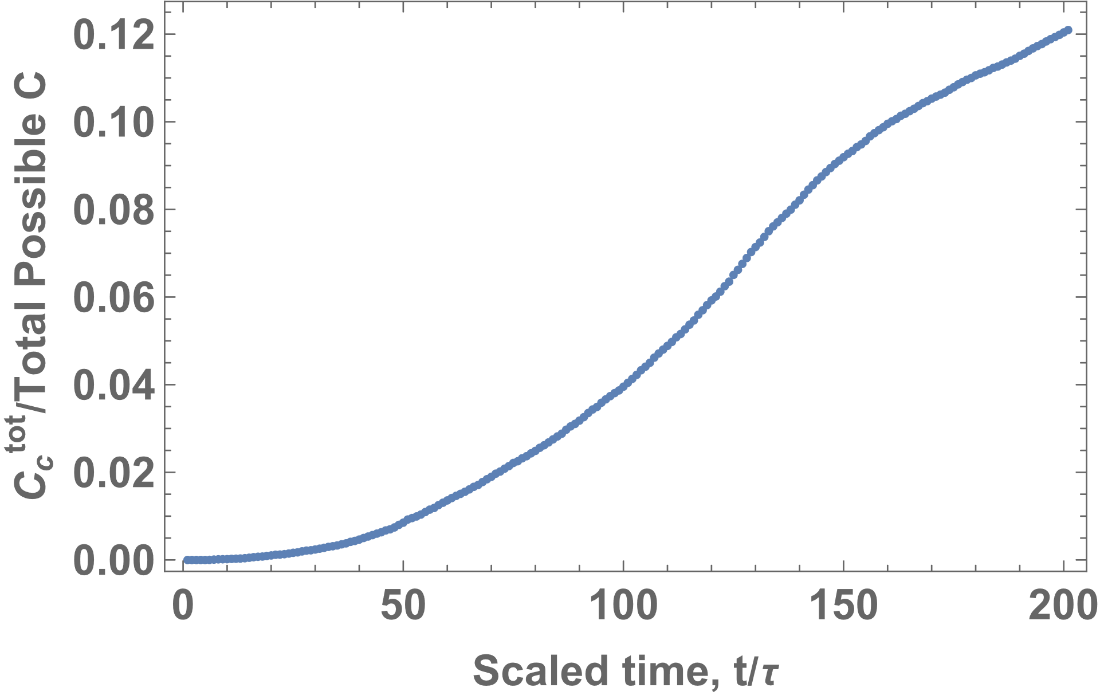
Single Crystal Growth by Solid State Reaction Synthesis: Informatics Driven Microstructural Analysis and Design
2022 Intellectual Merit
DMR 1929263
Helen M. Chan, Lehigh University
Experiment: Demonstrated solid state single crystal growth process (A + B → C) in Co-Ti-O system. Higher rates of transformation to single crystal CoTi₂O₅ were observed for samples ‘top-seeded’ with CoTi₂O₅ crystals. This type of reaction has not been observed previously and is potentially a new route for single crystal fabrication in other material systems.
Corresponding stochastic reaction-diffusion computer simulations were used to generate analogous transformation curves for a top-seeded microstructure composed initially of A and B lamellae. The influence of the reaction and transport rates on the evolution of the product C phase was explored.
Seed
Layer
C: Single crystal
A + B
Partially transformed microstructure
A
C
B
Unreacted computer simulation template
Spatial distribution of product phase
Total C vs time
Notes:
On heat-treatment above a critical temperature (T_{c} ~ 1140 deg. C), pseudo-single-crystal cobalt dititanate (CoTi₂O₅) can be produced by reaction of a duplex grain mixture of cobalt titanate and titania. The rate of transformation depends on a complex interplay between the advancement of the reaction front and dissolution of remnant cobalt titanate and titania grains left in the wake. The kinetics of these processes depend on different diffusion mechanisms. For unseeded samples, nucleation of the cobalt dititanate occurs at multiple locations at the sample surface. Seeding with a layer of dititanate particles nucleates the transformation with a near planar reaction front. In the micrograph the single crystal region is growing from left to right. For the shorter annealing times, the degree of transformation is greater in the seeded sample, versus the unseeded. The seeding technique provides a means of controlling the microstructural evolution.
For comparison with the experimental observations, a top-seeded lamellar template was studied, in combination with a variety of different diffusion and reaction rates. The upper image shows the starting template, whereas the lower image shows the production of C along the original A/B interfaces. Work to date has focused on the effect of different ‘seeding’ criteria and the time dependence of the growth of C starting from the strip at the edge of the template. The aim will be to correlate the modelling results with those of experiment to extract information on kinetics related materials parameters.

Slide 2
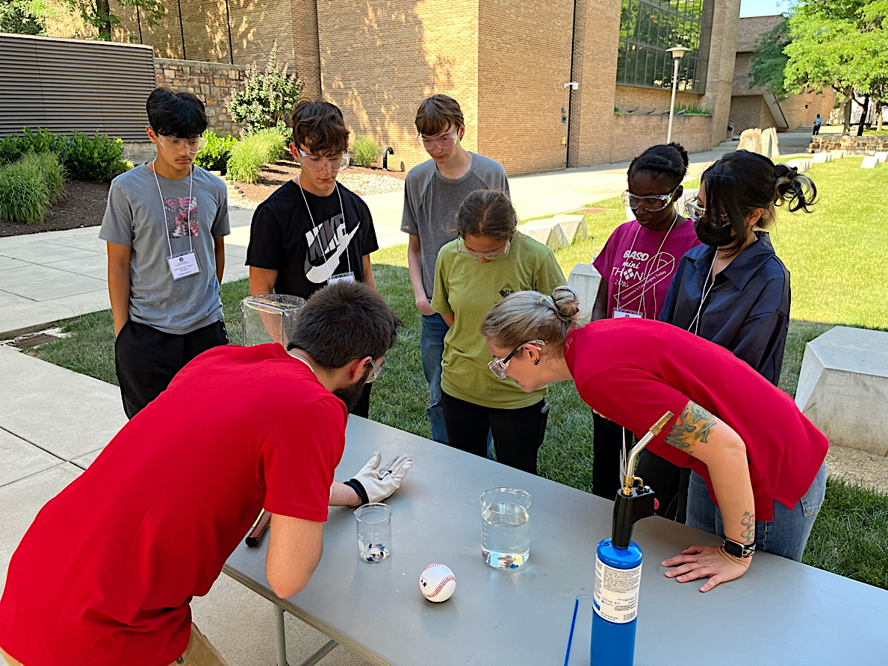
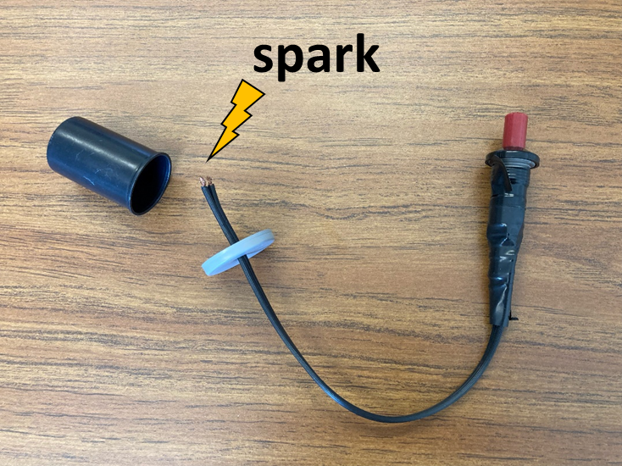
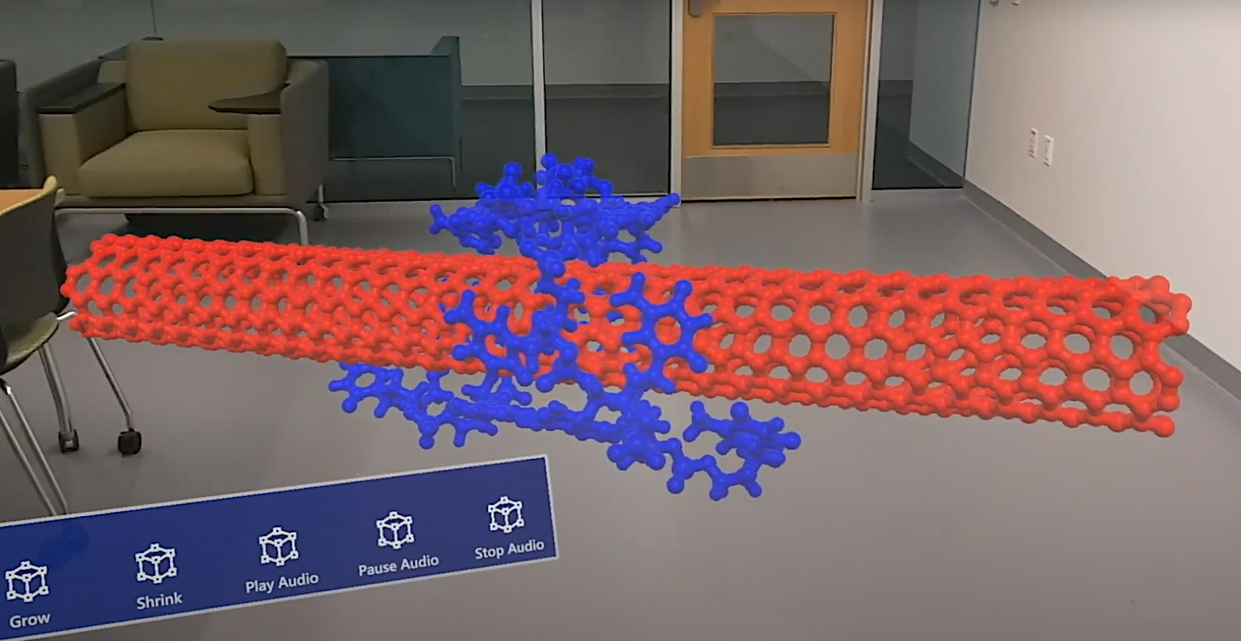
Single Crystal Growth by Solid State Reaction Synthesis: Informatics Driven Microstructural Analysis and Design
2022 Broader Impacts
DMR 1929263
Helen M. Chan, Lehigh University
The group participated in demonstrations for CHOICES (Charting Horizons and Opportunities In Careers in Engineering and Science) 2022. This program is dedicated to encouraging middle school girls to consider careers in STEM, and was attended by 34 students from 5 local area middle schools.
Graduate research assistants J. Zhang and C. McNamara helped organize and participated in MAT Camp (Lehigh University Materials Camp) 2022, a weeklong program that introduces materials science to local area high school students. Demonstrations and labs included “Rupert’s Drops”, metal casting, and utilizing the latest in virtual reality technology to help students visualize materials at the atomic level.
MAT Camp
CHOICES
Prince Rupert’s Drops demo
MAT Camp
Piezoelectric popper demo
Nanotube AR image
Notes:
During CHOICES 2022, we presented several interesting experiments and demonstrations related to science and engineering. This included the ‘piezo-popper’, where a drop of ethanol is added to a roll film cartridge. The spark generated by a piezoelectric lighter causes the vaporization of the ethanol, resulting in the cartridge body shooting across the room accompanied by a loud boom! (see LH photo).
MAT Camp 2022 is a weeklong program aimed at introducing Materials Science and Engineering to high school students. Junyan served as the camp student coordinator, helping design the curriculum and assisting with the preparation and set-up of all the experiments, including the ceramic mug drop. The upper RH photo shows the “Prince Rupert’s Drop” demonstration. Rupert’s Drops are tadpole-shaped droplets of glass formed by dripping molten glass into cold water. The residual stresses developed in the droplet are such that the head of the tadpole is very strong, and can sustain blows with a hammer. However, if the tail is broken, the droplet explodes into tiny fragments. Connor instructed the students in 3D modeling as well as directed them through experiences in virtual reality with Quest 2 headsets and augmented reality with HoloLens 2 headsets, see lower RH photo which shows an example of the images viewed by the students.

