Slide 1
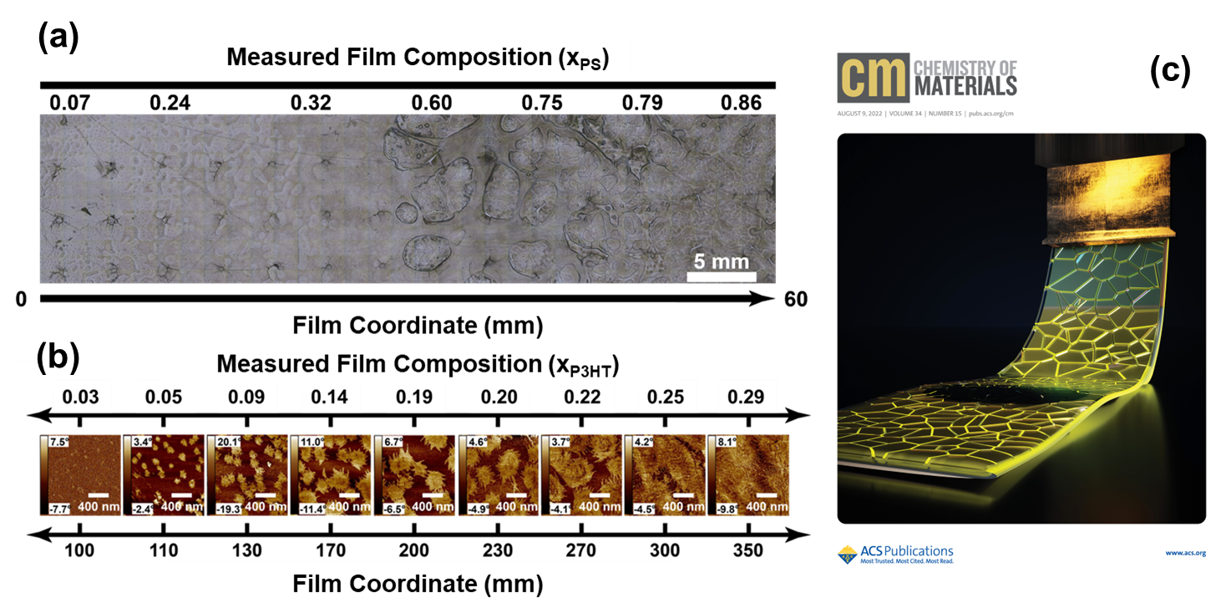
Composition Gradient High-Throughput Polymer Libraries Enabled by Passive Mixing and Elevated Temperature
DMR 1922111
Martha A. Grover, Georgia Tech Research Corporation
High-throughput experimentation (HTE) methods are key to enabling informatics-driven workflows to accelerate discovery of high-performance multicomponent materials. Here, we designed a solution coating system able to operate at temperatures over 110 °C to deposit composition gradient polymer libraries. The methodology provides an avenue for efficiently screening multiparameter spaces of a wide range of materials relevant to today’s applications.
The system is equipped with a custom, solvent-resistant, metallic passive mixer module for high-temperature mixing of polymer solutions.
Residence time distribution (RTD) models were generated and tested using poly(3-hexylthiophene) (P3HT) – poly(styrene) (PS) blends for prediction of coating conditions necessary to generate composition gradient films.
High temperature gradient film coating was demonstrated using poly(propylene) (PP) and poly(styrene) (PS) blends.
(a) Optical image stitch shows composition-dependence of phase behavior in a PP/PS gradient film. (b) Tapping-mode AFM phase images similarly shows structural morphology evolution across a P3HT/PS composition gradient film. (c) The published work was featured in cover art for an issue of Chemistry of Materials, Vol. 34, No. 15.
A. L. Liu, E. M. Dogan-Guner, M. McBride, R. Venkatesh, M.A. Gonzalez, E. Reichmanis, M. Grover, J.C. Meredith, Composition Gradient High-Throughput Polymer Libraries Enabled by Passive Mixing and Elevated Temperature Operability, Chem. Mater. 2022, 34, 15, 6659–6670. DOI: 10.1021/acs.chemmater.2c01500
DMREF-1922111/1922174

Slide 2
Graduate Certificate in Data Science for the Chemical Industry and Data Science Internships
DMR 1922111
Martha A. Grover, Georgia Tech Research Corporation
Meredith and Grover helped develop a new graduate certificate program consisting of four courses at Georgia Tech in Data Science for the Chemical Industry (DSCI).
The two PIs received the 2022 Curriculum Innovation Award presented by Tech’s Center for Teaching and Learning for the development of the graduate certificate.
Two chemical engineering graduate students funded by this DMREF were among the first cohort admitted to the DSCI program in Fall 2020.
The two graduate students have
applied the concepts they learned from DSCI classes to their current DMREF research activities, and
they have used learnings from the program to bolster data science-related opportunities at industrial internships.
One student built on the foundational data visualization tools from coursework to build a web application at BASF. The other participated in a data science internship in the polyurethanes (PU) predictive intelligence division at Dow Chemicals (a founding partner in the DSCI), where he applied data science techniques to develop structure-property ML models for Dow’s target properties of interest.
DMREF-1922111/1922174
Notes:
Curriculum innovation award story - https://www.chbe.gatech.edu/news/2022/04/chbe-professors-win-curriculum-innovation-award-online-graduate-certificate-data

Slide 3
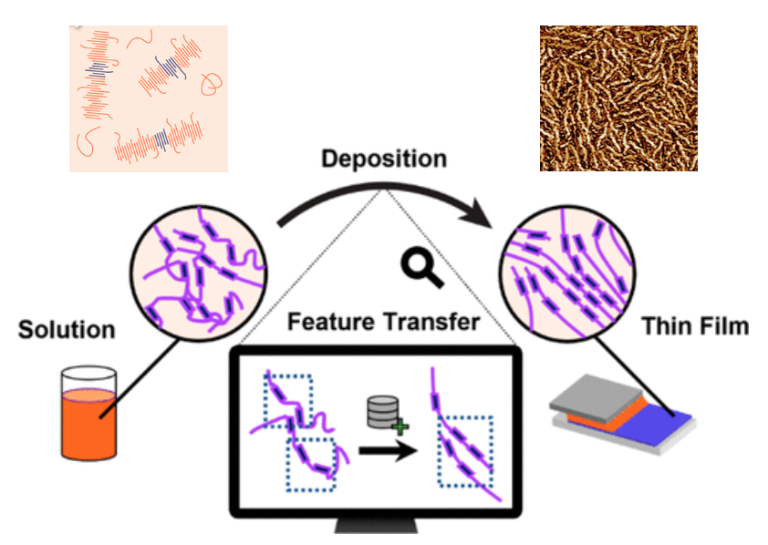
Data-Driven Elucidation of Solution-to- Device Feature Transfer for π‐Conjugated Polymer Semiconductors
DMR 1922111
Martha A. Grover, Georgia Tech Research Corporation
The DMREF team recently published a perspective article that discusses the need for additional fundamental insight into the solution behavior of donor-acceptor based organic semiconducting (OSC) conjugated polymers. The Perspective
Notes that combining high-throughput experimentation (HTE) laboratory techniques with materials informatics offers several avenues to navigate vast domains of tunable variables offered by OSC thin films.
Outlines steps necessary to incorporate a comprehensive informatics methodology into experimental development of polymer-based OSC technologies.
Key findings:
To inform efficient HTE for data collection and application of data-centric tools to construct new process−structure−property relationships, examination of the solution state prior to deposition, coupled with thin-film characterization is crucial for understanding underlying physicochemical mechanisms influencing final OSC performance.
Inclusion of data-driven approaches offers predictive capabilities previously unattainable via traditional experimental means.
C.P. Callaway, A.L. Liu et al., The Solution is the Solution: Data-Driven Elucidation of Solution-to- Device Feature Transfer for π‐Conjugated Polymer Semiconductors, ACS Appl. Mater. & Inter. 2022, 14, 3, 3613-360 (invited). DOI: 10.1021/acsami.1c20994
DMREF-1922111/1922174

