Slide 1
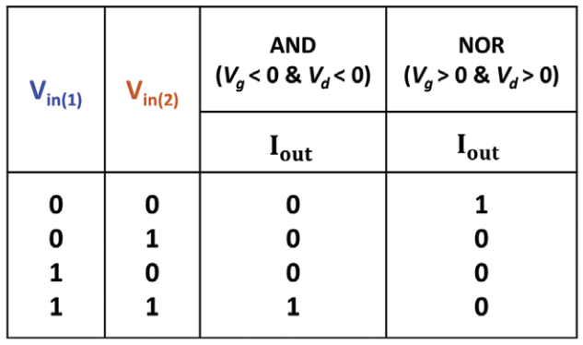
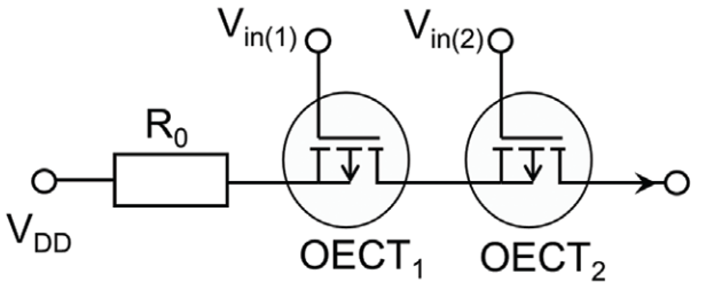
Data Driven Discovery of Conjugated Polyelectrolytes for Neuromorphic Computing
DMR 1922042
Gang Lu, The University Corporation, Northridge
Dual mode transistors, the type of transistors that work in both depletion mode and enhancement mode, were reported more than 50 years ago using inorganic semiconductors, such as Silicon, but have not been shown in organic electronics. We report the first dual mode organic transistors based on organic electrochemical transistors (OECTs) using CPE-K, a self-doped conjugated polyelectrolyte, as the active material. The work stems from a key finding that CPE-K can be both doped and dedoped upon the interaction with anions and cations in an electrolyte, such as sodium chloride [i.e., table salt] dissolved in water. This property enables dual-mode functionality in OECTs, whose mode switching is accomplished by simply altering the polarity of the applied gate and drain voltages. A physical model for the device was developed to explain its working mechanism and correctly predicts its behavior in both operation modes. We also demonstrated the utilization of dual-mode organic transistors in reconfigurable electronics by fabricating logic gates that could be switched between AND and NOR, and OR and NAND on the fly.
Impact: Being simple, power efficient, and compatible with high throughput microfabrication techniques, dual mode OECTs are a promising candidate for the next generations of efficient computing systems and adaptive electronics.
Dual-mode organic transistors based on conjugated polyelectrolytes (CPE-K) and their use in reconfigurable electronics. (top) (OECTs) based on CPE-K. The transistor works either in enhancement mode or in depletion mode, depending on applied voltages’ polarity. (bottom) An logic gate, consisting of two OECTs, can switch from a NOR gate to an AND gate on the fly, by simply reversing the voltage polarity.
T. Nguyen-Dang, S. Chae, J. Chatsirisupachai, H. Wakidi, V. Promarak, Y. Visell, T.-Q. Nguyen, Dual-Mode Organic Electrochemical Transistors Based on Self-Doped Conjugated Polyelectrolytes for Reconfigurable Electronics. Advanced Materials, 34, 2200274, (2022). (Front cover publication)
Award #: DMREF-1922042
Notes:
Addition notes:
polyelectrolyte refers to the fact that the polymer’s side chains have charges and ions attached to them, and conjugated refers to the fact that the backbone has alternating single and double bonds. Having conjugated bonds throughout the polymer makes it electronically conductive, and having ionic sidechains makes it ionically conductive.
reconfigurable electronics: Currently in electronics, functionality is defined by structure, but in reconfigurable devices, a single structure can have several functionalities. In our device, for example, you can change the behavior and make it something else just by changing the voltage applied to it. If we scale up this invention, from a single gate to much more complex circuits consisting of many such reconfigurable gates, we envision a powerful piece of hardware that can be programmed with many more functionalities than conventional ones having the same number of transistors.
doping process: doping refers to a process in which additives (dopants) are added into a semiconductor to increase its charge carrier density, inversely, dedoping refers to a process that decreases the charge carrier density in a semiconductor by adding additives (dedopants)
On the other advantages of organic semiconductor devices: Organic semiconductors offer several distinct advantages over conventional silicon-based semiconducting devices. They are made from abundantly available elements, such as carbon, hydrogen, and nitrogen; offer mechanical flexibility and low cost of manufacture; and can be fabricated easily at scale. Additionally, the polymers themselves can be crafted using a wide variety of chemistry methods to endow the resulting semiconducting devices with interesting optical and electrical properties. These properties can be designed, tuned, or selected in many more ways than can inorganic (e.g., silicon-based) transistors.

Slide 2
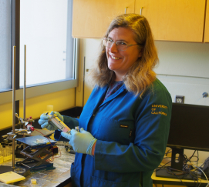
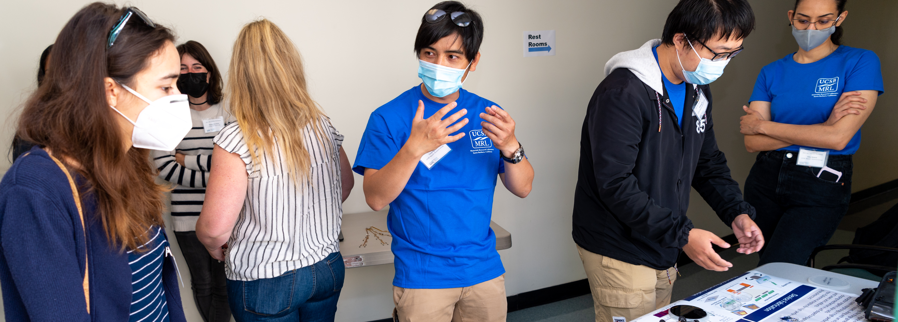
Data Driven Discovery of Conjugated Polyelectrolytes for Neuromorphic Computing
DMR 1922042
Gang Lu, The University Corporation, Northridge
The project provides an excellent opportunity to train high school, undergraduate and graduate students, postdoctoral scholars, and a high school teacher.
Undergraduate students:
Kunyun ‘George’ Li (3rd year Chem. Engineering, UCSB)
Yuxiang Wen (2nd year, Chem. Engineering, UCSB)
Brian Kim (3rd year Chemistry, UCSB)
Kelsey Harrison (4th Chemistry, UCSB, currently at Columbia University for PhD program)
Max Shrock (4th Chemistry, UCSB, currently at Stanford for PhD program)
Graduate students:
Sangmin Chae (3rd year graduate student, UCSB)
Luana Llanes (5th year, graduate student, UCSB)
Postdocs:
Dr. Yangyang Wan (CSNU)
Dr. Tung Nguyen-Dang (UCSB)
- Lompoc Junior High Teacher Melissa Moore spent 5 weeks working in the Nguyen group and she incorporated what she learned in the science curriculum at her school.
- Ventura High School student, Jaden Elizondo spent 8 weeks summer research working on the characterization of conjugated polyelectrolytes.
(A)
(B)
(C)
(D)
Training and Outreach activities in the program. (A) Melissa Moore, a teacher at Lompoc High school, (B) Kelsey Harrison, undergraduate student in Chemistry department at UCSB, (C) Tung Nguyen-Dang, presenting his NSF-funded research at the Materials Research Society. (D) The team demonstrated organic electronics at a Highschool Teacher workshop organized by the Materials Research Laboratory (an NSF MRSEC).
Award #: DMREF-1922042

Slide 3
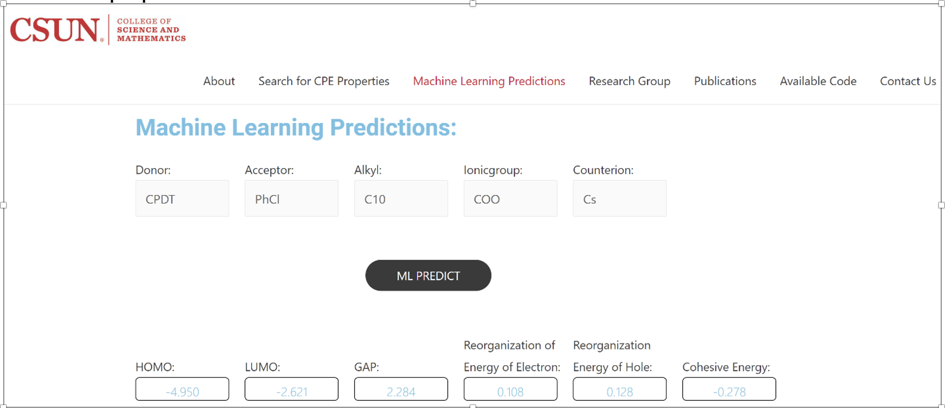
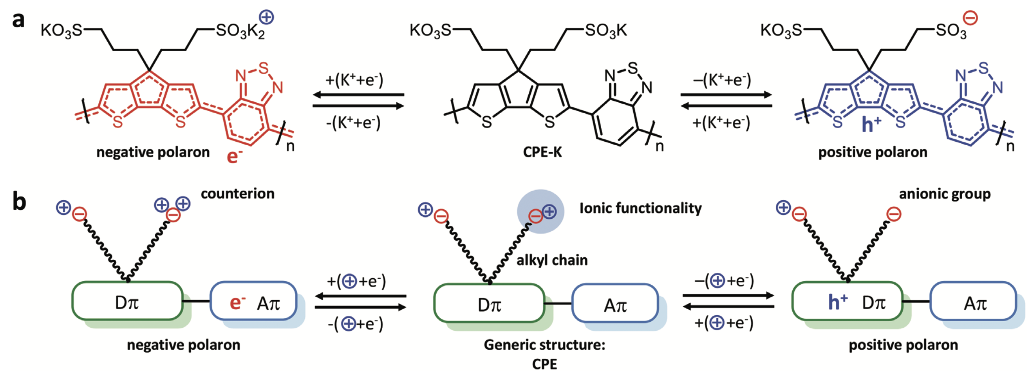
Data Driven Discovery of Conjugated Polyelectrolytes for
Neuromorphic Computing
DMR 1922042
Gang Lu, The University Corporation, Northridge
In this project, we have constructed a database on conjugated polyelectrolytes (CPEs) based on high-throughput first-principles calculations and machine learning modeling. The database (https://www.cpegenome.com/) contains the properties of over 10,000 CPEs that are relevant to neuromorphic and optoelectronic applications. These properties include optimized molecular structure, ionization potential, electron affinity, energy gap, reorganization energy for electron and hole, and cohesive energy, etc. Additional material properties are being included. The CPE database is freely available to the public. Using the database, we have recently performed a comprehensive study on polaron properties in CPEs, including the stability, structural deformation, electronic structure, and optical absorption of both positive and negative polarons and bi-polarons. We have explored how these properties depend on the electrostatic interaction between the polarons and ionic functionalities, including alkyl chains, ionic groups, and counterions. We further examined how bandgap, polaron binding energy, and optoelectronic structure of CPEs can be tuned by various combinations of the donor and acceptor units in their backbones. Finally, the electrochemical stability of CPEs is studied to shed on the absence of negative polarons in CPEs. The strategy to improve the electrochemical stability of n-doped CPEs is also discussed.
Publications:
Wan, Ramirez, Zhang, Nguyen, Bazan and Lu, “Data Driven Discovery of Conjugated Polyelectrolytes for Optoelectronic and Photocatalytic Applications”, npj Comput. Mater. 7, 69 (2021).
Wan, Zhang, Bazan, Nguyen and Lu, “Polarons in Conjugated Polyelectrolytes: A First-Principles Perspective” Adv. Funct. Mater. 2209394 (2022)
Award #: DMREF-1922042

