Slide 1
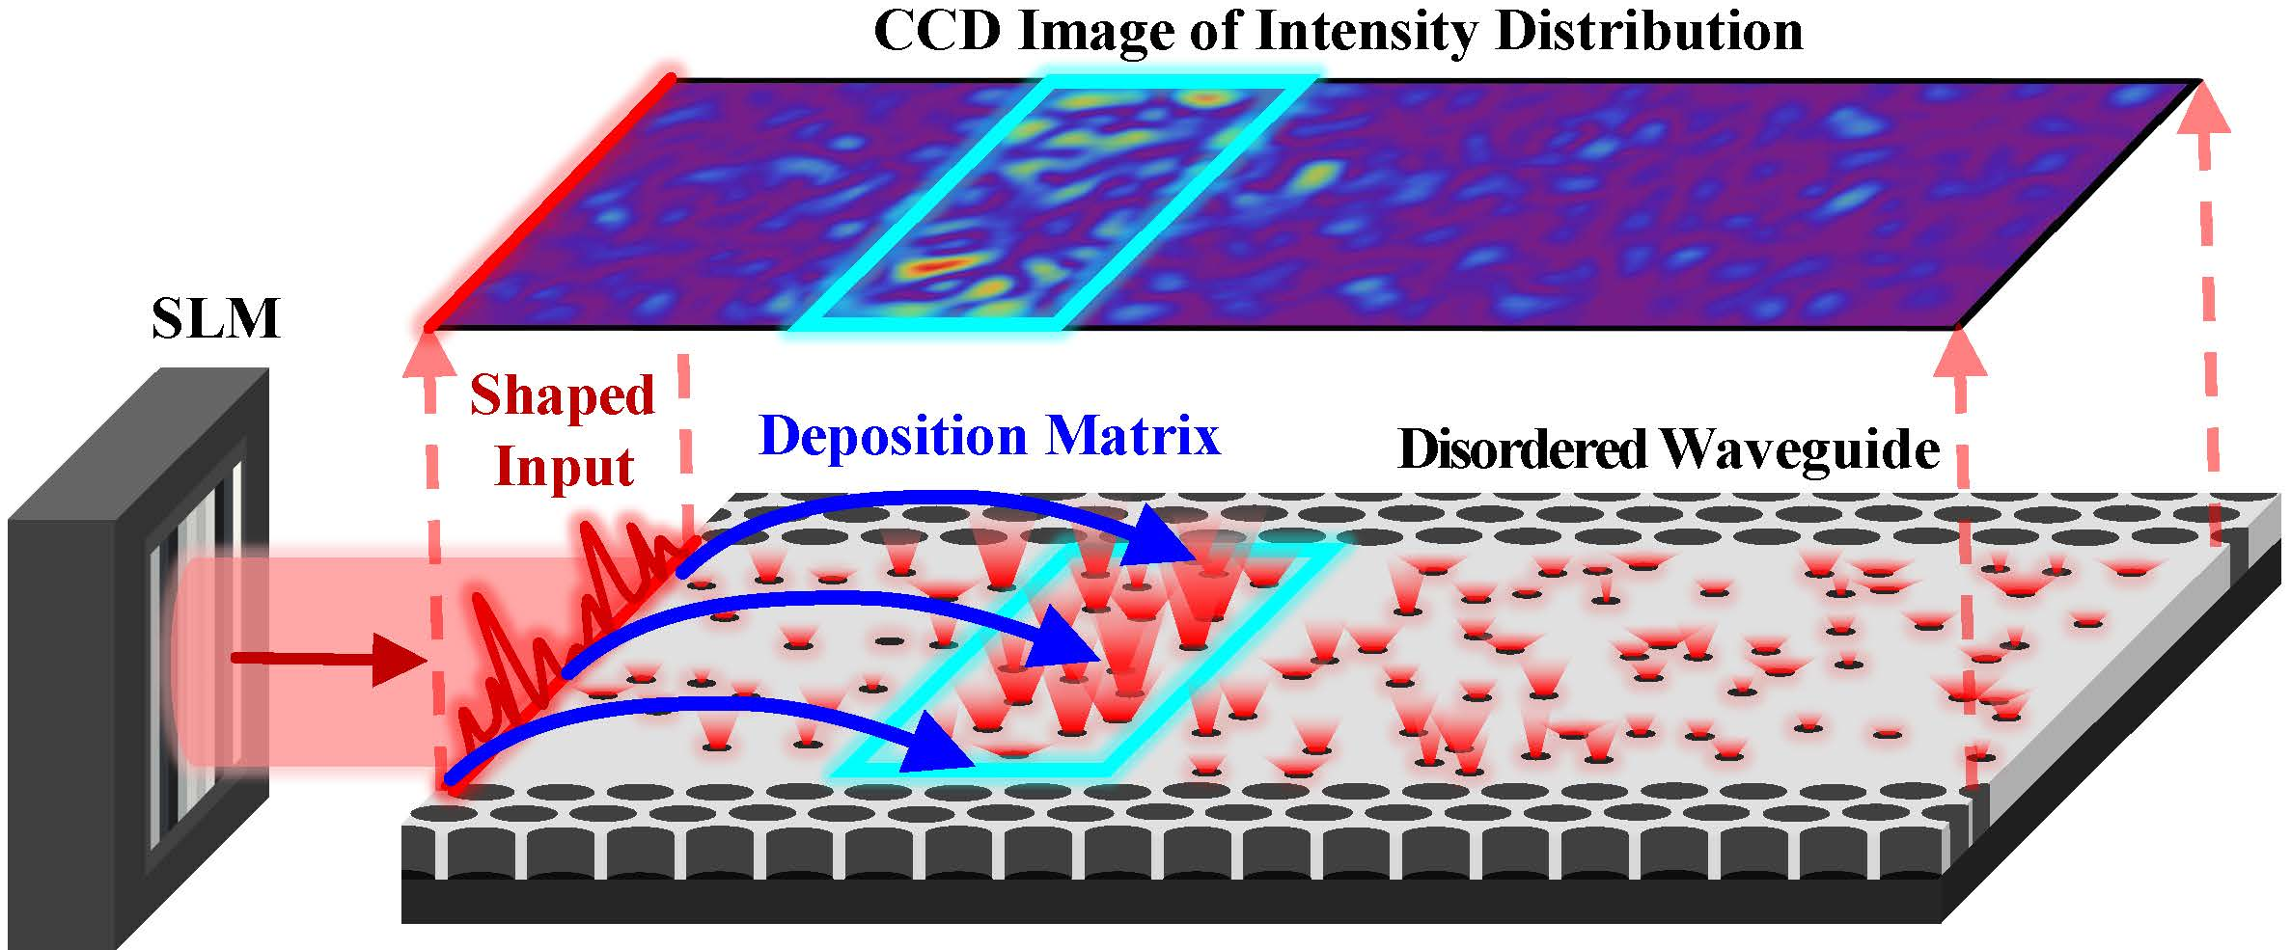
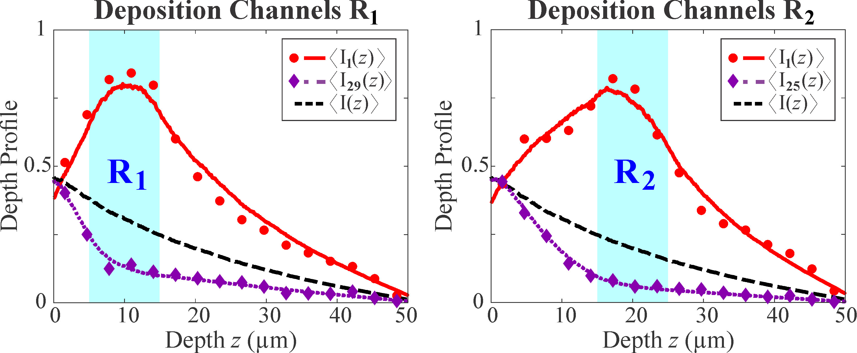
Wave transport via eigenchannels of complex media
2022 Intellectual Merit
DMR 1905442
Alexey G. Yamilov, Missouri University of Science and Technology
(a) Experimental setup
The collaborative research between Hui Cao’s experimental group at Yale University and Alexey Yamilov theory group at Missouri S&T is to study energy delivery deep into a diffusive system.
We developed a new systematic approach to concentrate the incident electromagnetic energy to a target of arbitrary size at any depth inside a strongly scattering medium [panel (a)] via the deposition eigenchannels.
Panel (b) shows scanning electron microscope image of the on-chip disordered waveguide, where the light is wavefront-shaped to enhance intensity in one of the four regions R₁-R₄ inside the diffusive medium.
Distinct depth profiles of high- and low-deposition eigenchannels are measured experimentally, and agree with the theoretical predictions, as shown for two regions R₁ and R₂ in panels (c,d) respectively.
Joint publication: Nicholas Bender, Alexey Yamilov, Arthur Goetschy, Hasan Yilmaz, Chia Wei Hsu, and Hui Cao, ‘‘Depth-Targeted Energy Deposition Deep Inside Scattering Media,” Nature Physics 18, 309 (2022)
(b) Disordered
waveguide
(c)
(d)

Slide 2
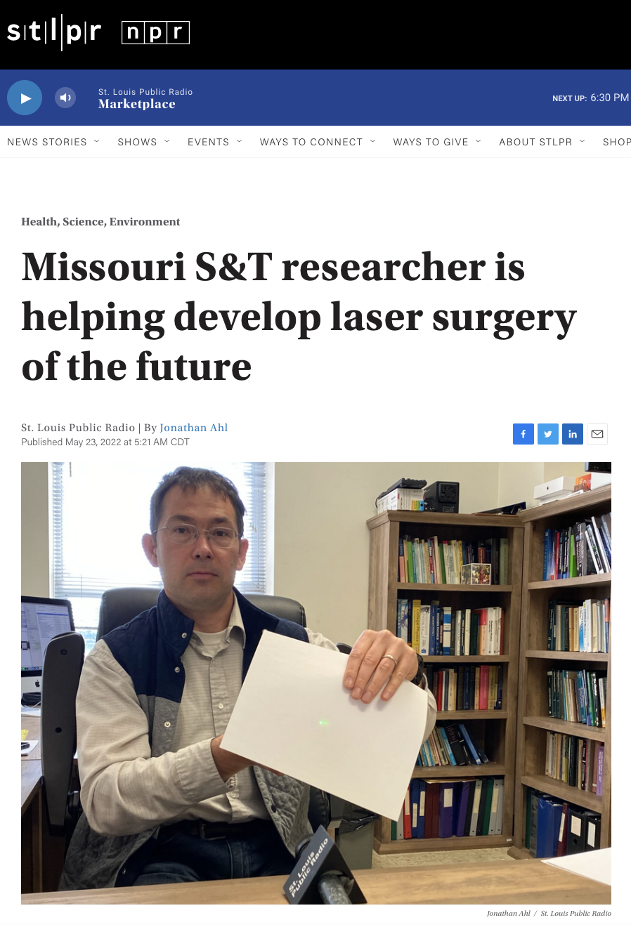
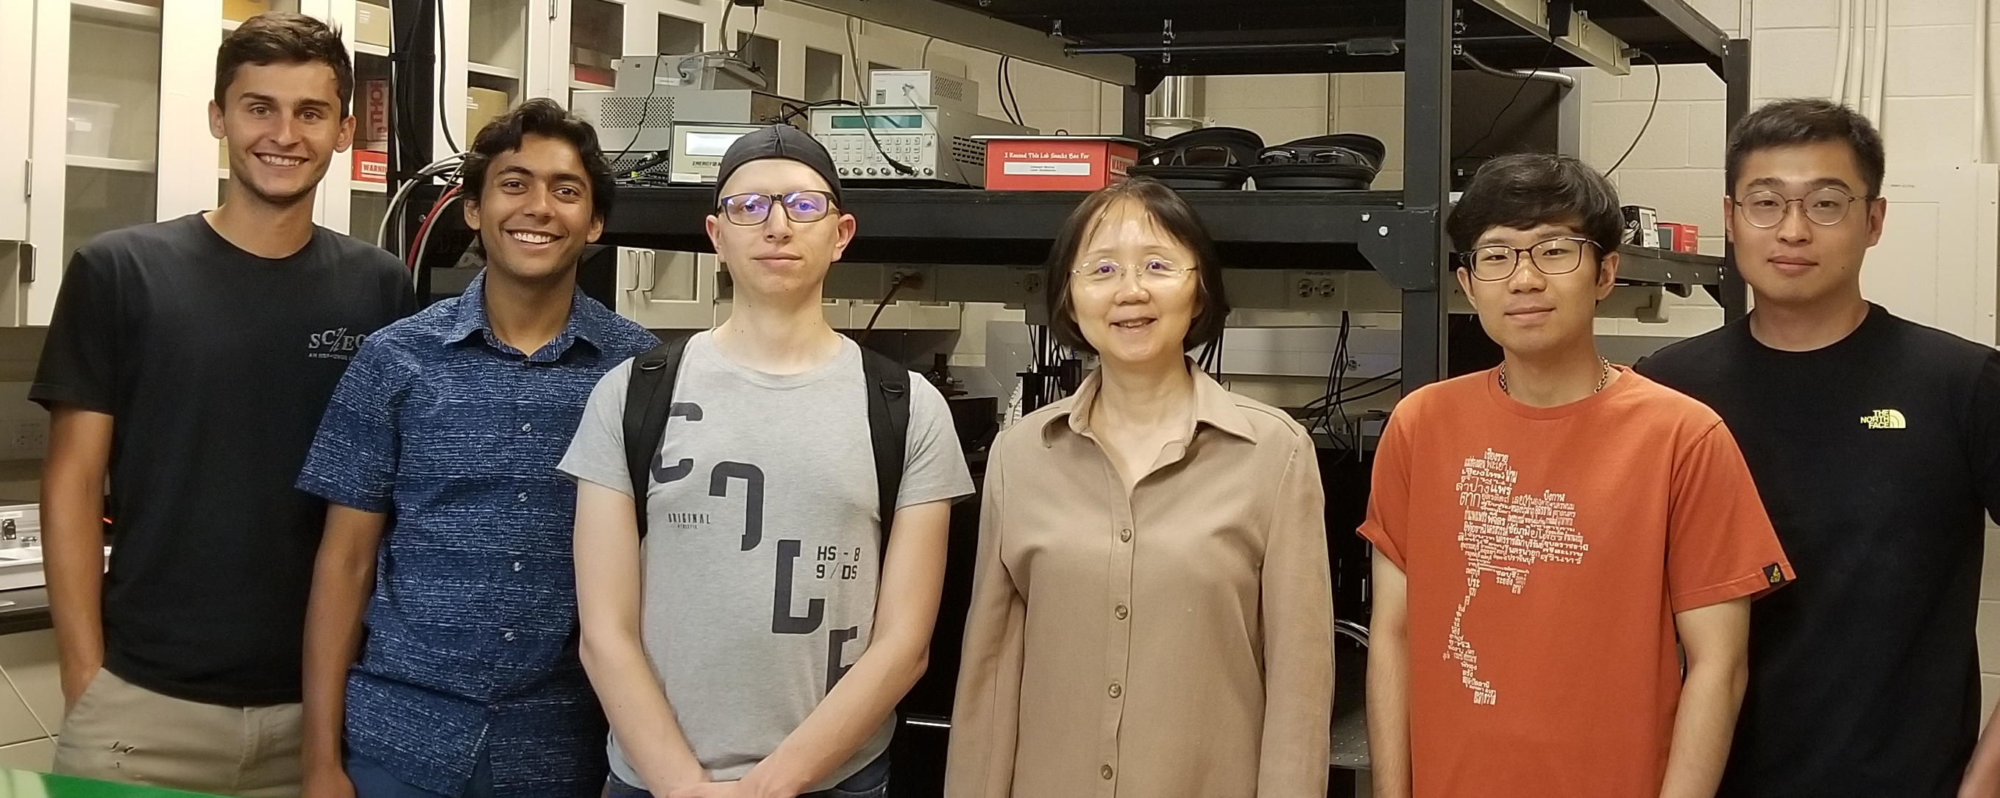
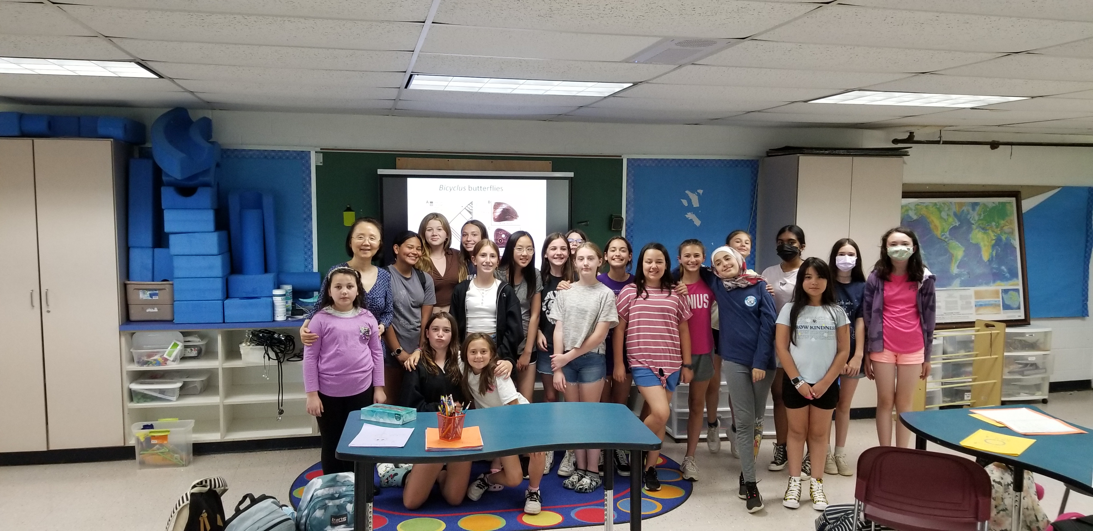
Wave transport via eigenchannels of complex media
2022 Broader Impacts
DMR 1905442
Alexey G. Yamilov, Missouri University of Science and Technology
Pablo Palacios (3rd form the left), the graduate student from the Missouri S&T group visited the Yale group as a part of student exchange in July 2022.
Photo from left to right: Liam Shaughnessy, Rohin McIntosh, Pablo Palacios, Hui Cao, SeungYun Han, Kyungduk Kim.
Hui Cao (second right) visited the Bethany Community School in Bethany, Connecticut, and participated in the GEMS (Girls Exploring Math and Science) program in June 2022.
Alexey Yamilov interviewed by Public Radio about joint paper on eigenchannels in 2022.
The work on deposition eigenchannels has been featured in News & Views in Nature Physics magazine: “Optical energy on demand,” O. S. Ojambati, Nat. Phys. 18, 227 (2022)

