Slide 1
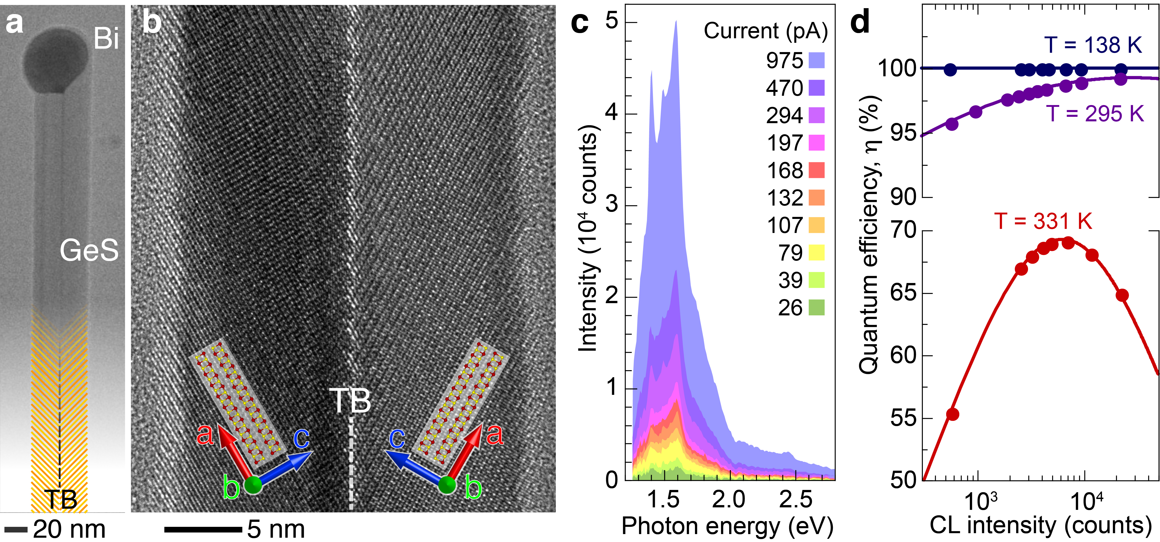
Nanowires from Layered van der Waals Crystals: Opportunities for Tuning Structure and Function in 1D-2D Hybrid Nanostructures
2022 Intellectual Merit
DMR 1904843
Nanostructure synthesis often involves defects that facilitate atomic attachment without energy barriers involved in nucleation. Remaining in the material, the defects usually compromise its properties, e.g., by reducing the quantum efficiency of converting electronic excitations to emitted light. Findings under this project revealed that this need not be the case:
Mirror twin boundary defects in nanoribbons of the layered semiconductor germanium sulfide facilitate rapid growth.
A newly developed approach for measuring light emission of individual nanoribbons, used to determine the radiative recombination quantum efficiency, showed efficiencies near 100%.
The results demonstrate that the fabrication of high-quality nanostructures of layered crystals can involve electronically benign defects that have no negative impacts on properties.
Reference: ACS Nano 16, 3735 (2022).
Peter W. Sutter, University of Nebraska-Lincoln
Layered germanium sulfide bicrystal nanoribbons: a. Electron microscopy of a nanoribbon with a central mirror twin boundary (TB) defect. b. High-resolution image showing the mirrored atomic lattices on either side of the TB. c. Analysis of the light emission from a single nanoribbon. d. Near-ideal (~100%) radiative recombination quantum efficiencies up to room temperature (295 K) demonstrate the absence of losses in light emission due to the defect.

Slide 2
Nanowires from Layered van der Waals Crystals: Opportunities for Tuning Structure and Function in 1D-2D Hybrid Nanostructures
2022 Broader Impacts
DMR 1904843
Peter W. Sutter, University of Nebraska-Lincoln
The project provided inspiration and mentoring to a team of five Electrical Engineering students at the University of Nebraska:
Guided by the PIs, the students developed a powerful device for measuring and storing a variety of physical data in K-12 science classrooms.
The student team designed and built a prototype with six measurement functions, data storage and transfer capabilities, as well as a versatile user interface.
The project involved hardware design, software programming, iterative testing and improvement. Dealing with chip shortages required skills in navigating supply chain issues encountered in many workplaces today.
The outreach addresses the need for inexpensive classroom tools that can be built in schools to support a variety of uses in K-12 education, including independent data acquisition and measurements by students, physical and earth science demonstrations, science fair projects, etc.

