Slide 1
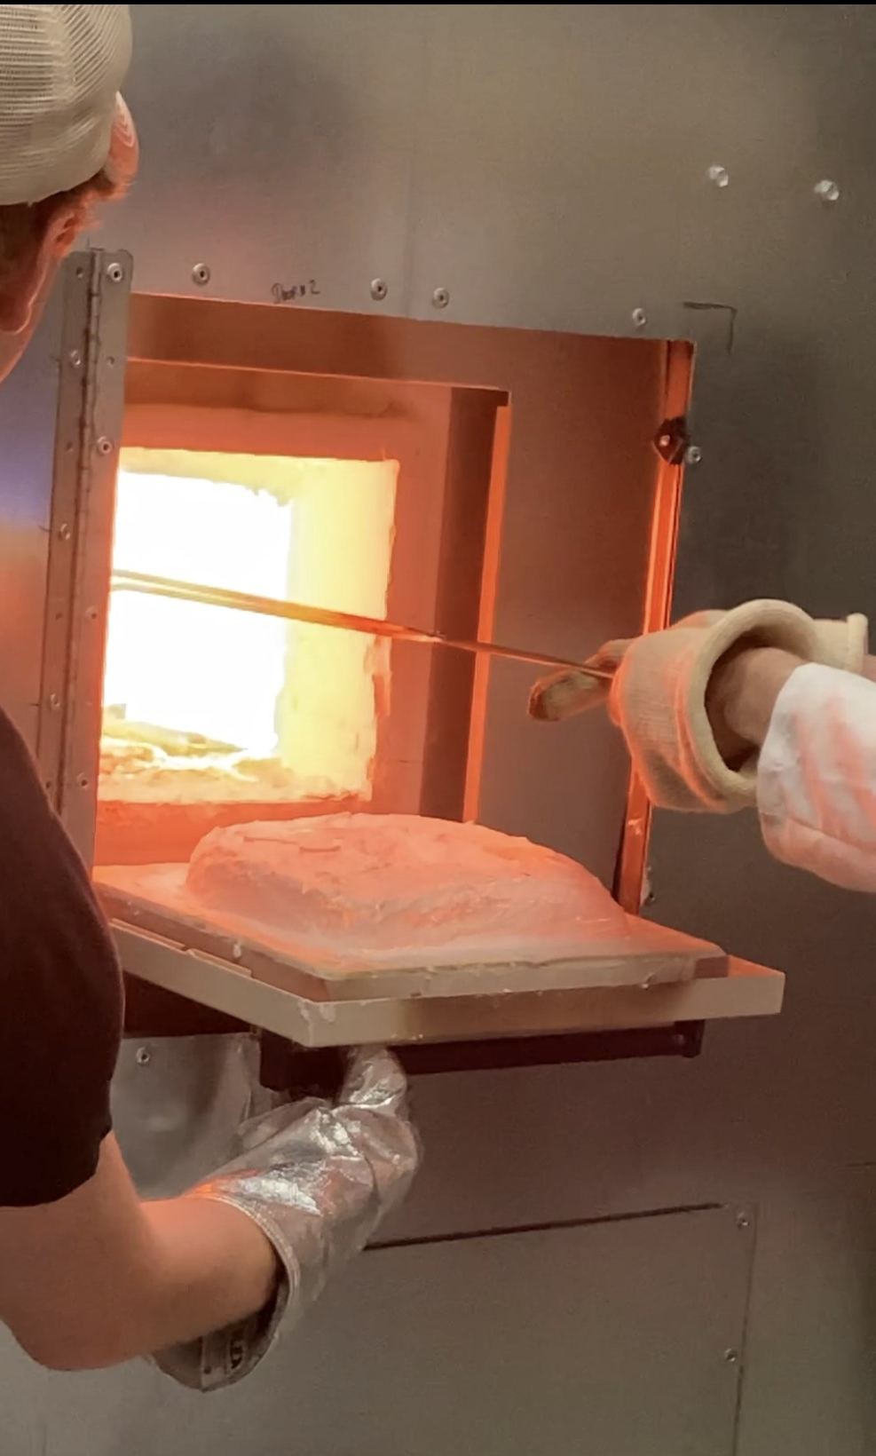
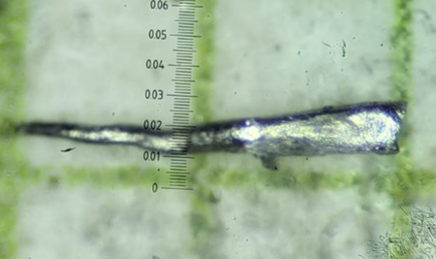
REU Site: Condensed Matter Physics and Applied Materials
2022 Intellectual Merit
DMR 1852138
Selman P. Hershfield, University of Florida
Exploring New Materials
High Entropy Alloys have many, e.g., five, different elements mixed together yet still forming a crystal structure as measured by X-ray diffraction. While they have been shown to have some exceptional mechanical properties, there has been relatively little work done on their magnetic properties. Two REU participants grew a total of 10 samples of CrMnFeCoNi with different ratios of the elements to tune the magnetic properties.
Growing Materials at High Magnetic Field is challenging because it requires both high temperatures and high magnetic fields. Using a new facility at the University of Florida, one student grew cobalt at fields up to 9 Tesla. This created an elongated structure compared to the samples grown at zero field (right images). Research on the sample differences at the microscopic level is continuing.
Cobalt sample grown at 0 Tesla
Cobalt sample grown at 9 Tesla
High Entropy Alloy being removed from furnace
Notes:
High Entropy Alloys: The stoichiometry of the samples was adjusted to try to produce a sample magnetic moment given previous data on how each element effected the magnetic moment of the sample. They were able to reduce the magnetic moment of the grown samples, but not to zero, probably indicating the simple model used to predict the magnetization is not accurate.
Growing Materials at High Magnetic Field: These samples were grown in a flux to allow for a lower growth temperature. Increasing the magnetic field clearly creates elongated structures. It is not clear at present what difference is at the microscopic level between the zero field and high field grown samples.

Slide 2
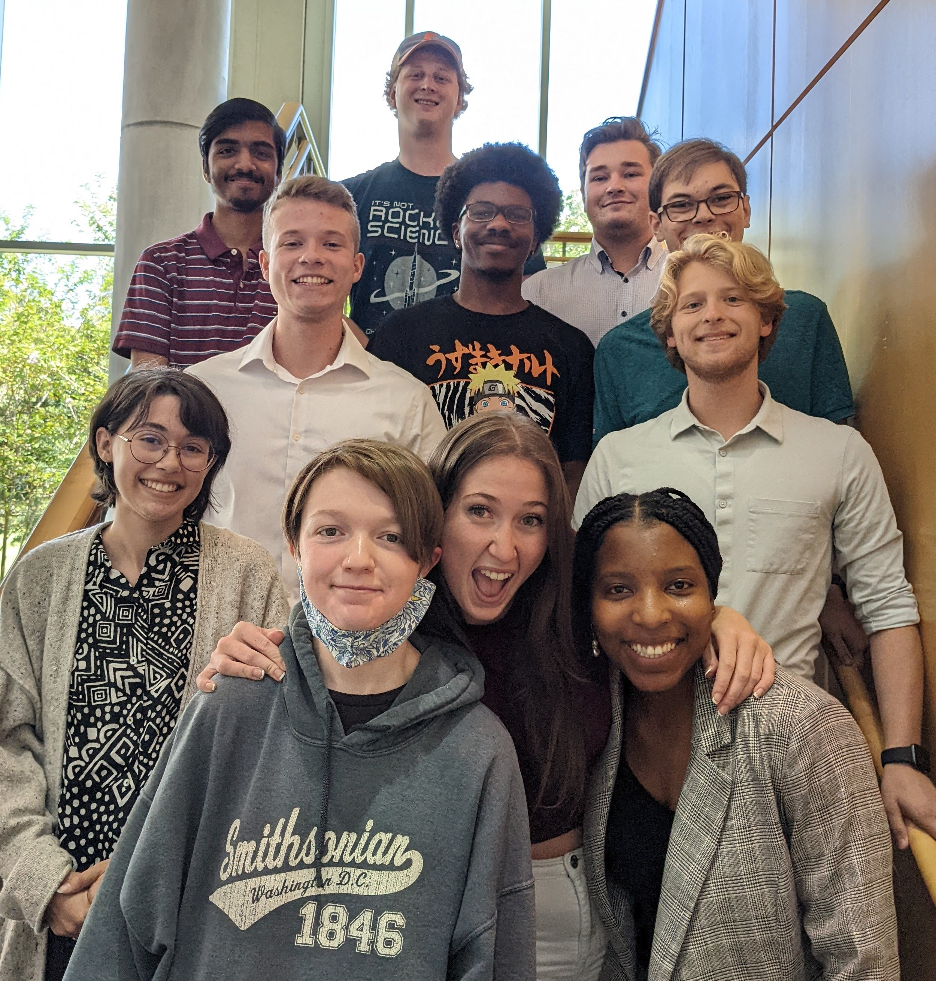
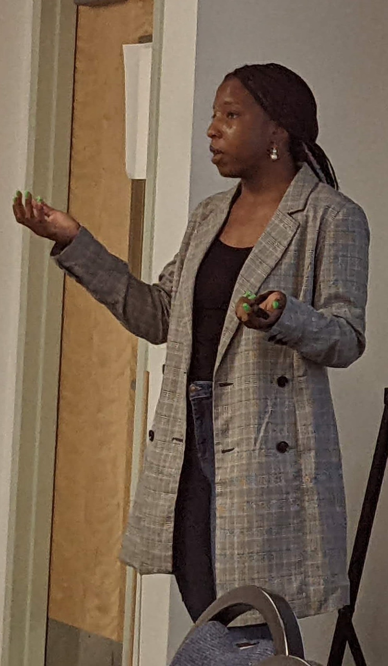
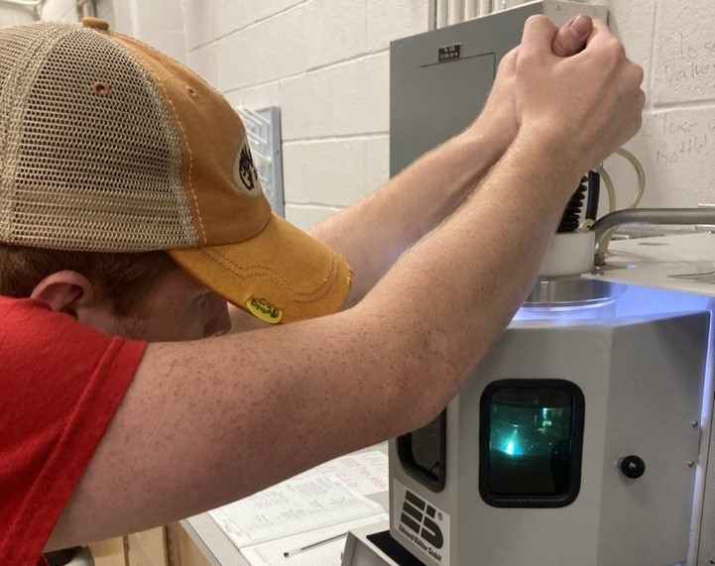
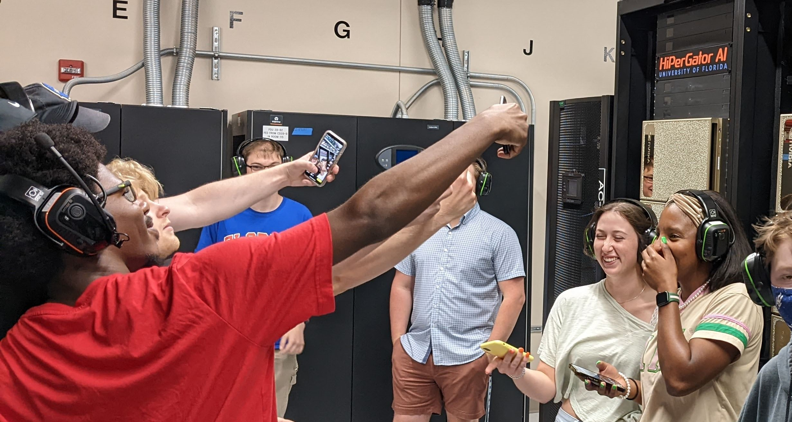
REU Site: Condensed Matter Physics and Applied Materials
2022 Broader Impacts
DMR 1852138
Selman P. Hershfield, University of Florida
Helping to Create the Next Generation STEM Workforce
Eight students participated in the 2022 Summer Research program as well as two students from the NHMFL REU program and 2 students sponsored by the UF Foundation. (top left photo)
They participated in professional development activities such as public speaking (top right), scientific talks and tours such as the HiPerGator Supercomputer (bottom left) and spent 35 hours per week doing research (bottom right).
Members of underrepresented groups and students from schools with limited research opportunities were actively recruited. By matching with appropriate projects freshmen as well as sophomores and juniors were able to participate.
This both gave them an opportunity to experience research and also encouraged them to stay with a STEM career. Long term tracking of our program indicates that over 90% of the participants will remain in STEM careers.
Notes:
While not specifically for this year, the long term tracking does show the effectiveness of REU programs. We have current tracking data for students back to our 2009 program, having lost track of only a few of them. This is the detailed breakdown of their present jobs.
Still in graduate school: 21
Postdoc or equivalent: 8
Non-academic scientist: 8
Medical physics: 3
Teaching: 6
Business and consulting: 3
Other: 6
Engineer: 22
Software: 20
Data Science: 13
Total = 110 former participants
Employment Number

