Slide 1
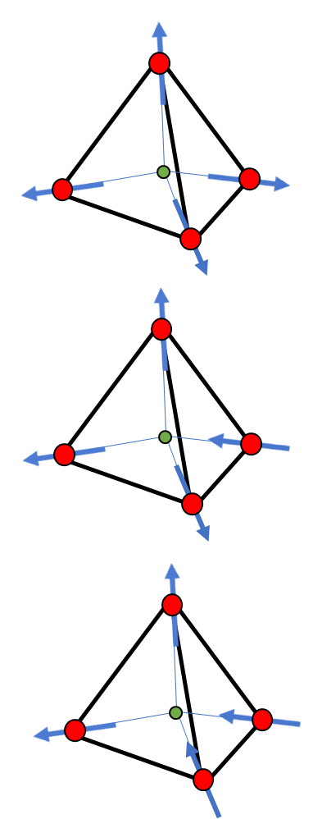
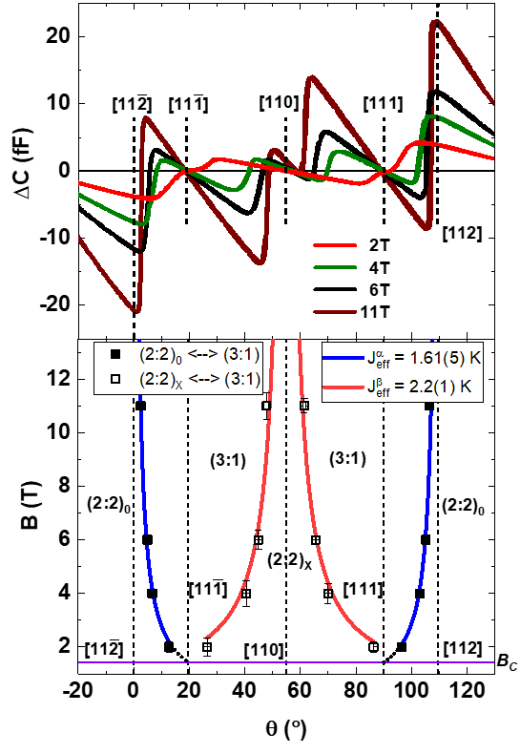
Measuring effective spin-correlation strengths with torque magnetometry
2022 Intellectual Merit
DMR 1847887
The work described in this highlight can be found in,
Anand et al. Nature Communications, 13, 3818 (2022)
Christianne Beekman, Florida State University
In the spin ice Ho₂Ti₂O₇, magnetic moments (or spins) reside on the Holmium ions in the material, which are periodically spaced on corner-sharing tetrahedra. How strongly near-neighbor spins interact with each other (J_{eff}) determines the relative energies of the different possible spin textures (see Fig. 1(a)) and the energy cost of spin-flip excitations on this lattice.
The award PI benchmarked the use of capacitive torque magnetometry (CTM) as a unique tool to characterize the transitions between noncollinear spin textures in spin-ice single crystals.
Systematic characterization of magnetic-field-induced phase transitions provides a measure of how strongly individual spins on the α and β sublattices interact with the rest of the spins in the lattice depending on the spin ice state involved in the transition (see Fig. 1 (b)).
Typical CTM response and associated phase diagram as function of field direction are shown in Fig. 1(c). Fits are used to extract the spin interaction strength.
Another publication regarding IR reflectometry on spin-ice single crystals was published as well, for more details see, Physical Review B, 105, 165102 (2022)
(c)
ΔE
Fig. 1: (a) Energy differences between the spin ice states in zero applied field with indicated degeneracy. Tetrahedra show one possible configuration of the two-in/two-out, 1-in/3-out, and all-in/all-out states. (b) Energy difference between spin ice states for different field directions, spin flips nucleating on the different spin sublattices (α or β) require different energies. (c) Torque response (top) and phase diagram (bottom) as a function of field direction. Fits are used to extract the spin interaction strength.

Slide 2
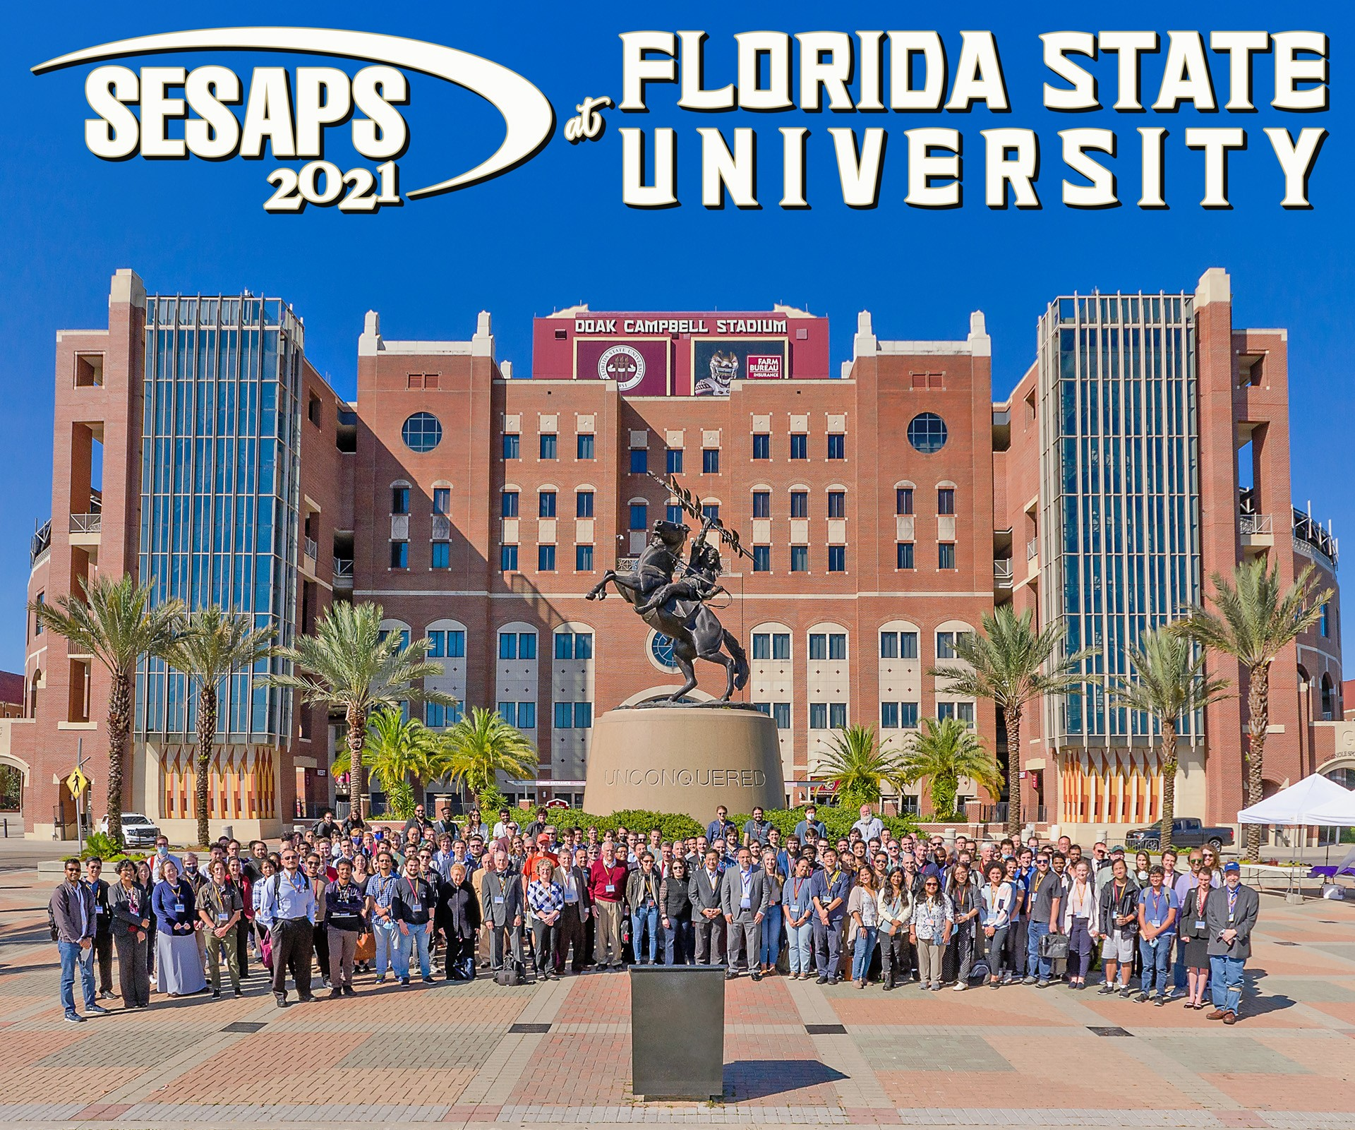
Student Mentoring, Conference Organization, and Service to the APS
2022 Broader Impacts
DMR 1847887
Christianne Beekman, Florida State University
This project has supported the training of graduate, undergraduate, and high-school students in thin-film-growth and characterization techniques. A female high-school extern started in the award PI’s group in Sept. 2022 and spends around 8 hours per week performing materials characterization measurements on quantum materials.
Biwen Zhang, a student on the project graduated in 2022, thesis title:
Strongly Correlated Insulators for High-Efficient Photovoltaics.
The award PI was co-chair of the SESAPS 2021 (in-person) conference, which was held in November 18-20, 2021 at the University Center Club in Tallahassee (http://sesaps21.physics.fsu.edu/). It was a success with over 200 registered participants.
The award PI is a member-at-large in the APS-GMAG executive committee. Her service tasks included serving on the GMAG fellowship committee, ranking APS fellow submissions submitted through GMAG. She also serves as Lead FT organizer of “Frustrated Magnetism” for the 2023 APS March meeting.
(Left) Group photo taken at the SESAPS conference in Tallahassee.
High School Externship Program: https://nationalmaglab.org/education/k12-students/high-school-externship

