Slide 1
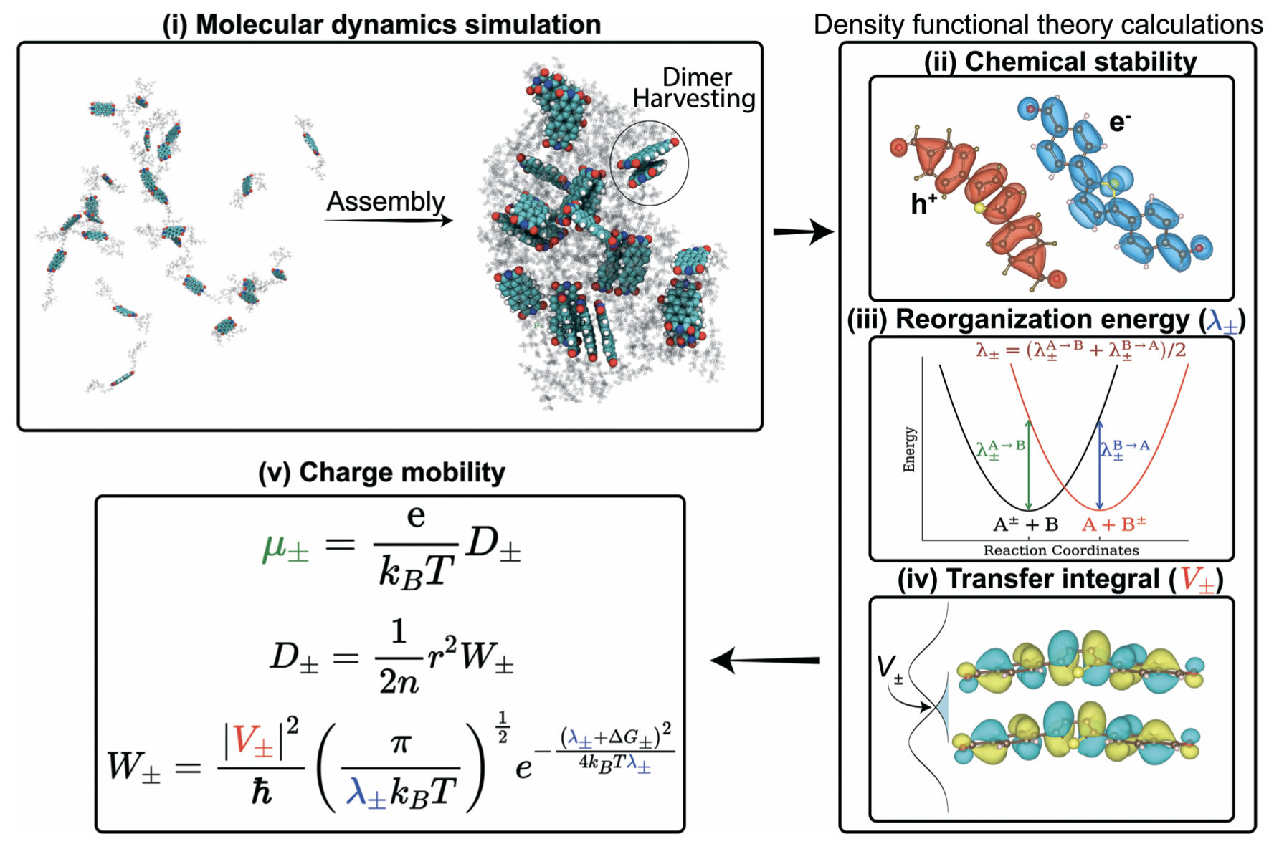
Self-assembled peptide-pi-electron supramolecular polymers for bioinspired energy harvesting, transport and management
DMR 1841897
Andrew Ferguson, University of Chicago
Organic electronics offer a route toward electronically active biocompatible soft materials capable of interfacing with biological and living systems. Discovering new organic molecules capable of high charge mobility is challenging due to the vast size of molecular design space and the multi-scale nature of charge transport that requires modeling electrons, molecules, and supramolecular assemblies.
We developed a multi-scale screening paradigm coupling (i) all-atom molecular dynamics to predict supramolecular structures, (ii) density functional theory to compute chemical stability, reorganization energy, and charge transfer integrals, and (iii) Marcus’s theory to predict charge mobility. This integrated virtual screening platform enabled us to identify new synthetic peptide-based molecules capable of producing self-assembled biocompatible nanoaggregates with predicted hole mobilities of 0.224 cm²V/s and electron mobilities of 0.143 cm²V/s, and uncovered design rules for high charge mobility.
This work embraced the MGI philosophy in its use of high-performance computation and multi-scale methods to accelerate advanced materials discovery. It was recognized as an editor’s choice “HOT” article in Molecular Systems Design & Engineering.
Schematic illustration of our computational pipeline for measuring π-conjugated peptide charge mobility. (i) All-atom classical molecular dynamics to predict the self-assembled structures. Density functional theory calculations predict the (ii) chemical stability, (iii) reorganization, and (iv) transfer integrals. (v) Marcus theory to predict the drift mobility of holes and electrons.
K. Shmilovich, Y. Yao, J.D. Tovar, H.E. Katz, A. Schleife, and A.L. Ferguson, Computational discovery of high charge mobility self-assembling π-conjugated peptides, Mol. Syst. Des. Eng. 7 447-459 (2022). DOI: 10.1039/D2ME00017B
DMREF-1841807

