Slide 1
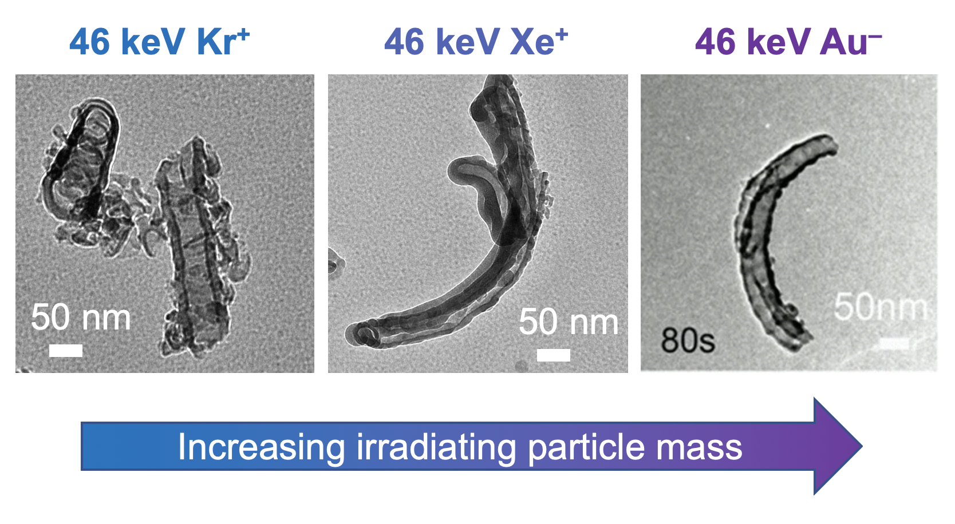
Tunable Control of Mixed Ionic and Electronic Conductivity Through Ion Irradiation in Electroceramic Materials for Energy Storage Systems
2022 Intellectual Merit
DMR 1838605
Janelle P. Wharry, Purdue University
TiO₂ is promising electrode material for lithium-ion batteries
We investigate morphological and structural transformation in amorphous TiO₂ nanotubes under 46 keV Kr⁺, Xe⁺, and Au– ion irradiation through in situ ion irradiation transmission electron microscopy (TEM) with complementary molecular dynamics (MD) simulations.
Amoprhous TiO₂ nanotubes exhibit morphological stability throughout Kr⁺ irradiation, and remain straight. Meanwhile, the Xe⁺ and Au– irradiated nanotubes, which are initially straight, exhibit curvature. The nanotube curvature is caused by partial crystallization along the length of the nanotube.
These partially crystalline regions may be sites for enhanced electrochemical activities.
TEM still frames taken at 80 sec or beyond, showing effect of in situ irradiating ion mass (at fixed ion energy of 46 keV) on curvature of amorphous TiO₂ nanotubes; curvature is attributed to partial irradiation-induced crystallization.
J. Mater. Res., 2022, 37 (6), 1144-1155
Notes:
In situ ion irradiation transmission electron microscopy was conducted on amorphous TiO₂ nanotubes using different ions (Kr+, Xe+, Au-) at 46 keV. Amoprhous TiO₂ nanotubes exhibit morphological stability throughout Kr⁺ irradiation, and remain straight and amorphous. Meanwhile, the Xe⁺ and Au– irradiated nanotubes, which are initially straight, exhibit curvature. The nanotube curvature is caused by partial crystallization along the length of the nanotube. These partially crystalline tubes also bend during irradiation, due to internal stresses associated with the densification that occurs through crystallization, as confirmed by MD calculations. This mechanism presents a novel irradiation-based pathway for tuning the structure and morphology of advanced energy storage materials.

Slide 2
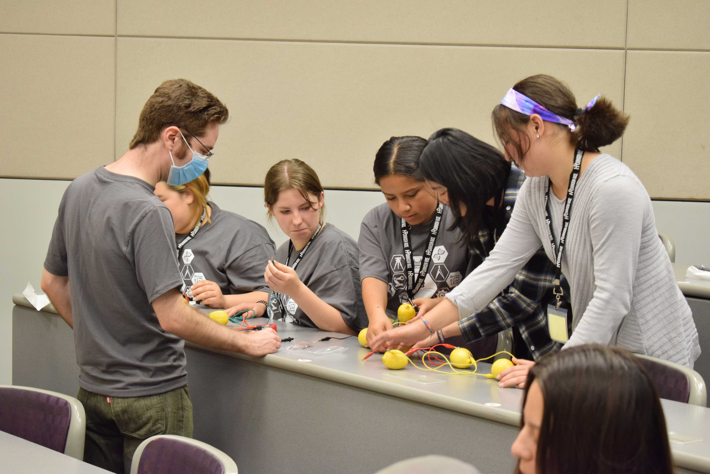
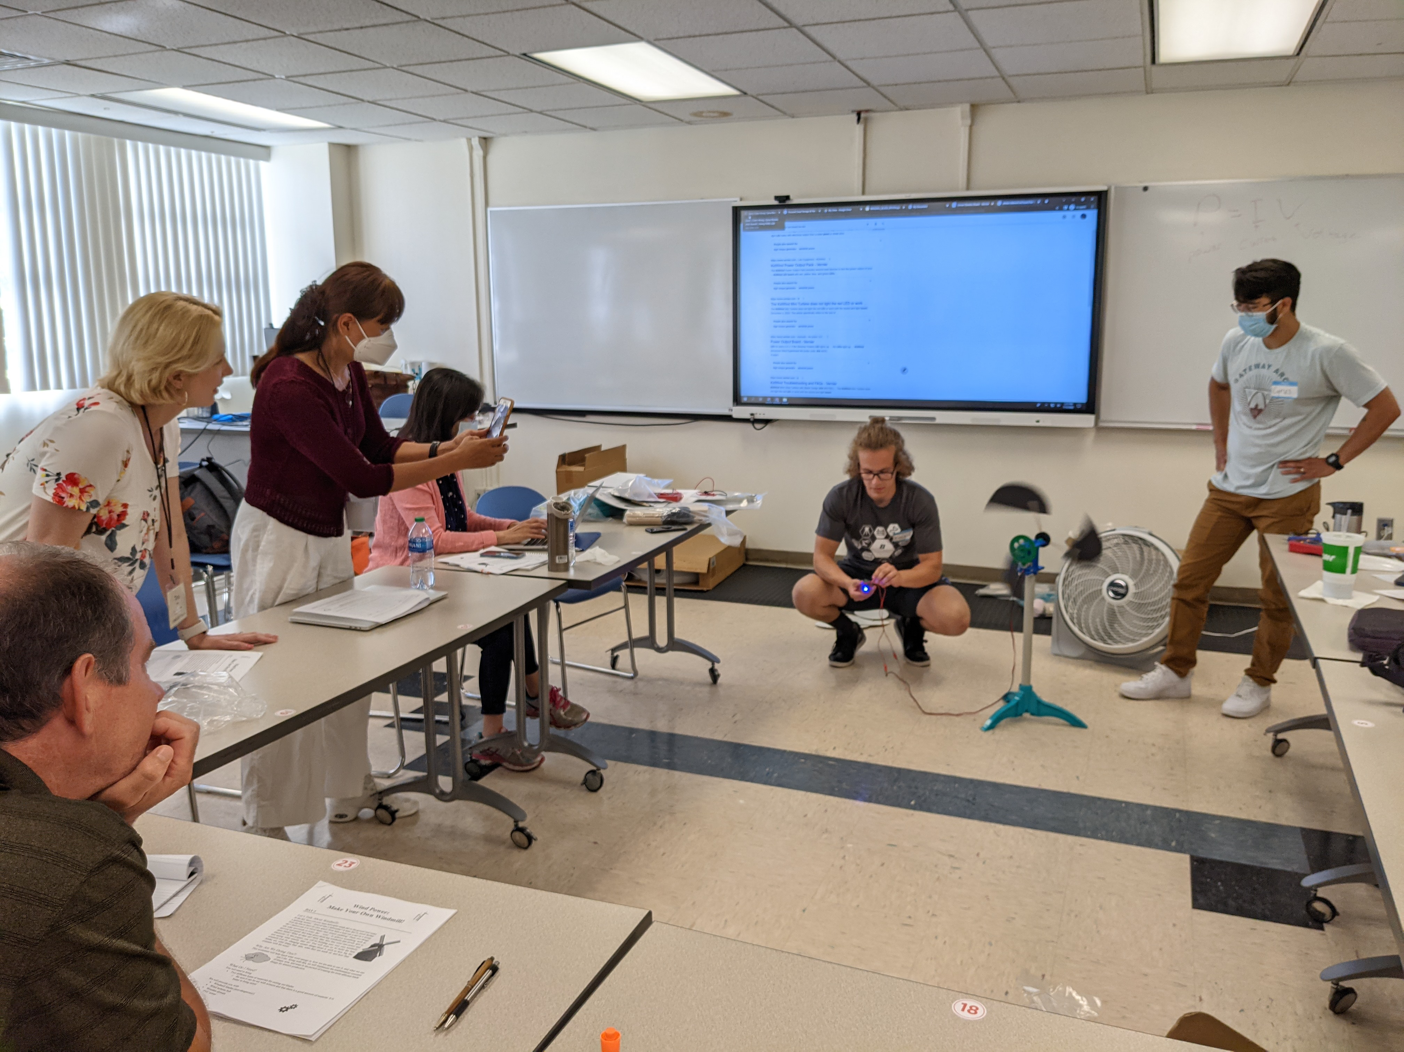
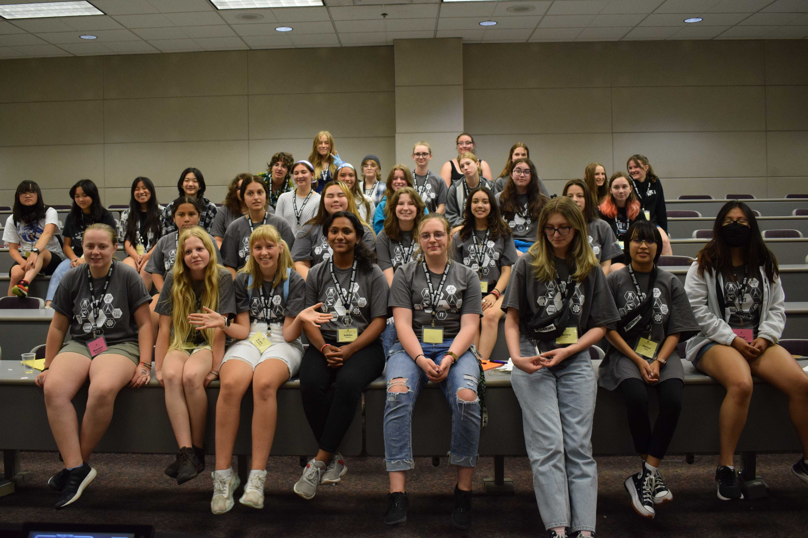
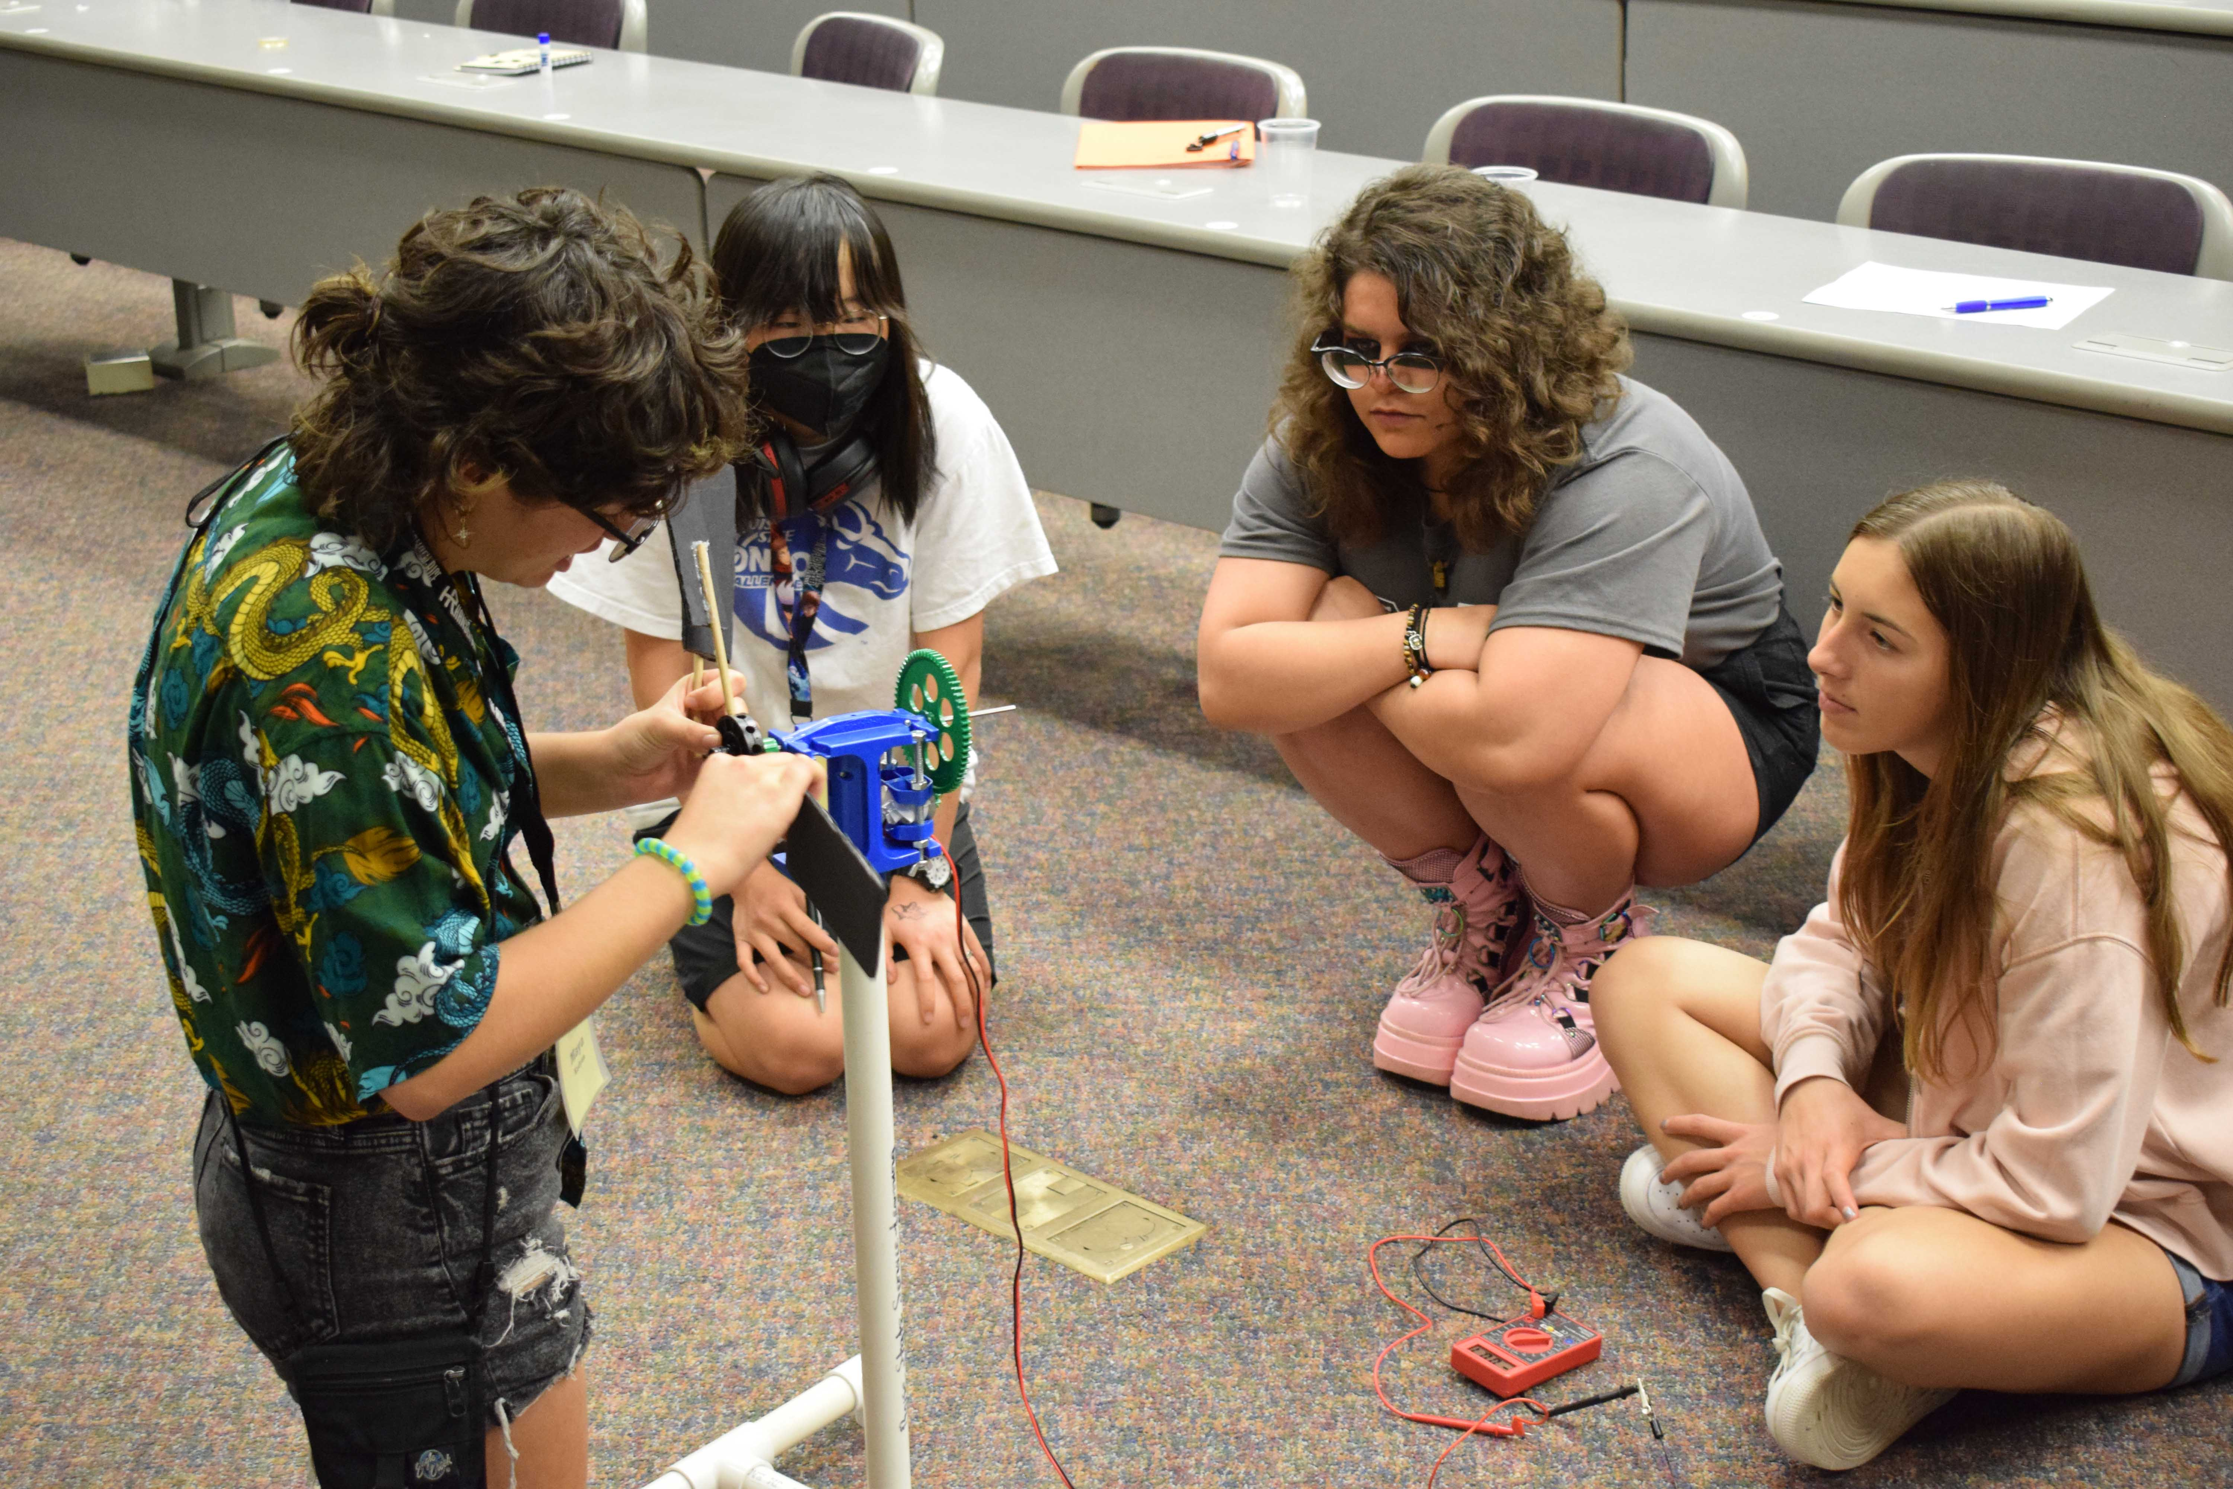
Tunable Control of Mixed Ionic and Electronic Conductivity Through Ion Irradiation in Electroceramic Materials for Energy Storage Systems
2022 Broader Impacts
DMR 1838605
Janelle P. Wharry, Purdue University
Students from Xiong’s group hosted STEM workshops for Idaho middle and high school girls at the annual e-girl camp and provided training to Math class instructors from different institutions (Boise State, Augusta University, the University of Texas at San Antonio, and Kapi’olani Community College) incorporating STEM modules in their math classes for pre-service teachers.
Xiong mentored 3 REU students (1 female), 1 LSAMP student, and 1 ACS SEED student during summer 2022.
Wharry mentored 4 undergraduate researchers during the past reporting period, of which 3 are Purdue Honors College students and 3 are from underrepresented minority groups.

