Slide 1
Collaborative Research: Chemomechanical Degradation of Oxide Cathodes in Li-ion Batteries: Synchrotron Analysis, Environmental Measurements, and Data Mining
2022 Intellectual Merit
DMR 1832707
Kejie Zhao, Purdue University
Discovery: Dynamics of battery degradation
We demonstrated the dynamic nature of the electrochemical activity and mechanical damage of particle network in commercial batteries. The fundamental studies provide guidelines for the design of conductive network to optimize battery performance.
We called for statistical studies of heterogeneous behaviors of battery materials through a Viewpoint article.
We structured the current studies on chemomechanics of batteries in an invited review article.
Impact and Importance
The project creates fundamental knowledge about mechanical degradation of the leading-edge ceramic battery materials. Such knowledge is crucial to elucidating the aging mechanisms of batteries which in turn synergistically contributes to the development of materials of enhanced reliability.
Dynamics of particle network in composite electrodes of commercial Li-ion batteries analyzed by nanotomography and machine learning (Science, 2022)
Li et al. Science 376, 517-521 (2022). Li et al. Nat. Commun. 13, 704 (2022). Sharma et al. Nano Lett. 22, 5883-5890 (2022). de Vasconcelos et al. Chem. Rev. 122, 13043-13107 (2022). Lin et al. ACS Energy Lett. 6, 4065-4070 (2021). Mu et al. Nano Lett. 22, 1278−1286 (2022). Spence et al. ACS Energy Lett. 7, 690-695 (2022). Hou et al. Nat. Commun. 13, 3437 (2022).

Slide 2
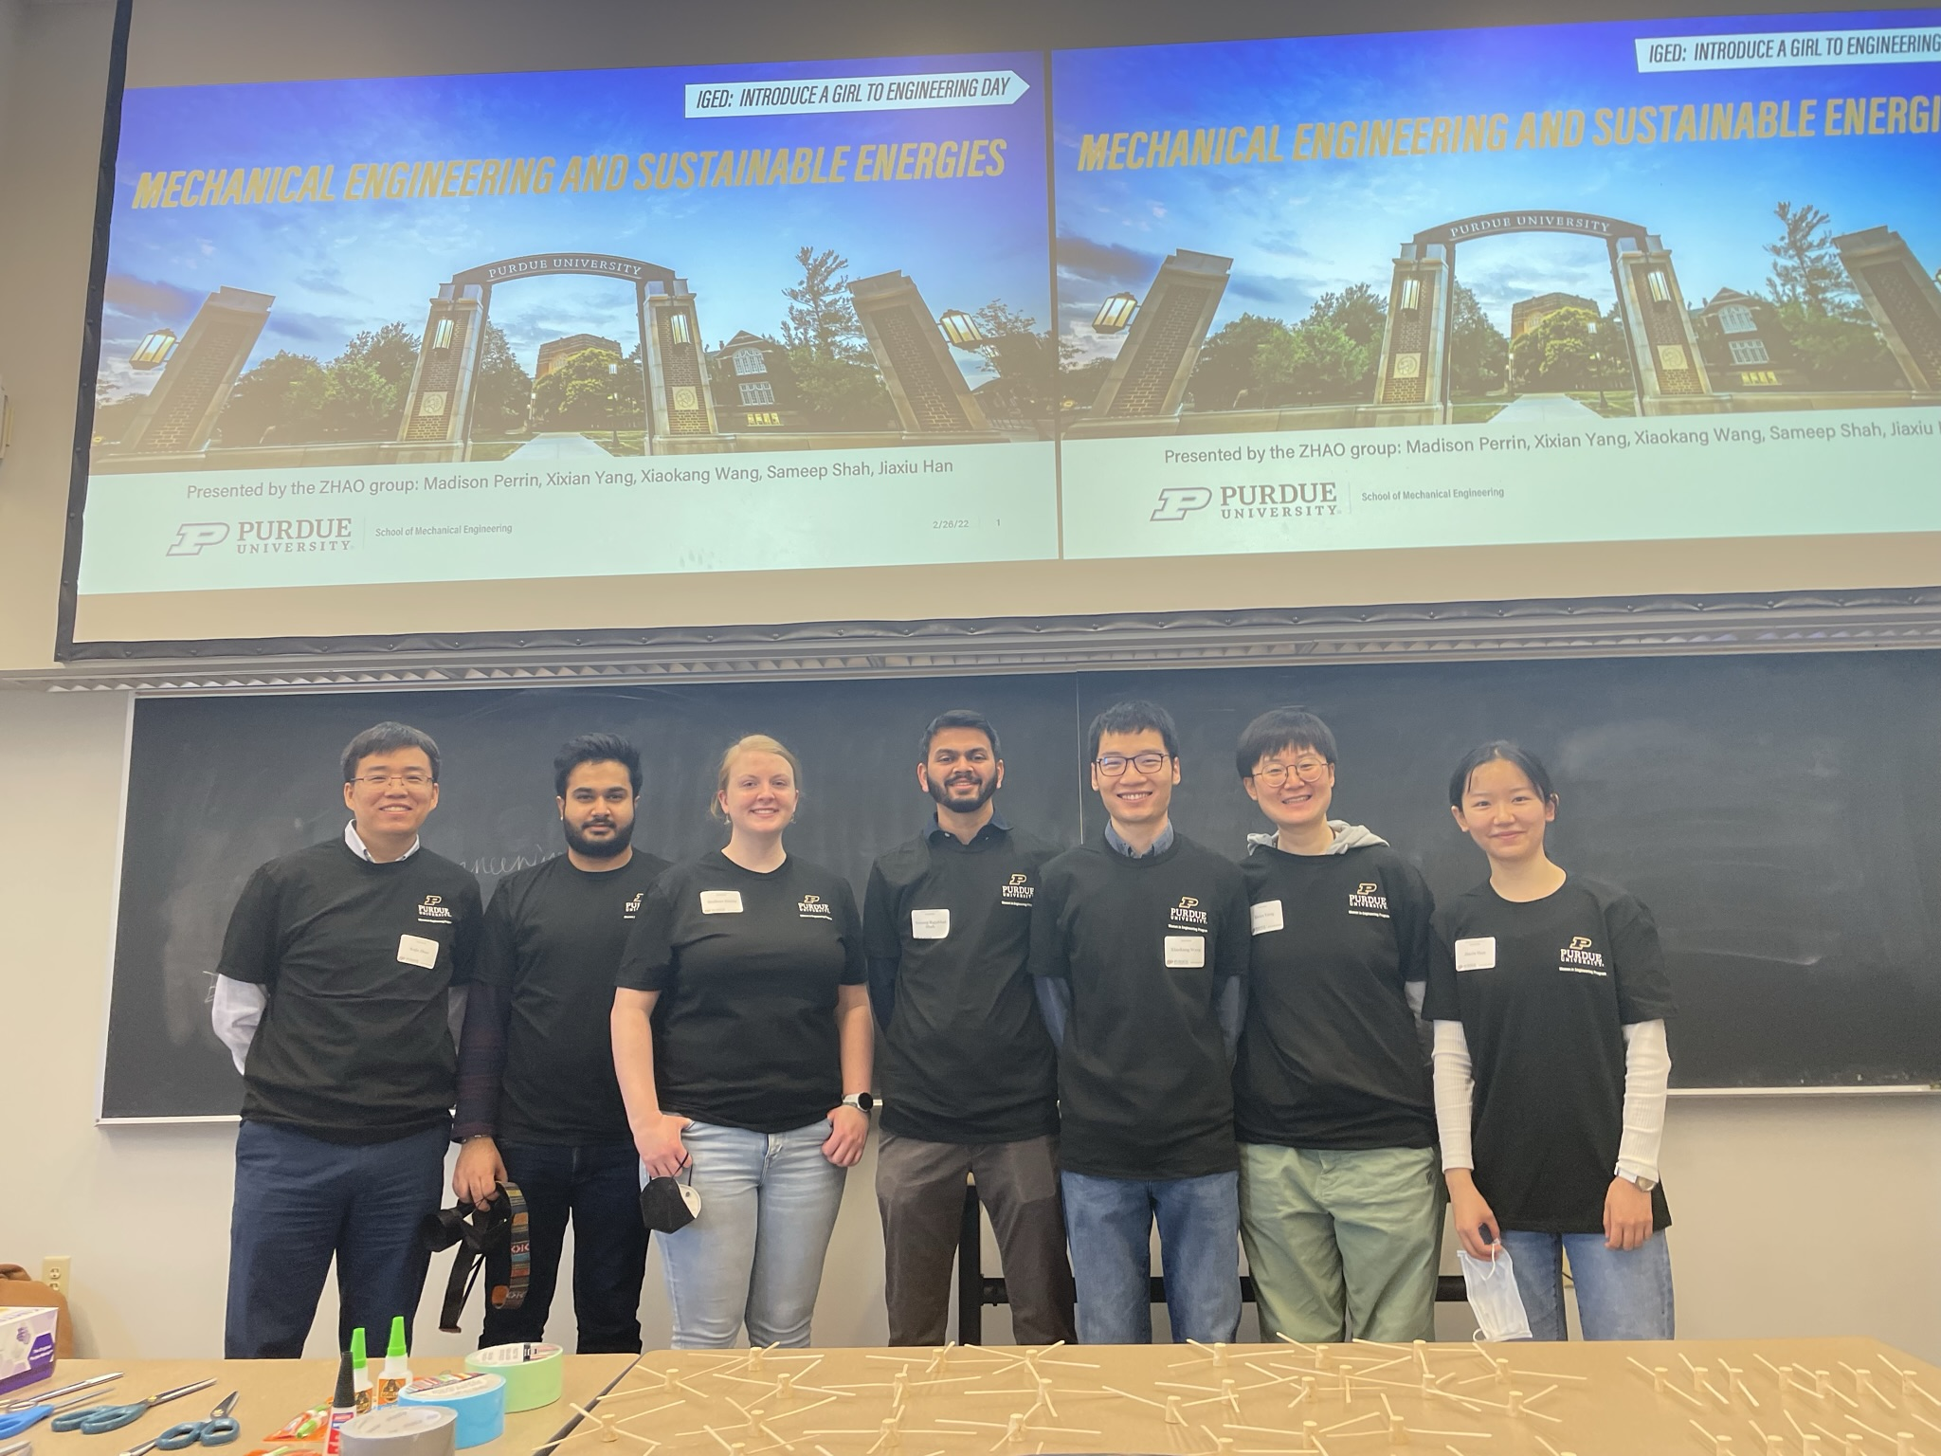
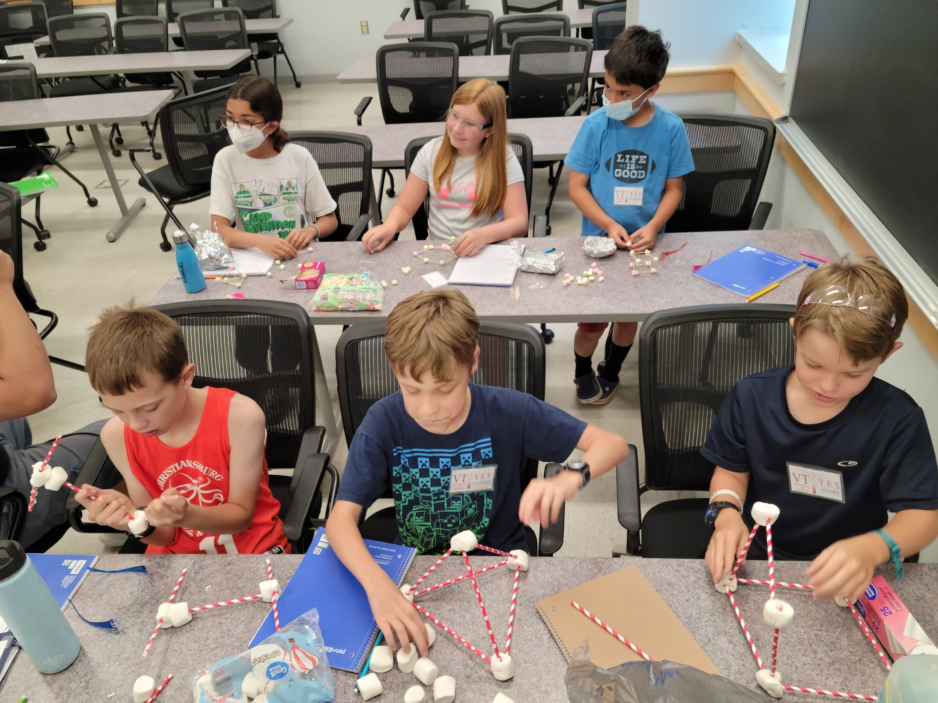
Collaborative Research: Chemomechanical Degradation of Oxide Cathodes in Li-ion Batteries: Synchrotron Analysis, Environmental Measurements, and Data Mining
2022 Broader Impacts
DMR 1832707
Kejie Zhao, Purdue University
Introduce a Girl to Engineering
The PI Zhao’s group led the outreach activities in Introduce a Girl to Engineering Day with a variety of concept demonstrations and hands-on projects. The outreach attracted ~150 local middle/high school girl students. The PI Lin’s group organized the Youth Experiencing Science (YES) Children's Camp. The in-person event attract many elementary school students in Southwest Virginia.
Students training
Collaborations between the co-PI’s groups are very fruitful. Students in both groups are well exposed and trained interdisciplinary skills of materials chemistry, material synthesis and characterization, and mechanics modeling and experiments. The training prepares students to conduct impactful research.
Recruitment of minority students
The project has involved two African American PhD students. Both have published papers for this project.
ZHAO group led the outreach activity for middle/high school girl students with Women in Engineering Program.
Lin group organized the outreach activity for elementary school students in Southwest Virginia. This annual YES summer camp is a collaborative activity among multiple VT chemistry PIs and across several NSF projects.

