Slide 1
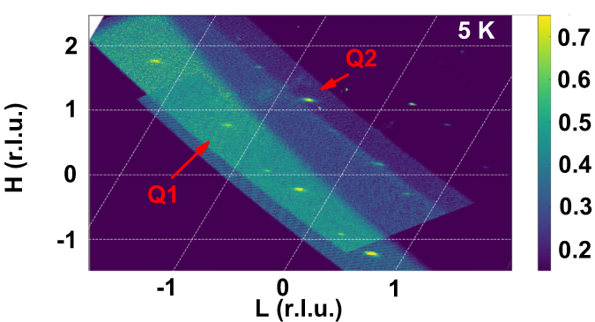
Joel D. Brock, Cornell University, DMR 1829070
Incommensurate charge order in a low-dimensional superconductor
Z Shi, SJ Kuhn, F Flicker, T Helm, J Lee, W Steinhardt, S Dissanayake, D Graf, J Ruff, G Fabbris, D Haskel, and S Haravifard
What is the new discovery?
The ternary telluride Ta₄Pd₃Te₁₆ (TPT) was recently discovered to host a superconducting ground state. NMR, transport, and Raman measurements previously inferred that a charge density wave (CDW) phase may also exist in this material, although the evidence was inconclusive and the reported transition temperatures varied widely (from 20K to 200K). Now, a team lead by Sara Haravifard from Duke University has conclusively and directly identified the subtle CDW phase in TPT emerging below 12K. The CDW couples to the superconducting transition and is suppressed by pressure at a critical point that maximizes the superconducting Tc.
Why is it important?
Understanding how superconductivity competes with other electronic ground states is a central challenge for quantum materials research. Electron-phonon coupling can render a metallic “normal” state unstable to both CDW formation and superconductivity, with a subtle interplay of competing interactions determining the ultimate material behavior. It is necessary to identify and quantify these competing phases, if we ever want to understand and control the mechanisms that promote or suppress superconductivity.
Subtle superstructures at low temperatures in Ta₄Pd₃Te₁₆ | High dynamic range diffraction maps collected at T = 5K show a superlattice of weak, sharp features that are absent at high temperature. These are signatures of a coherent charge density wave modulation of the crystal structure. The map above displays the incommensurate K=4.21 plane. Two CDW peaks, labeled Q1 and Q2, appear in each Brillouin zone.
Why CHEXS?
The <QM>² beamline at CHEXS is optimized for high dynamic range mapping measurements of quantum materials at very low temperatures. A core mission of this beamline is to hunt down and quantify subtle and “hidden” ordered states, like the multiply incommensurate CDW phase in Ta₄Pd₃Te₁₆.
This work is supported by NSF under award DMR-1829070.

Slide 2
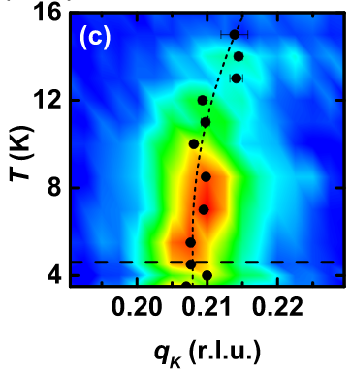
Joel D. Brock, Cornell University, DMR 1829070
Incommensurate charge order in a low-dimensional superconductor
Z Shi, SJ Kuhn, F Flicker, T Helm, J Lee, W Steinhardt, S Dissanayake, D Graf, J Ruff, G Fabbris, D Haskel, and S Haravifard
What are the Broader Impacts?
The surprising ubiquity of charge density wave phases in superconducting materials is a recurring theme over the past decade of materials research. To date, no conclusive explanation has been accepted for why these phenomena so often coexist. A core goal of quantum materials research is to understand quantum phenomena so that we can eventually learn to engineer useful properties. There is no quantum property more potentially useful, or more consistently confusing, than unconventional superconductivity, where materials conduct electricity without resistance. The promise of engineered high temperature superconducting materials, which could revolutionize computing, energy, and transportation industries, drives ongoing fundamental research into the interplay between SC and CDW order.
How was the work funded?
This work is based upon research conducted at CHESS and CHEXS, supported by the National Science Foundation under awards DMR-1332208 and DMR-1829070. Work at Argonne was supported by the US DOE Office of Science, Office of Basic Energy Sciences, under Award DE-AC02-06CH11357. FF acknowledges the Astor Junior Research Fellowship of New College, Oxford. ZS, WS, SD, and SH acknowledge support from the Powe Junior Faculty Enhancement Award, and William M. Fairbank Chair in Physics at Duke University. A portion of this work was performed at the National High Magnetic Field Laboratory, which is supported by National Science Foundation Cooperative Agreement DMR-1157490 and the State of Florida.
Rise and fall of the CDW | As TPT is cooled below 12K, the CDW emerges with a repeating period that doesn’t match the underlying lattice. The wavevector varies smoothly with temperature, until reaching the superconducting (SC) transition (dashed horizontal line). Within the SC phase, the CDW peak intensity is suppressed, but remains non-zero. This could imply that TPT is separating into SC and CDW domains, or that the opening of the SC gap simply alters the amplitude of the CDW everywhere.
Reference :
Incommensurate two-dimensional checkerboard charge density wave in the low-dimensional superconductor Ta₄Pd₃Te₁₆
Z Shi, SJ Kuhn, F Flicker, T Helm, J Lee, W Steinhardt, S Dissanayake, D Graf, J Ruff, G Fabbris, D Haskel, and S Haravifard
Physical Review Research 2, 042042(R) (2020); https://doi.org/10.1103/PhysRevResearch.2.042042
This work is supported by NSF under award DMR-1829070.

