Slide 1
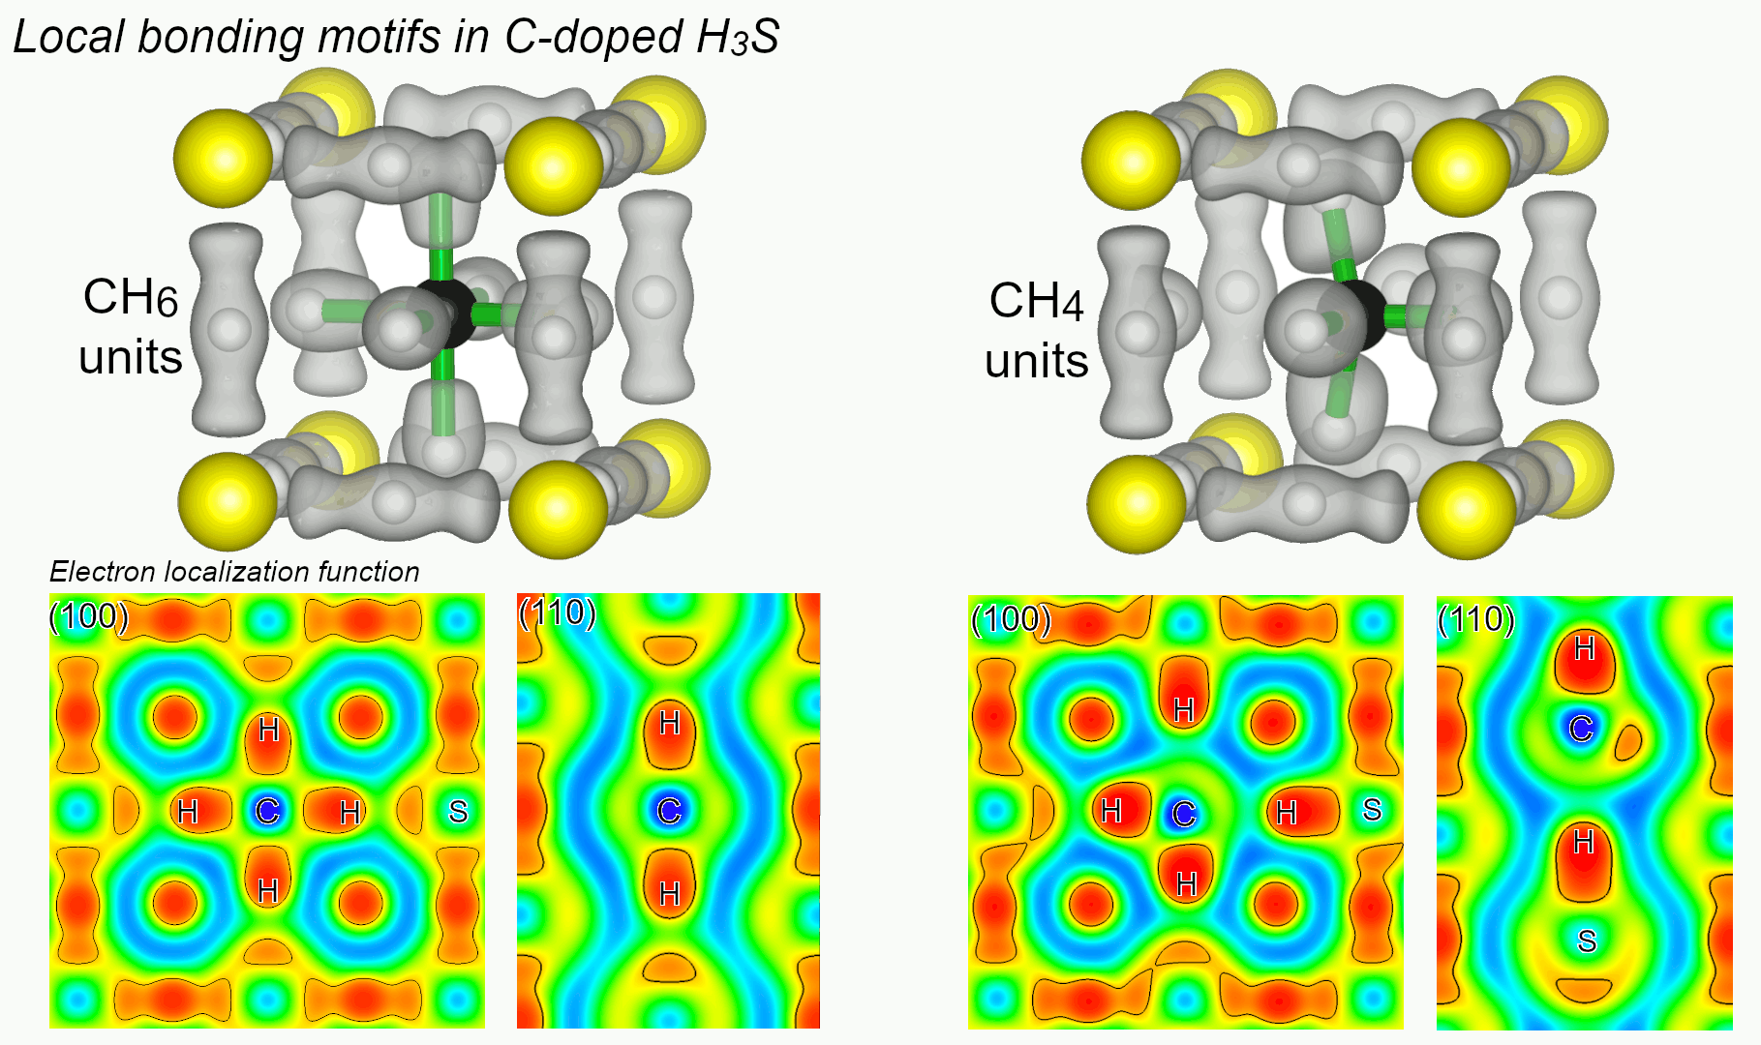
Superconductivity in H₃S Phases Doped with Carbon or Phosphorus
2022 Intellectual Merit
DMR 1827815
Eva Zurek, SUNY at Buffalo
Unlike in a normal material, electricity can flow without resistance in a superconductor. But most materials are superconducting only at very low temperatures. In 2020 experimentalists reported near room-temperature superconductivity at pressures of 267 GPa in a compound identified as carbon-doped H₃S. However, they were unable to characterize the chemical content or structure of the newly synthesized compound.
To help uncover the structure of the superconducting compound we carried out quantum mechanical calculations on model structures where small amounts of carbon had been added to H₃S. At a pressure of 270 GPa the carbon was found to be stabilized in either a six or a four-coordinate environment. In both cases, strong C-H bonds were formed decreasing the metallicity and superconducting properties of H₃S, in contrast with the reported experiments. However, a similar study on phosphorus doped H₃S suggested that its superconducting critical temperature could be slightly higher than that of the undoped phase. Because the atomic radius and bonding properties of P are more similar to those of S as compared with C, phosphorus doping did not diminish the superconducting properties of H₃S.
Electron Localization Function showing strong C-H bonds in C-doped H₃S with (left) six-coordinate carbon and (right) four-coordinate carbon.
Notes:
References: doi:10.1038/s41524-022-00769-9 and doi:10.1021/acs.jpcc.1c10976

Slide 2
Engagement with the American Physical Society (APS)
2022 Broader Impacts
DMR 1827815
Eva Zurek, SUNY at Buffalo
Neil Ashcroft, an eminent solid-state physicist, died in March 2021. In addition to making numerous insightful predictions on the behavior of matter at conditions of high pressure, Neil was best known in the broader physics community for his textbook (co-authored with David Mermin) “Solid State Physics”, which is considered as a gold standard of the field.
PI Zurek met and collaborated with Neil during her postdoctoral appointment at Cornell. After Neil died, she worked with the Ashcroft family, and several members of the APS to establish an award recognizing an early-career scientist who carried out research on matter at extreme high-pressure conditions. The award was established in 2022.
In addition, Zurek was elected as Vice-Chair for APS’ division of computational physics (DCOMP).
Notes:
https://www.aps.org/programs/honors/prizes/ashcroft.cfm
Shanti Deemyad from Utah had the idea for establishing this award and approached me and a number of scientists with this idea. Shanti and I mentioned the idea to Judith Ashcroft who immediately offered to donate funds to establish the award. Next, Shanti and I had to find a home for it. Judith originally suggested the GRC since Neil enjoyed these conferences so much. However, after looking into the options Shanti and I decided the APS would be a better choice. We also decided that the Topical Group on Shock Compression of Condensed Matter, which is currently trying to rebrand themselves to include static compression, would be more appropriate than DCOMP. We then worked with GSCCM and the Ashcroft family to craft an award proposal that was appropriate and in-line with the wishes of the Ashcroft family.

