Slide 1
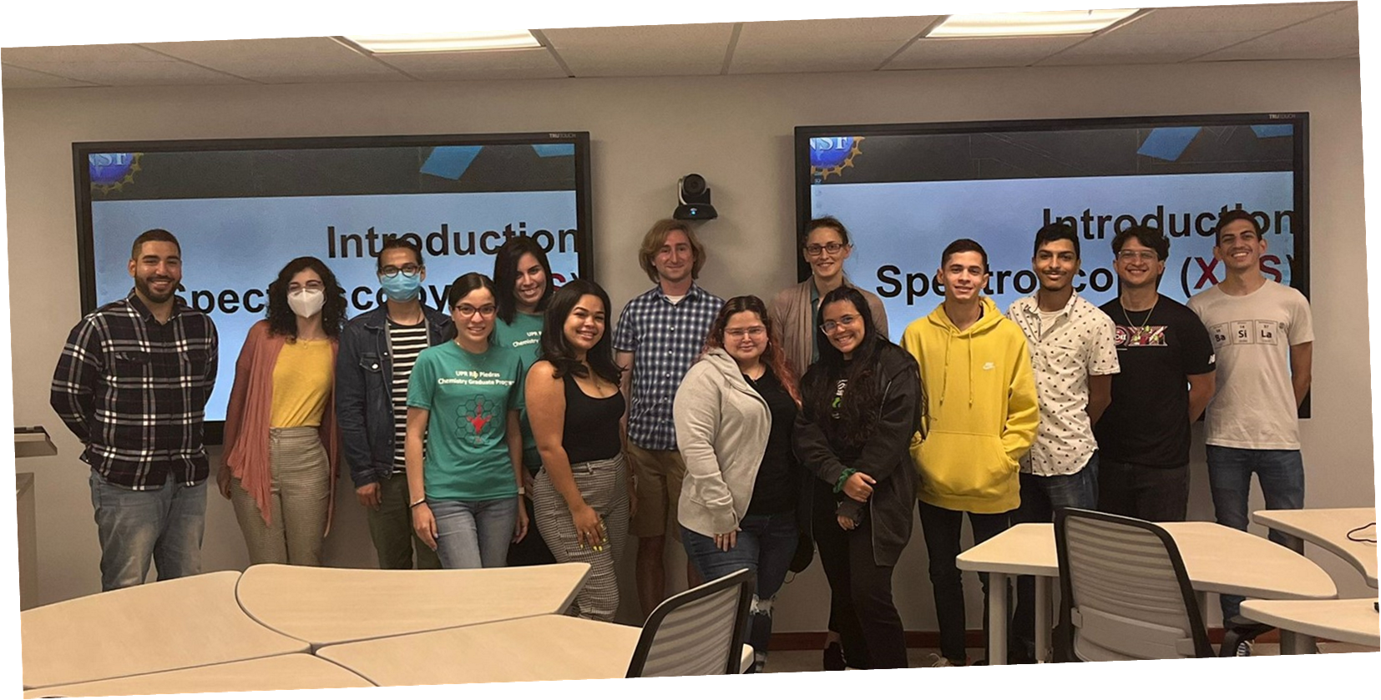
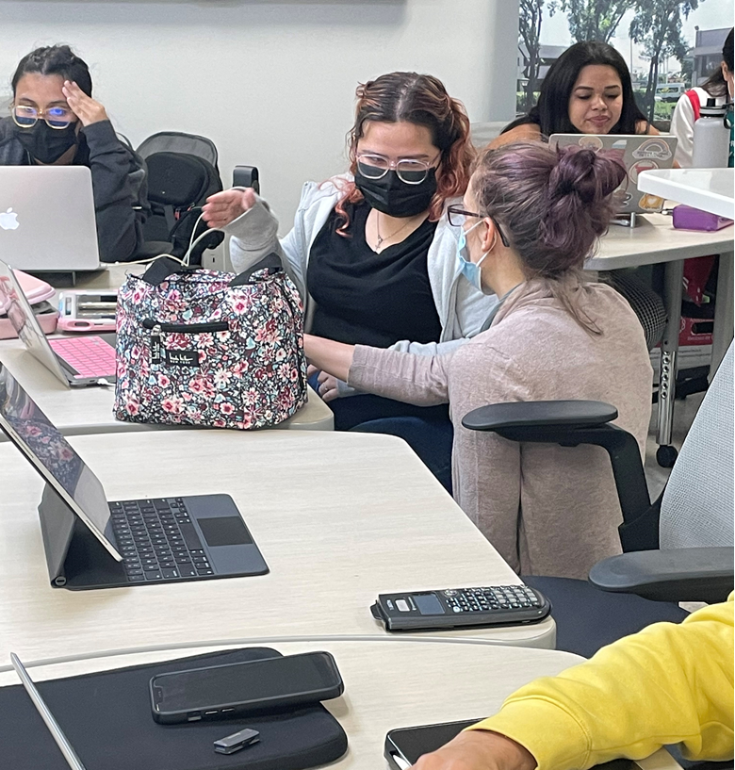
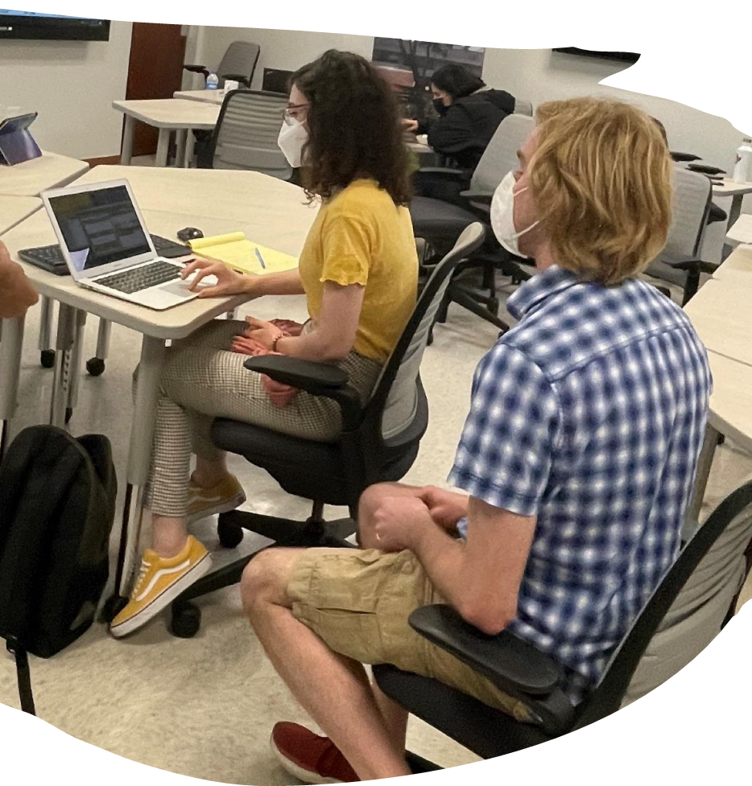
Hands-on XAS Data Analysis Workshop March 31- April 1, 2022
Jorge L. Colon, University of Puerto Rico-Rio Piedras, DMR 1827622
Twelve students participated in this workshop offered by CHESS Staff Scientists, Dr. Louise Debefve and Dr. Chris Pollock, at the Universidad Ana G. Méndez-Cupey Campus. They were able to analyze their XAS data acquired at CHESS.
https://www.chess.cornell.edu/2022-prem-xas-workshop-held-san-juan-puerto-rico

Slide 2
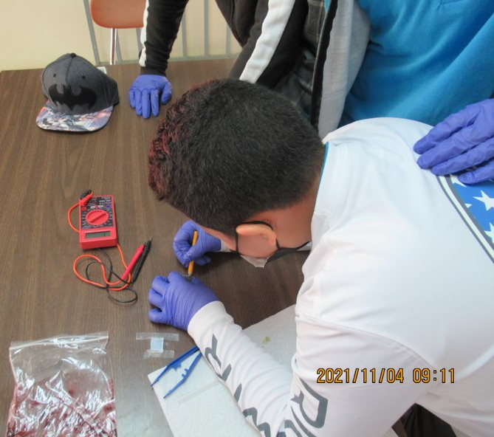
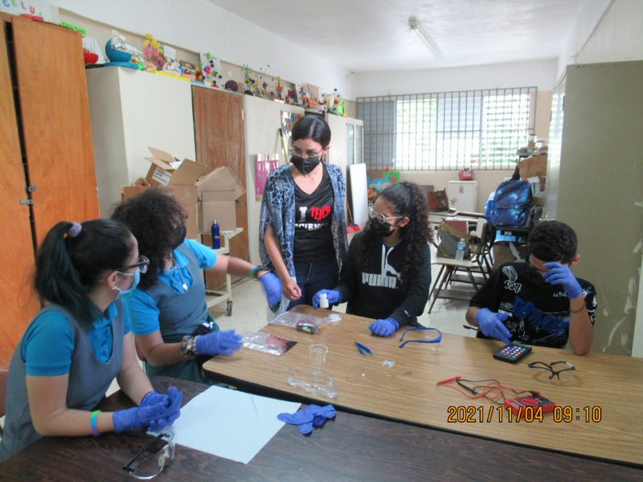
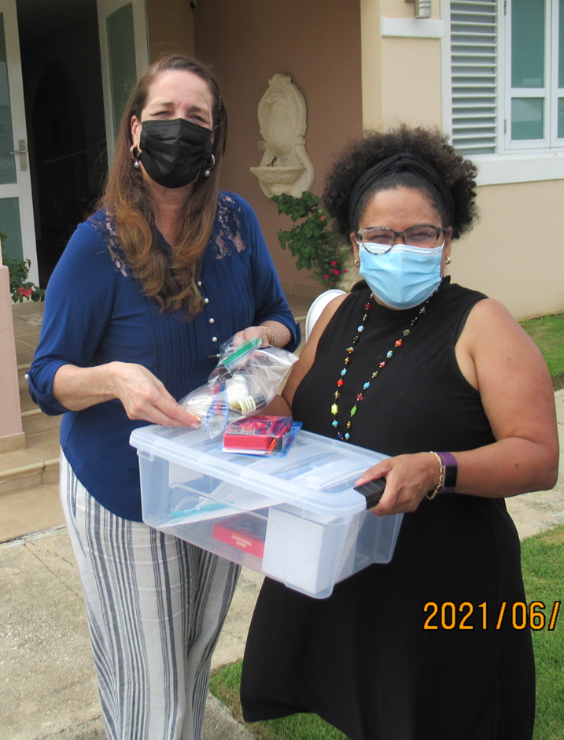
Summer Teacher Development Program 2021 Remote
Jorge L. Colon, University of Puerto Rico-Rio Piedras, DMR 1827622
Five Chemistry and Physics teachers had the opportunity to participate in the Virtual Summer Teachers Development Program. The PREM program then visited those teachers’ classrooms during the academic year to give workshops on energy and materials science.

Slide 3
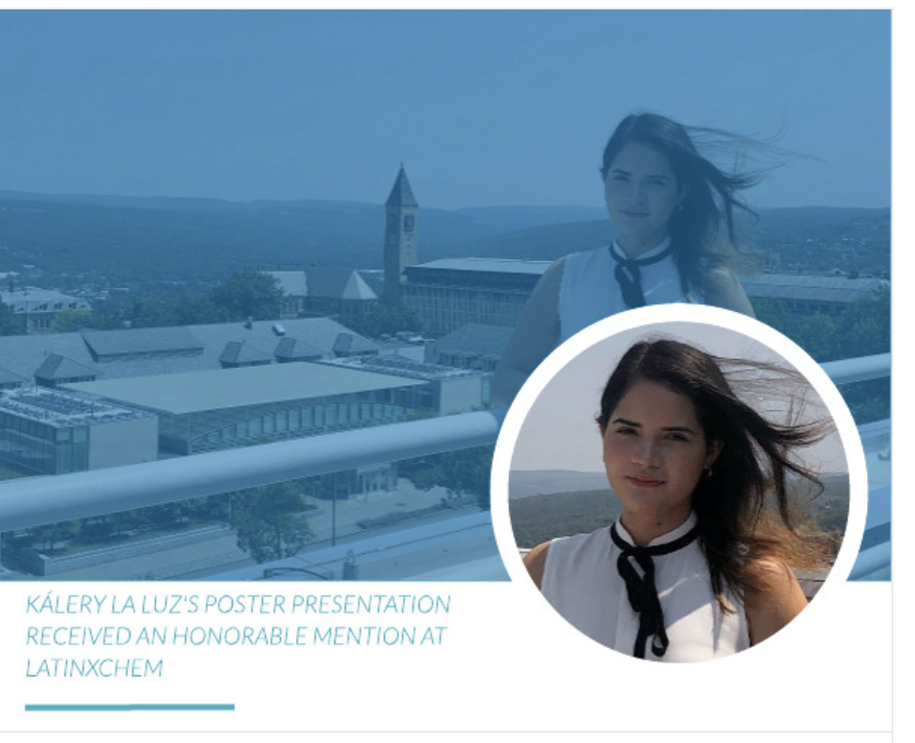
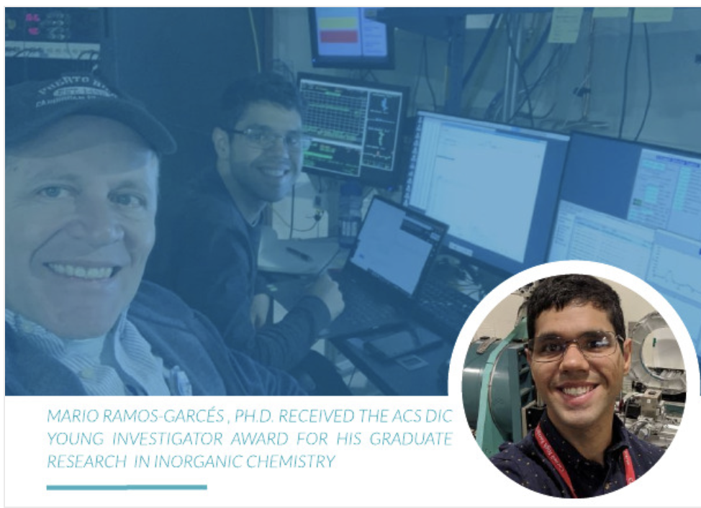
Students’ Awards
Kálery La Luz-Rivera Received an Honorable Mention at the Twitter LatinXChem Poster Competition in September 2021.
Jorge L. Colon, University of Puerto Rico-Rio Piedras, DMR 1827622
Mario Ramos-Garcés, Ph.D., Received the 2021 ACS Division of Inorganic Chemistry (DIC) Young Investigator Award For His Graduate Research.

