Slide 1
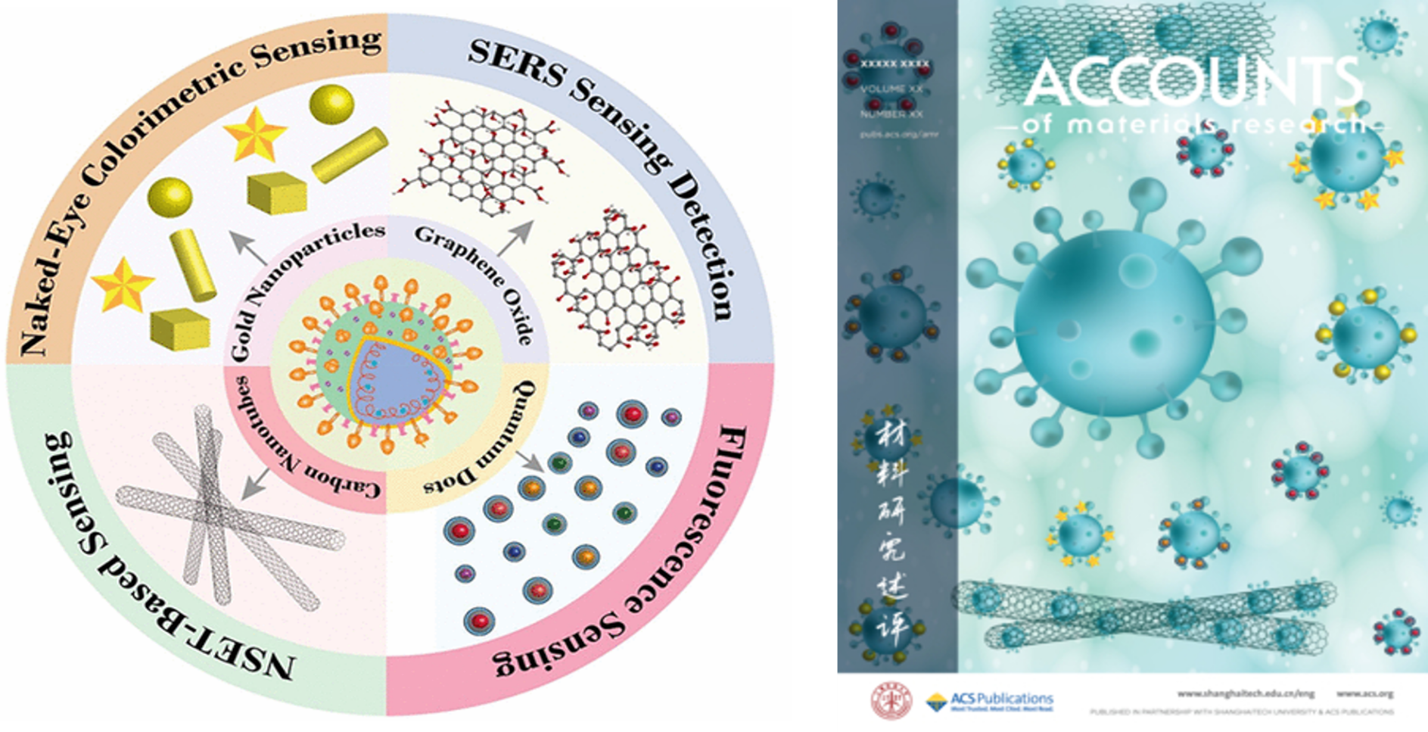
(Published in Acc. Mater. Res. 2022, 3, 2, 134–148)
Designing Bio conjugated Nanomaterial for Targeted Identification of COVID-19
Paresh C. Ray, Jackson State University, DMR 1826886
Notes:
Article authored by PREM team from Jackson State University. The article made the cover page of “Accounts of materials research” – an ACS publication.

Slide 2
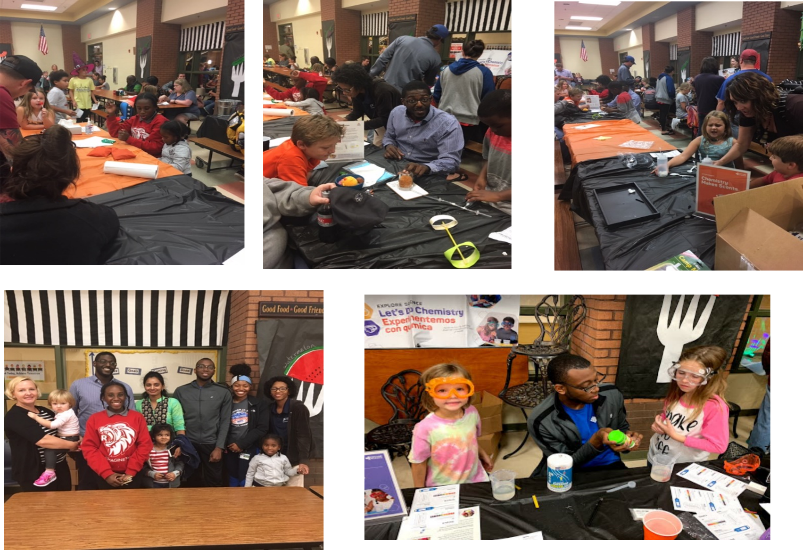
JSU-UCSB PREM’s Nanoday Activity in Jackson Public School: Impact on the Community
Paresh C. Ray, Jackson State University, DMR 1826886
Notes:
Jackson State University PREM hosted Nanoday activity at Mississippi Museum of Natural Science. More than 500 children and 100 adults participated in this event.

