Slide 1
Synthesis and Spectroscopy of Complex Halide and Chalcogenide Nanocrystals
2022 Intellectual Merit
DMR 1807394
Daniel R. Gamelin, University of Washington
ABX₃ metal-halide perovskite nanostructures are critical materials for future solar, lighting, and quantum-information technologies
Most studies have focused on lead-halide perovskites, such as CsPbBr₃
This project has developed and studied nanocrystals and thin films of the lead-free perovskite, CsEuCl₃
Whereas Pb²⁺ is non-magnetic, Eu²⁺ has a large magnetic moment, but CsEuCl₃ magnetism has never been investigated
This project has discovered extraordinary magnetic and magneto-optical properties in CsEuCl₃ nanostructures, including ferromagnetism and very strong magneto-optical responses
These findings expand our fundamental understanding of materials and introduce new magnetic functionalities attractive for future advanced technologies based on metal-halide perovskites
CsEuCl₃ nanocrystals (~10 nm diameter) show ferromagnetism and strong magneto-optical responses at low temperatures. As the first intrinsic magnetic metal-halide perovskite, these materials may enable future spin-based technologies quantum or optoelectronic technologies.
Notes:
Results published in: Walsh, K. M.; Pressler, K.; Crane, M. J.; Gamelin, D. R., ACS Nano, 2022, 16, 2569–2576.
MCPL = Magnetic Circularly Polarized Luminescence.
MCD = Magnetic Circular Dichroism.
The degree of circular polarization in each experiment reflects the material's magnetization.
In this material, we have used these spectroscopic techniques to demonstrate ferromagnetism in CsEuCl3 nanocrystals and thin films, and to show that these metal-halide perovskites show extremely large magneto-optical responses in both MCD and MCPL.
These are the first intrinsic magnetic metal-halide perovskites ever discovered, and are envisioned as enabling the integration of magnetic functionality into perovskite device architectures, e.g., for spin-based information processing ("spintronics").

Slide 2
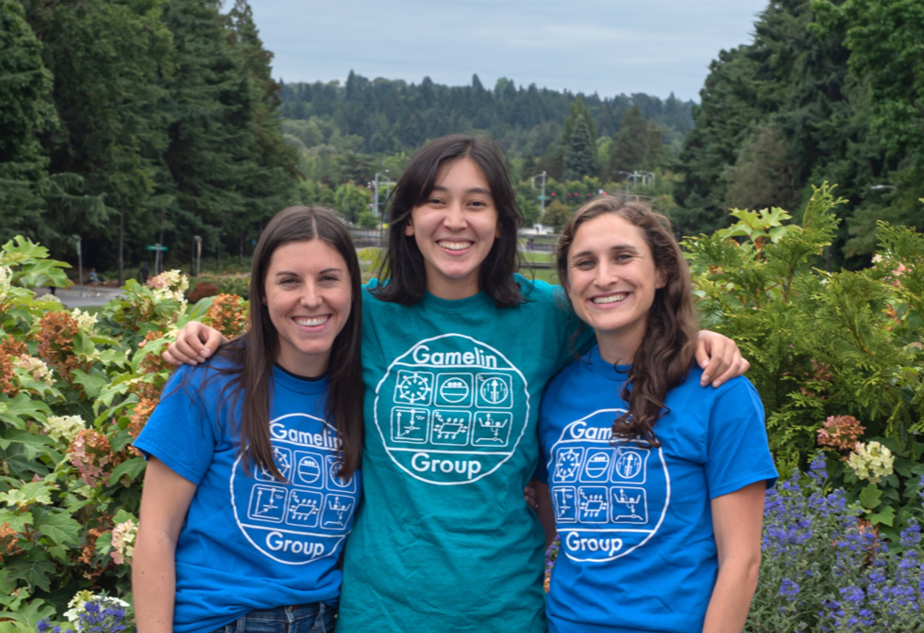
Synthesis and Spectroscopy of Complex Halide and Chalcogenide Nanocrystals
2022 Broader Impacts
DMR 1807394
Daniel R. Gamelin, University of Washington
This year, graduate students in the Gamelin Group participated in multiple mentoring and outreach activities.
Graduate student project participants have mentored four undergraduate and REU students in the laboratory, all in their first research experiences. Under the guidance of these graduate students, the undergraduate researchers have learned laboratory techniques, taken ownership of their own research projects, and presented their results within and outside of the group in talks and poster sessions.
Graduate student project participants volunteered as mentors in NanoCamp! 2022, a program organized by UW's NSF MRSEC and UW's Youth & Teen Programs to offer 6th to 8th grade campus visitors hands-on opportunities to explore the properties of nanomaterials and to tour UW nanoscience laboratories. Students prepared lithography experiments and solar photovoltaic demonstrations.
Carmelita Ro-Mendez (center, REU) spent the summer between her freshman and sophomore years of college in the Gamelin Group synthesizing doped colloidal nanocrystals of CsEuCl₃ and characterizing them spectroscopically. She worked closely with graduate-student mentors Kelly Walsh (L) and Laura Jacoby (R).

