Slide 1
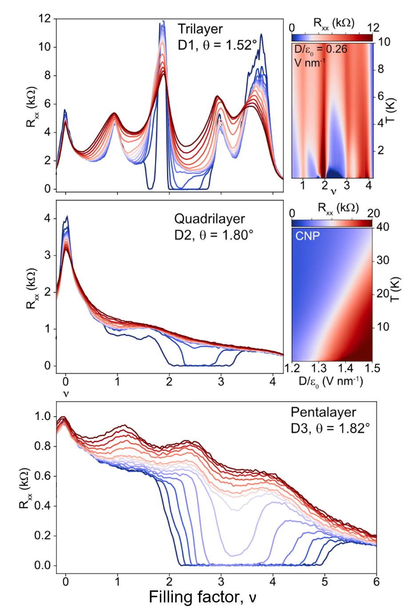
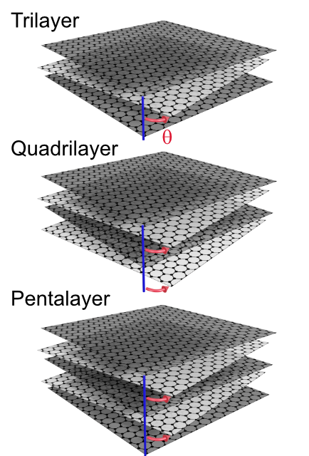
Promotion of superconductivity in twisted graphene multilayers
2022 Intellectual Merit
DMR 1753306
Stevan Nadj-Perge, California Institute of Technology
Graphene moiré superlattices show an abundance
of exotic quantum electronic phases. Whereas the origins of strong correlations and nontrivial topology in these structures can be directly linked to emerging flat bands, the nature of superconductivity remains enigmatic.
In our work (Science 2022), we demonstrated that structures made of twisted tri-, quadri-, and pentalayer graphene placed on monolayer tungsten diselenide exhibit symmetry-breaking transitions and superconductivity. As the number of layers increases, superconductivity emerges over an enhanced filling-factor range, and in the pentalayer, it extends well beyond the filling of four electrons per moiré unit cell.
These results highlight the role of the interplay between flat and more dispersive bands in extending superconducting regions in graphene moiré superlattices and will guide future theories on the origin of superconductivity in these systems.
Adapted from Y. Zhang et al., Science 377, 1538-1543(2022)

Slide 2
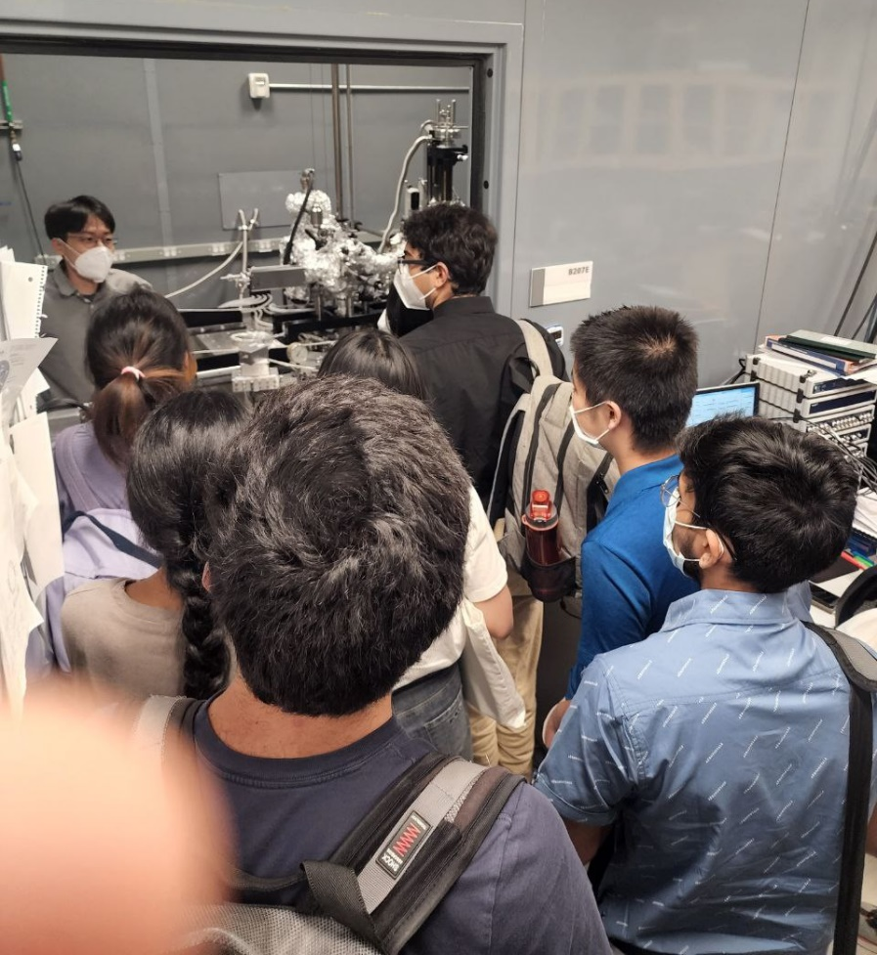
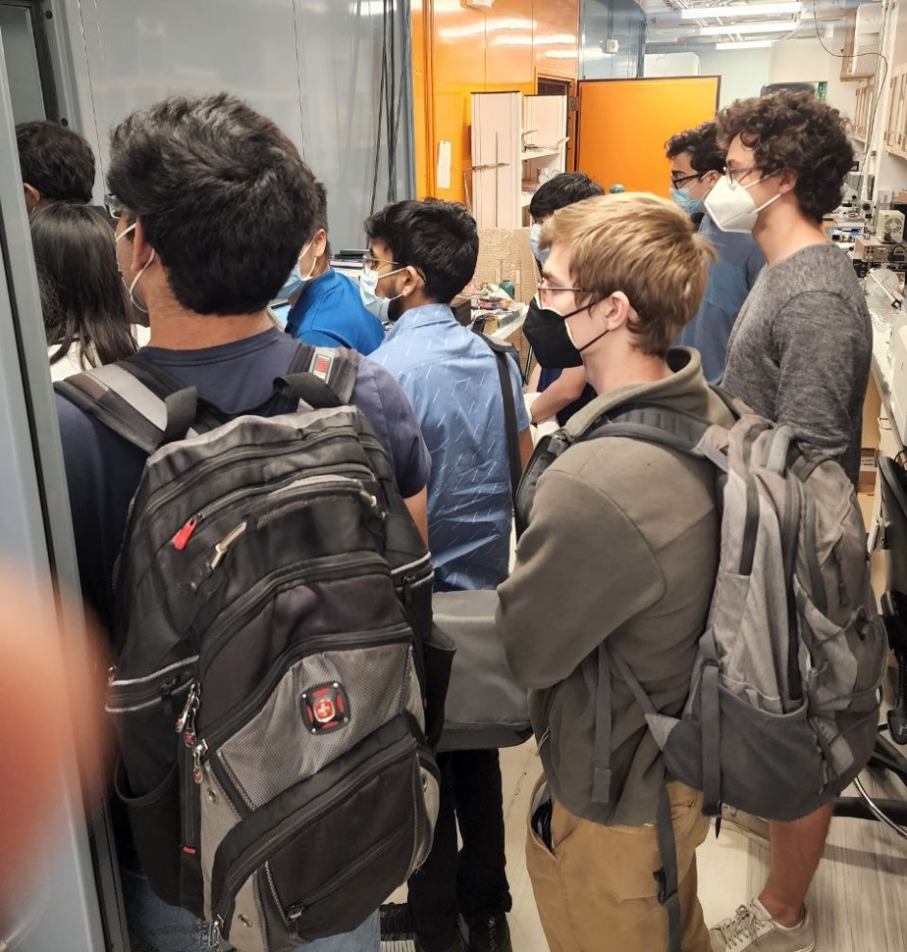
Twisted Graphene Multilayers in Education and Outreach
2022 Broader Impacts
DMR 1753306
PI: Stevan Nadj-Perge, California Institute of Technology
Twisted graphene structures offer unique opportunities for education and outreach. These materials provide an intuitive way of explaining how complex electronic phases emerge and can be used to engage the audience at various levels visually.
This year, the physics of twisted graphene multilayers was incorporated into the applied physics curriculum at Caltech (in classes covering condensed matter physics and physics of semiconductors) as well as in the summer program lectures and outreach seminars for undergraduates.
The image on the right shows one of the lab tours this year featuring our scanning tunneling microscope used to obtain a microscopic image of emerging moiré pattern in twisted trilayer graphene (adapted from H. Kim et al., Nature 606, 494–500 (2022)). This tour was given to students participating in the quantum summer undergraduate research fellowship program (QSURF).

