Slide 1
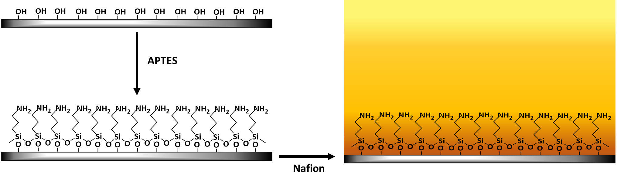
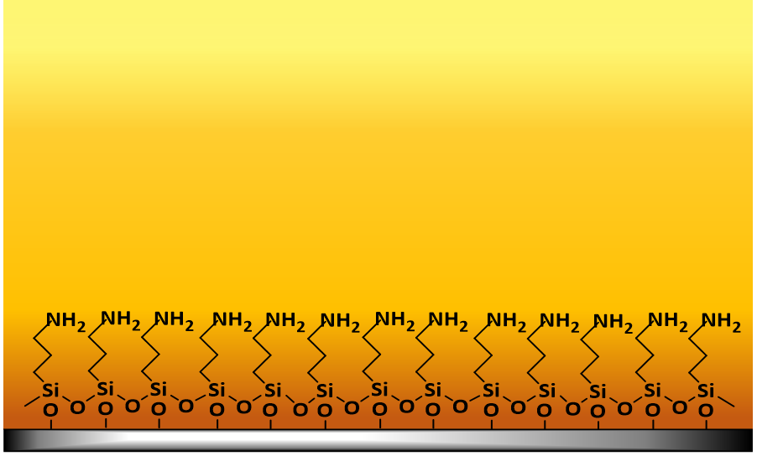

CAREER: Confined Ionomeric Systems and Imaging Ionic Distribution
2022 Intellectual Merit
DMR 1750040
On a fuel cell electrode, a thin layer of an ion-conducting polymer or ionomer (typically Nafion) is used to bind catalyst particles to electrode.
Earlier in this project, we revealed that in these thin layers, Nafion exhibits a weakly proton-conducting, broad zone next to substrate interface.¹
The slow proton transport to catalyst active sites makes the electrochemical reaction on the electrode sluggish and impacts the fuel cell efficiency.
This made us think:
Can we manipulate the distribution of ion conduction environment across ionomer films?
To find the answer, we did a simple experiment where we added a sandwich layer in between Nafion layer and substrate. The sandwich layer was made of aminosilane (APTES).
Shudipto K. Dishari, University of Nebraska-Lincoln
Nafion film on
silane-treated substrate
Silane layer helped to narrow down
the weakly proton-conducting region
next to substrate and
improved the overall proton conductivity across the Nafion film.
Changing the chemical makeup of substrate can be an effective tool to control interfacial and overall ionic conductivity.
¹ Farzin. S.; Zamani, E.; Dishari, S. K. ACS Macro Lett. 2021, 10, 791-798

Slide 2
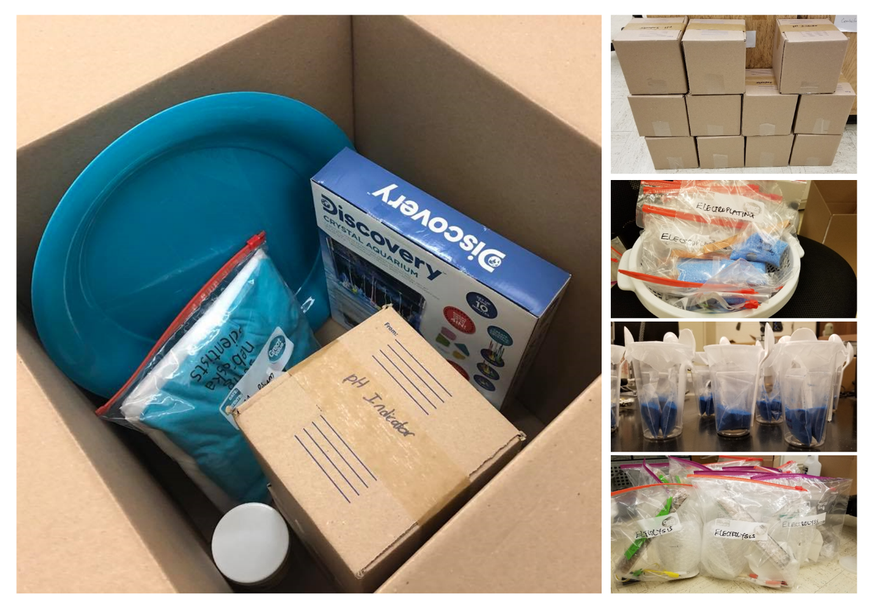
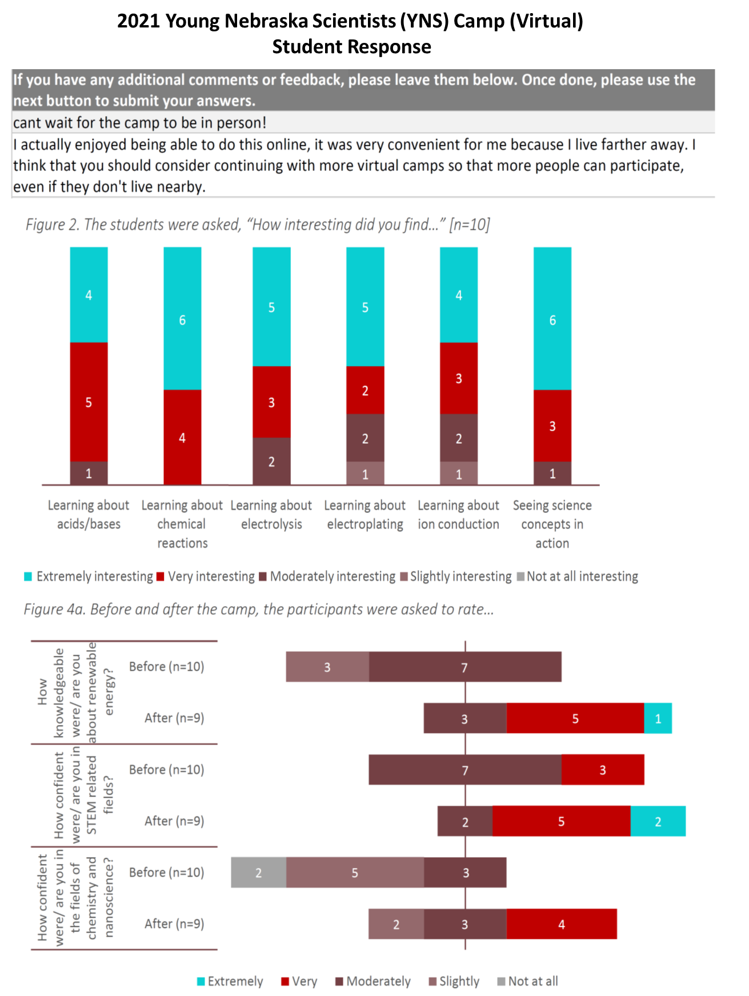
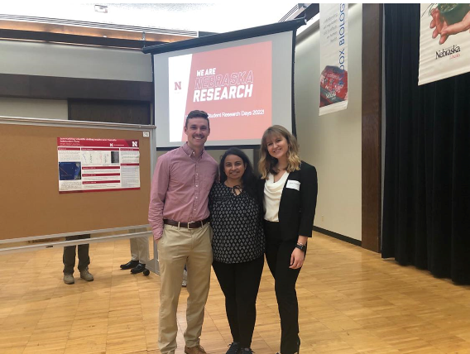
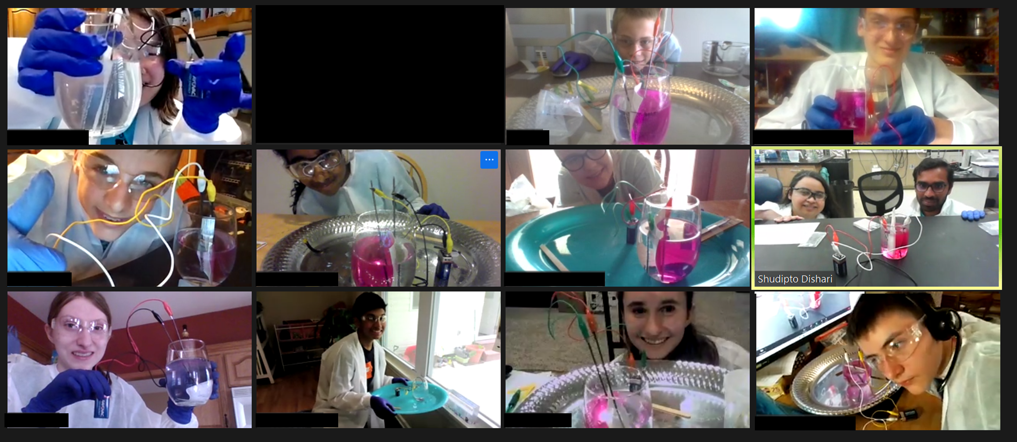
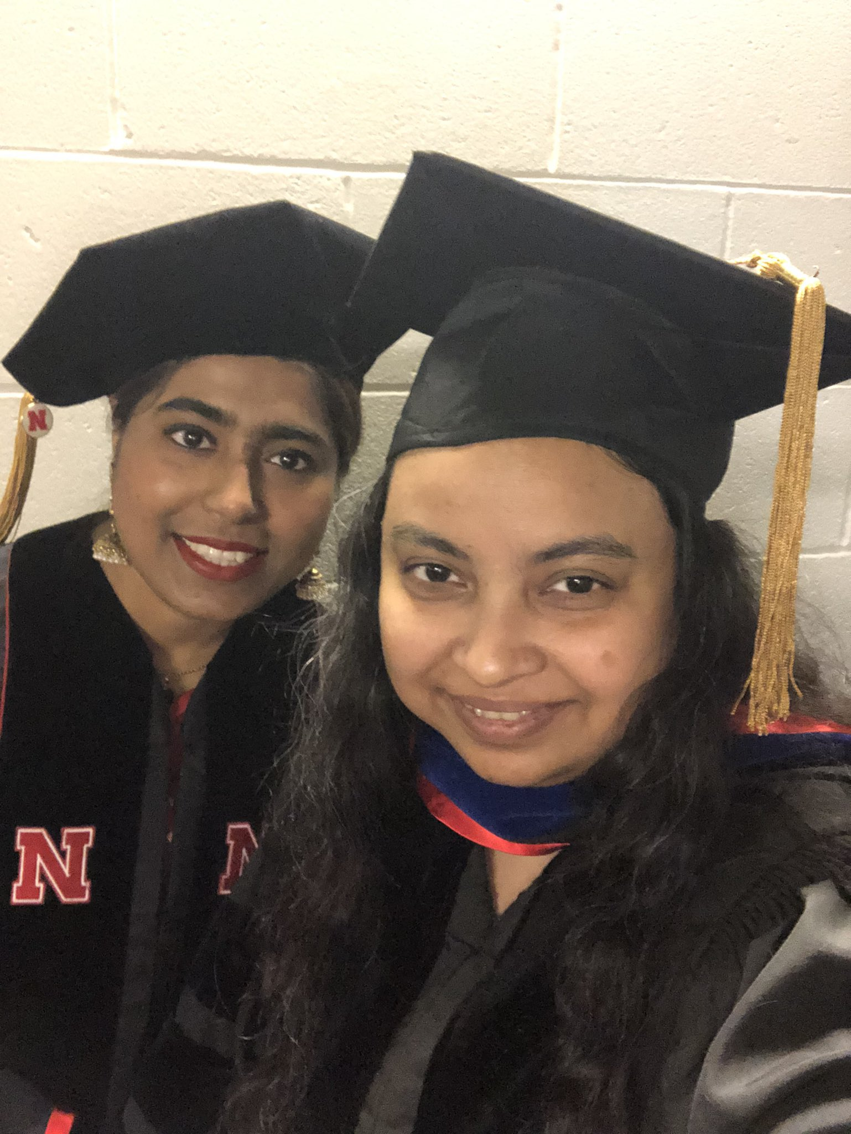
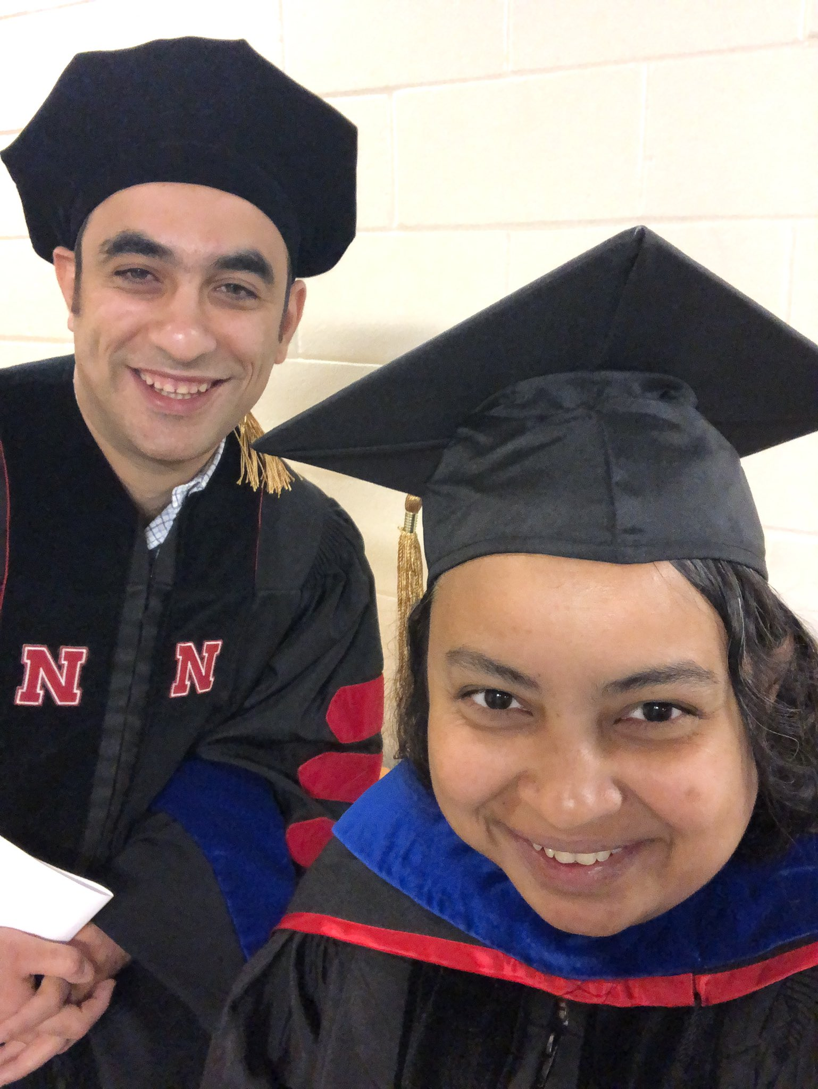
DMR 1750040
2022 Broader Impacts
CAREER: Confined Ionomeric Systems and
Imaging Ionic Distribution
Shudipto K. Dishari, University of Nebraska-Lincoln
In summer 2021, team Dishari went virtual for the Young Nebraska Scientists (YNS) Summer Camp, a great opportunity to engage K8-12 students in energy-related STEM activities. For this camp, team Dishari developed 7 different science kits from scratch in her lab and shipped those to campers.
Graduated:
2 undergraduate students
honors thesis (1)
2 Ph.D. students
Currently working at:
Syngenta (3), Intel (1)
Happy faces of the campers after they successfully completed a water electrolysis experiment at their home using the kits we designed and shipped to them.
Survey responses spoke volumes about
the effectiveness of our virtual camp

