Slide 1
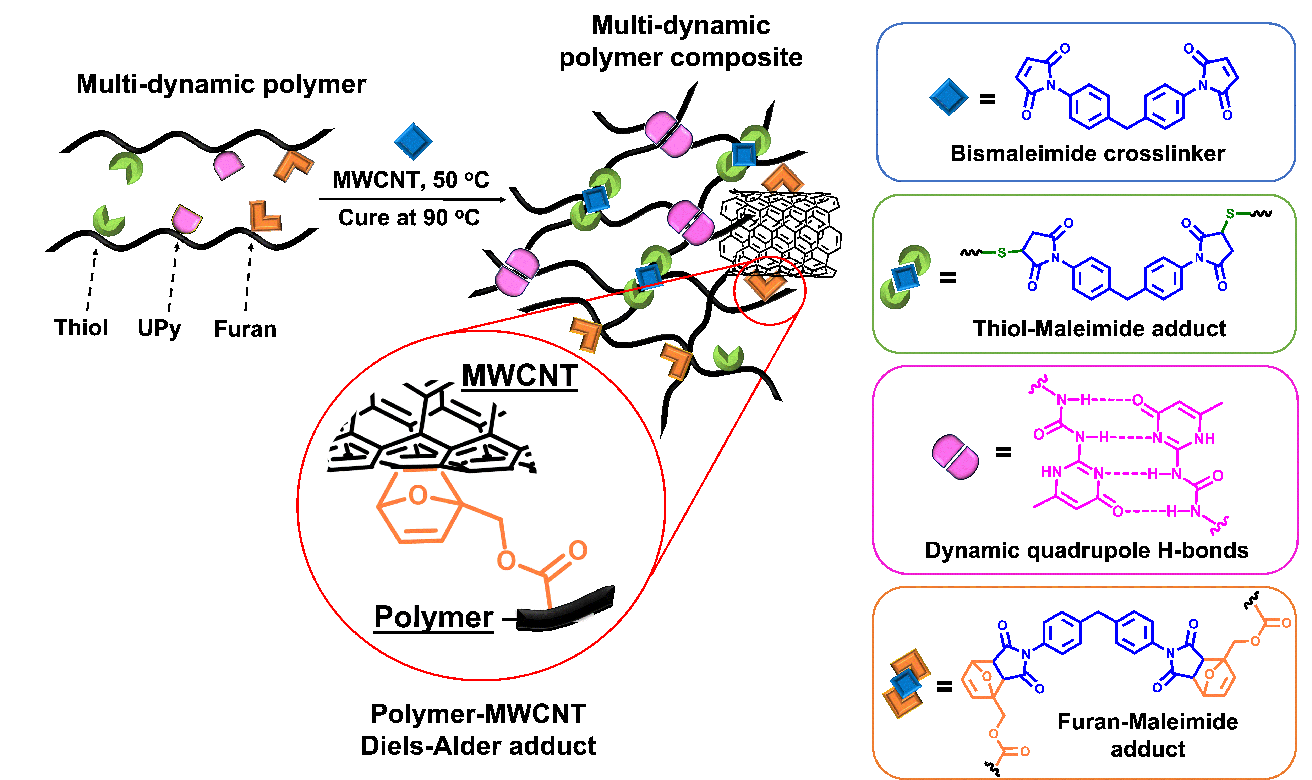
CAREER: Dynamic Polymer Materials with Advanced Polymer Architecture and Carbon Nanotube Reinforcements
2022 Intellectual Merit
DMR 1749730
Dominik Konkolewicz, Miami University
Dynamic polymer materials containing multiple exchangeable bonds were developed.
Polymers capable of bonding to the carbon nanotube surface were developed through temperature reversible chemistry, without requiring harsh chemical treatments
Excellent enhancement of mechanical properties were achieved by carbon nanotube reinforcement:
No loss in extensibility was found despite 2-fold increase in strength.
Polymer microstructure had a substantial impact on material properties with higher molecular weight polymers enhancing reinforcement.
Polymer composites containing carbon nanotubes had substantially higher conductivity, comparable to existing undoped semi-conductors.
Top left: Schematic of multiply dynamic polymer materials containing carbon nanotubes, hydrogen bonded units, thiol-Michael, and Diels Alder.
Top right: Comparison of stress-strain curve with and without nanotubes including self healing.
Bottom Right: Evolution of mechanical properties in self-healing experiments.

Slide 2

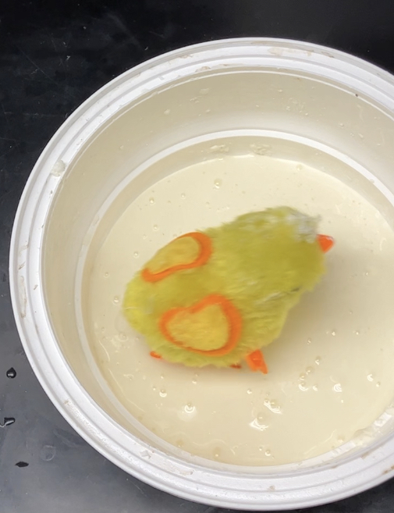
CAREER: Dynamic Polymer Materials with Advanced Polymer Architecture and Carbon Nanotube Reinforcements
2022 Broader Impacts
DMR 1749730
Dominik Konkolewicz, Miami University
Broader impact efforts have focused on public domain resources and outreach activities
Development of open access and public domain curricular, professional development and outreach through the macromolecular alliance for community resources and outreach, shown Top image. Contributions include public domain resources in:
Organic Polymer Chemistry
Polymer Characterization
Live Webinars/Panels on Graduate Studies, REU sites, Careers after graduate studies and managing stress during graduate studies
Resume and CV development and curation
Outreach activities have focused on visiting libraries and working with local school districts
New focus includes how complex fluids can change properties depending on timescales.
Demonstrated with a wind-up toy walking on cornstarch suspension and sinking after stopping.
Top: Logo of the Macromolecular Alliance for Community, Resources and Outreach. Right: Demonstrations, focusing on complex fluid properties, aiming to make a surface that a mechanical toy can be supported on cornstarch suspension.

