Slide 1
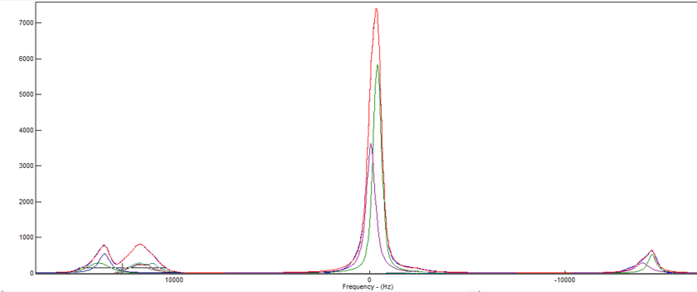
RUI: Structure and Properties of New, Practical Glasses
2022 Intellectual Merit
DMR 1746230
Steven A. Feller, Coe College
Lithium thioborate glasses are based on sulfur rather than oxygen. The large sulfur atoms creates pathways that allow lithium ions to conduct well, ionically. In fact, the conductivity has been shown to increase over a thousand-fold compared to the analogous oxide-based lithium borates.
In this collaborative study with Professor SW Martin’s group at Iowa State University, Coe College undergraduate students have fit ¹¹B MAS NMR spectra to help quantitatively determine the atomic arrangements of the glasses. This has yielded details of the abundances of three and four-coordinated boron atoms as well as fractions of borons with non-bridging sulfurs. Models for the changing structures as a function of composition were developed.
The fraction of four-coordinated borons, N₄, plotted from lithium borate and thioborate glasses shows very different behavior for the borates and thio-borates. A remarkable 80+ % of the thioborate units contain tetrahedral borons at some compositions. This is double the case for lithium borates, also shown in the figure.
¹¹B MAS NMR spectrum of a 0.55Li₂S.0.45B₂S₃ glass. A deconvolution is shown as well
The fraction of four-coordinate borons from lithium borate and lithium thioborate glasses.
Notes:
Note that the spectrum has been deconvoluted using DM-Fit which employs the quadrupole interaction. From left to right the ¹¹B MAS NMR spectrum of a 0.55Li₂S.0.45B₂S₃ glass displays spinning sidebands, three-coordinate borons, four-coordinated borons, and additional spinning sidebands.

Slide 2
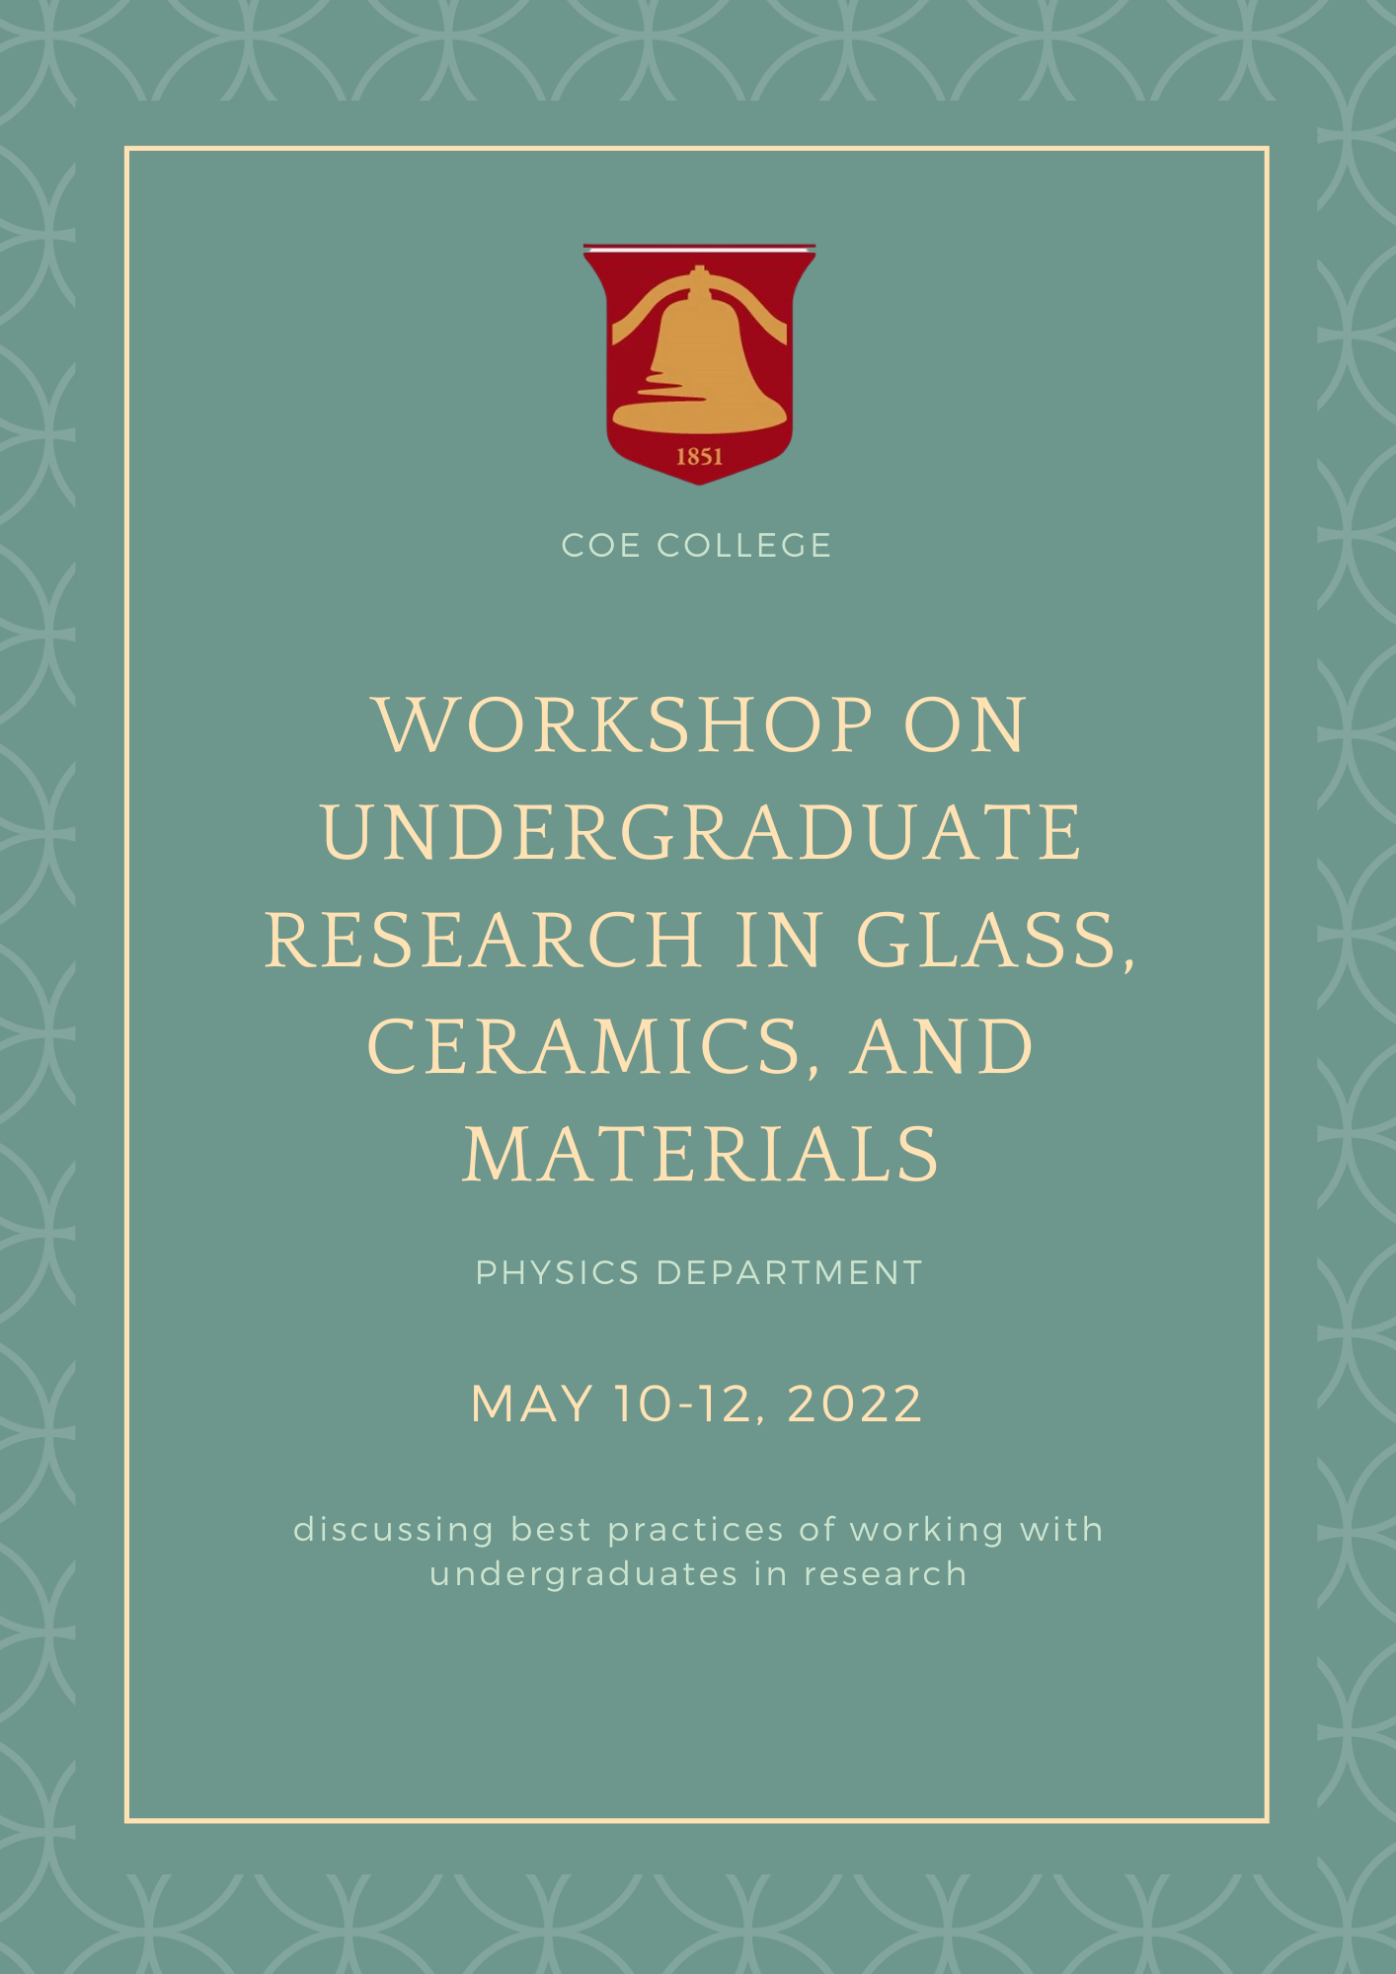
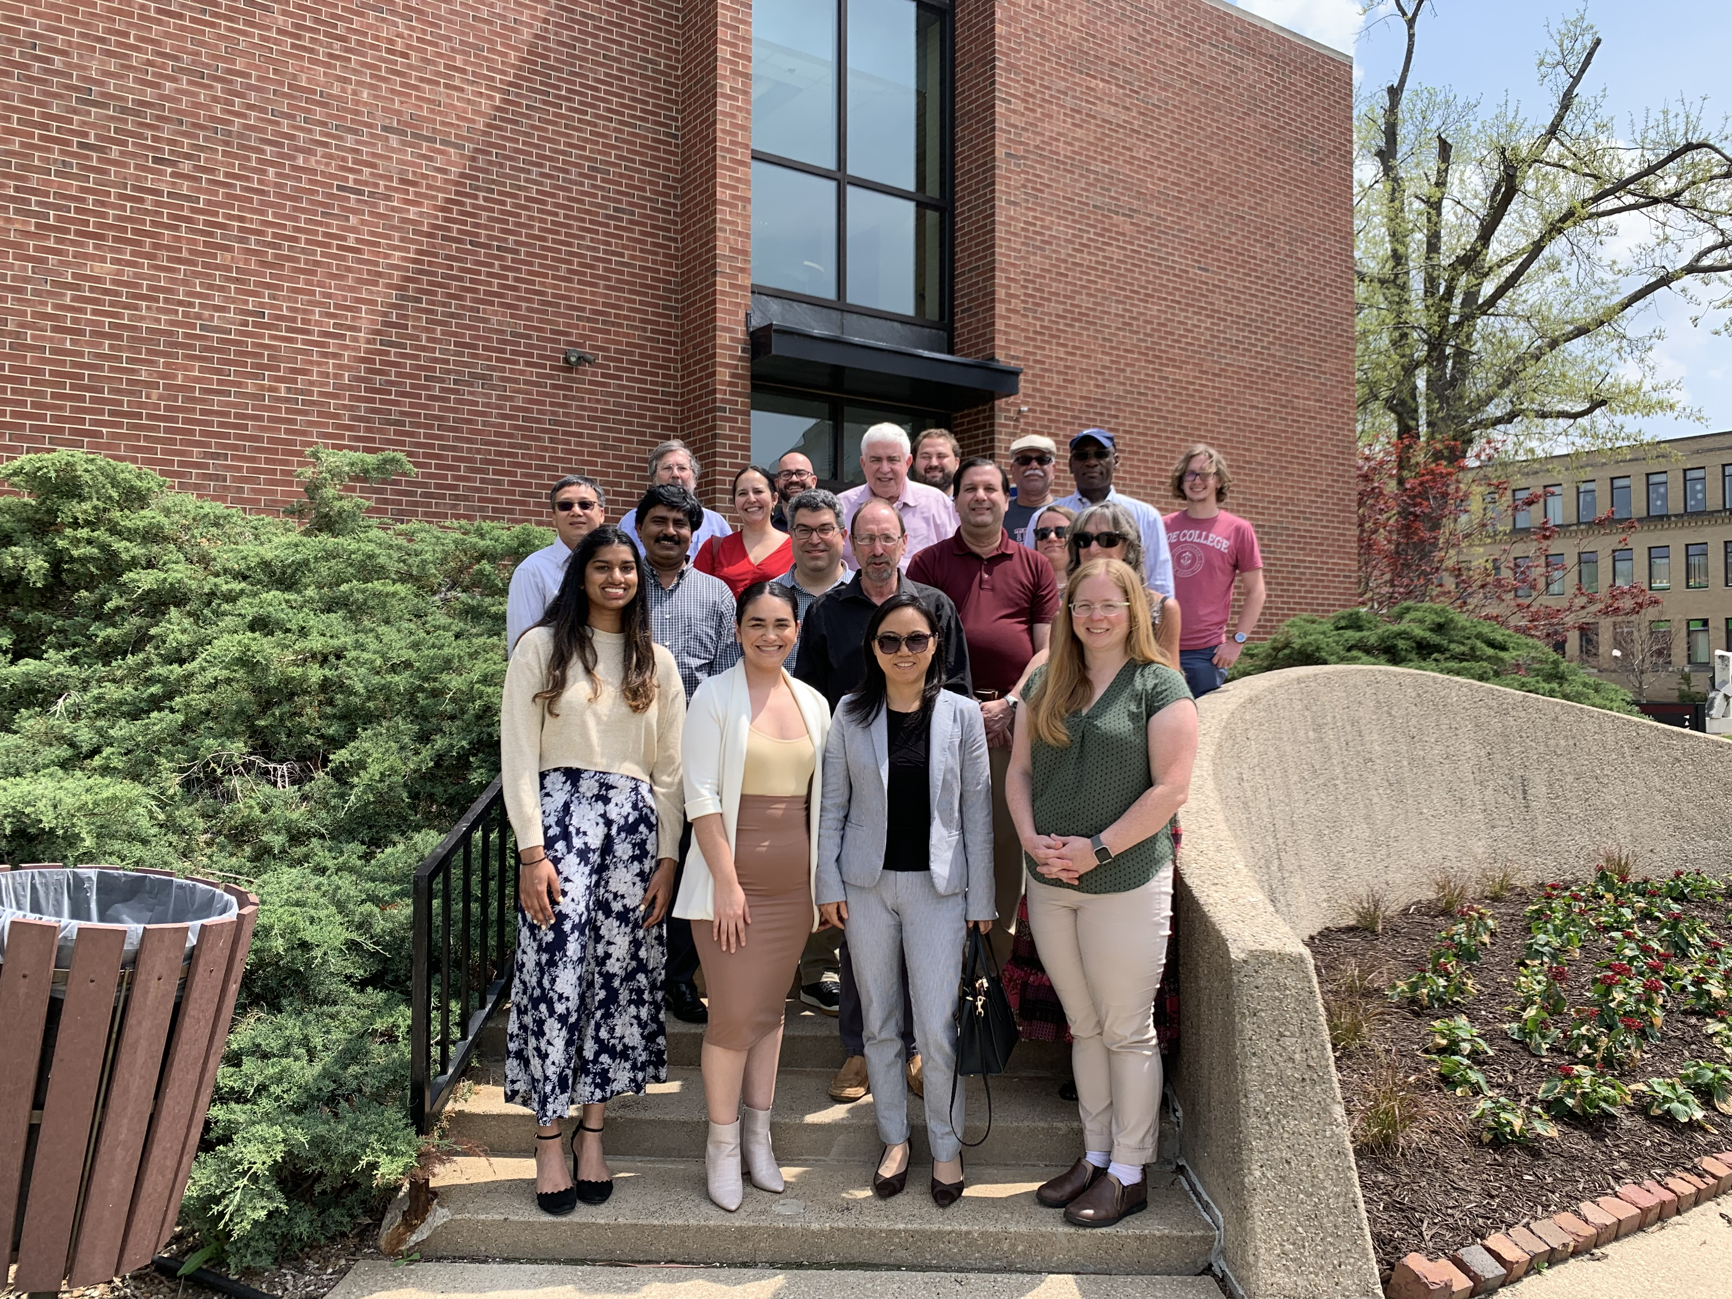
RUI: Structure and Properties of New, Practical Glasses and
2022 CONFERENCE: A Workshop on Undergraduate Research for Faculty in Glass Science and Engineering (Cedar Rapids, Iowa)
2022 Broader Impacts
DMR 1746230
Steven A. Feller, Coe College
In May 2022 we hosted a three-day faculty workshop on undergraduate research in glass, and ceramics materials.
A diverse group of around twenty participants attended the workshop, including representation from Tuskegee (AL), Morgan State (MD), Seton Hall (NJ), RPI (NY), Creighton (NE), Henderson State (AR), and Central New Mexico Community College (NM). A half-dozen leaders in the field gave presentations on best practices.
Two undergraduate students-- Leilani Rocha and Sophia John-- were conference coordinators. Other undergraduate researchers served on various panels.
Stemming from this workshop, a full symposium on undergraduate research was organized for the October 2022 MS&T conference in Pittsburgh.
Beginning in September 2022 and throughout the 2022-2023 academic year, Feller and Affatigato are set to visit many participants of the workshop in order to listen and offer advice on increasing undergraduate participation in undergraduate research in these fields.
These efforts are to increase undergraduate research in order to increase national participation in materials research at this crucial level.
Participants of the Coe College faculty workshop on undergraduate research in glasses, ceramics, and materials. This was held in May 2022.
Cover page from the NSF-supported workshop on undergraduate research.
Notes:
This workshop is part of an organized multi-prong effort to promote undergraduate research in glass, ceramics, and materials. The PIs have over 70 years of experience directing almost 400 undergraduates in research.

