Slide 1
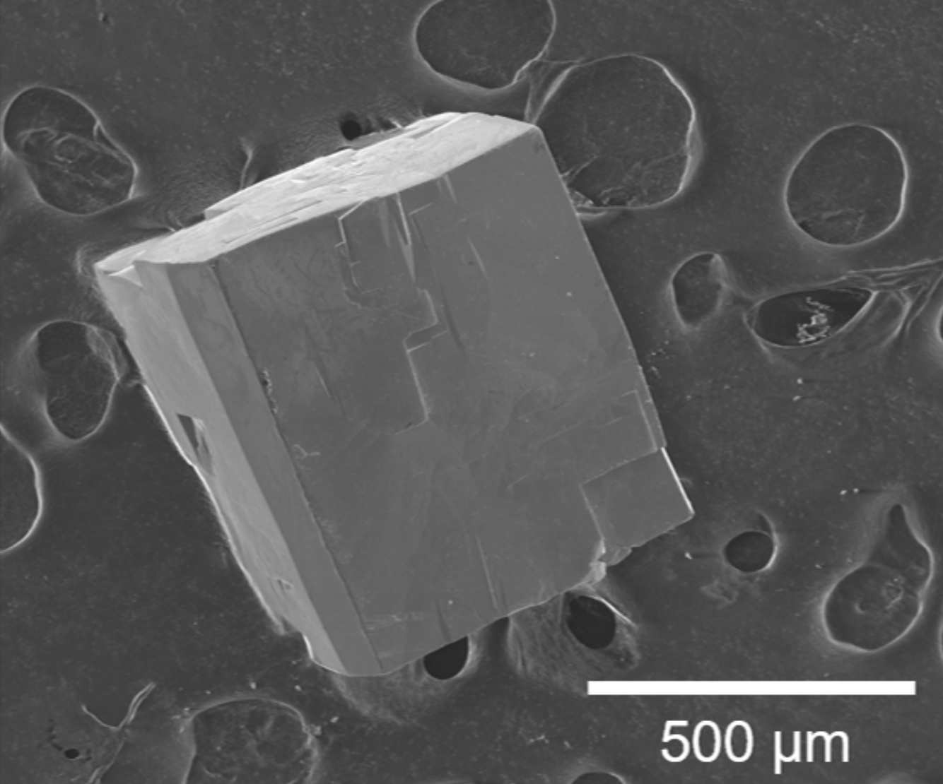
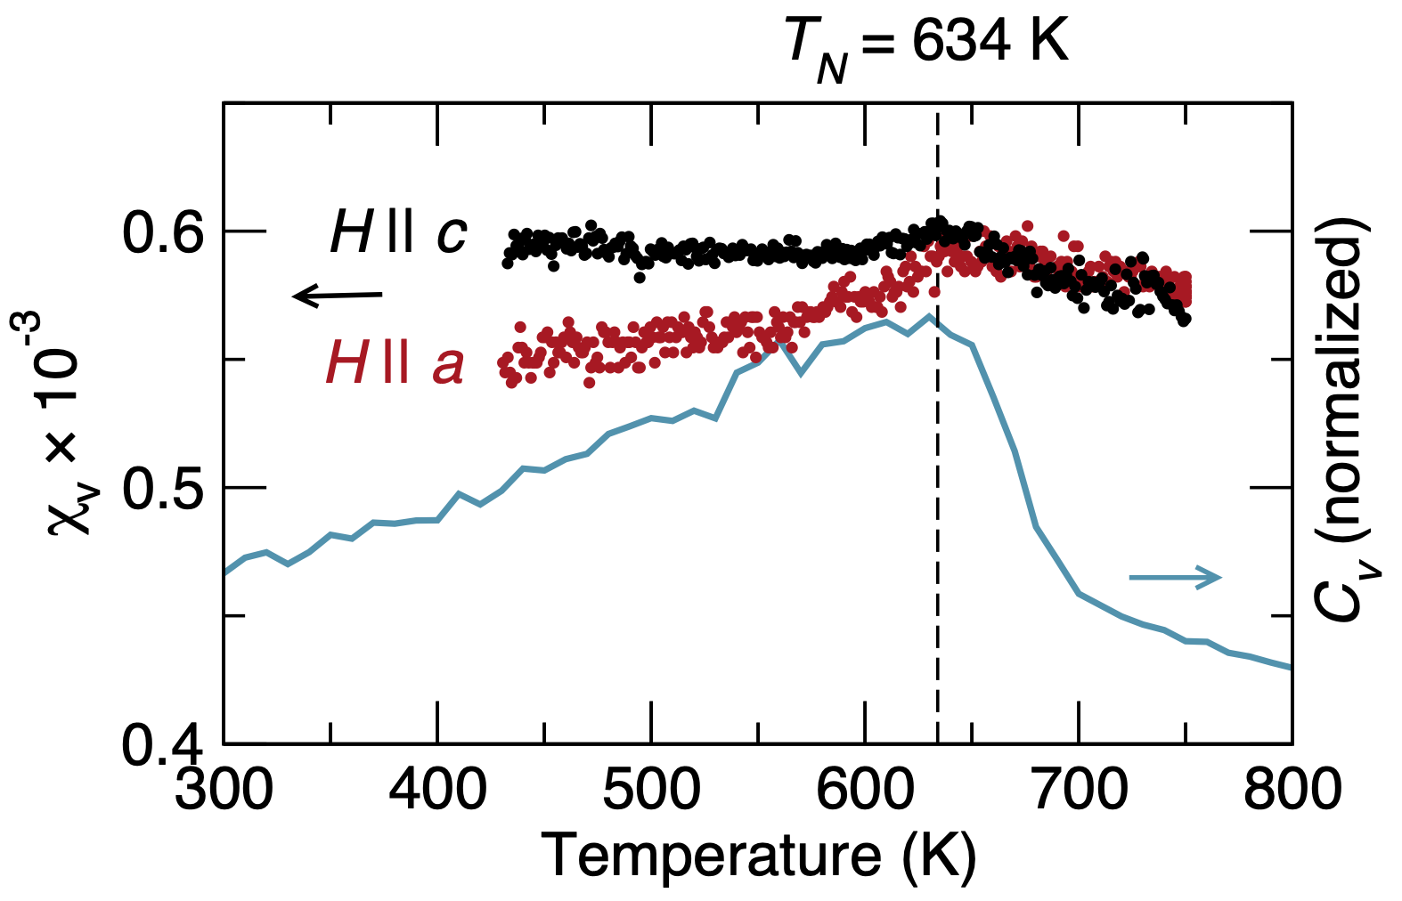
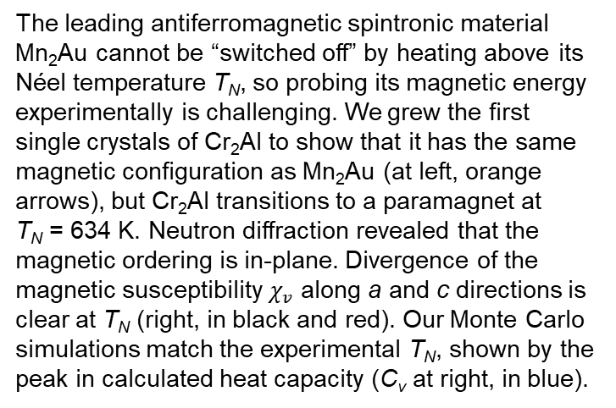
First crystal growth and magnetic structure of the high-temperature antiferromagnet Cr₂Al
DMR 1720633
Nadya Mason, University of Illinois Urbana–Champaign
Switching Néel vector orientations in antiferromagnets has been proposed as an ultrafast means of data storage, but the fundamental energy scales of switching cannot be evaluated without oriented measurements on single crystals. These single-crystal methods are vital for understanding if first-principles calculations can predict the energies and dynamics that govern these devices.
The leading antiferromagnetic spintronic material Mn₂Au cannot be “switched off” by heating above its Néel temperature T_{N}, so probing its magnetic energy experimentally is challenging. We grew the first single crystals of Cr₂Al to show that it has the same magnetic configuration as Mn₂Au (at left, orange arrows), but Cr₂Al transitions to a paramagnet at
T_{N} = 634 K. Neutron diffraction revealed that the magnetic ordering is in-plane. Divergence of the magnetic susceptibility $χ_{v}$ along a and c directions is clear at T_{N} (right, in black and red). Our Monte Carlo simulations match the experimental T_{N}, shown by the peak in calculated heat capacity (C_{v} at right, in blue).
Conclusion: Flux growth of metallic single crystals provides critical opportunities to benchmark theory and understand energy scales of magnetic switching.
C. Zhao, et al., Phys. Rev. Mater. 5 084411 (2021)
Notes:
In-plane magnetic structure and exchange interactions in the high-temperature antiferromagnet Cr2Al
The ordered tetragonal intermetallic Cr2Al forms the same structure type as Mn2Au, and the latter has been heavily investigated for its potential in antiferromagnetic spintronics due to its degenerate in-plane Néel vector. We present the single-crystal flux growth of Cr2Al and orientation-dependent magnetic properties. Powder neutron diffraction of Cr2Al and first-principles simulations reveal that the magnetic ordering is likely in-plane and therefore identical to Mn2Au, providing a second material candidate in the MoSi2 structure type to evaluate the fundamental interactions that govern spintronic effects. The single ordering transition seen in thermal analysis and resistivity indicates that canting of the moments along the c axis is unlikely. Magnetometry, resistivity, and differential scanning calorimetry measurements confirm the Néel temperature to be 634±2 K. First-principles simulations indicate that the system has a small density of states at the Fermi energy and confirm the lowest-energy magnetic ground-state ordering, while Monte Carlo simulations match the experimental Néel temperature.

